Slide 1
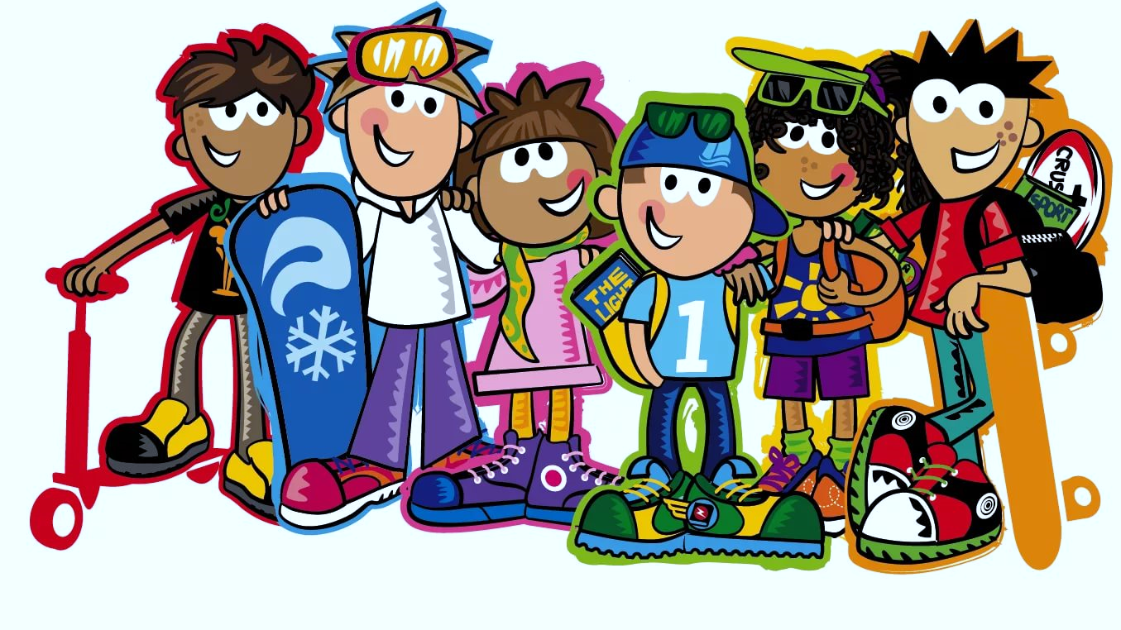




IrinaPapakhinac

Slide 2

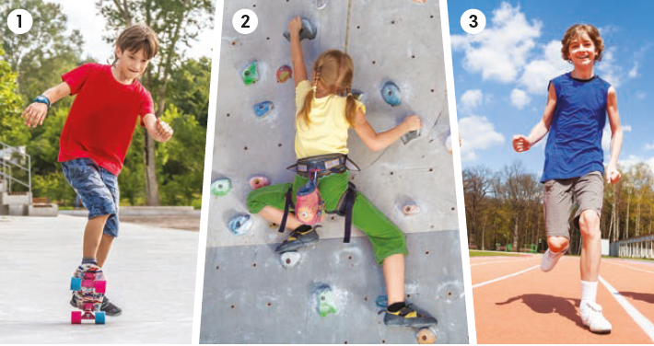
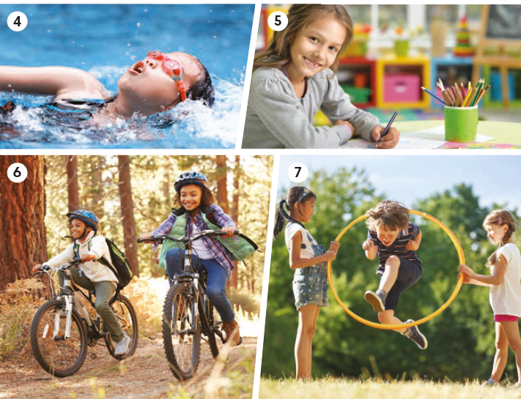
Match the actions to the photos
climb
draw
jump
ride a bike
run
skateboard
swim
IrinaPapakhinac

Slide 3
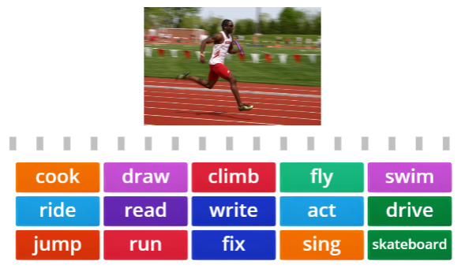
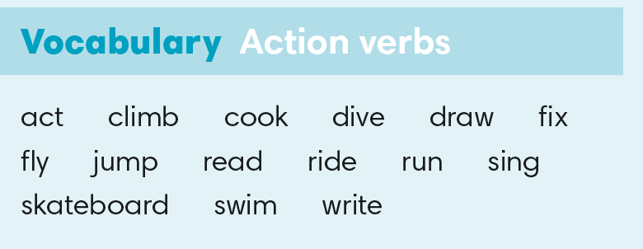

IrinaPapakhinac

Slide 4
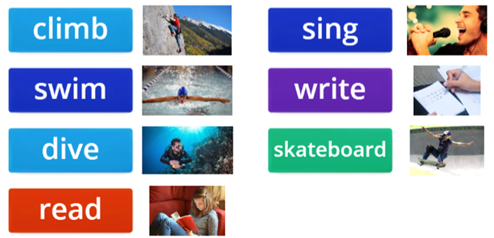
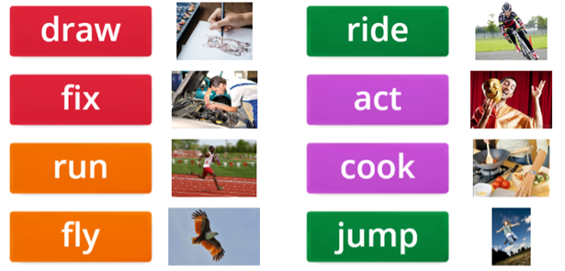

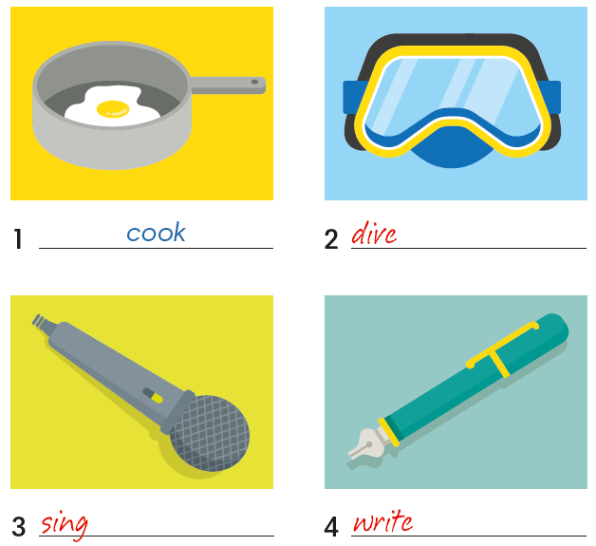
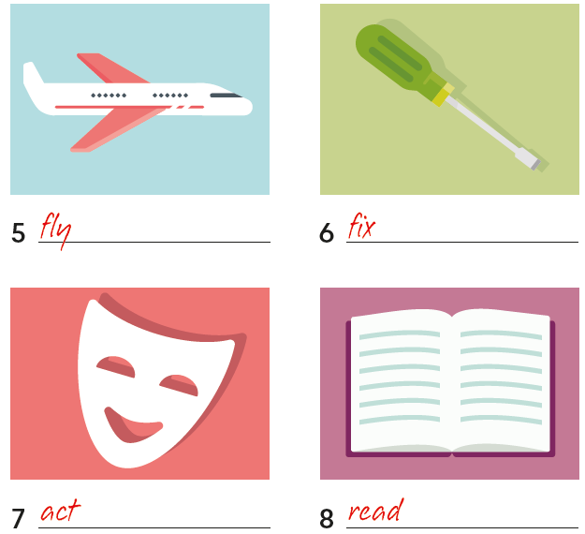

IrinaPapakhinac

Slide 5

IrinaPapakhinac

Slide 6
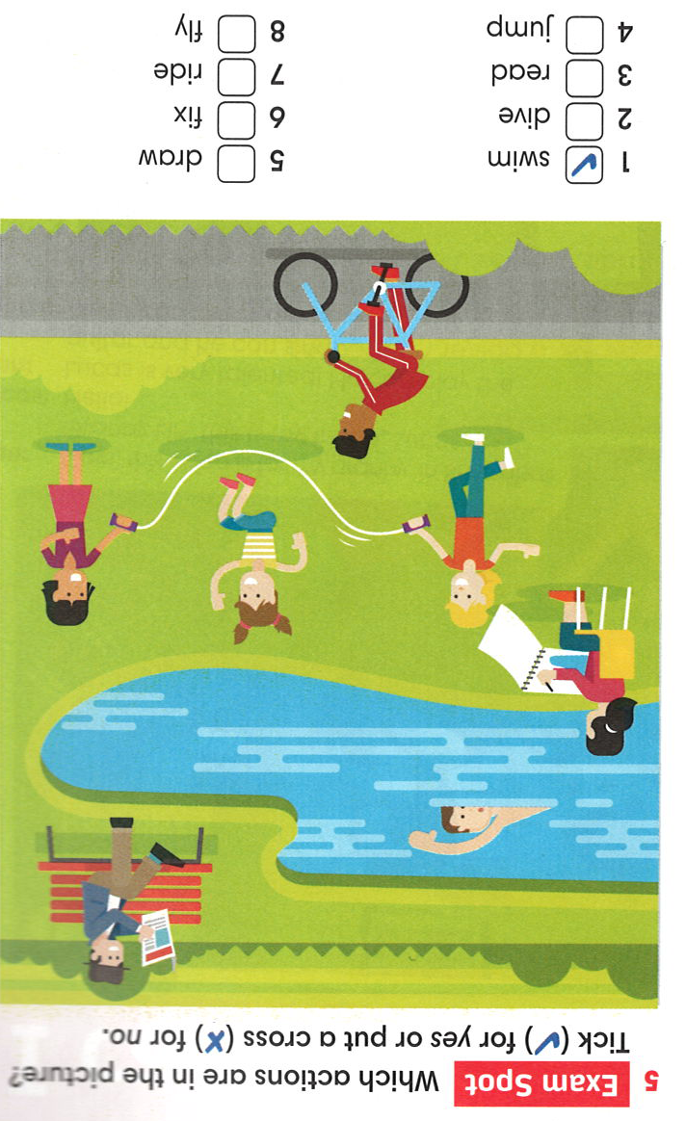

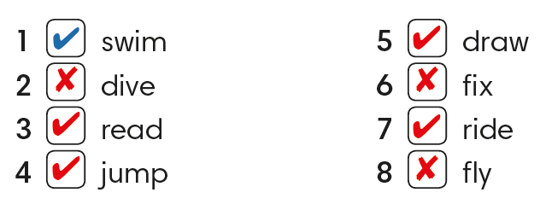
a
b
c
d
e
IrinaPapakhinac

Slide 7
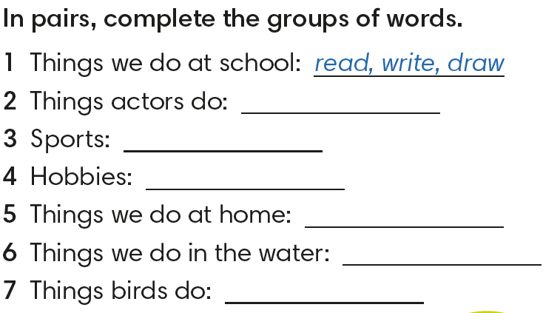
IrinaPapakhinac

Slide 8

IrinaPapakhinac

Slide 9
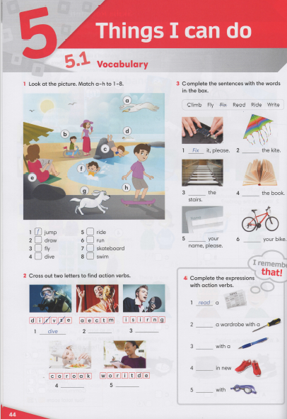


IrinaPapakhinac

Slide 10

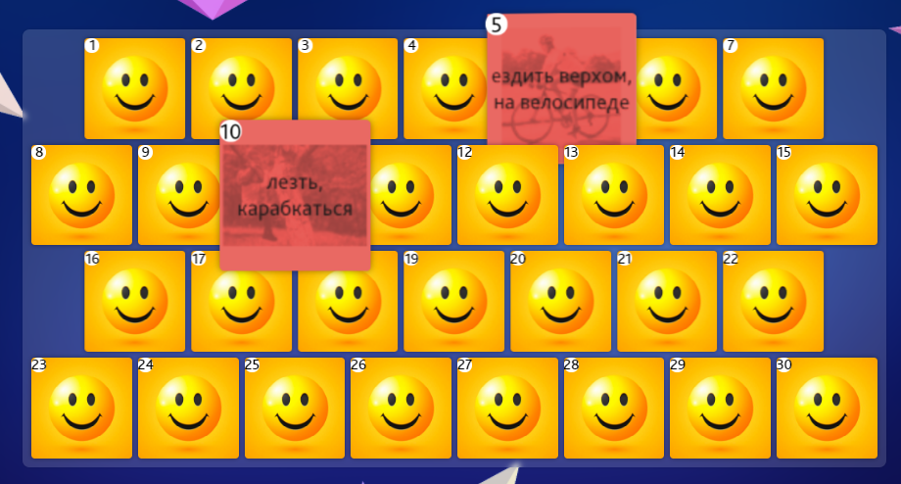
IrinaPapakhinac

