Slide 1


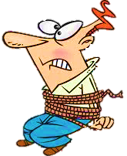


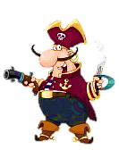



SUBJECT / OBJECT PRONOUNS

Slide 2
Click on the right option to save Peter
1/10
I
me
NEXT
Peter and ____ were exploring an island.
I

Slide 3
2/10
we
us
NEXT
We
______ were birdwatching when a ship appeared in the distance.

Slide 4
3/10
we
us
NEXT
Some pirates came and chased _______.
us

Slide 5
5/10
I
me
NEXT
He told _____ that he was in danger.
me

Slide 6
4/10
he
him
NEXT
The pirates catched _______ at the beach.
him

Slide 7
6/10
he
him
NEXT
______ was really frightened.
He

Slide 8
7/10
she
her
NEXT
His wife was at home.
I talked to ______ in the evening.
her

Slide 9
8/10
she
her
NEXT
______ was really surprised.
She

Slide 10
10/10
they
them
EXIT
They have two children.
Peter was thinking of _______ .
them

Slide 11
9/10
they
them
NEXT
______ live in a house on the coast.
They

