Slide 1

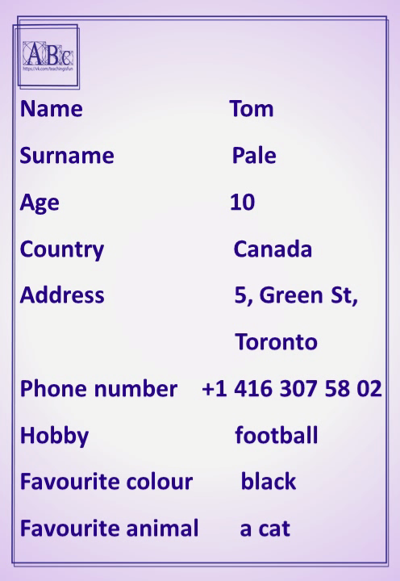

What’s your name?
https://vk.com/teachingisfun

