Slide 1
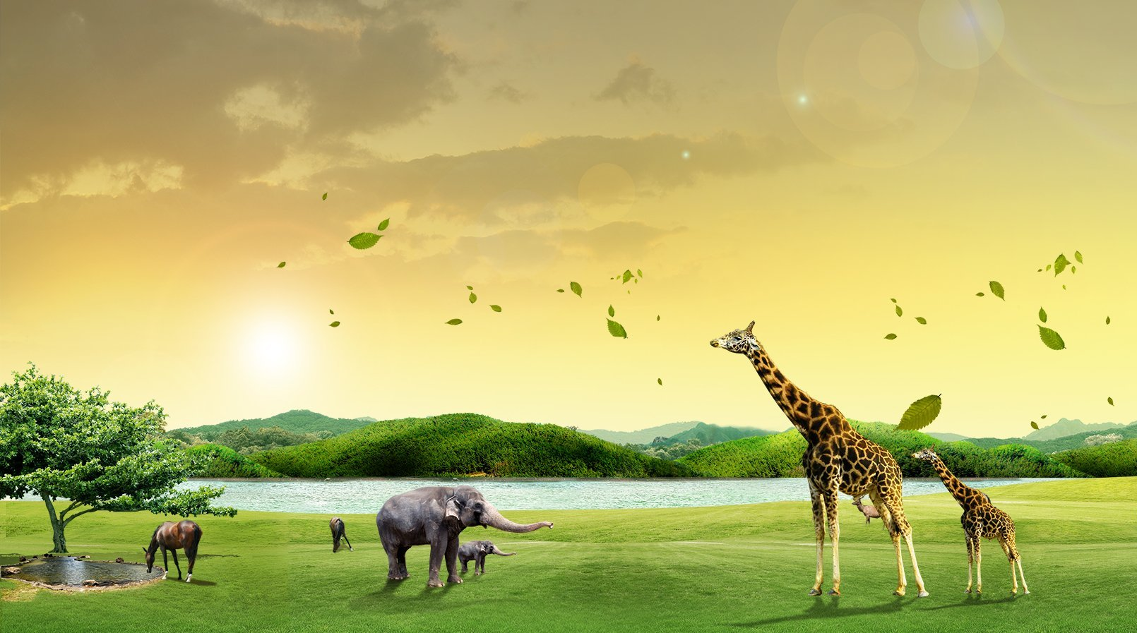


IrinaPapakhinac

Slide 2

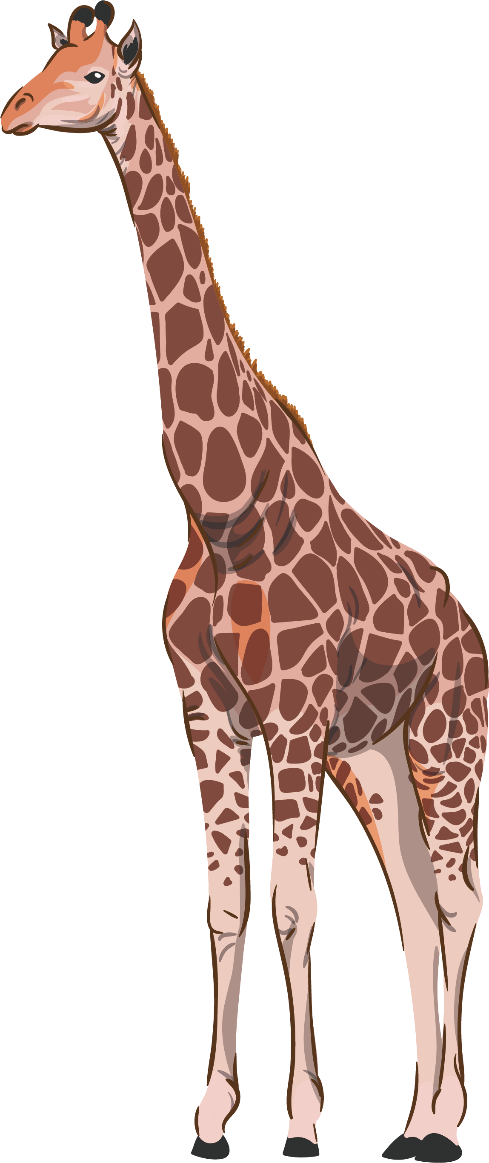
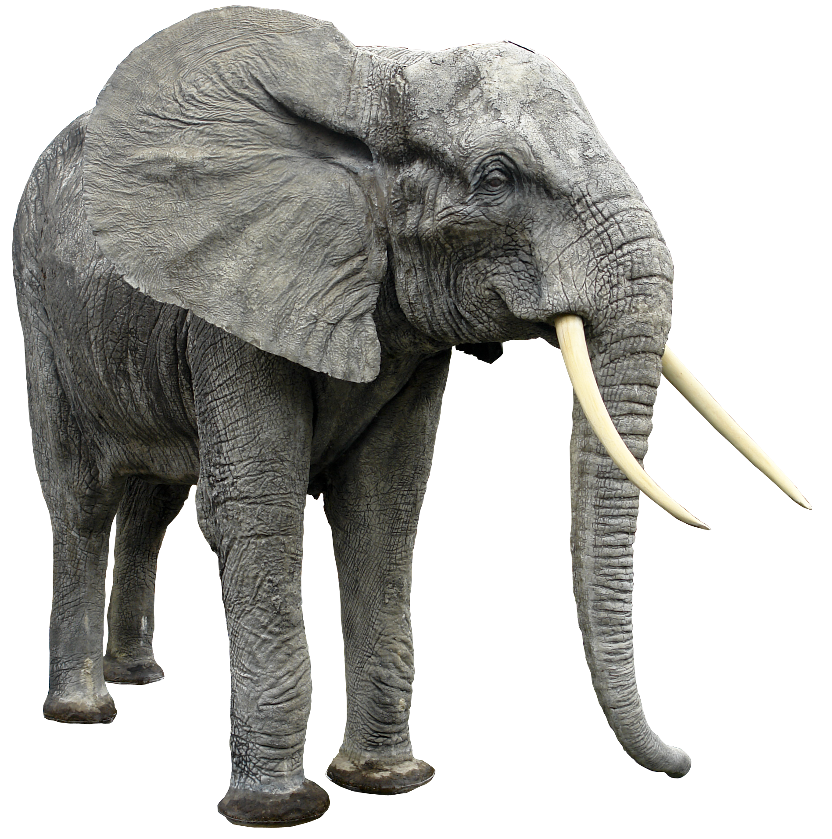
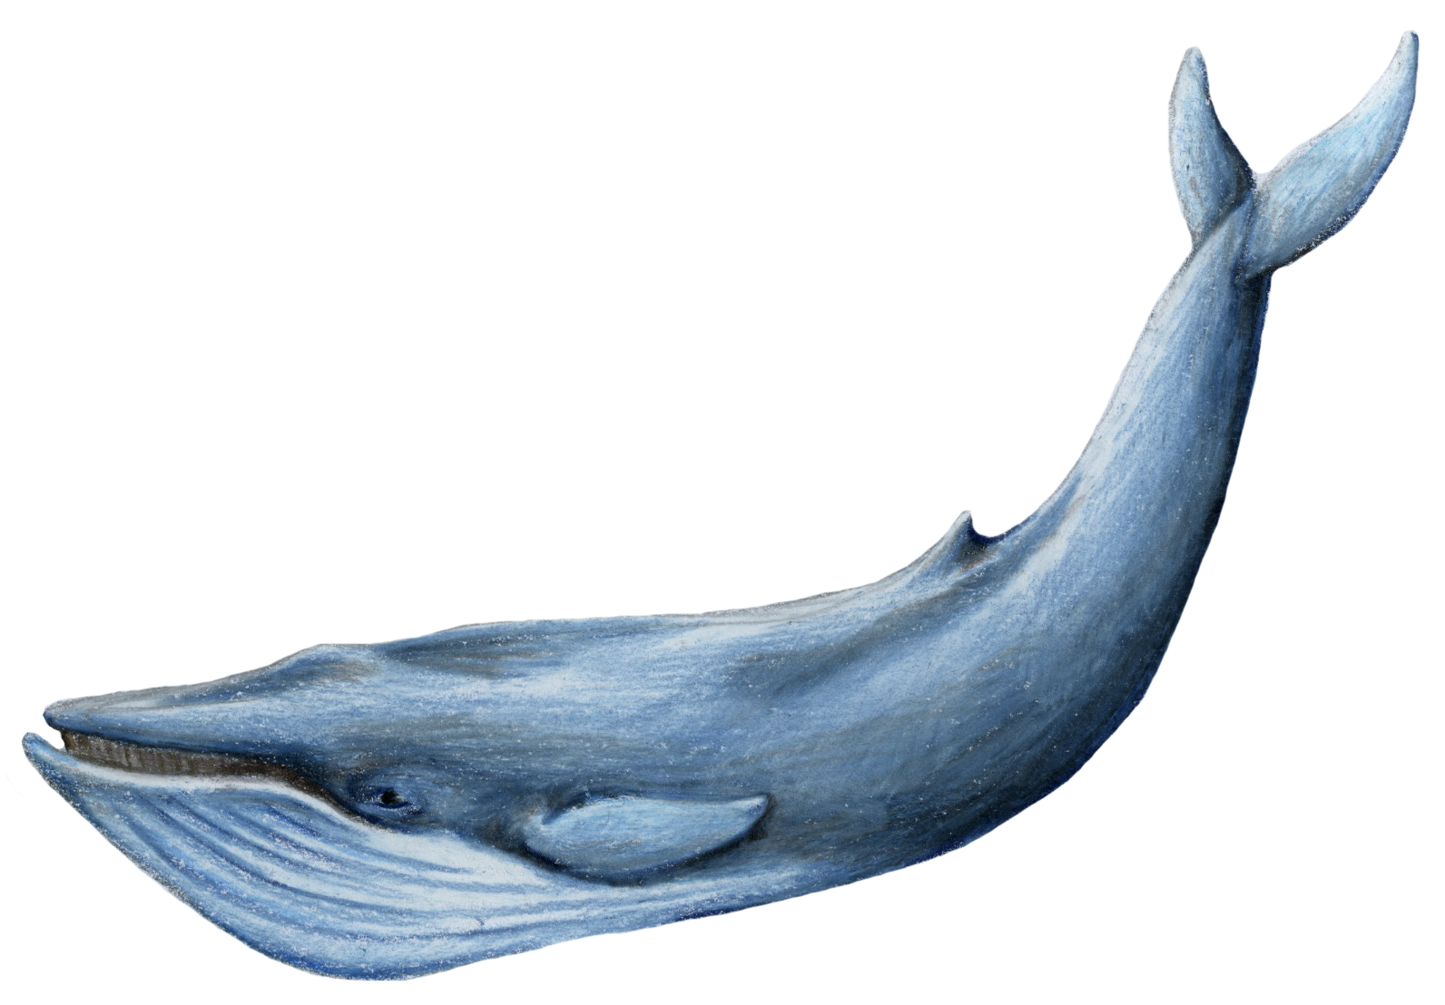
Guess the animals.
1. It’s big. It eats a lot. It can run. It can awim. It’s got a long nose.
2. It’s big. It can run. It eats leaves. It’s got a long neck. It’s very tall.
3. It’s very big. It can swim. It eats fish. It lives in water.
IrinaPapakhinac

Slide 3

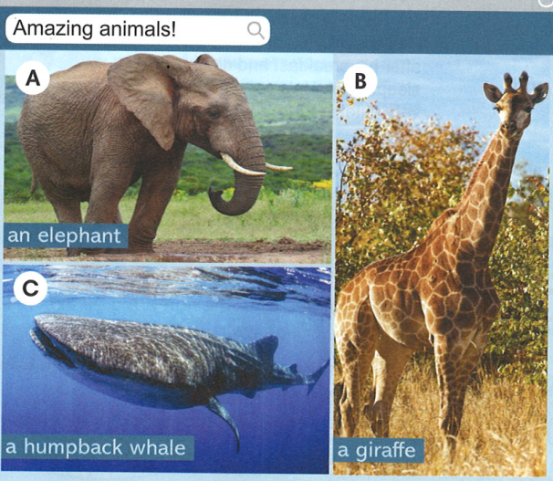
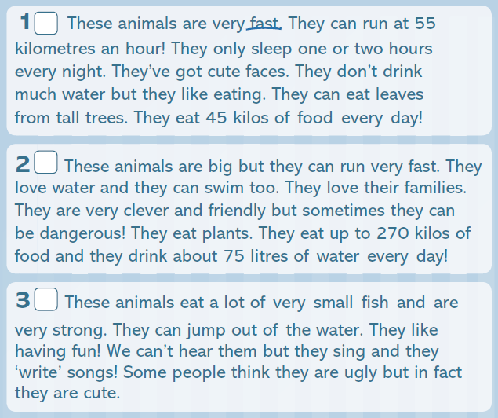
Match texts 1 – 3 to photos A – C.
B
A
C
IrinaPapakhinac

Slide 4
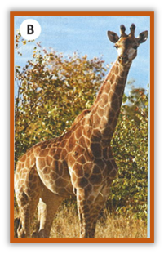
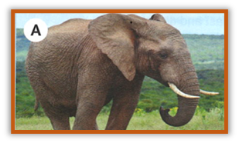
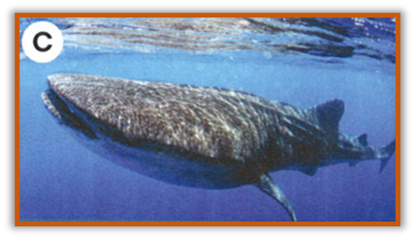
Read the text again and complete the table.
B
 | giraffes | elephants | humpback whales
What do they eat / drink? | leaves, water | plants, water | fish
What can they do? | run, eat leaves from tall trees | run, swim | jump, sing, “write songs”
What do they like / love? | eating | their families | having fun
A
C
IrinaPapakhinac

Slide 5
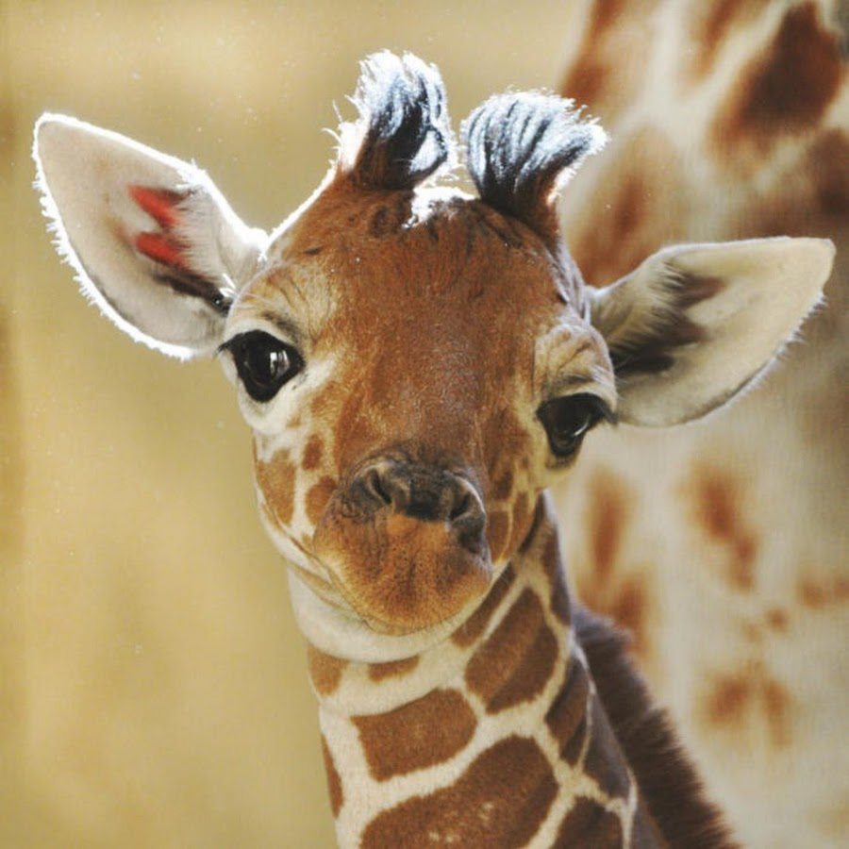
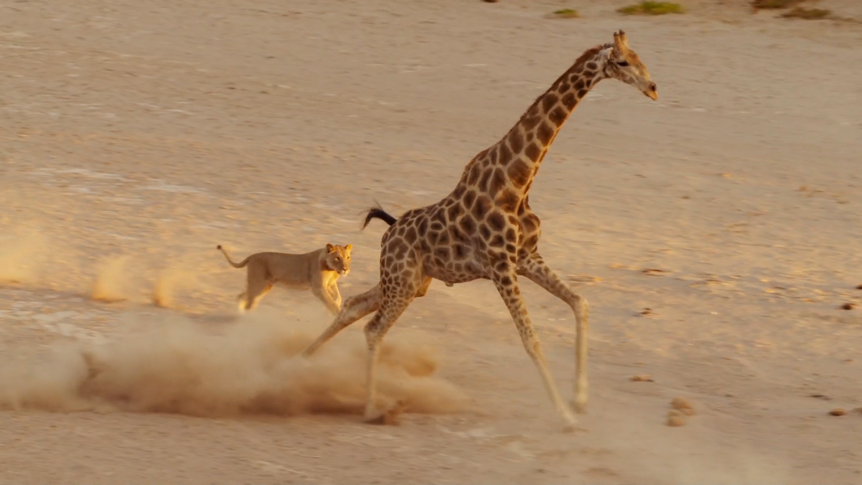
Giraffes are very fast. They can run at 55 km an hour.
They’ve got cute faces.
cute
fast
IrinaPapakhinac

Slide 6
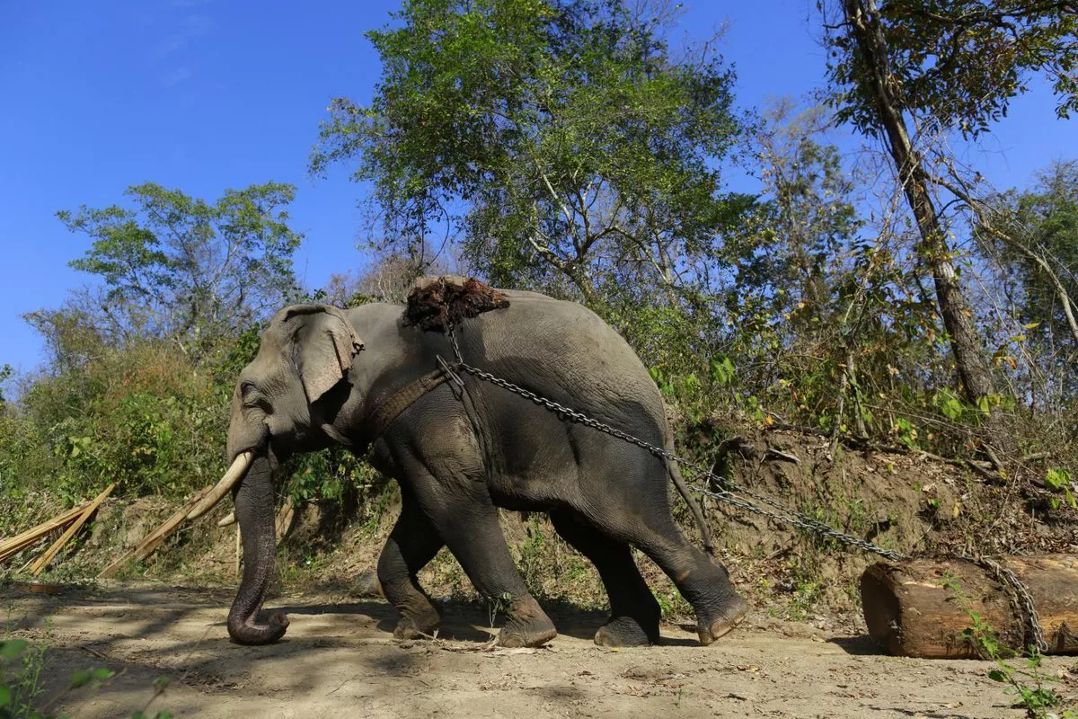
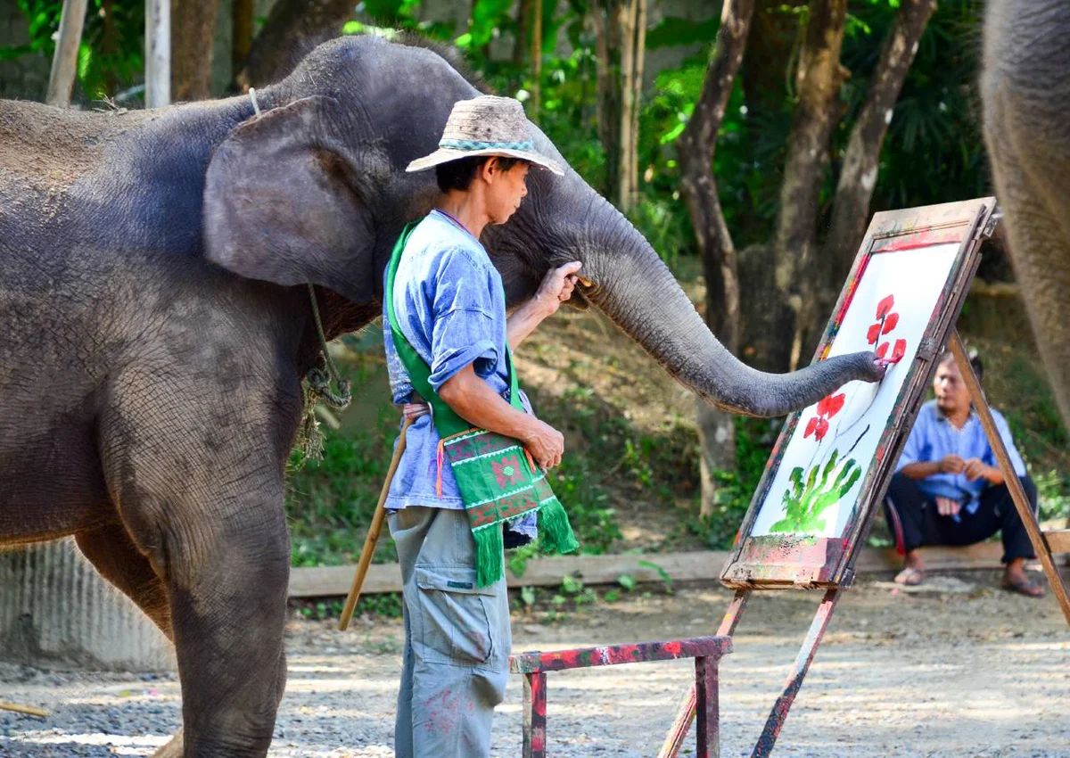
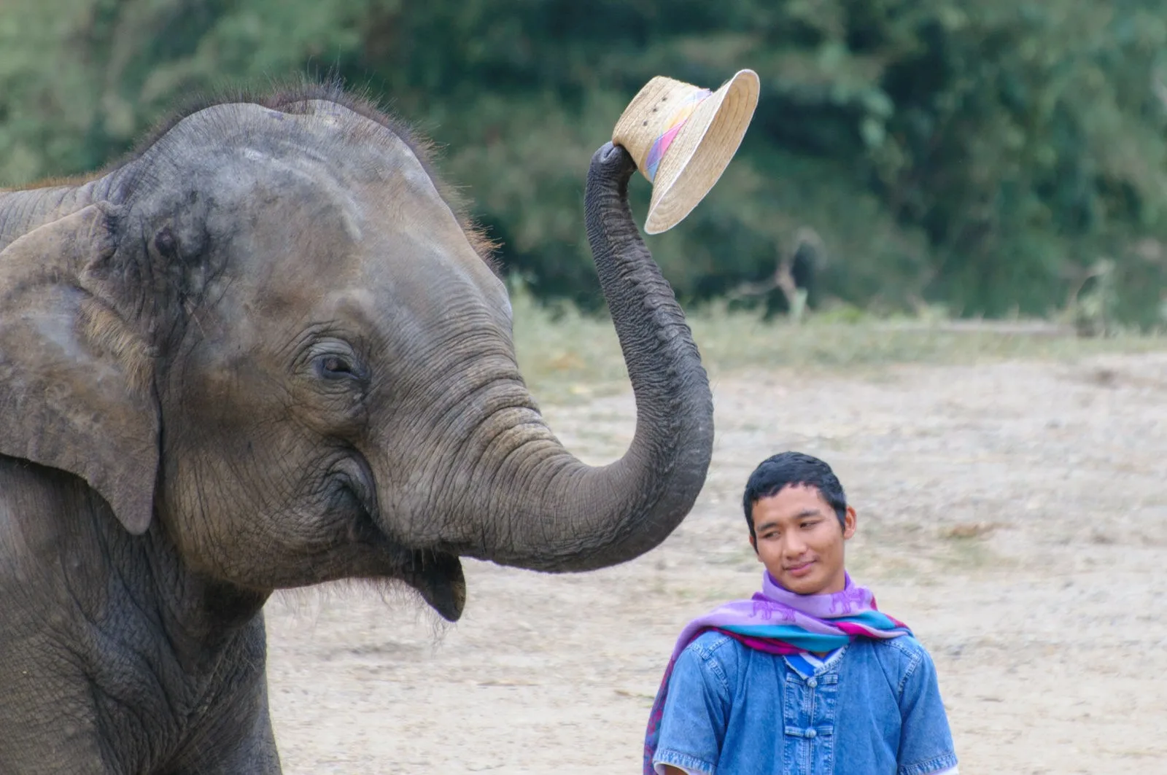
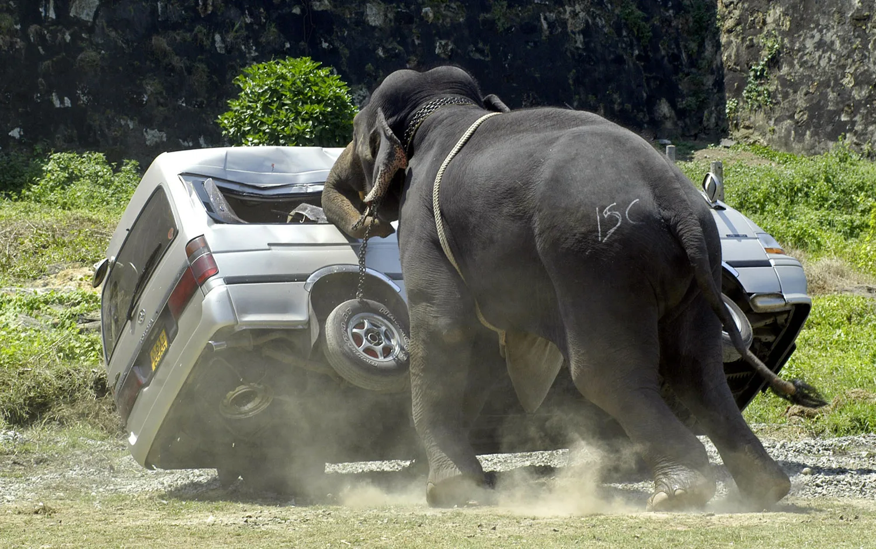
strong
Elephants are very strong, clever and friendly
but sometimes they cab be dangerous.
clever
friendly
dangerous
IrinaPapakhinac

Slide 7
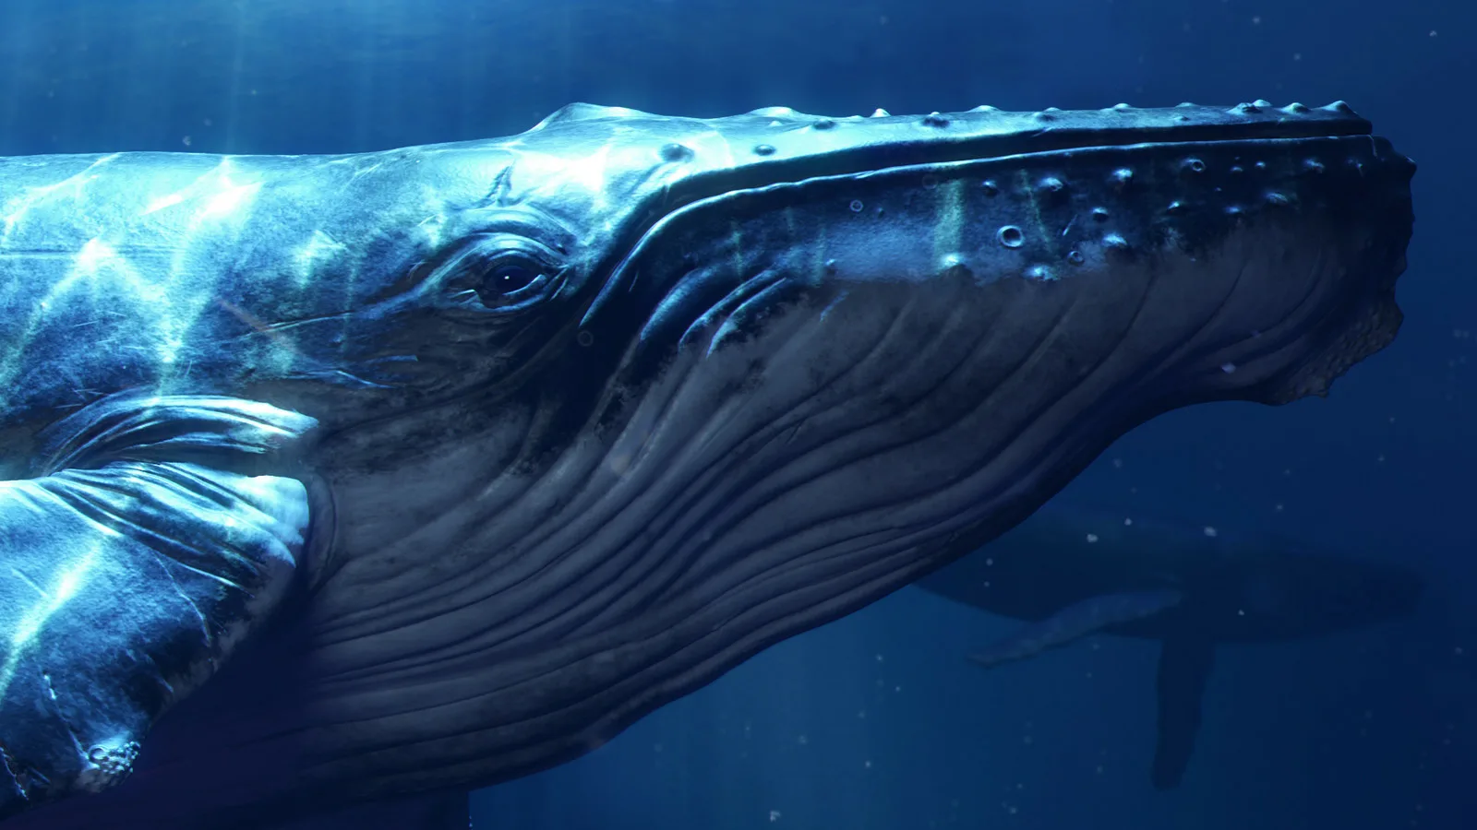
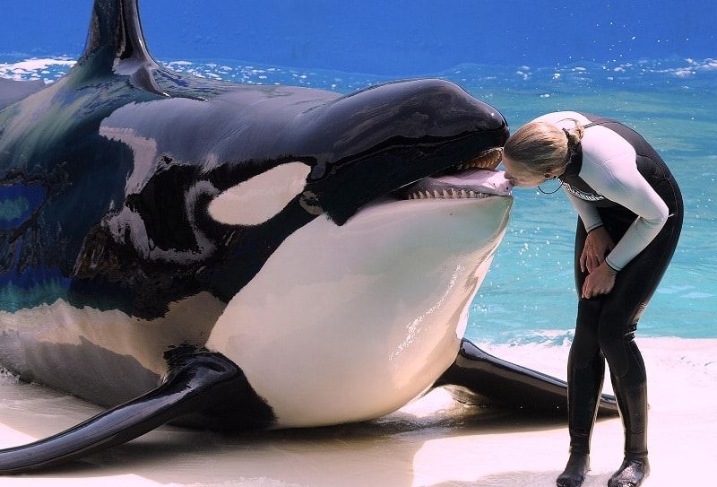
Some people think that whales are ugly
but in fact they are cute.
ugly
cute
IrinaPapakhinac

Slide 8
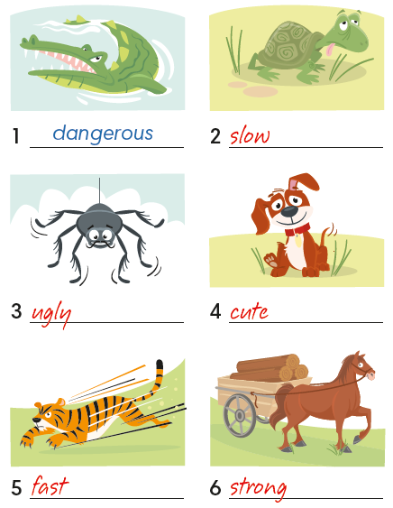
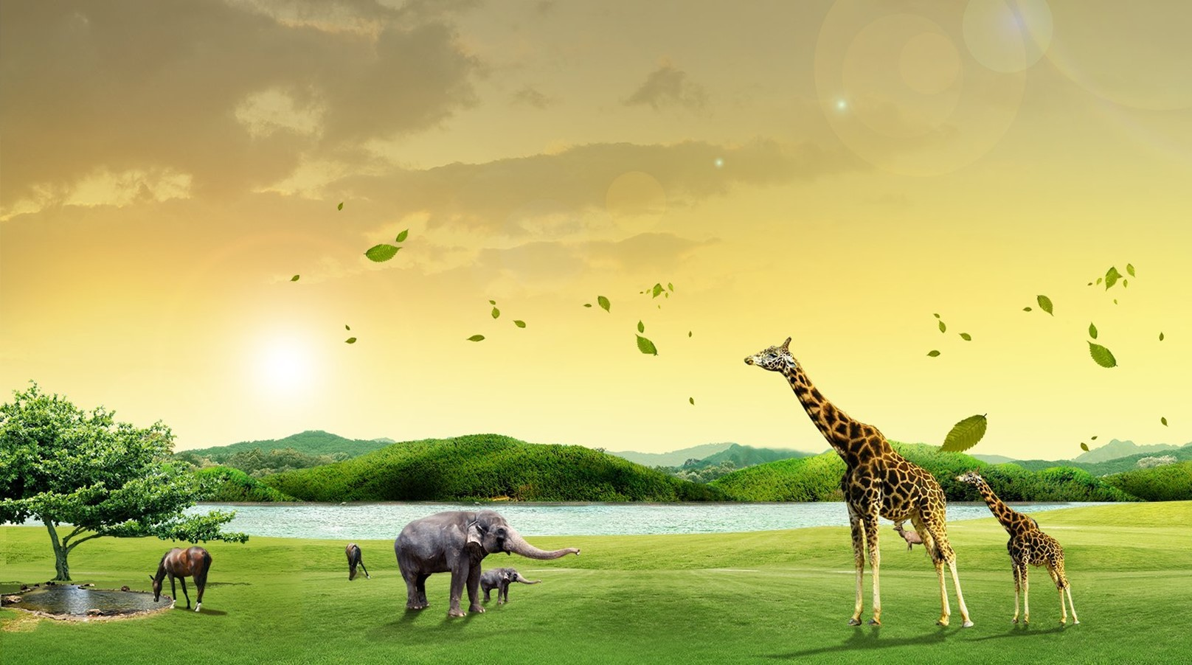
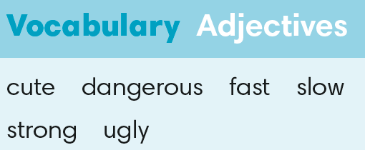
IrinaPapakhinac

Slide 9
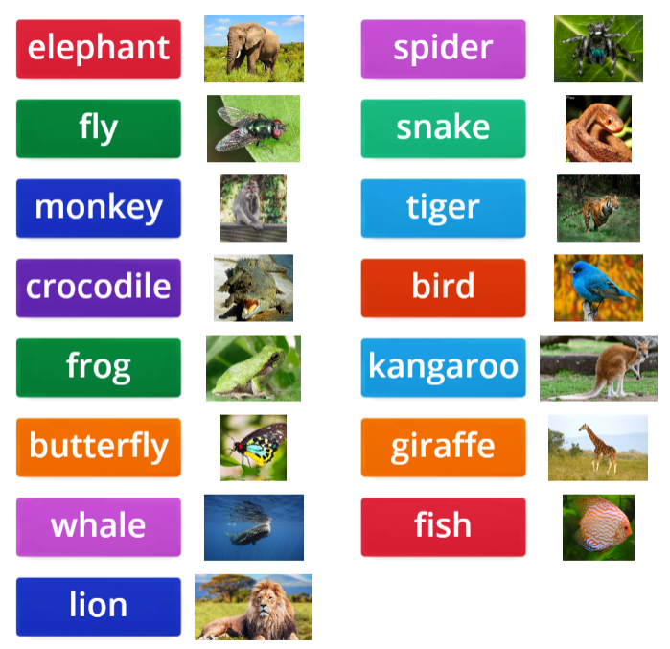

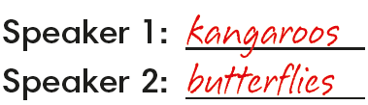
IrinaPapakhinac

Slide 10
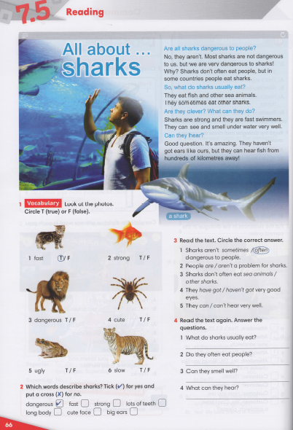


IrinaPapakhinac

