Slide 1


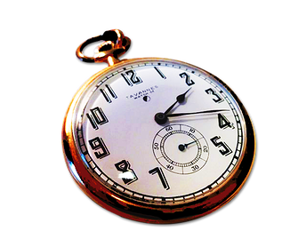
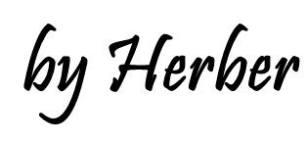

Slide 2



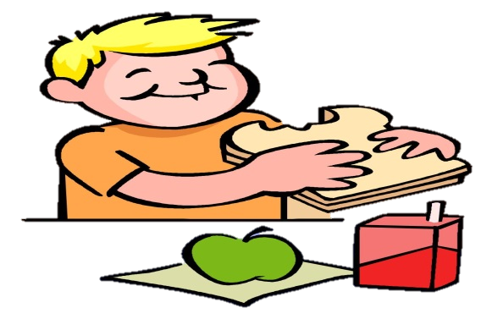



in
at
on
Click on the right preposition
He had lunch ___ noon

Slide 3


in
at
on
Click on the right preposition
Christmas is ___ 25th December

Slide 4
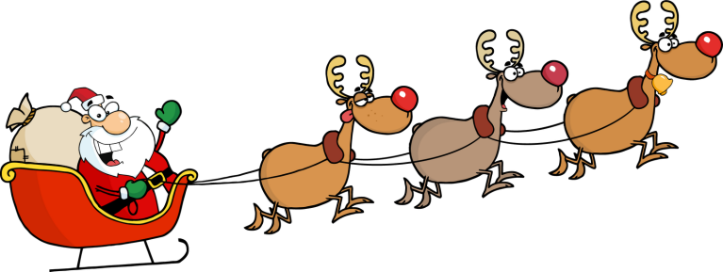
in
at
on
Click on the right preposition
Santa comes to town __ Christmas

Slide 5


in
at
on
Click on the right preposition
He was born ___ 1987

Slide 6
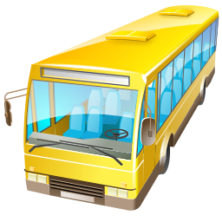
in
at
on
Click on the right preposition
The bus is leaving __ two o’clock

Slide 7

in
at
on
Click on the right preposition
America was discovered ___ 1492

Slide 8

in
at
on
Click on the right preposition
She goes to the beach ___ Summer

Slide 9


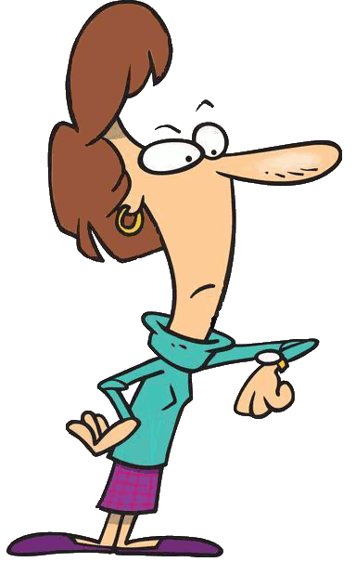
in
at
on
Click on the right preposition
He arrived home __ midnight

Slide 10

in
at
on
Click on the right preposition
They had fun ___ his birthday

Slide 11

in
at
on
Click on the right preposition
Valentine‘s Day is ___ February

Slide 12

in
at
on
Click on the right preposition
She got a present ___ Christmas Day

Slide 13
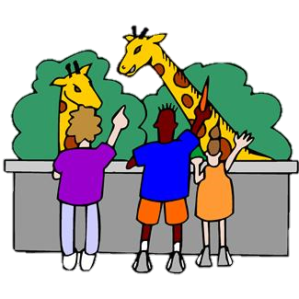
in
at
on
Click on the right preposition
They visited the zoo __ the weekend

Slide 14

in
at
on
Click on the right preposition
She goes shopping ___ the morning

Slide 15
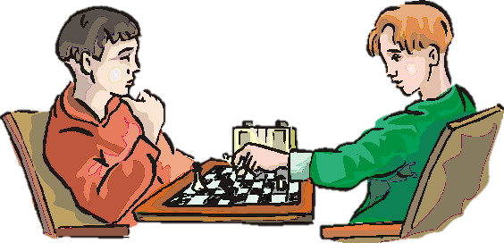
in
at
on
Click on the right preposition
They play chess ___ Sunday

Slide 16

in
at
on
Click on the right preposition
They went to the disco ___ Saturday night

