Slide 1
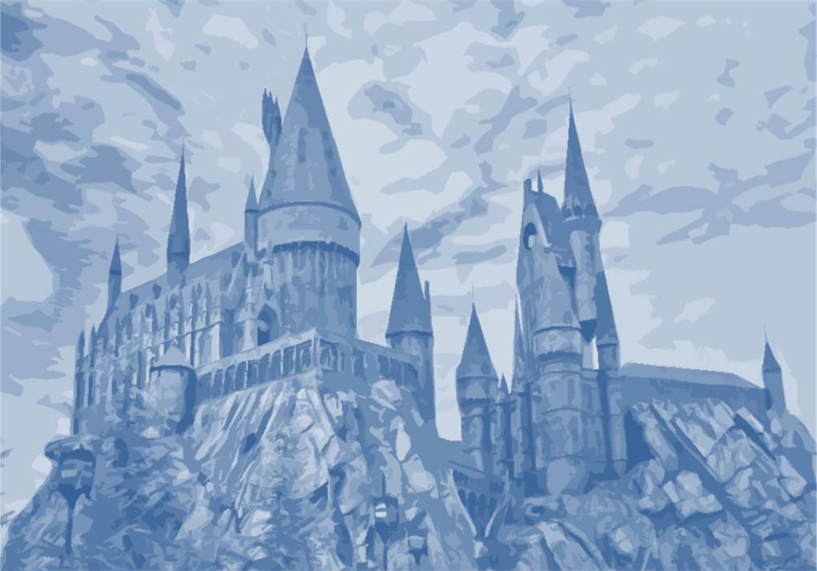



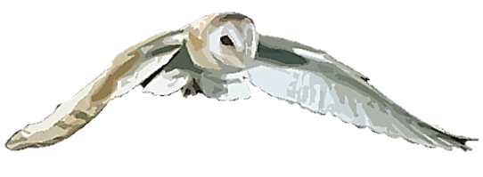
by HERBER

Slide 2

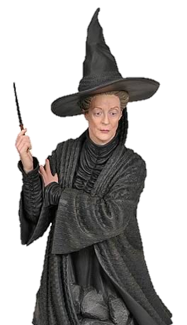
Countable nouns:
They are persons, animals or things that we can count.
They can be singular or plural.
Uncountable nouns:
They are substances, concepts, etc. that we cannot divide into separate elements.
We usually treat uncountable nouns as singular.

Slide 3

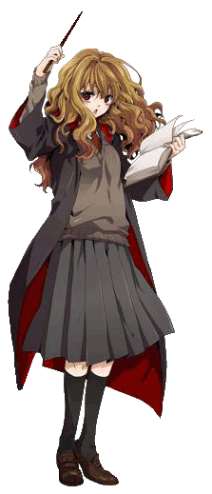
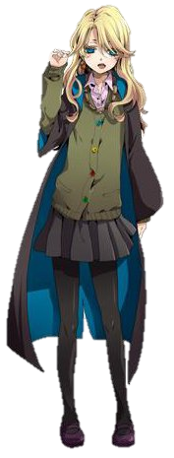
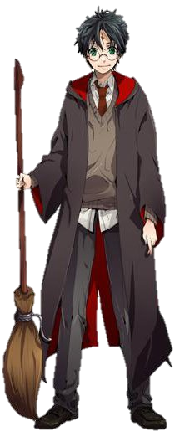

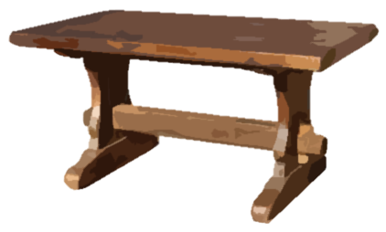
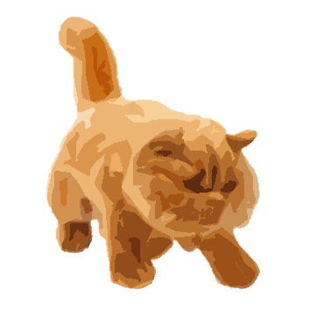
an owl
some girls
an apple
some apples
a table
a cat
a boy

Slide 4

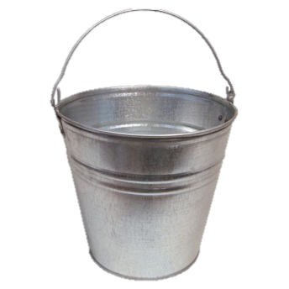
some bread
some water

Slide 5
Countable nouns:
We can use the indefinite article a/an with countable nouns in singular.
We can use some (affirmative) and any (negative/interrogative) with countable nouns in plural.
Uncountable nouns:
We can use some (affirmative) and any (negative/interrogative) with uncountable nouns.

Slide 6
We use There is with countable nouns in singular and uncountable nouns.
We use There are with countable nouns in plural.

Slide 7
There is
an owl on the table.

Slide 8
There isn’t
any owl on the table.

Slide 9

There is
a cat under the table.

Slide 10

There isn’t
any cat under the table.

Slide 11
There is
some water on the floor.

Slide 12
There isn’t
any water on the floor.

Slide 13

There are
some books on the table.

Slide 14
There aren’t
any books on the table.

Slide 15

INTERROGATIVE FORM
Is there
any
some
?
There
is
a cat/some water
Yes, there is
No, there isn’t
Are there
any
some
?
There
are
books
Yes, there are
No, there aren’t

Slide 16
Yes, there is.
Is there
any water on the floor?

Slide 17
No, there isn’t.

Slide 18
Yes, there is.
Is there
a cat on the table?

Slide 19
No, there isn’t.

Slide 20
Yes, there are.
Are there
any books on the table?

Slide 21
No there aren’t.

Slide 22
Click on the right option
_______ some students here.
There is
There are
There isn’t
There aren’t
Is there
Are there

Slide 23
Click on the right option
_________ any students here.
There is
There are
There isn’t
There aren’t
Is there
Are there

Slide 24
Click on the right option
_________ an owl here.
There is
There are
There isn’t
There aren’t
Is there
Are there

Slide 25
Click on the right option
_________ any cat here?
There is
There are
There isn’t
There aren’t
Is there
Are there

Slide 26
Click on the right option
_________ any water here.
There is
There are
There isn’t
There aren’t
Is there
Are there

Slide 27
Click on the right option
_________ any students here?
There is
There are
There isn’t
There aren’t
Is there
Are there

Slide 28


