Slide 1
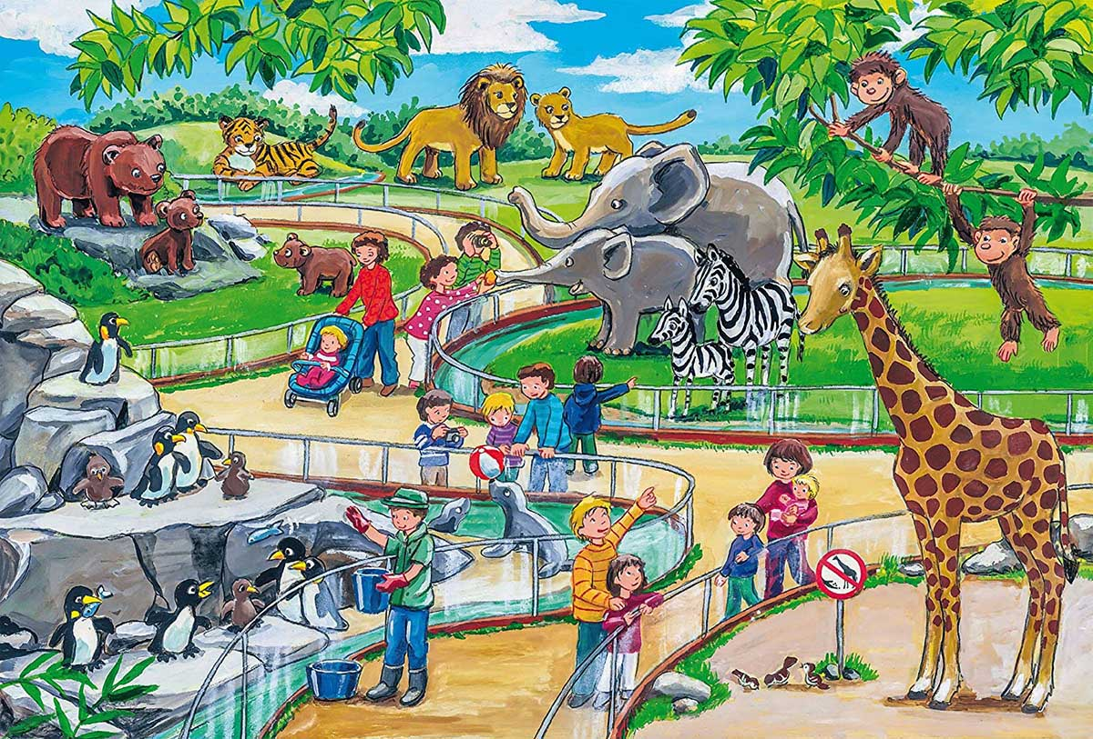
there / any / are / tigers / ?

Slide 2
are/ any / giraffes/ there/ ?

Slide 3
are/ cats/ any/ there/ ?

Slide 4
there / any / are / elephants/ ?

Slide 5
any/ there/ are / foxes/ ?

Slide 6
there / lions/ are / any/ ?

Slide 7
are/ bears/ there/ any/ ?

Slide 8
crocodiles/ any / are / there/ ?

Slide 9
there / any / penguins/ are/ ?

Slide 10
there / camels/ are / any/ ?

Slide 11
there / any / pandas/ are/ ?

Slide 12
there / any / are / zebras/ ?

Slide 13
monkeys/ any / are / there/ ?

Slide 14
there / kangaroos/ are / any/ ?

Slide 15
there / any / are / wolves/ ?

