Slide 1
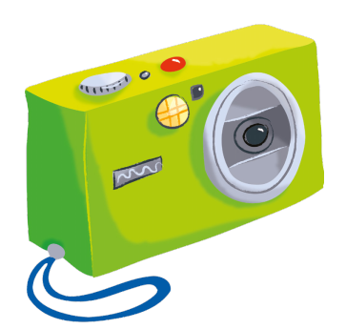

Whose watch is this? It’s Lola’s watch.

Slide 2
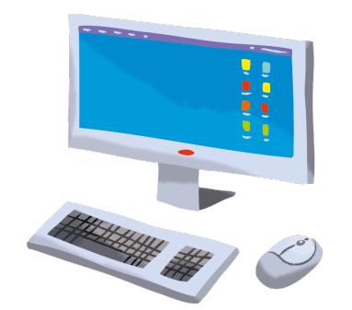

Whose watch is this? It’s Lola’s watch.

Slide 3
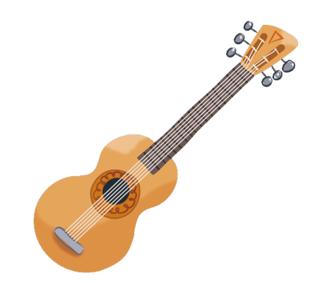

Whose watch is this? It’s Lola’s watch.

Slide 4
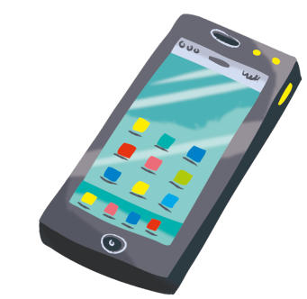

Whose watch is this? It’s Lola’s watch.

Slide 5


Whose watch is this? It’s Lola’s watch.

Slide 6


Whose watch is this? It’s Lola’s watch.

Slide 7


Whose watch is this? It’s Lola’s watch.

Slide 8
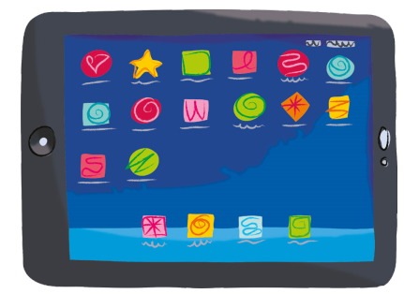

Whose watch is this? It’s Lola’s watch.

Slide 9


Whose watch is this? It’s Lola’s watch.

Slide 10
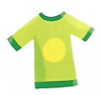

Whose watch is this? It’s Lola’s watch.

Slide 11


Whose trainers are these?
They’re Lola’s trainers.

Slide 12


Whose trainers are these?
They’re Lola’s trainers.

Slide 13


Whose trainers are these?
They’re Lola’s trainers.

Slide 14
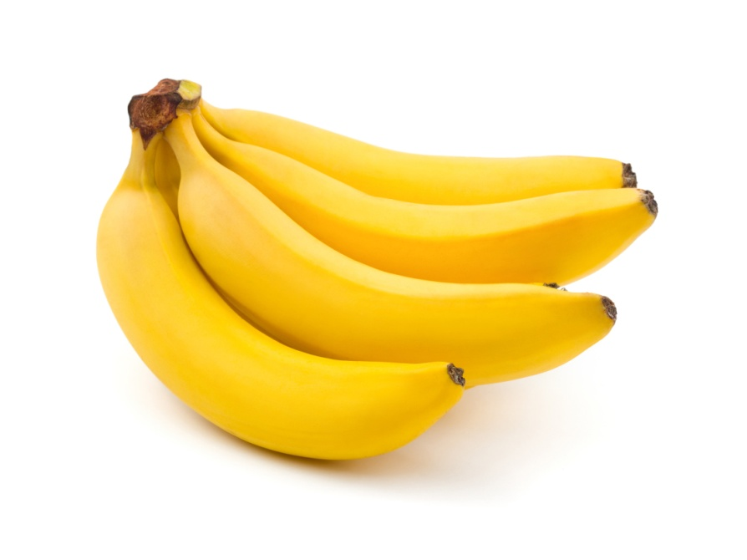

Whose trainers are these?
They’re Lola’s trainers.

Slide 15
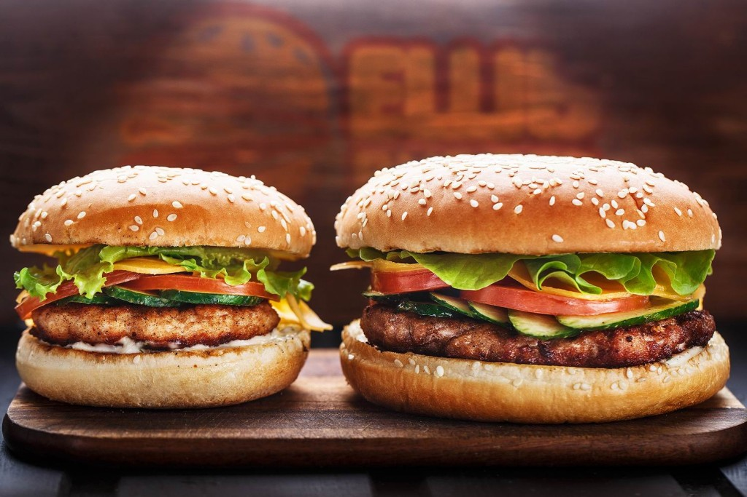

Whose trainers are these?
They’re Lola’s trainers.

Slide 16


Whose trainers are these?
They’re Lola’s trainers.

Slide 17
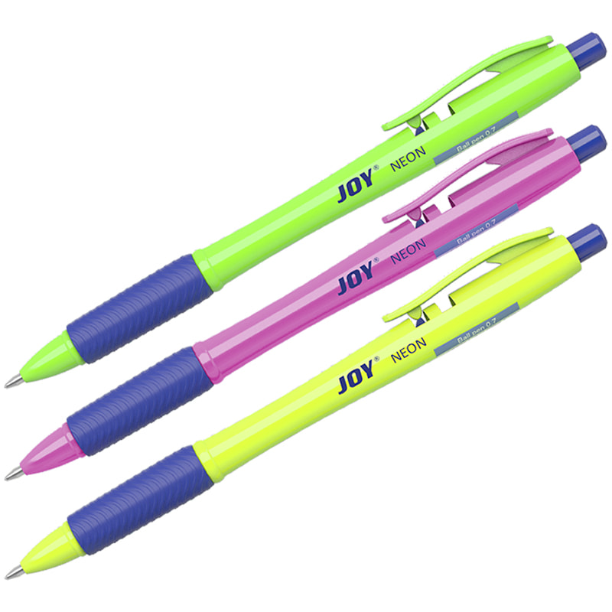

Whose trainers are these?
They’re Lola’s trainers.

Slide 18
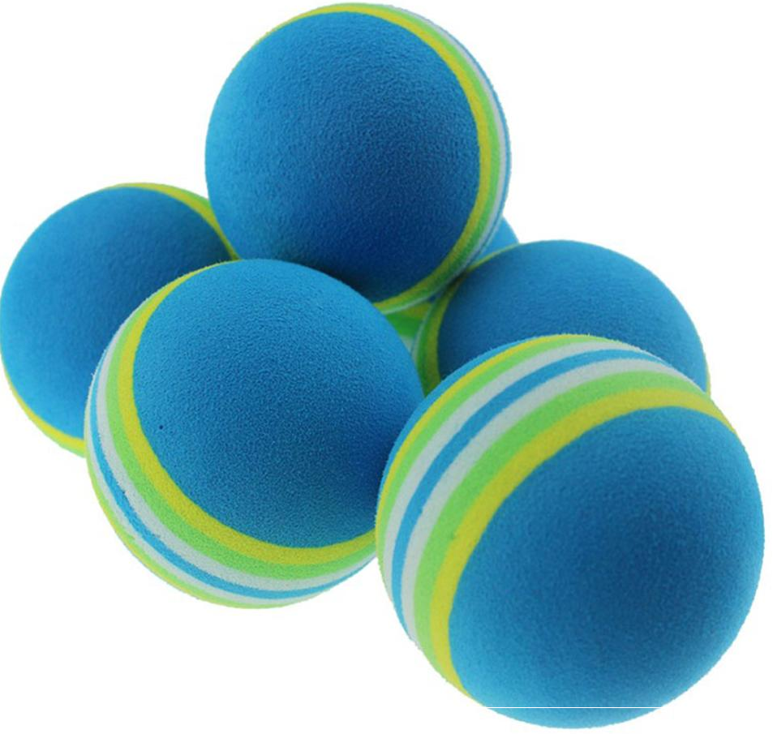
Whose trainers are these?
They’re Lola’s trainers.

Slide 19
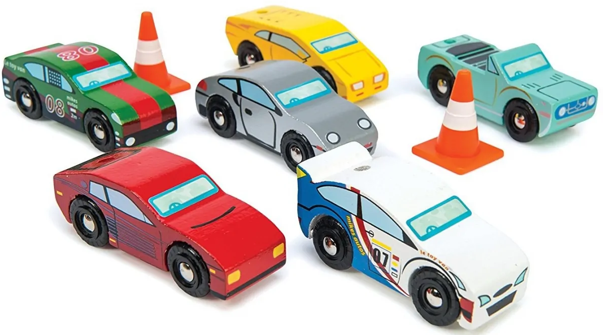

Whose trainers are these?
They’re Lola’s trainers.

Slide 20
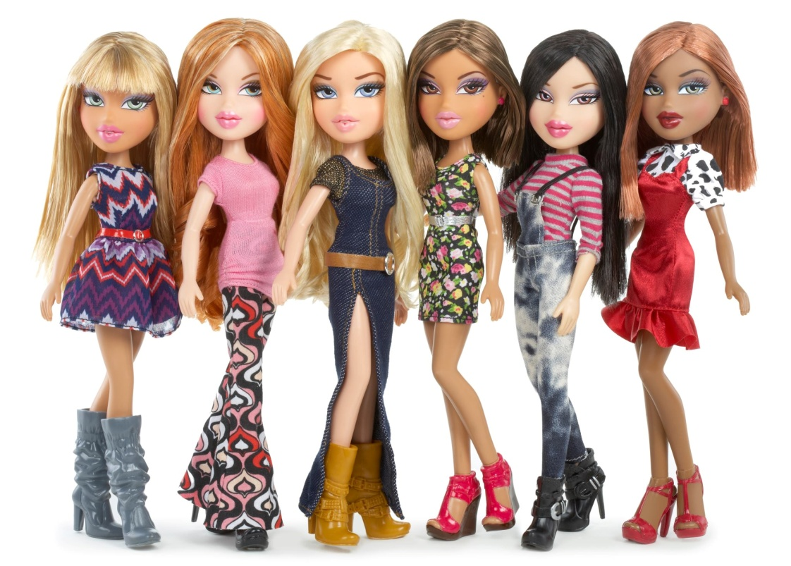

Whose trainers are these?
They’re Lola’s trainers.

