Slide 1
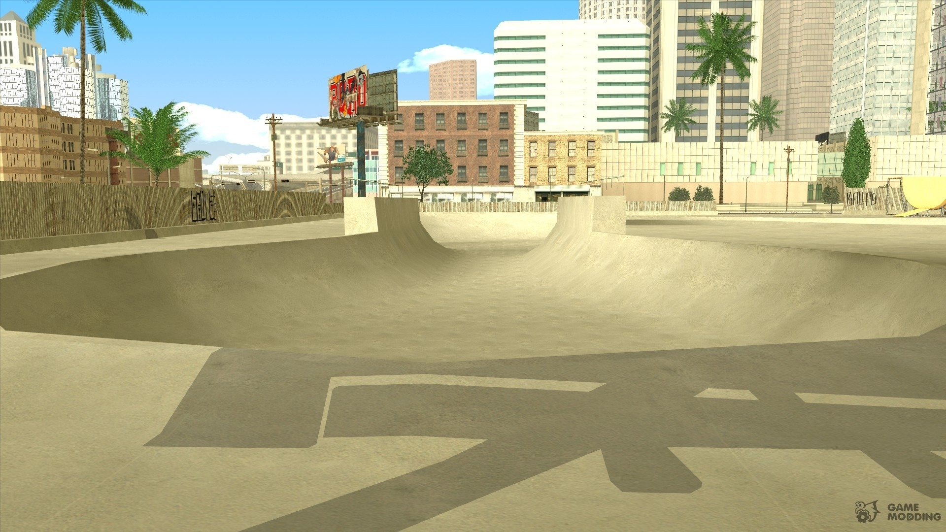



IrinaPapakhina

Slide 2

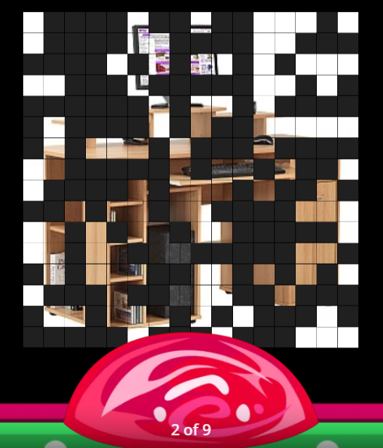
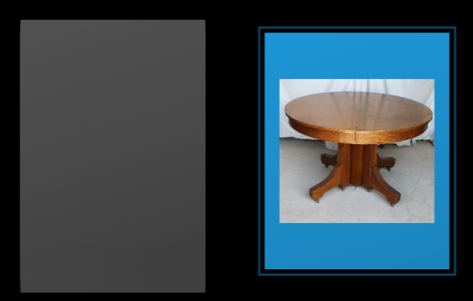
Guess the image.
Where are these things in your home?
There is a desk in my bedroom.
There are two armchairs in the living room.
IrinaPapakhina

Slide 3
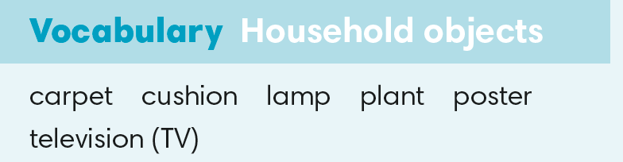

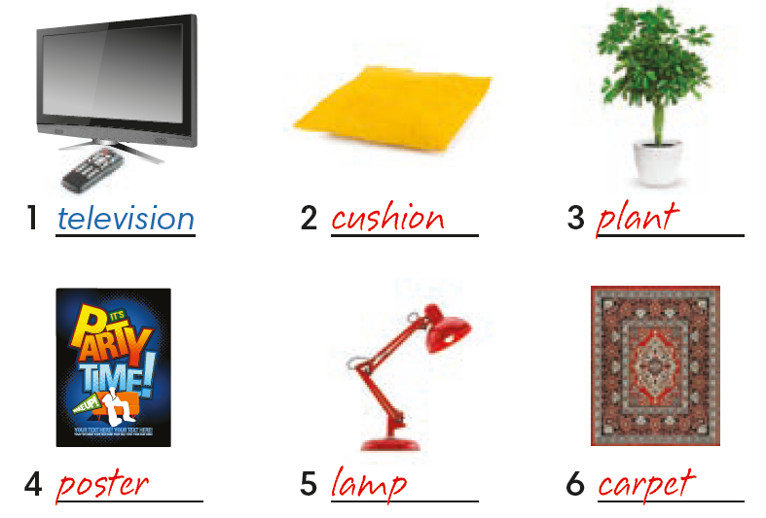
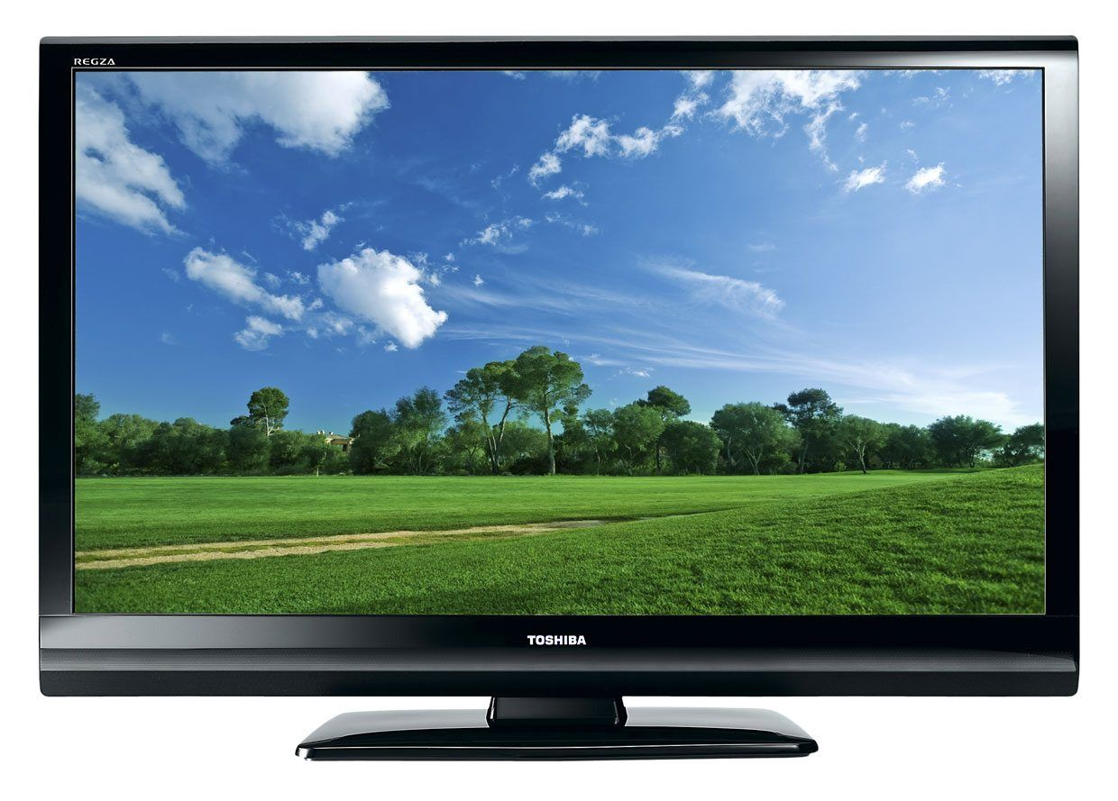
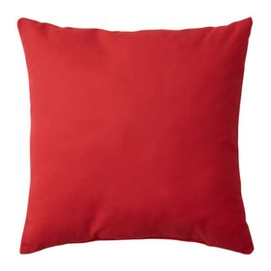

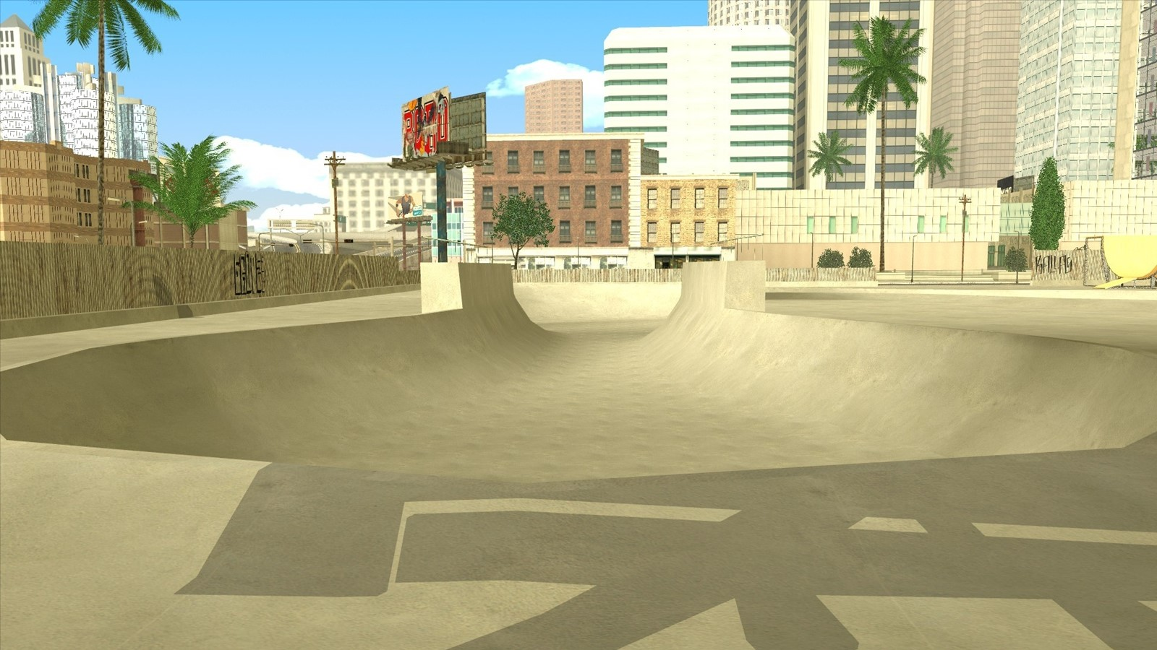

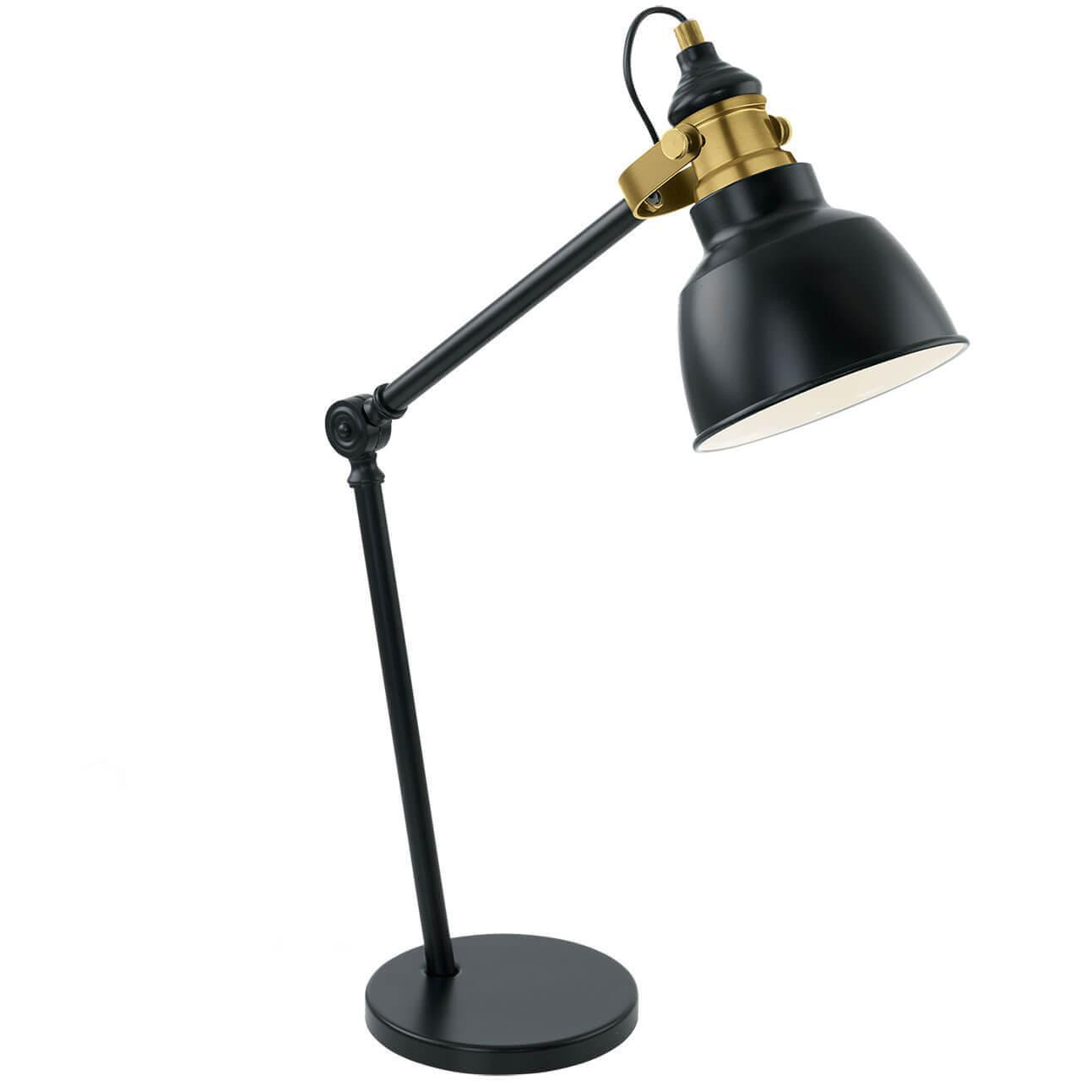
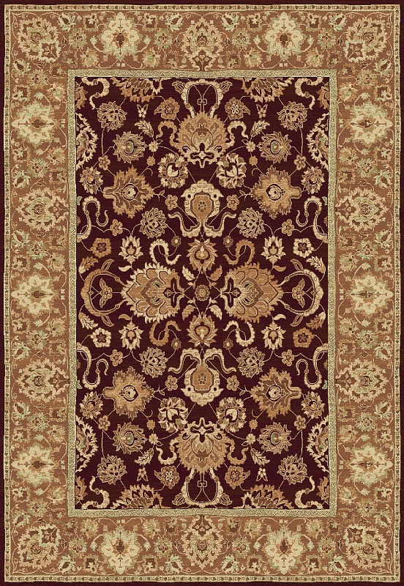
Label the pictures.
Where are these things in your home?
IrinaPapakhina

Slide 4
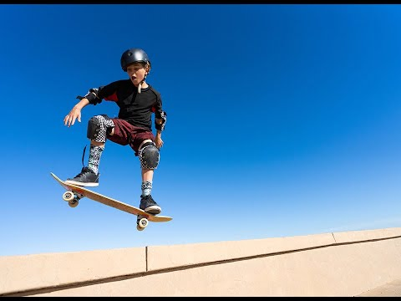
1. What can this boy do?
2. Can you skateboard?
3. Where do you usually skateboard?
IrinaPapakhina

Slide 5
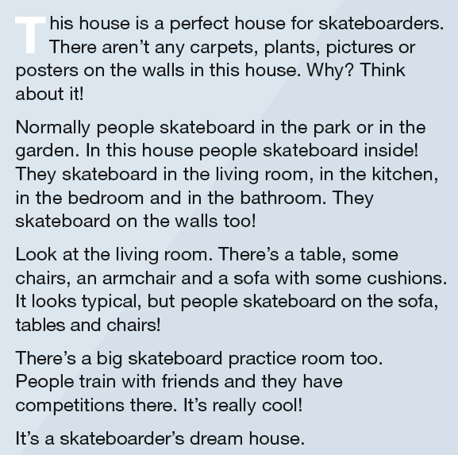
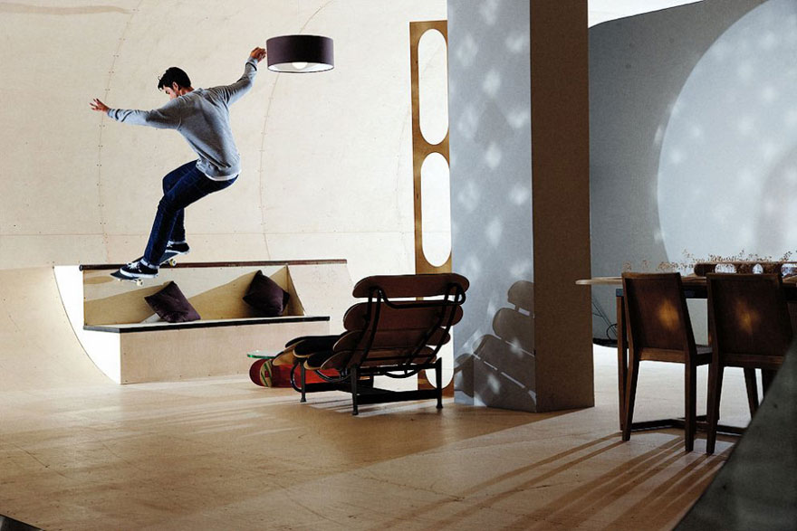
You’re going to read a text.
Look at the title.
What can be the text about?
a) a sport
b) a person
c) a house
Read and check.
IrinaPapakhina

Slide 6
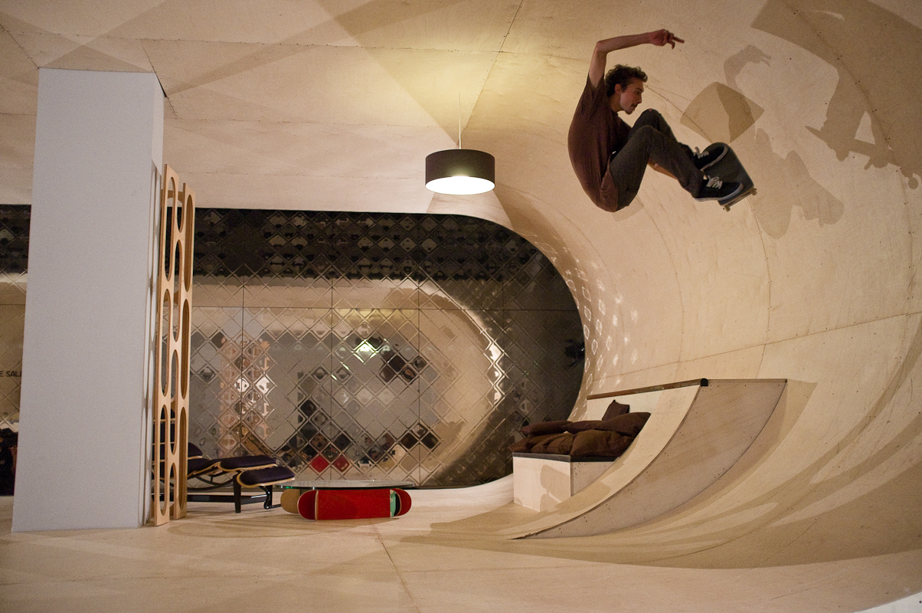
Do you like this house?
Would you like to live there?
IrinaPapakhina

Slide 7
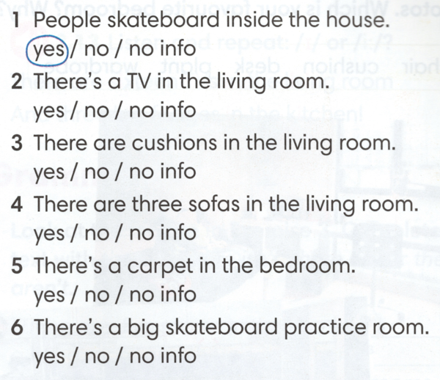
Read the sentences.
Circle yes, no or no info.
IrinaPapakhina

Slide 8
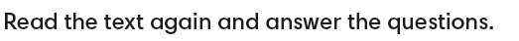
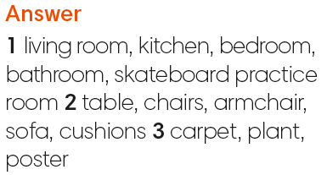
What rooms are there in the house?
What objects are there in the house?
3. What objects in the box are NOT in the house?
IrinaPapakhina

Slide 9
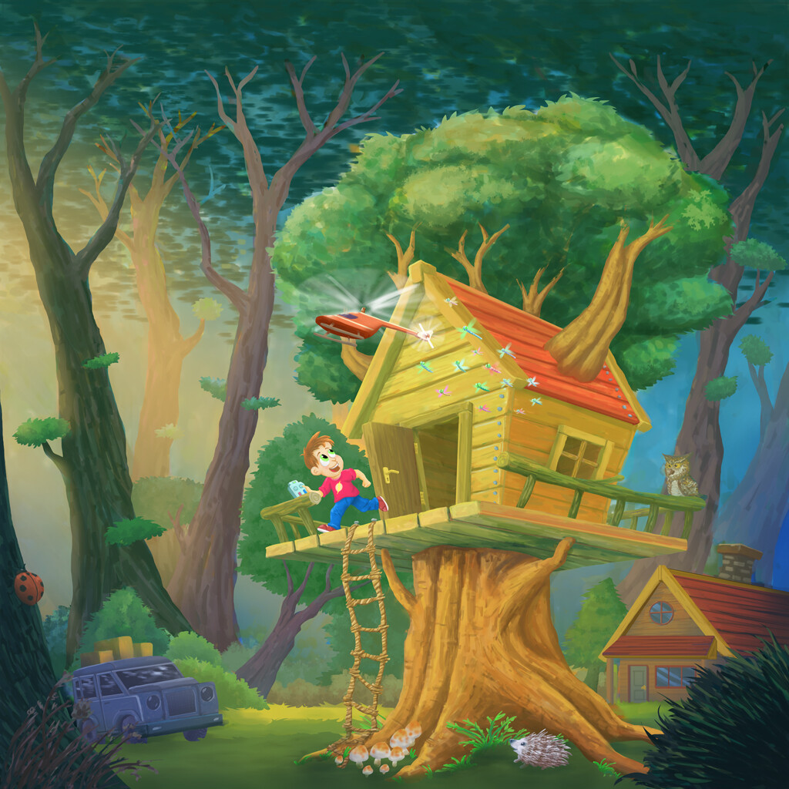
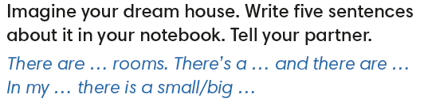

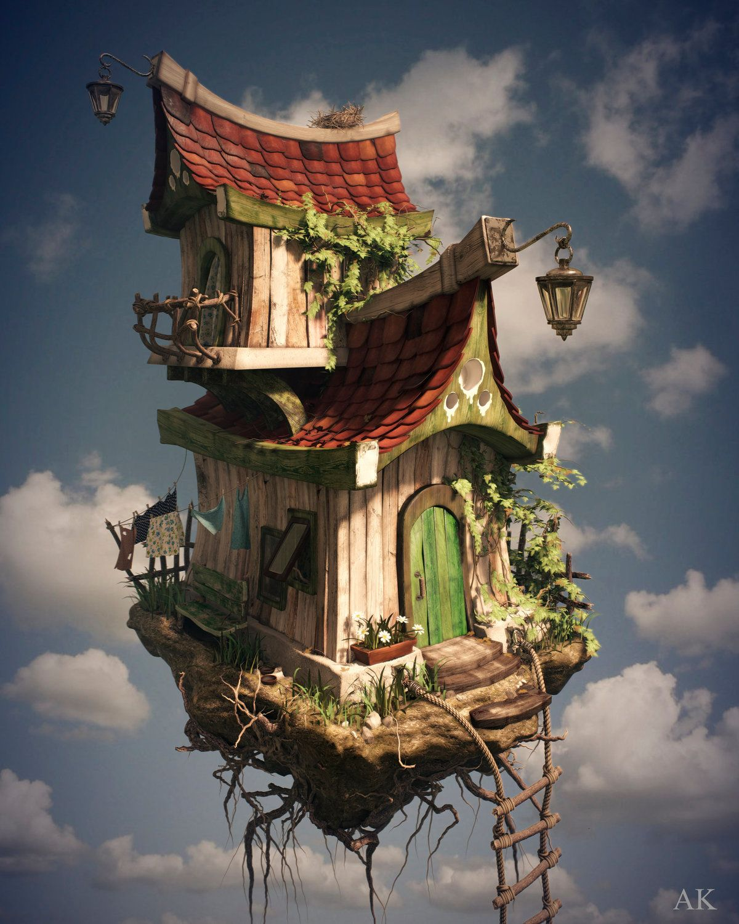


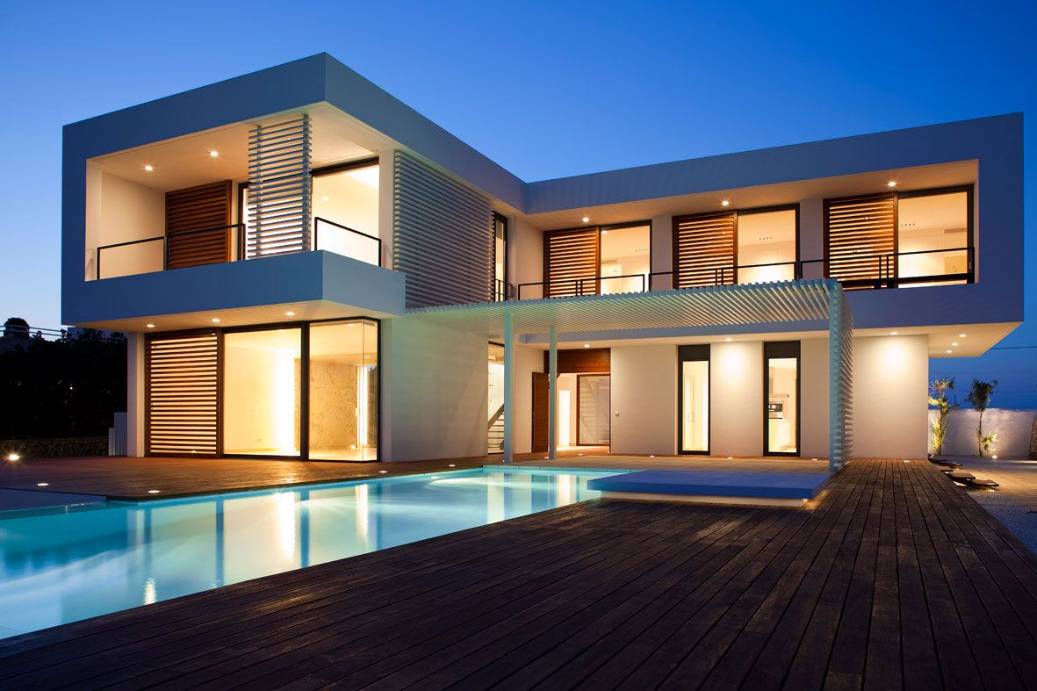
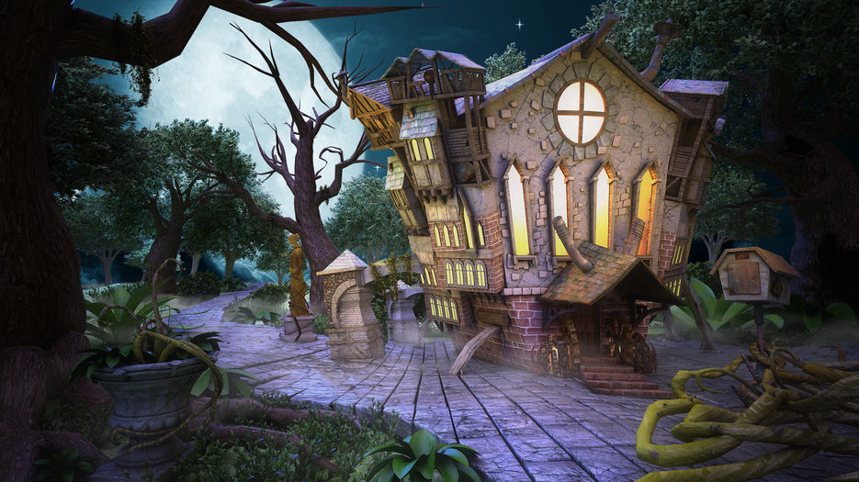

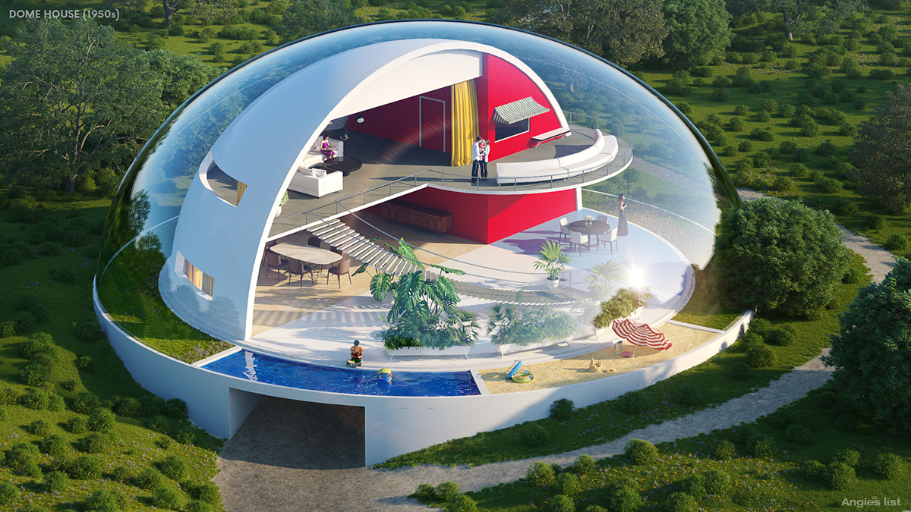
IrinaPapakhina

Slide 10
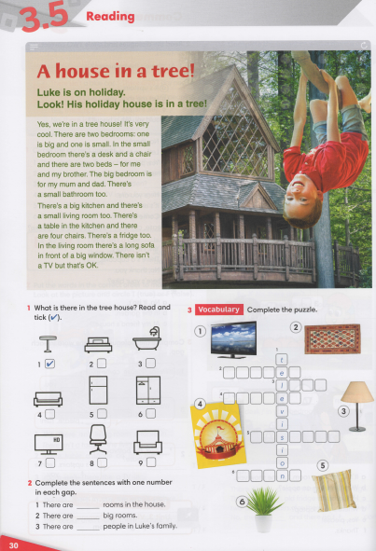


IrinaPapakhina

