Slide 1
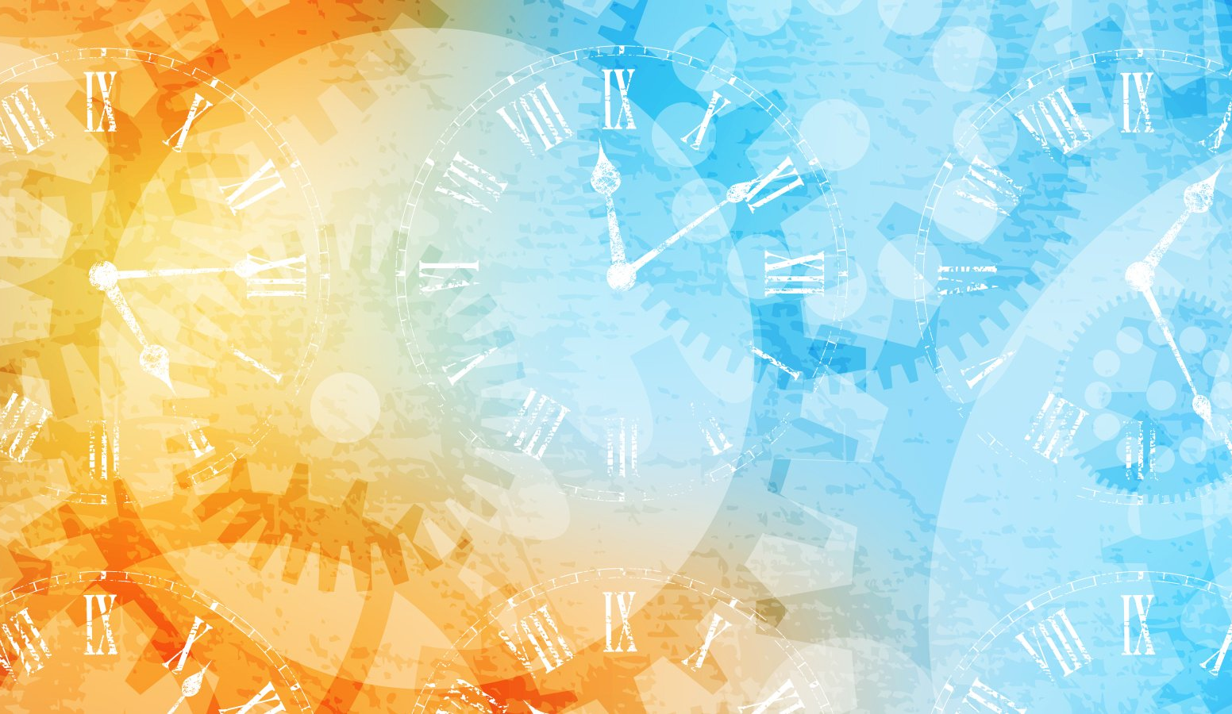

IrinaPapakhinac

Slide 2
HOURS
0
It’s … o’clock.
5
12
5
1
2
3
11
1
4
5
6
10
10
10
2
7
8
9
10
11
12
1/4
9
3
1/4
MINUTES
8
4
1
2
3
20
20
4
5
6
7
5
6
7
8
9
25
25
1/2
10
11
12
IrinaPapakhinac
Notes:
O’clock

Slide 3
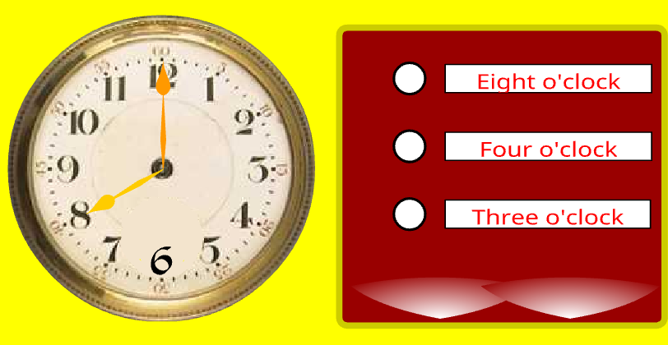
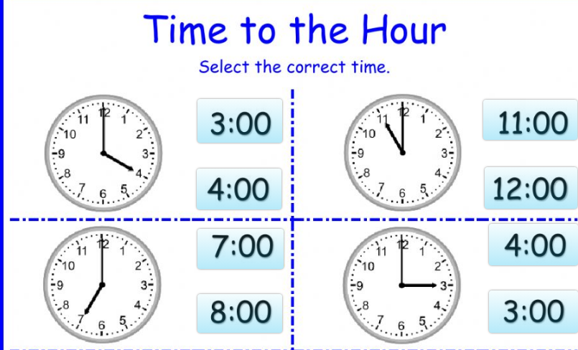
IrinaPapakhinac

Slide 4
HOURS
0
5
12
5
1
2
3
11
1
4
5
6
10
10
10
2
7
8
9
10
11
12
1/4
9
3
1/4
MINUTES
8
4
1
2
3
20
20
4
5
6
7
5
6
7
8
9
25
25
1/2
10
11
12
It’s half past … .
IrinaPapakhinac

Slide 5
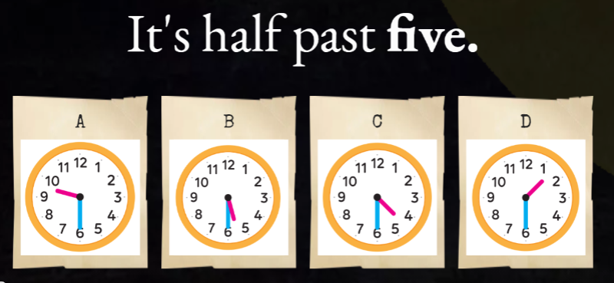
IrinaPapakhinac

Slide 6
HOURS
0
It’s … o’clock.
5
12
5
1
2
3
11
1
4
5
6
10
10
10
2
7
8
9
10
11
12
1/4
9
3
1/4
MINUTES
8
4
1
2
3
20
20
4
5
6
7
5
6
7
8
9
25
25
1/2
It’s half past … .
10
11
12
IrinaPapakhinac

Slide 7
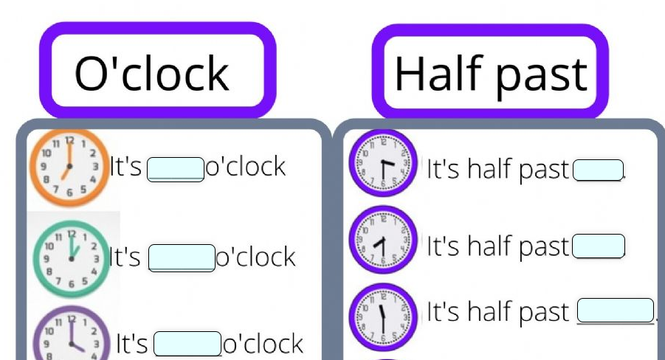
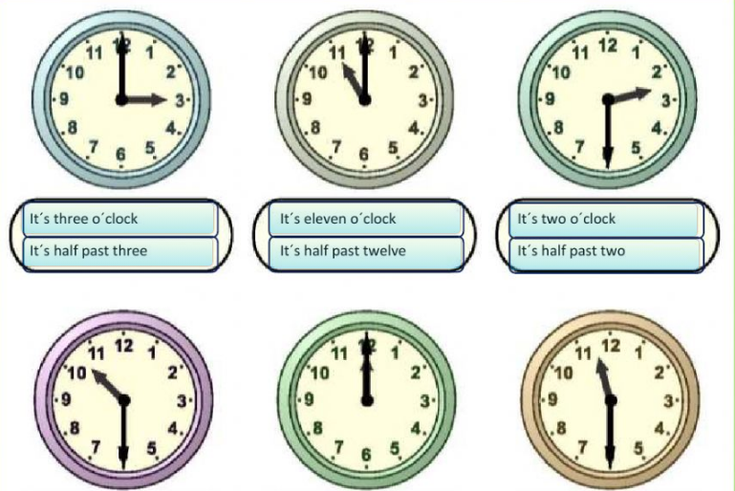
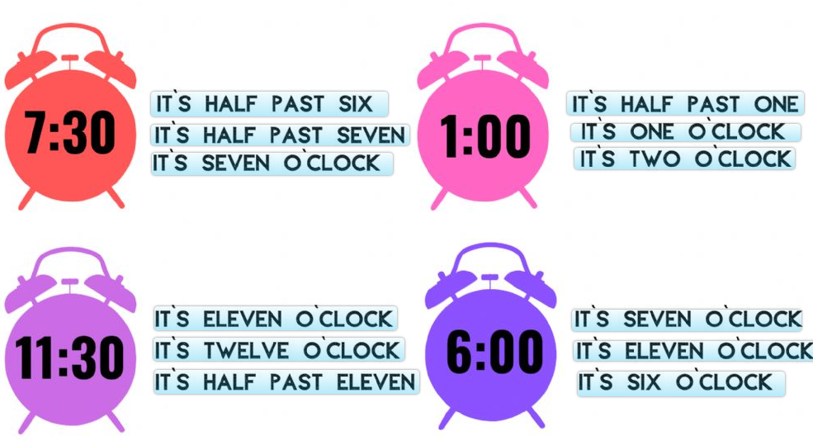
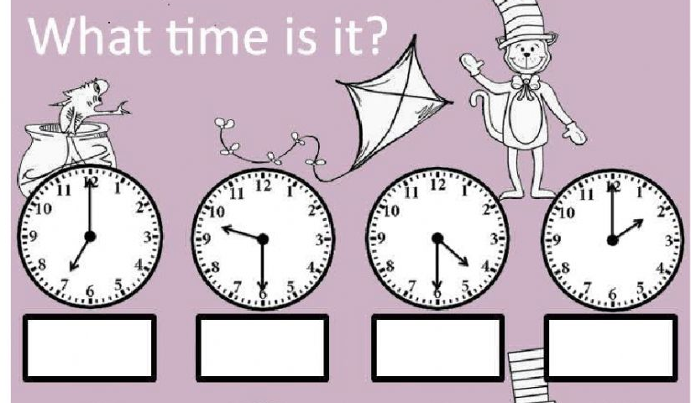
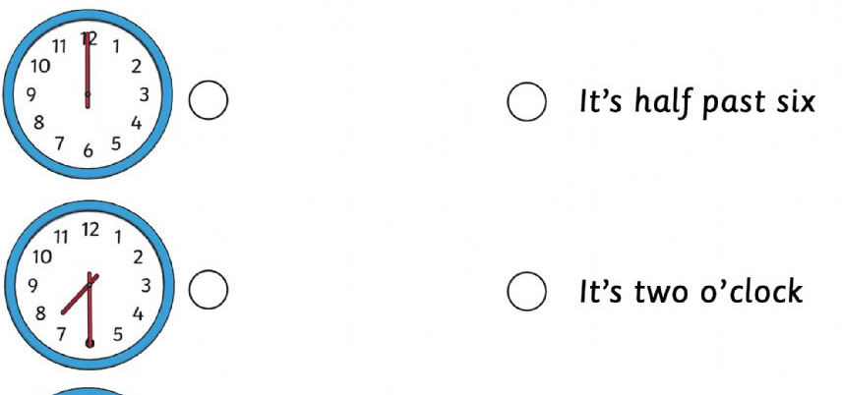
IrinaPapakhinac

Slide 8
HOURS
0
5
12
5
1
2
3
11
1
4
5
6
10
10
10
2
7
8
9
10
11
12
1/4
9
3
1/4
It’s quarter past … .
MINUTES
8
4
1
2
3
20
20
4
5
6
7
5
6
7
8
9
25
25
1/2
10
11
12
IrinaPapakhinac

Slide 9
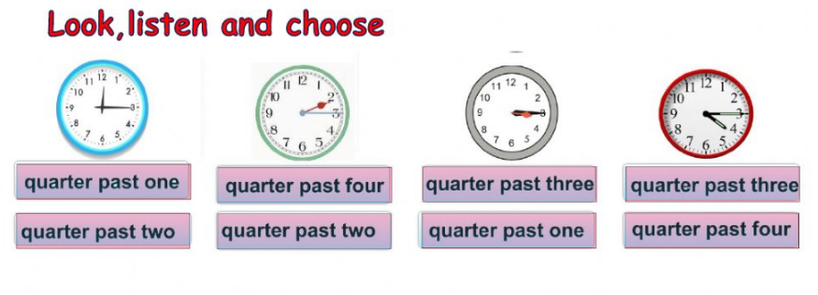
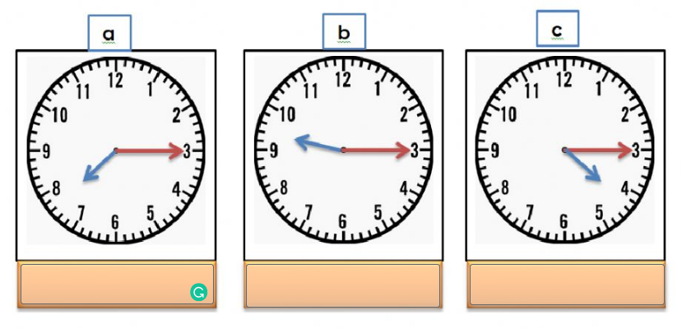
IrinaPapakhinac

Slide 10
HOURS
It’s … o’clock .
0
5
12
5
1
2
3
11
1
4
5
6
10
10
10
2
7
8
9
10
11
12
1/4
9
3
1/4
It’s quarter past … .
MINUTES
8
4
1
2
3
20
20
4
5
6
7
5
6
7
8
9
25
25
1/2
It’s half past … .
10
11
12
IrinaPapakhinac

Slide 11
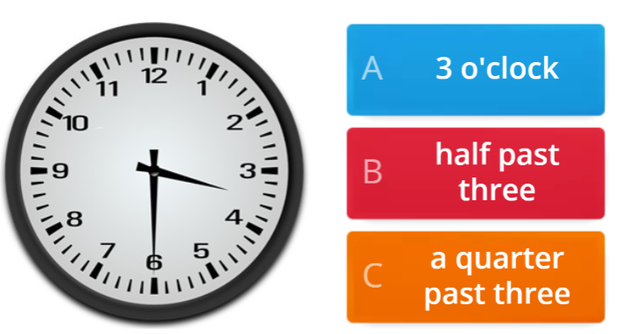
IrinaPapakhinac

Slide 12
HOURS
0
5
12
5
1
2
3
11
1
4
5
6
10
10
10
2
7
8
9
10
11
12
1/4
9
3
1/4
It’s quarter to … .
MINUTES
8
4
1
2
3
20
20
4
5
6
7
5
6
7
8
9
25
25
1/2
10
11
12
IrinaPapakhinac

Slide 13
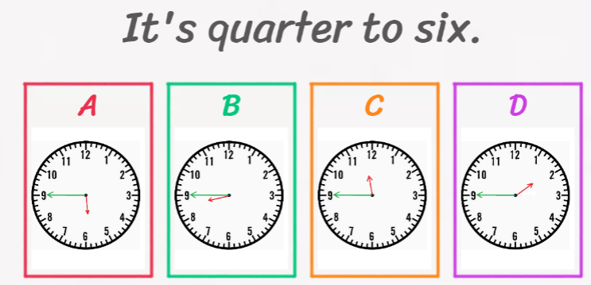
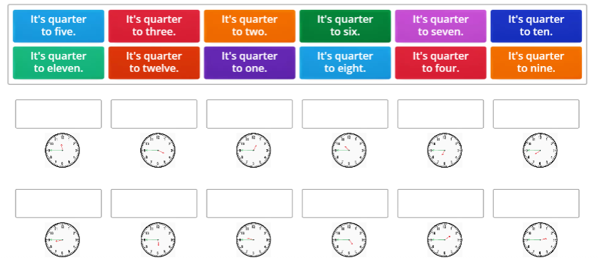
IrinaPapakhinac

Slide 14
HOURS
0
5
12
5
1
2
3
11
1
4
5
6
10
10
10
2
7
8
9
10
11
12
1/4
9
3
1/4
It’s quarter to ….
It’s quarter past … .
MINUTES
8
4
1
2
3
20
20
4
5
6
7
5
6
7
8
9
25
25
1/2
10
11
12
IrinaPapakhinac

Slide 15
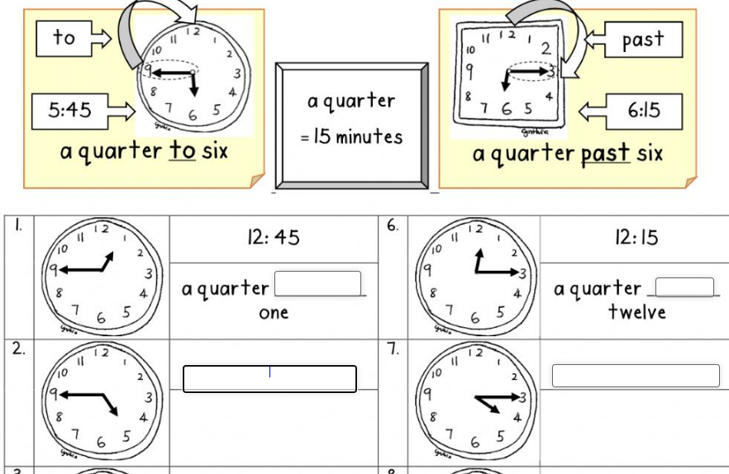
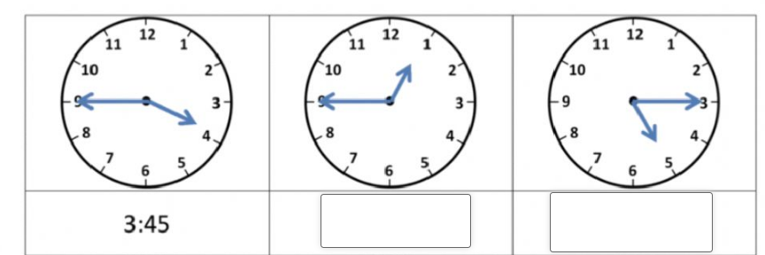
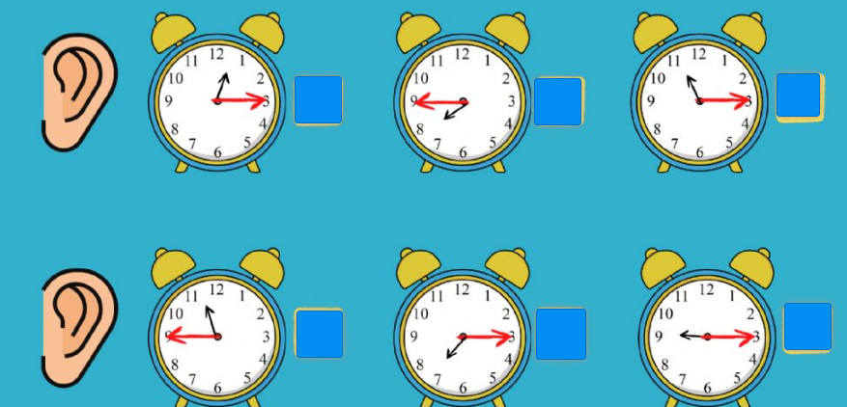
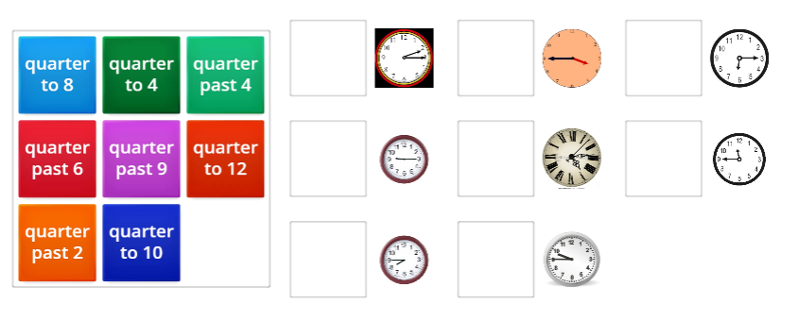
IrinaPapakhinac

Slide 16
HOURS
0
It’s … o’clock .
5
12
5
1
2
3
11
1
4
5
6
10
10
10
2
7
8
9
10
11
12
1/4
9
3
1/4
It’s quarter to ….
It’s quarter past … .
MINUTES
8
4
1
2
3
20
20
4
5
6
7
5
6
7
8
9
25
25
1/2
It’s half past … .
10
11
12
IrinaPapakhinac

Slide 17
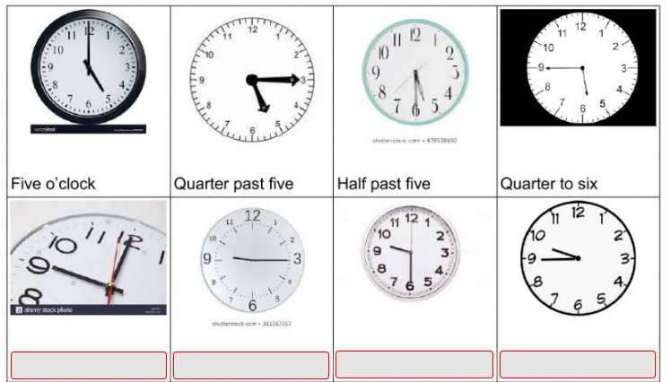
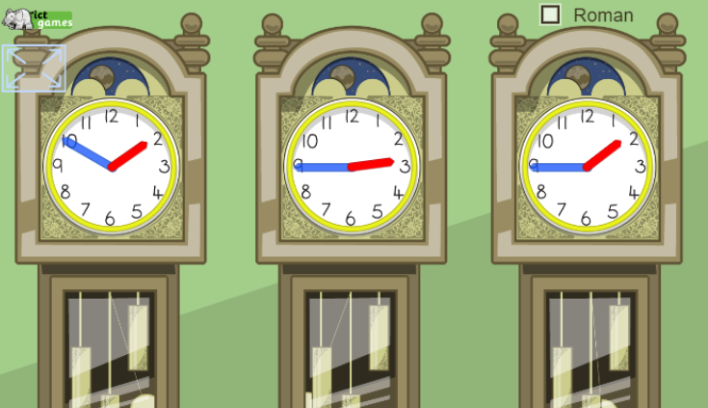
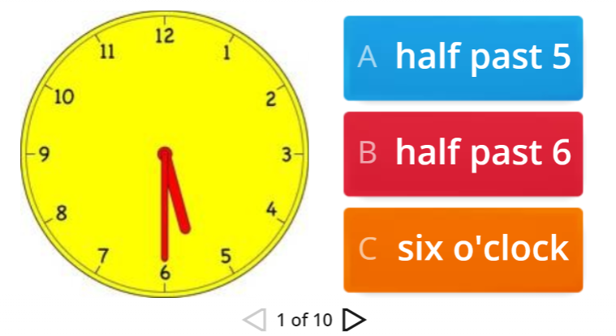
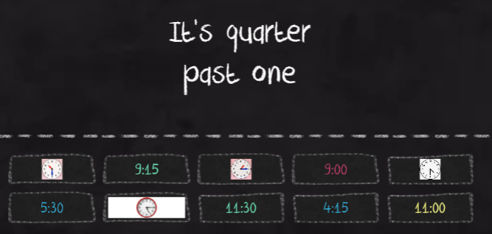
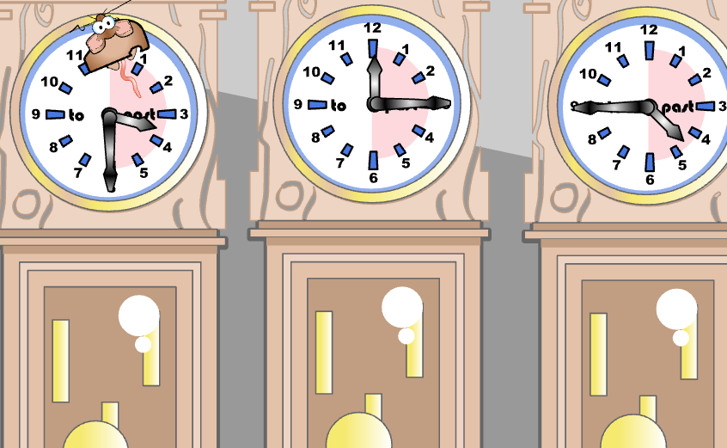
IrinaPapakhinac

Slide 18
HOURS
0
5
12
5
It’s five past … .
1
2
3
11
1
4
5
6
10
10
It’s ten past … .
10
2
7
8
9
10
11
12
1/4
9
3
1/4
It’s quarter past … .
MINUTES
8
4
1
2
3
20
20
It’s twenty past … .
4
5
6
7
5
6
7
8
9
25
25
It’s twenty-five past … .
1/2
10
11
12
It’s half past … .
IrinaPapakhinac

Slide 19
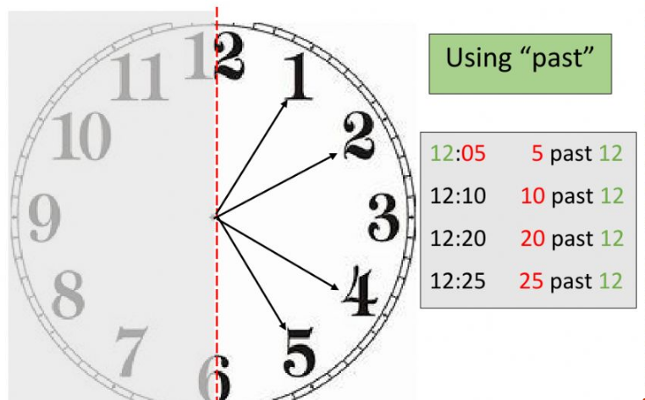
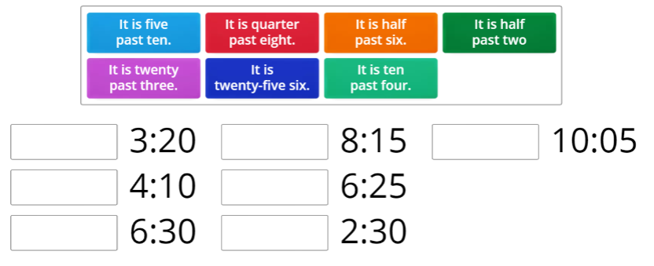
IrinaPapakhinac

Slide 20
HOURS
0
5
12
5
1
2
3
It’s five to … .
11
1
4
5
6
10
10
It’s ten to … .
10
2
7
8
9
10
11
12
1/4
9
3
1/4
It’s quarter to … .
MINUTES
8
4
1
2
3
It’s twenty to … .
20
20
4
5
6
7
5
6
7
8
9
25
25
It’s twenty-five to … .
1/2
10
11
12
IrinaPapakhinac

Slide 21
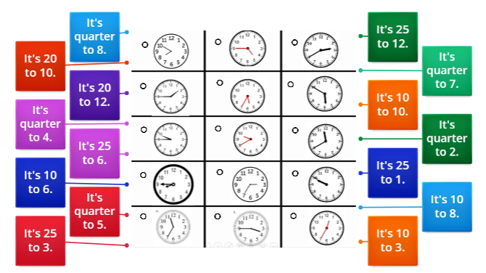
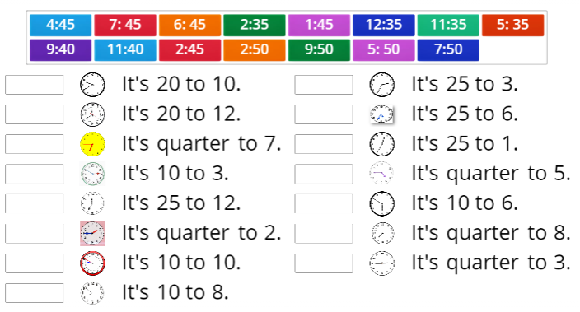
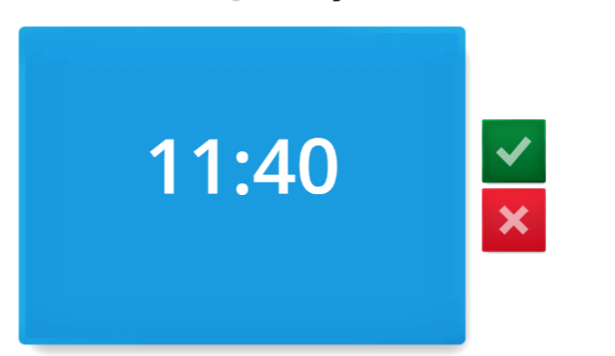
IrinaPapakhinac

Slide 22
HOURS
0
It’s … o’clock .
5
12
5
It’s five past … .
1
2
3
It’s five to … .
11
1
4
5
6
10
10
It’s ten past … .
It’s ten to … .
10
2
7
8
9
10
11
12
1/4
9
3
1/4
It’s quarter past … .
It’s quarter to … .
MINUTES
8
4
1
2
3
It’s twenty to … .
20
20
It’s twenty past … .
4
5
6
7
5
6
7
8
9
25
25
It’s twenty-five past … .
It’s twenty-five to … .
1/2
10
11
12
It’s half past … .
IrinaPapakhinac

Slide 23
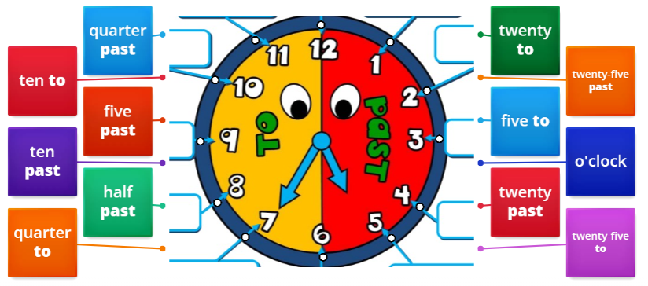
IrinaPapakhinac

Slide 24
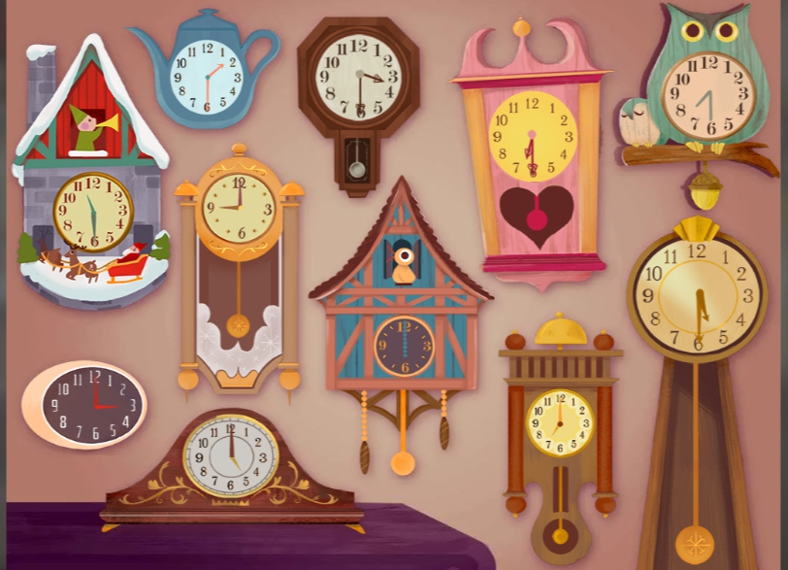
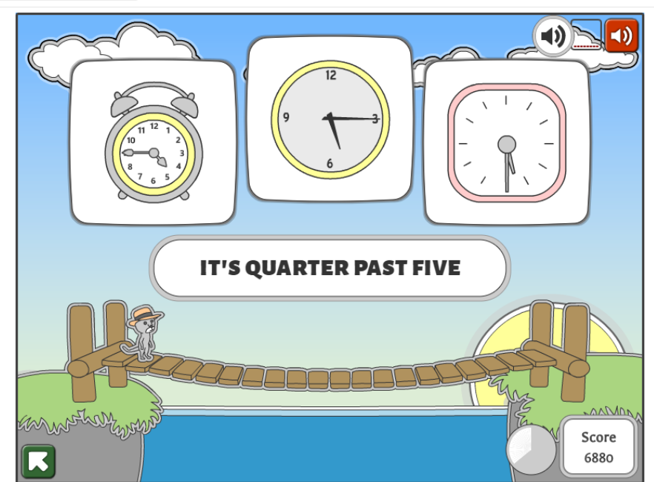
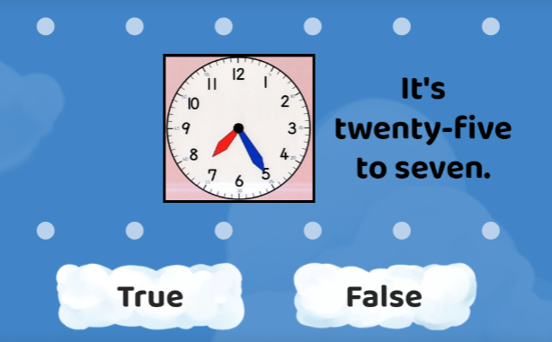
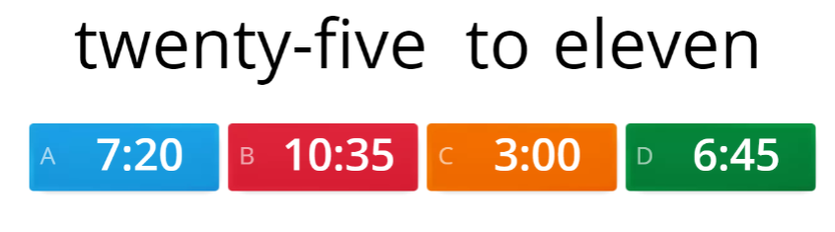
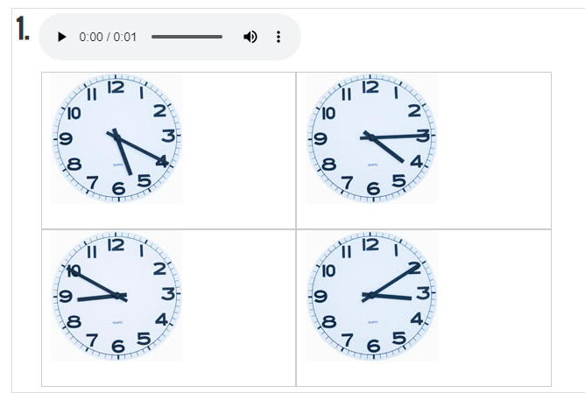
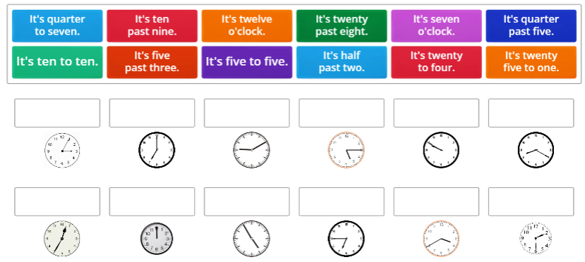
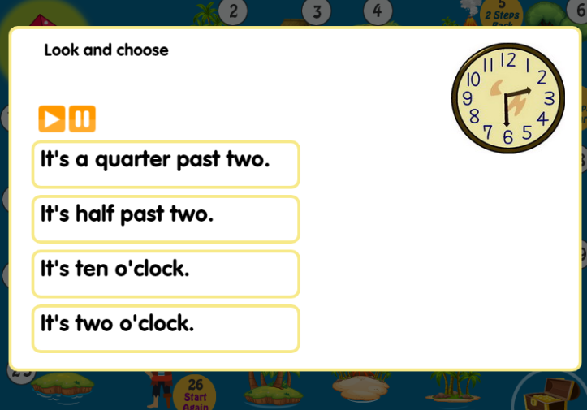
IrinaPapakhinac

