Slide 1
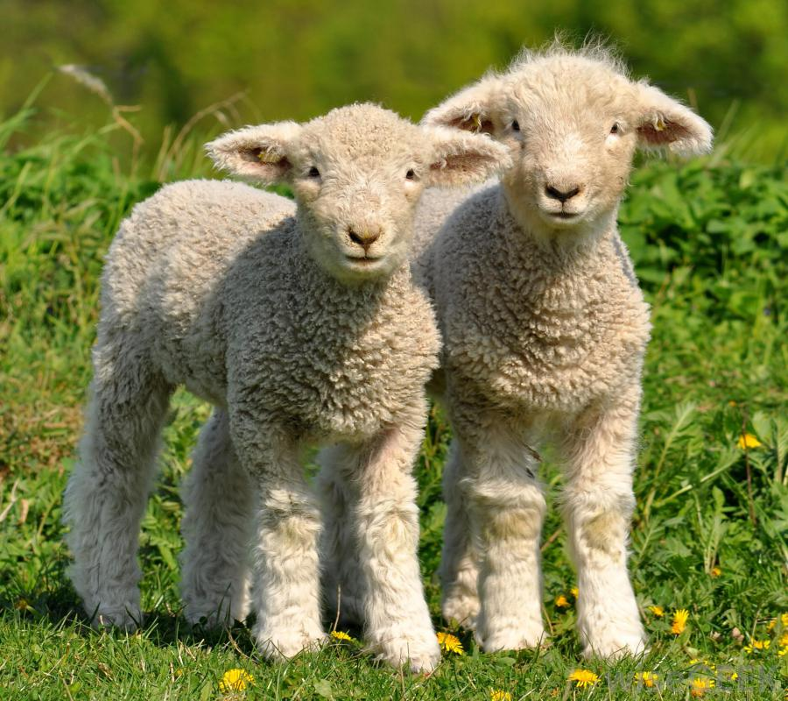
I’d like to feed the

Slide 2
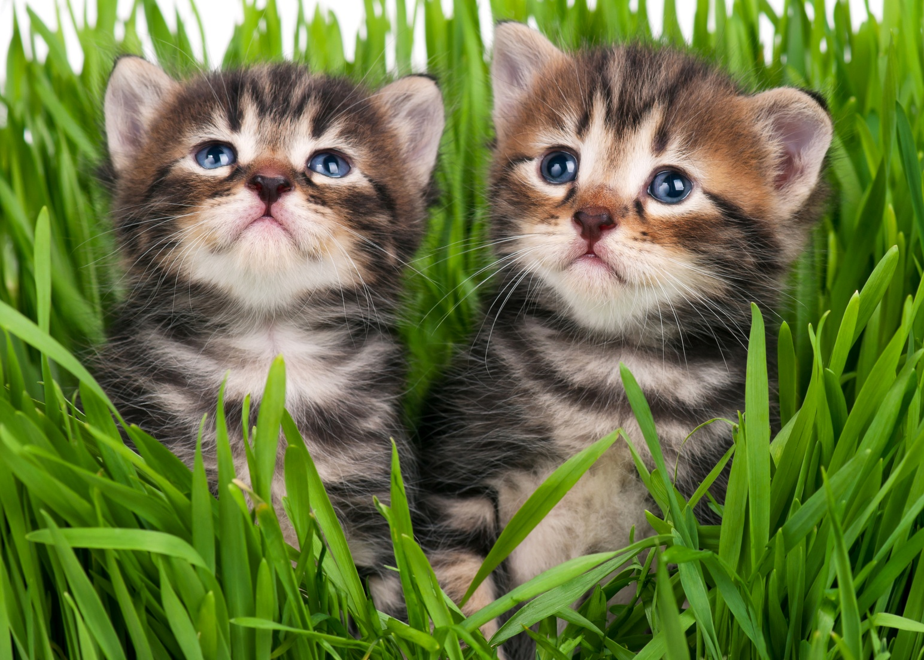
I’d like to feed the

Slide 3
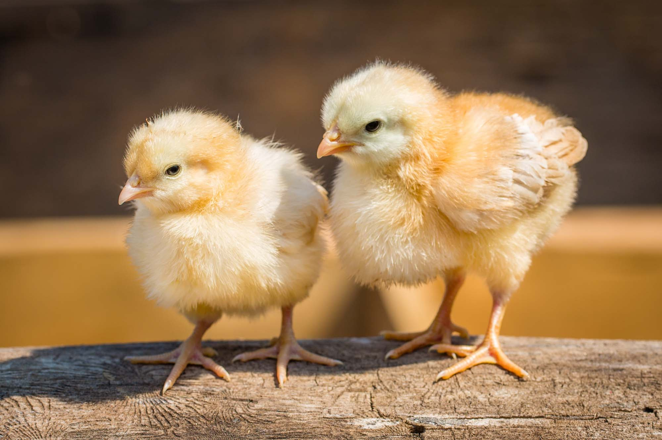
I’d like to feed the

Slide 4
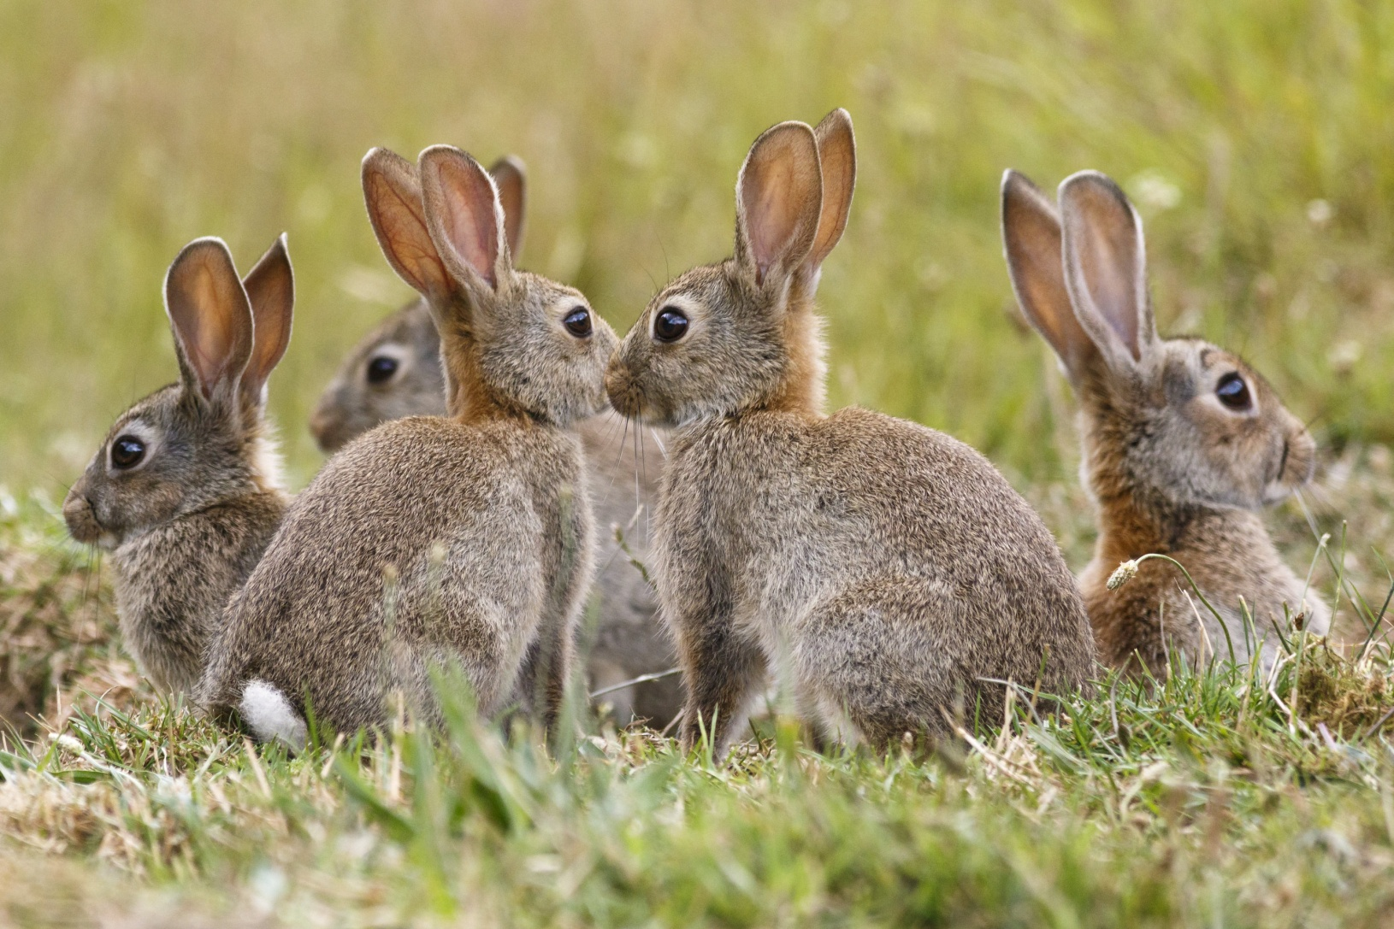
I’d like to feed the

Slide 5
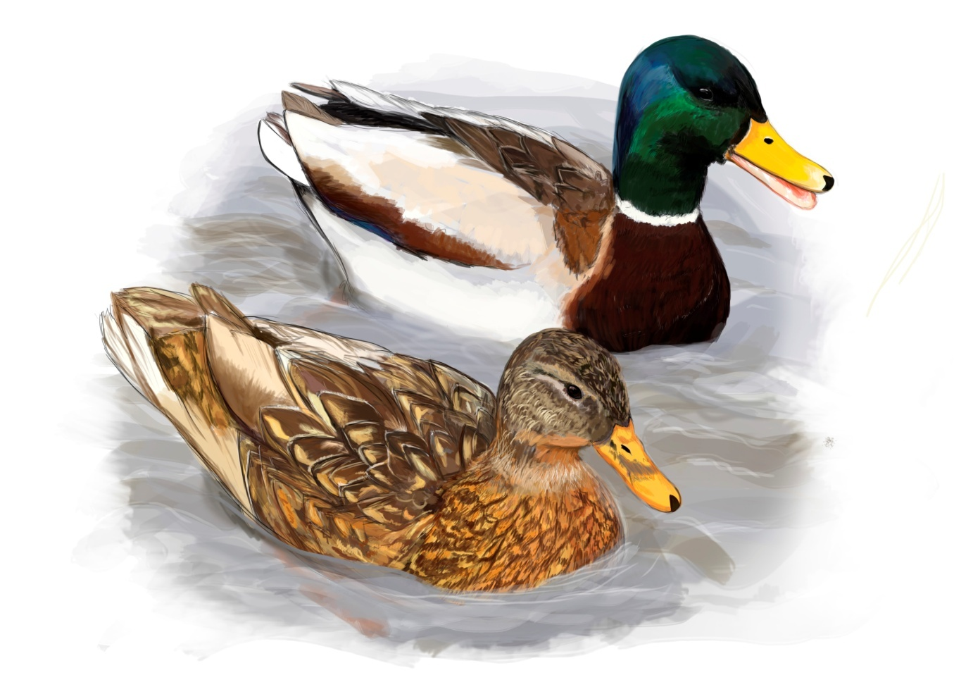
I’d like to feed the

Slide 6
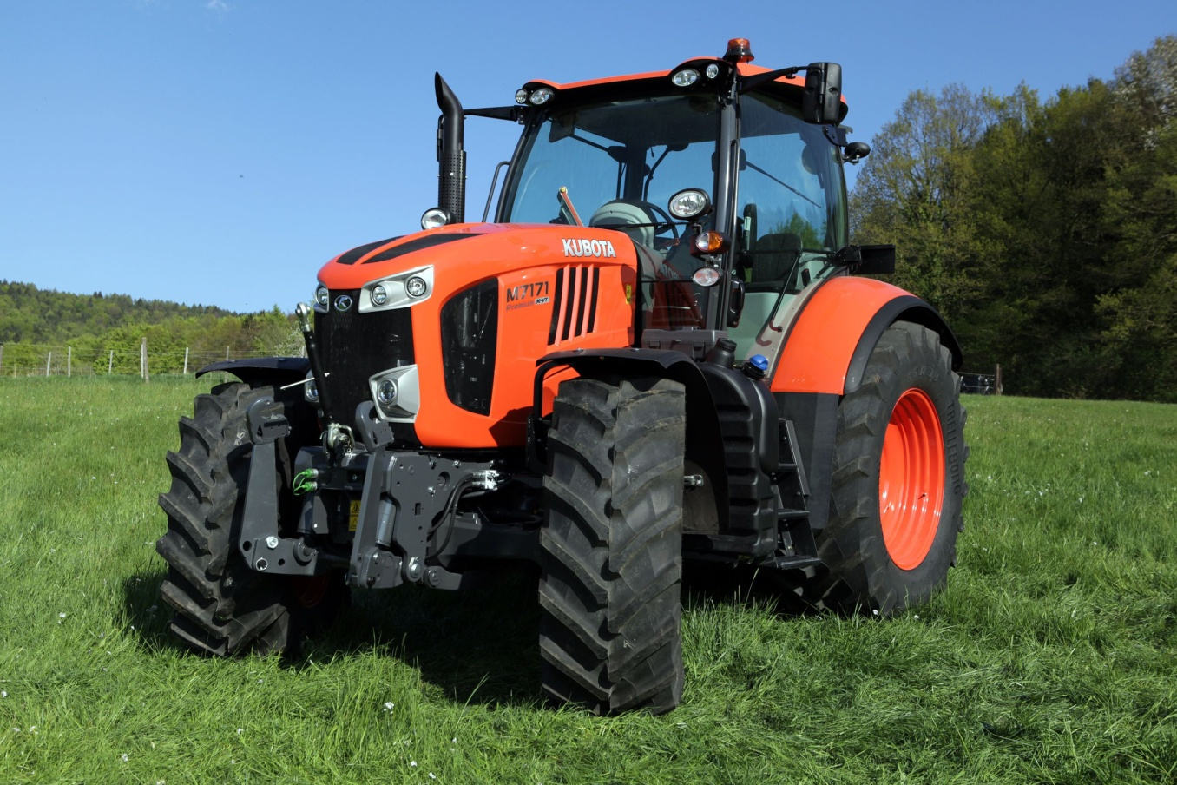
I’d like to ride on a

Slide 7
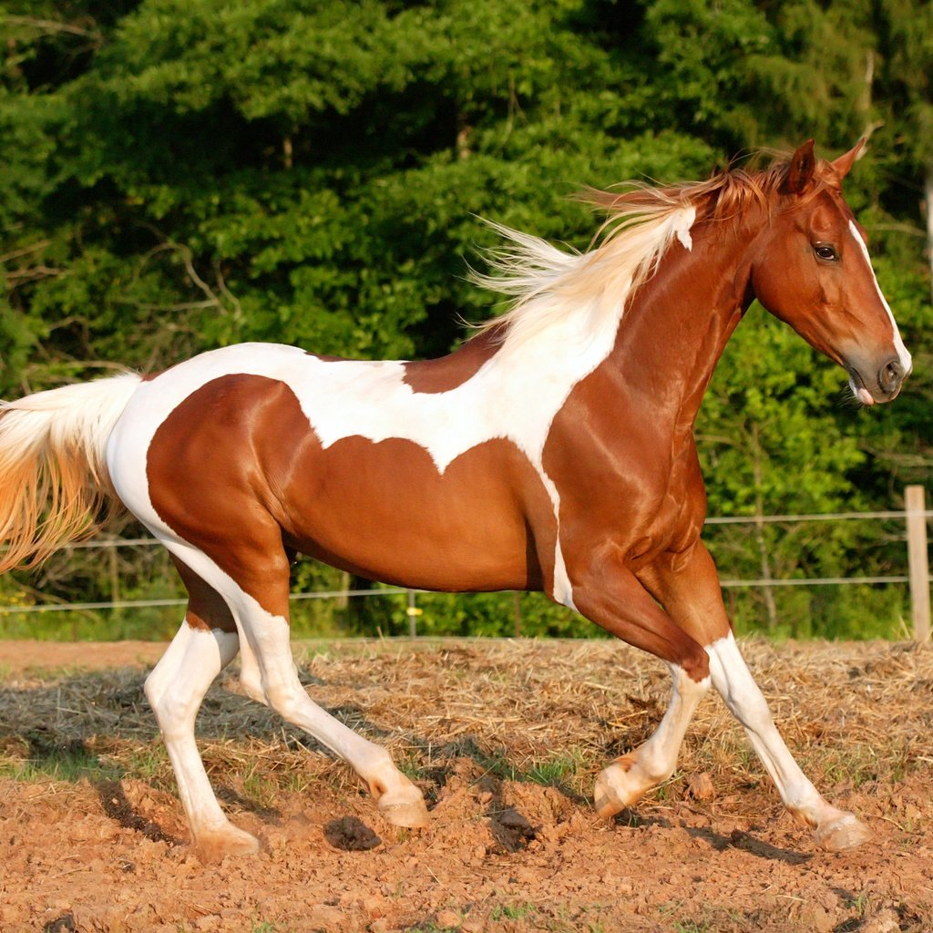
I’d like to ride on a

Slide 8
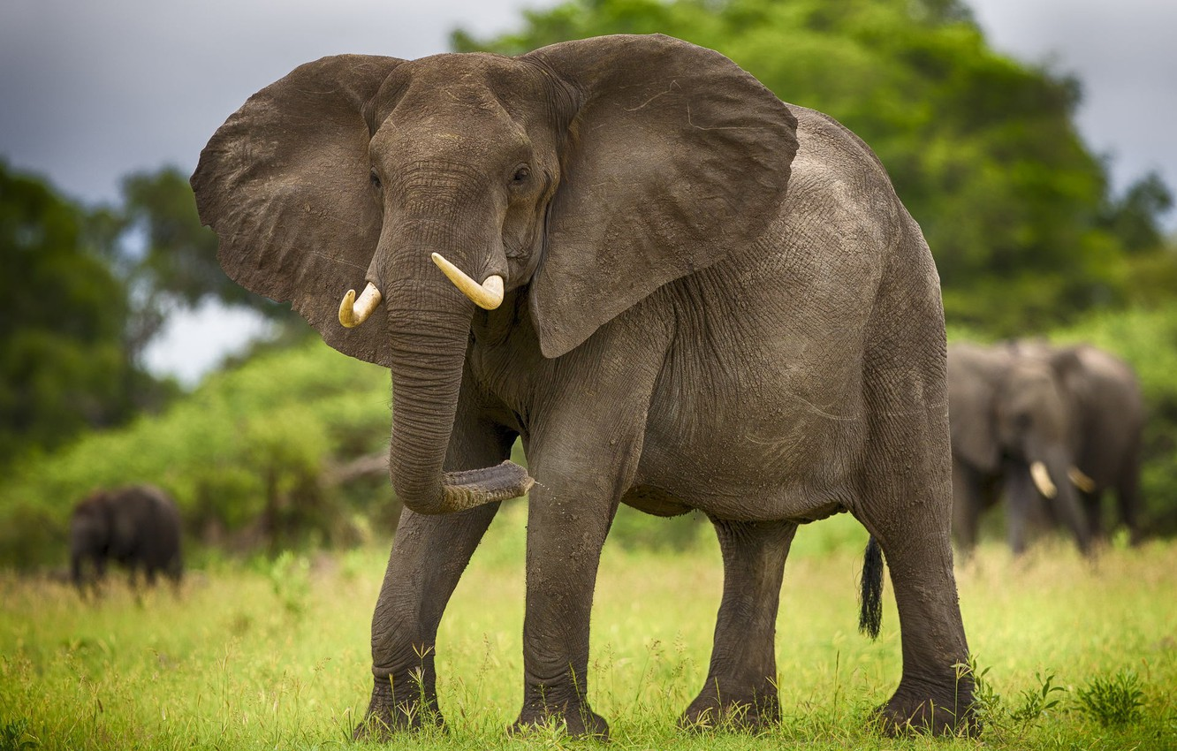
I’d like to ride on an

Slide 9
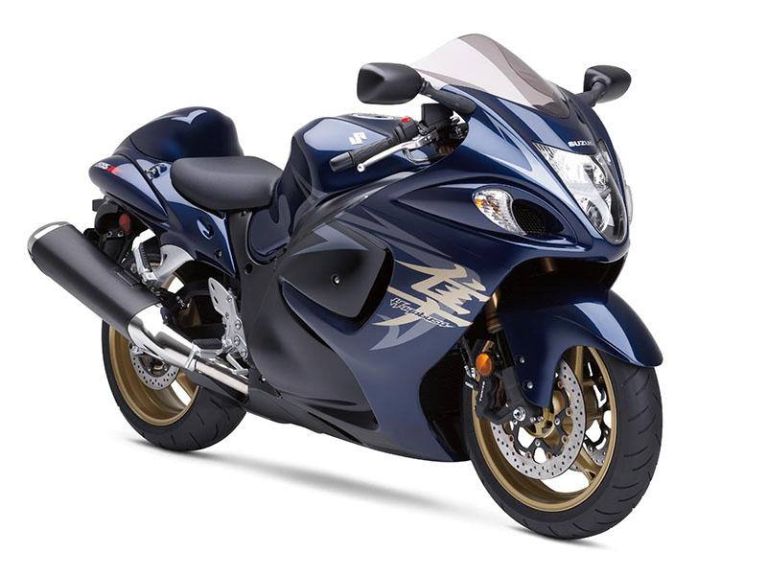
I’d like to ride on a

Slide 10
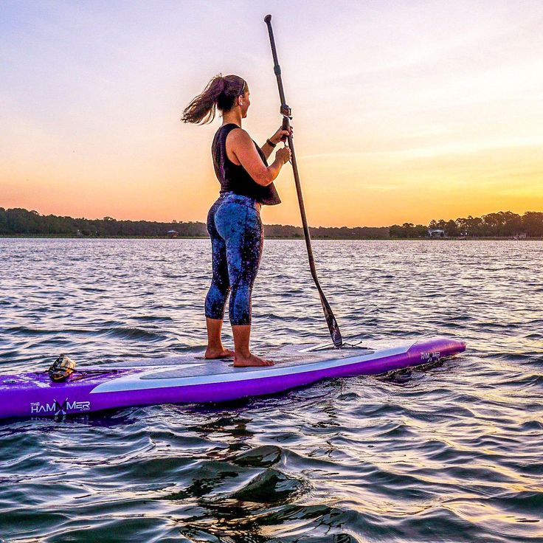
I’d like to ride on a

Slide 11
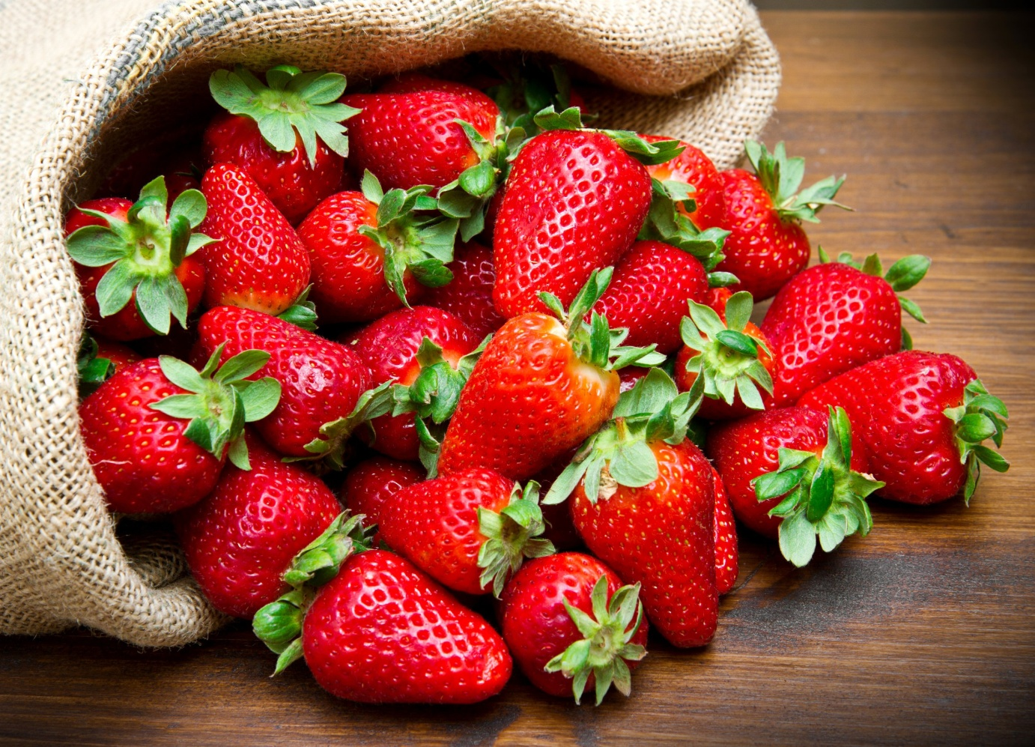
I’d like to pick some

Slide 12
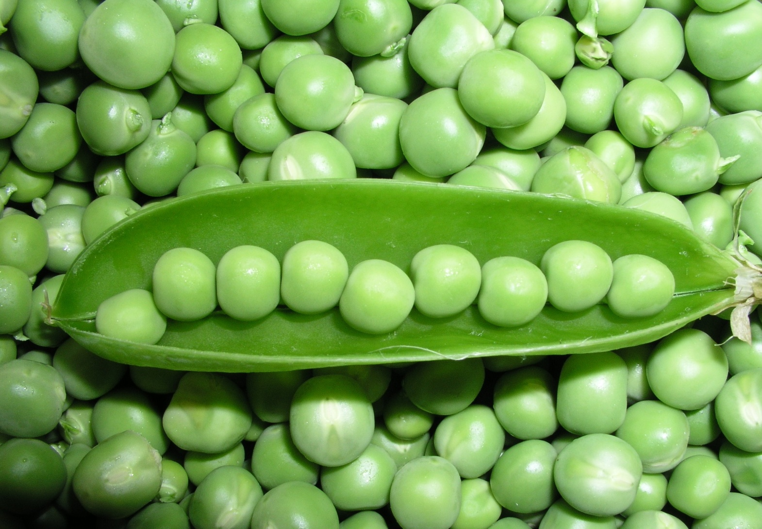
I’d like to pick some

Slide 13

I’d like to pick some

Slide 14

I’d like to pick some

Slide 15
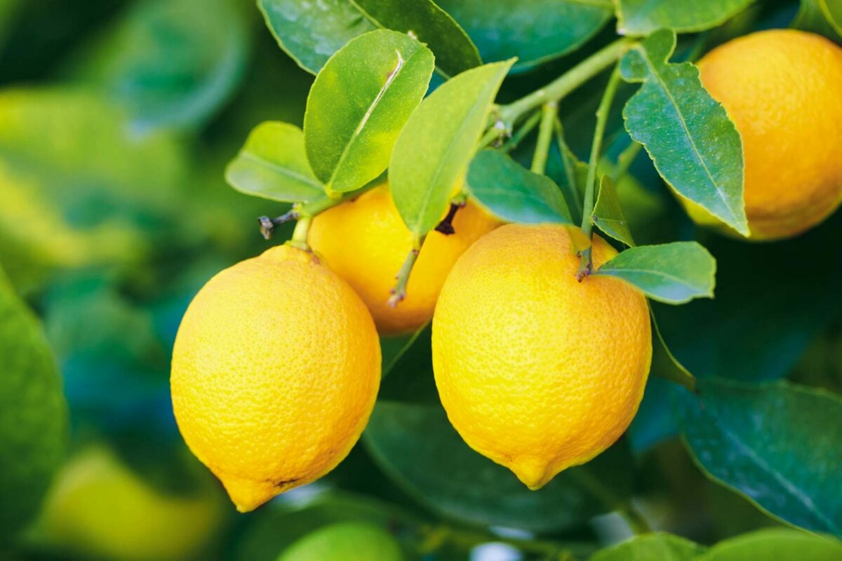
I’d like to pick some

Slide 16
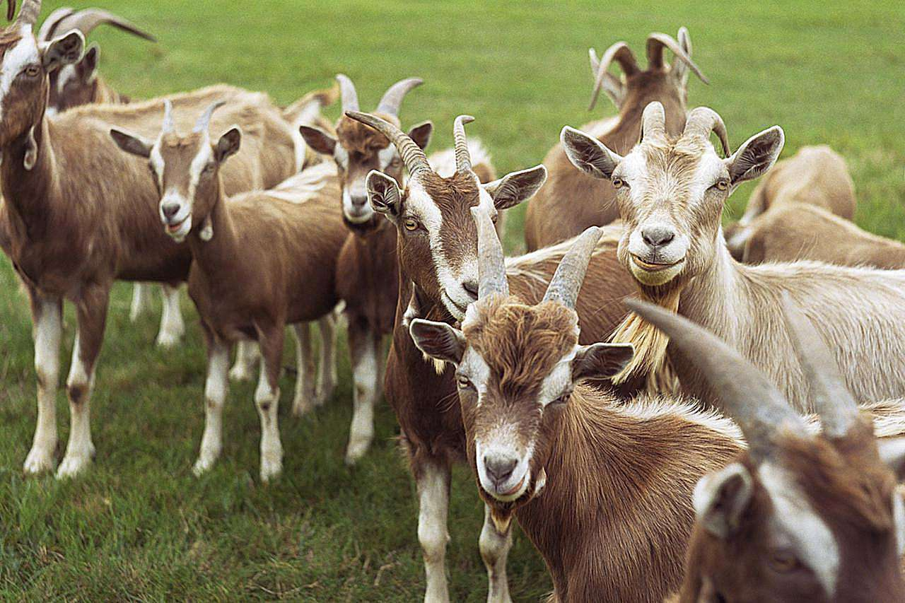
I’d like to see the

Slide 17
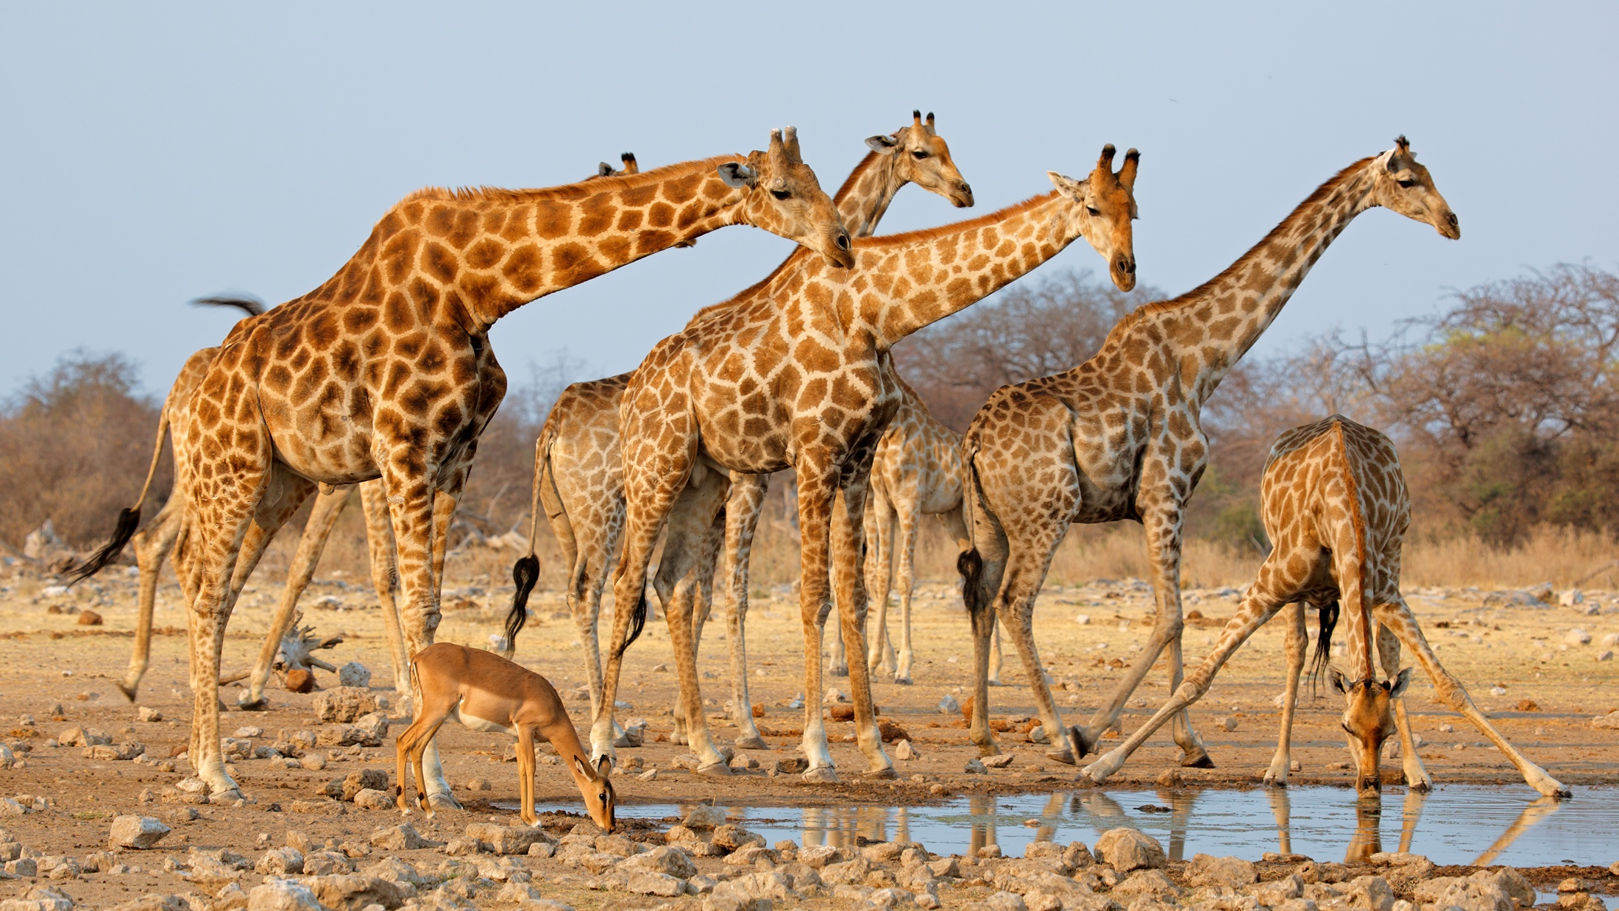
I’d like to see the

Slide 18
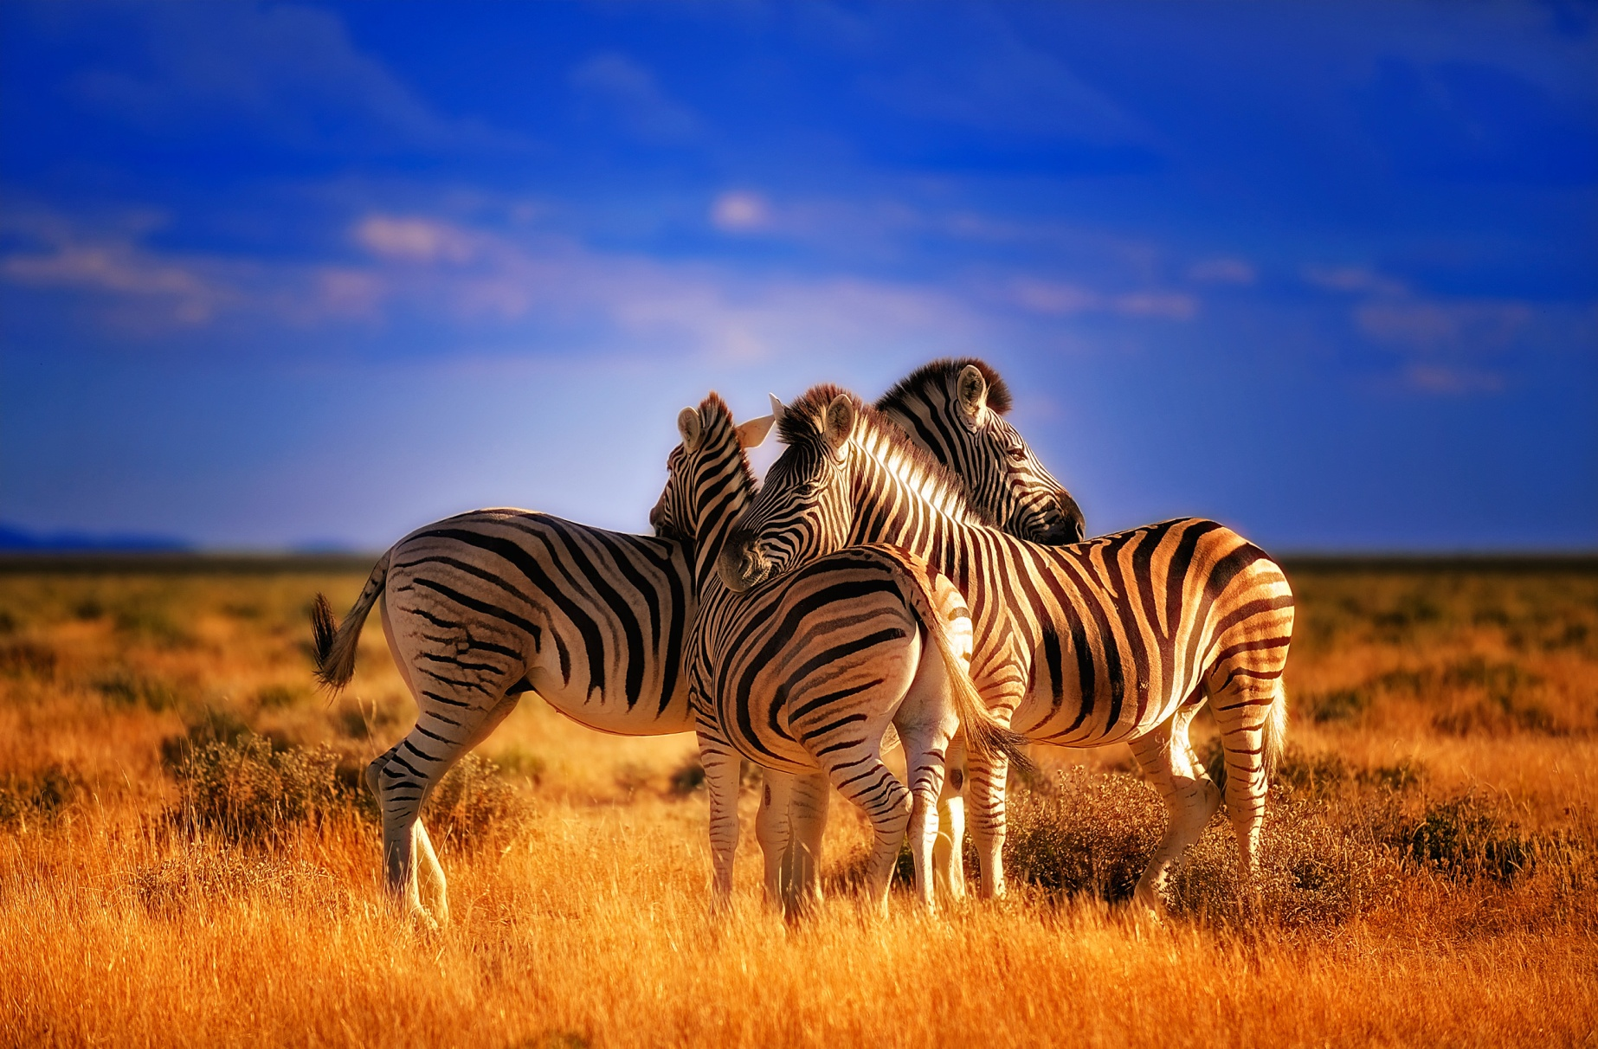
I’d like to see the

Slide 19
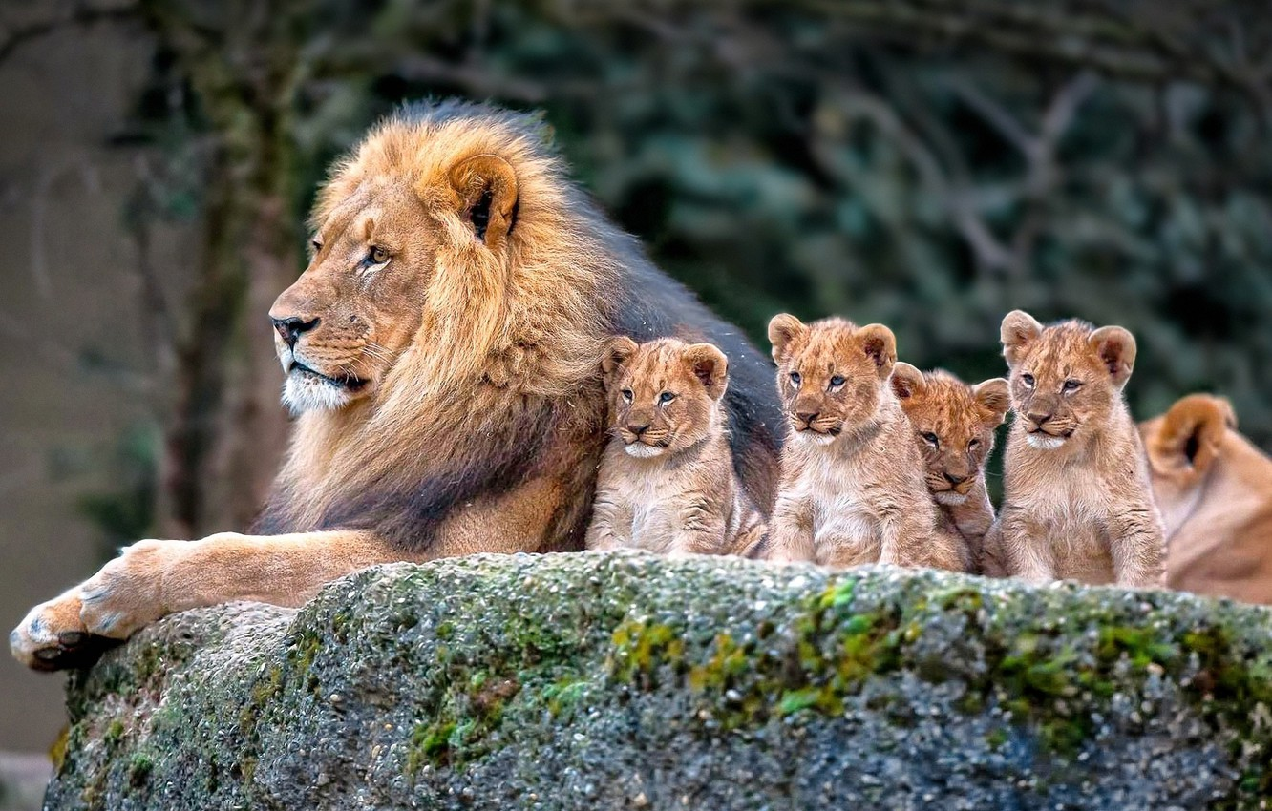
I’d like to see the

Slide 20
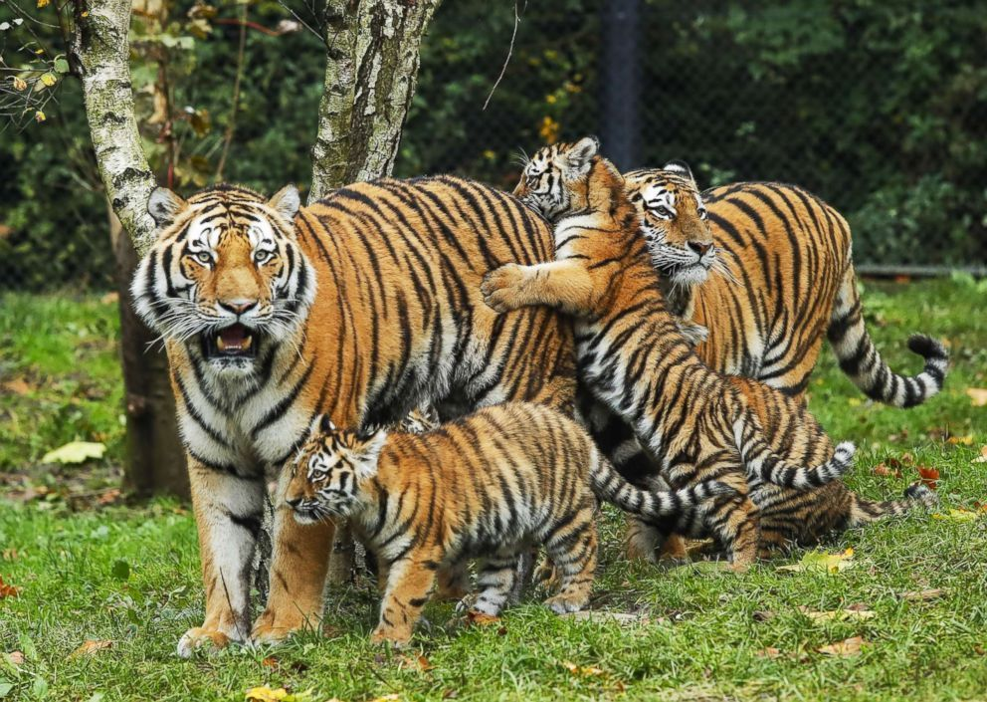
I’d like to see the

