Slide 1


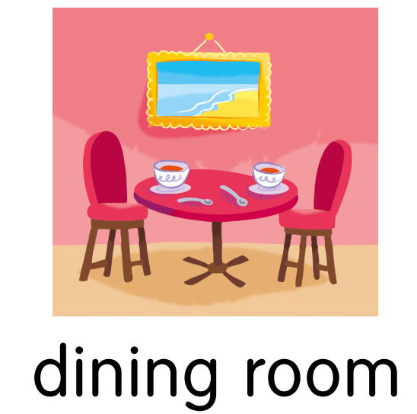
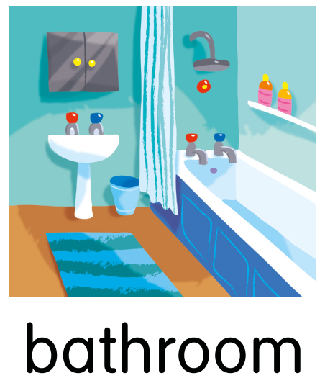
Yesterday I…., but I….

Slide 2
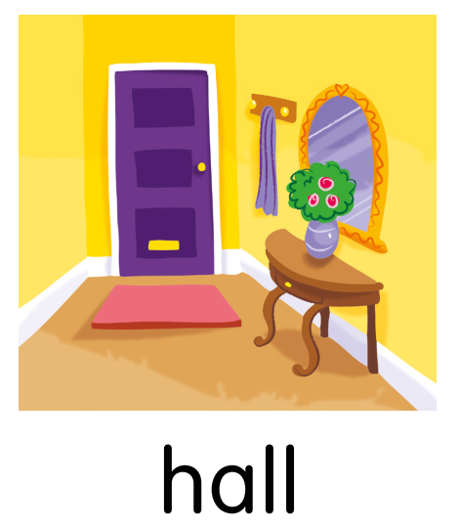
Yesterday Sophie …, but she …

Slide 3
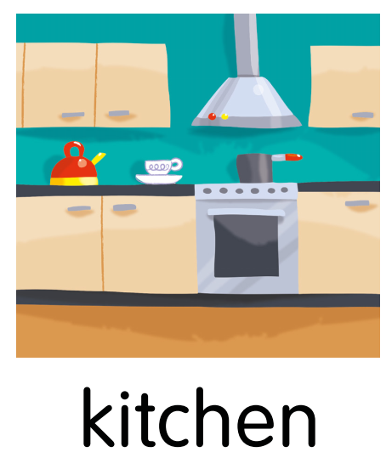
Yesterday Mike …, but he …

Slide 4
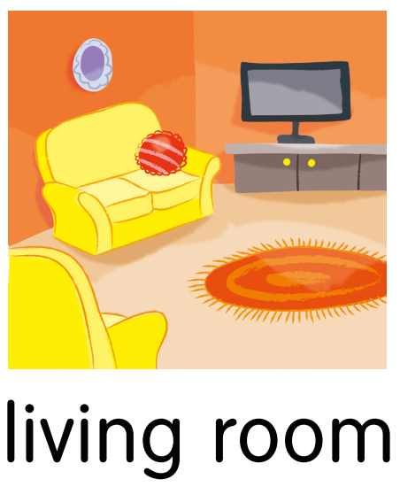
Yesterday I …, but I …

Slide 5
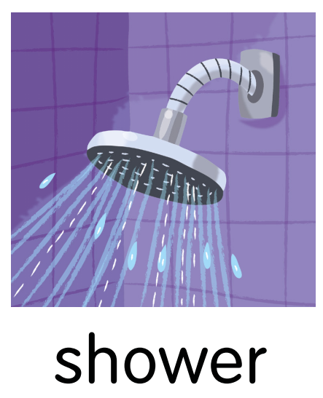
Yesterday Liza …, but she …

Slide 6

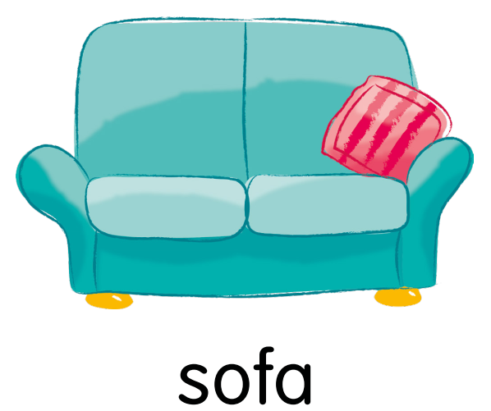
Yesterday the bird …, but it …

Slide 7
Yesterday Mum …, but she …

Slide 8
Yesterday Dad …, but he …

