Slide 1



IrinaPapakhinac

Slide 2

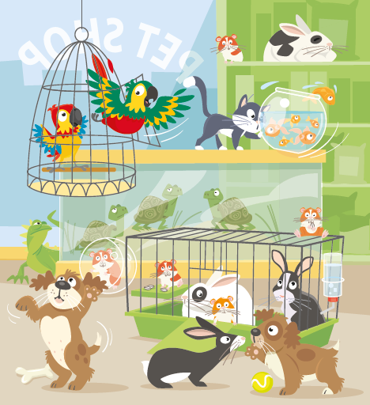
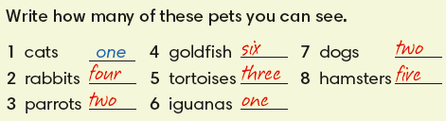
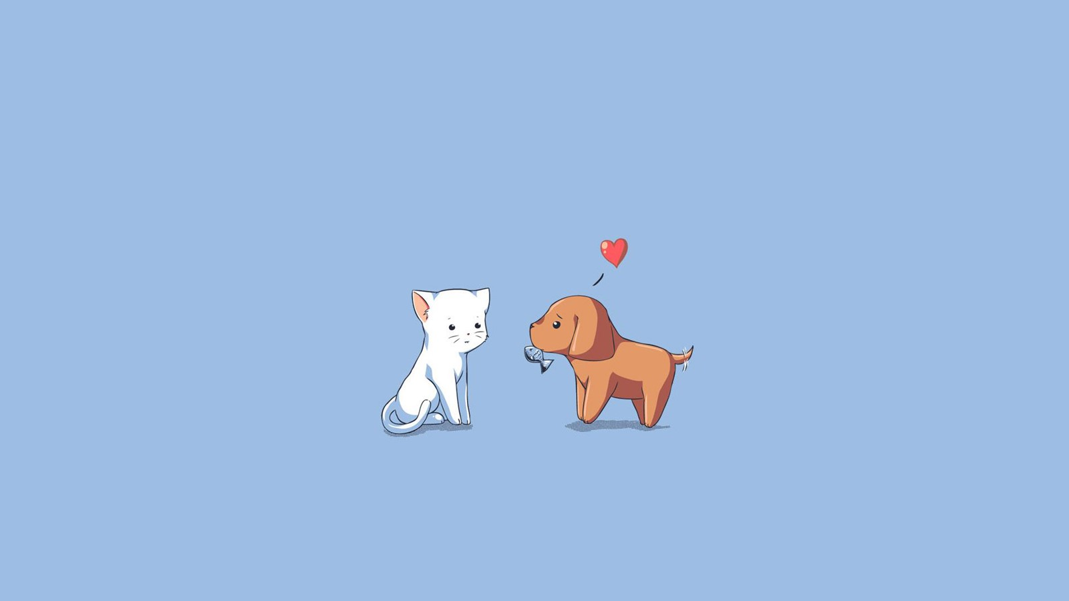
IrinaPapakhinac

Slide 3
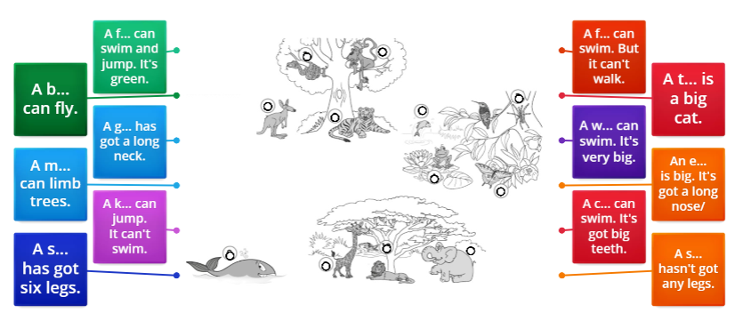
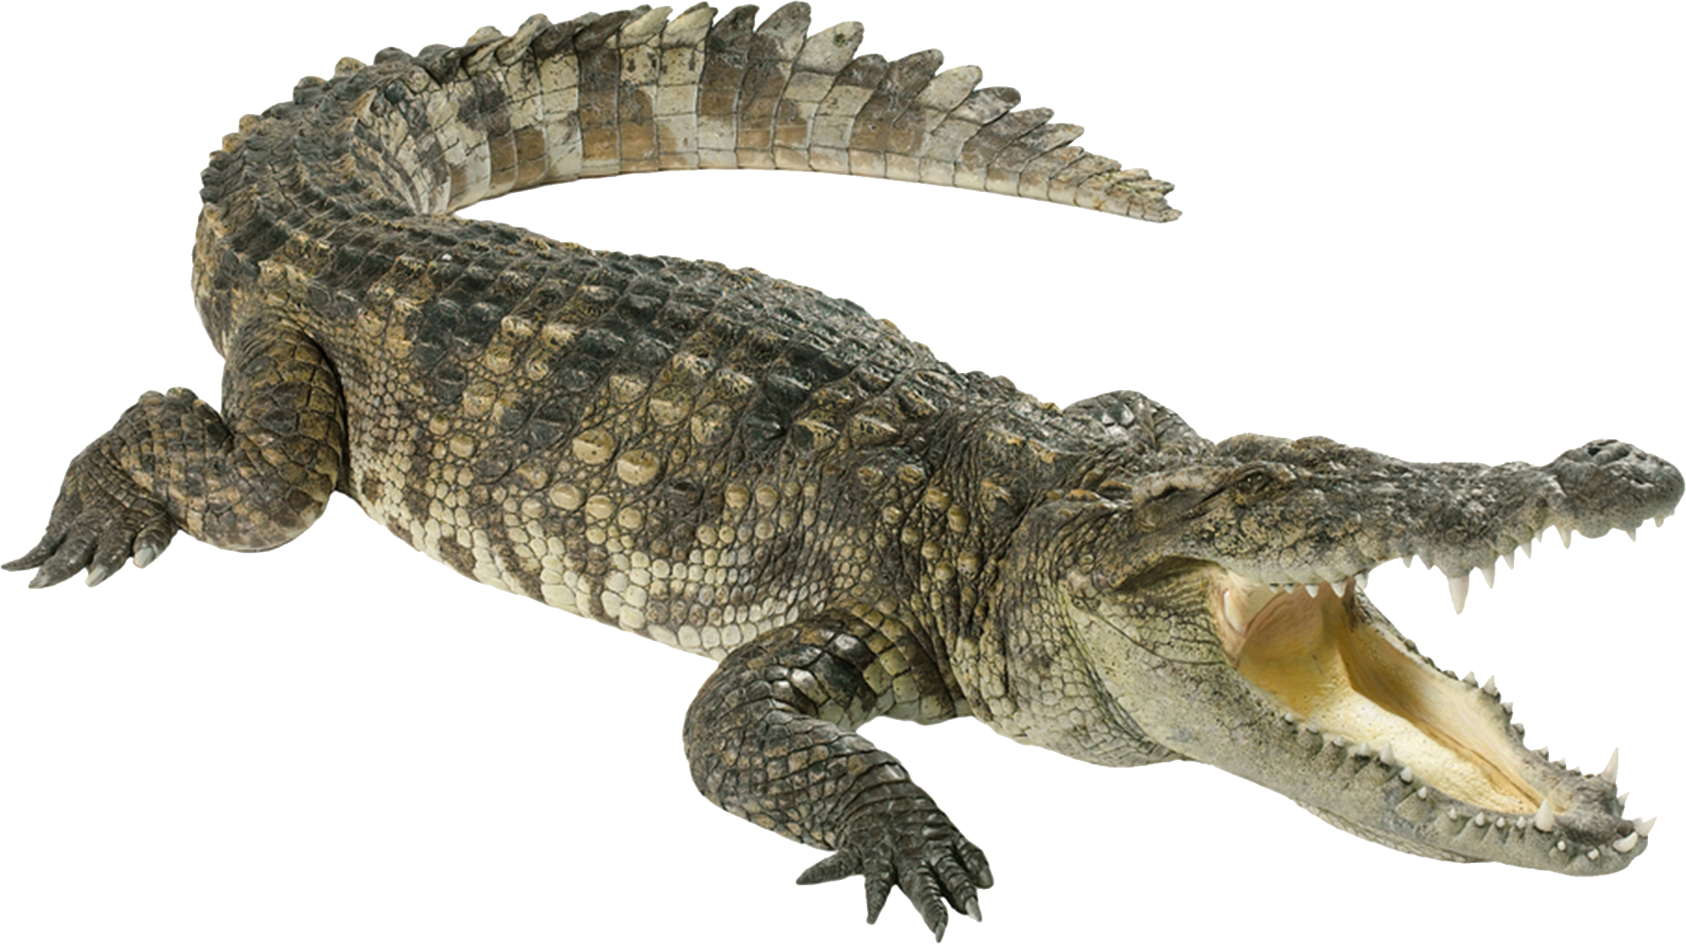
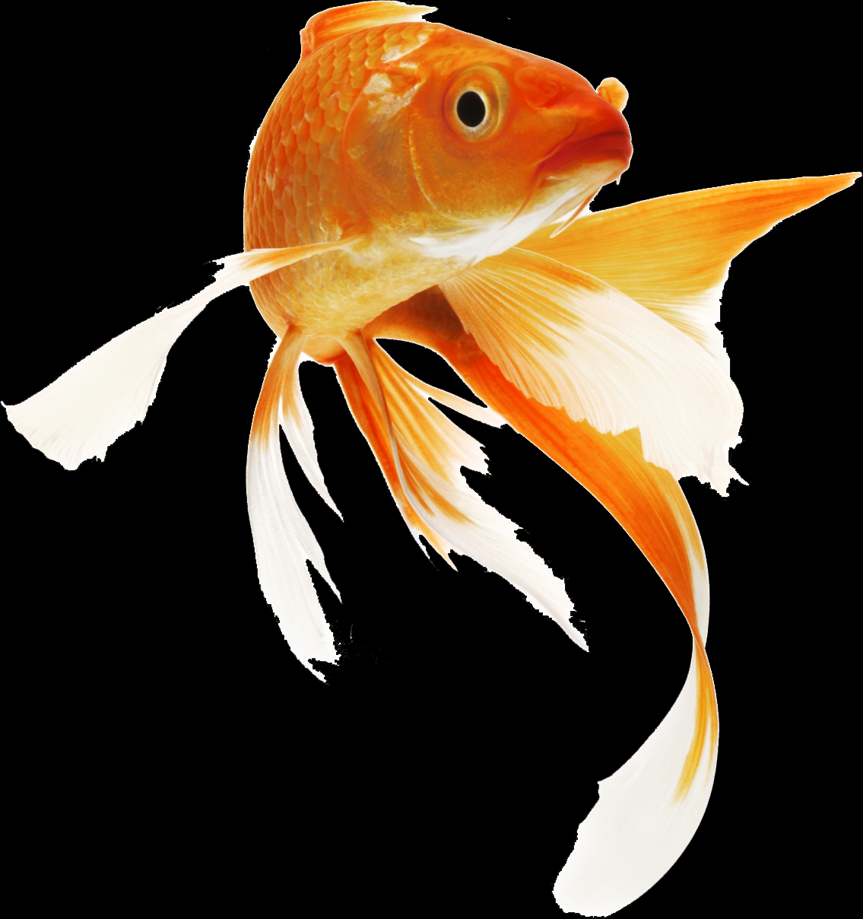
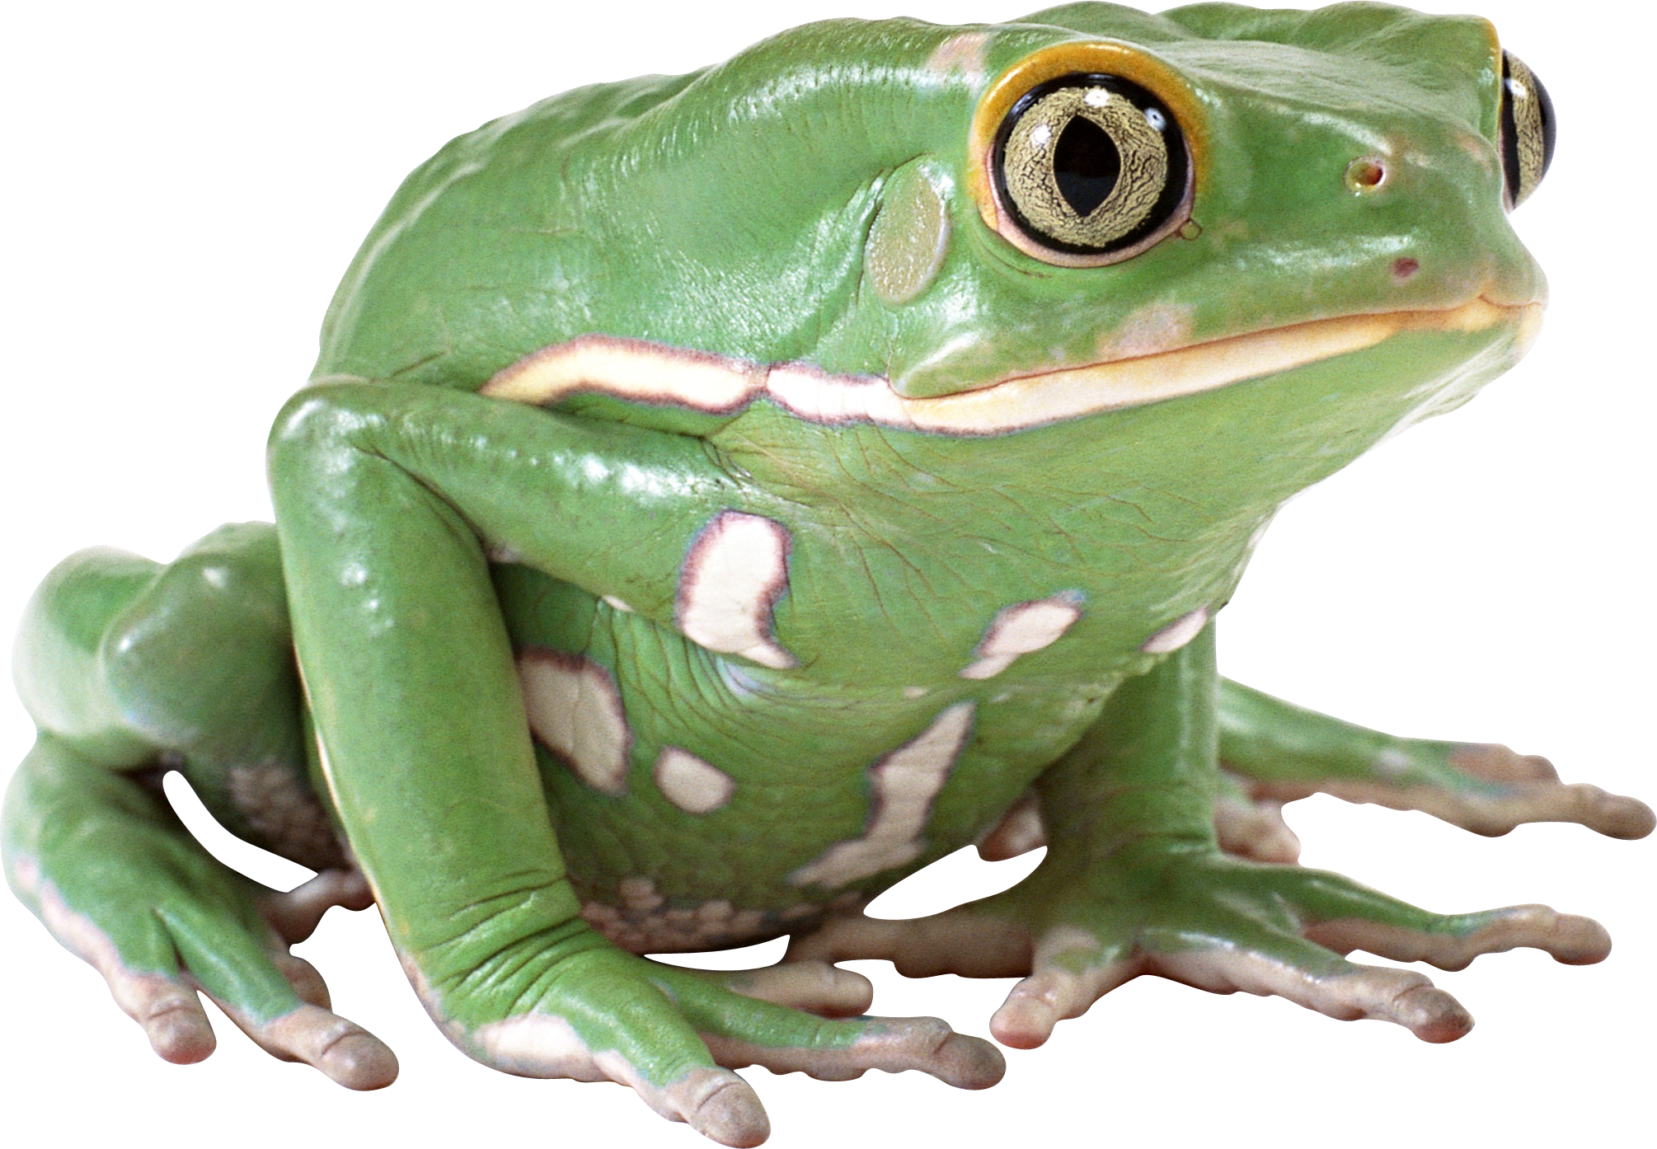
IrinaPapakhinac

Slide 4
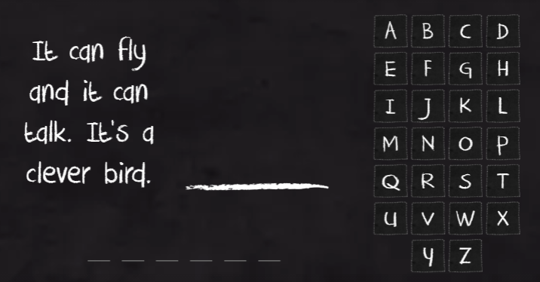
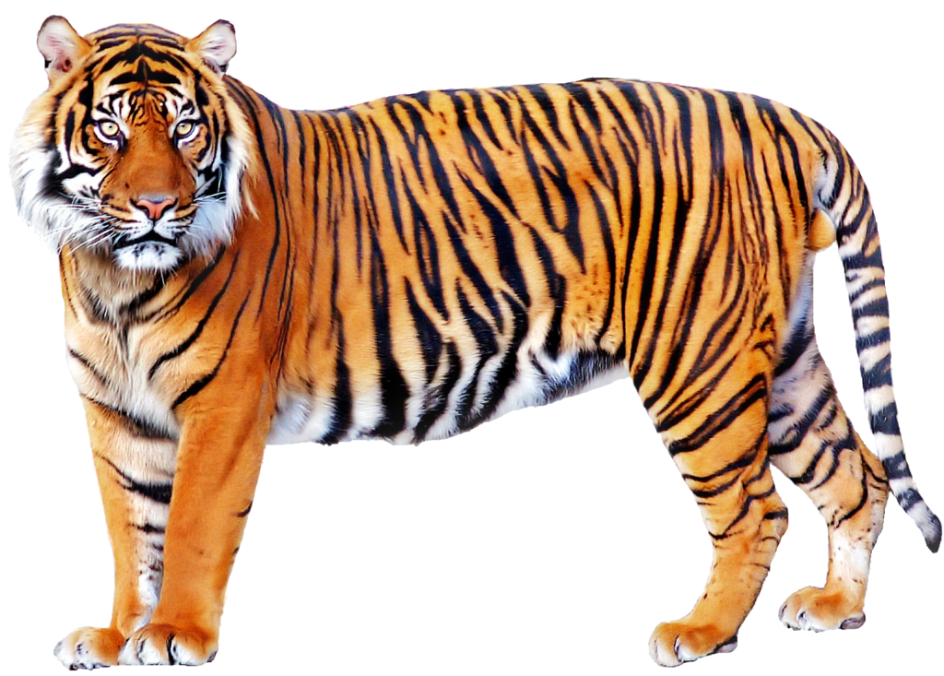
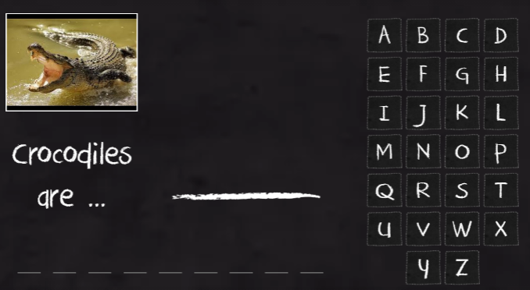
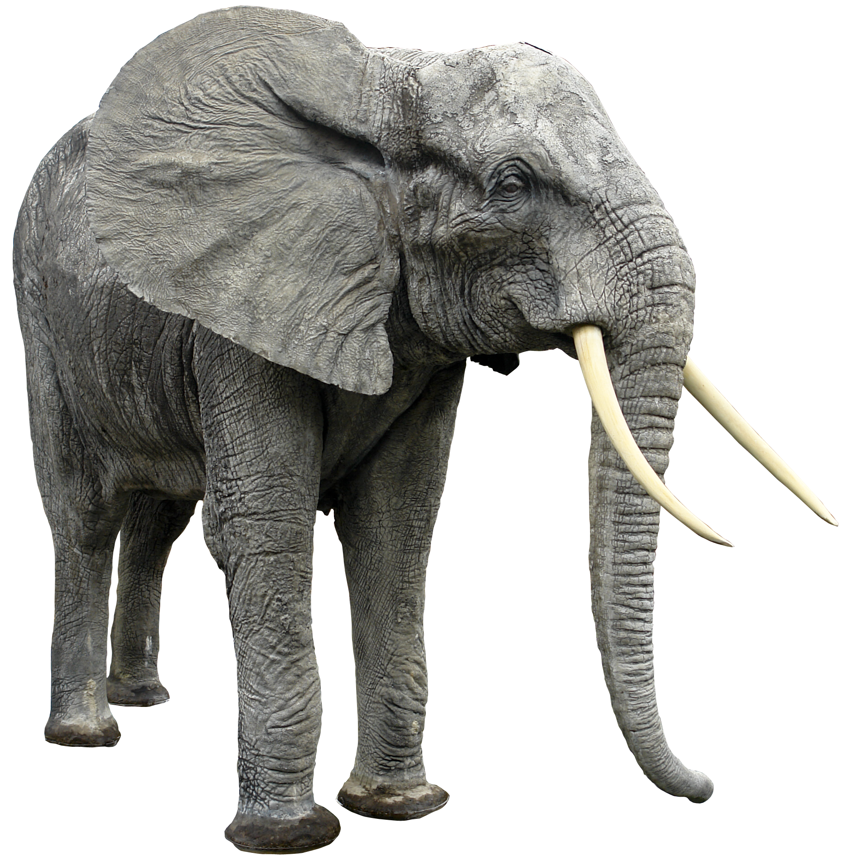
IrinaPapakhinac

Slide 5
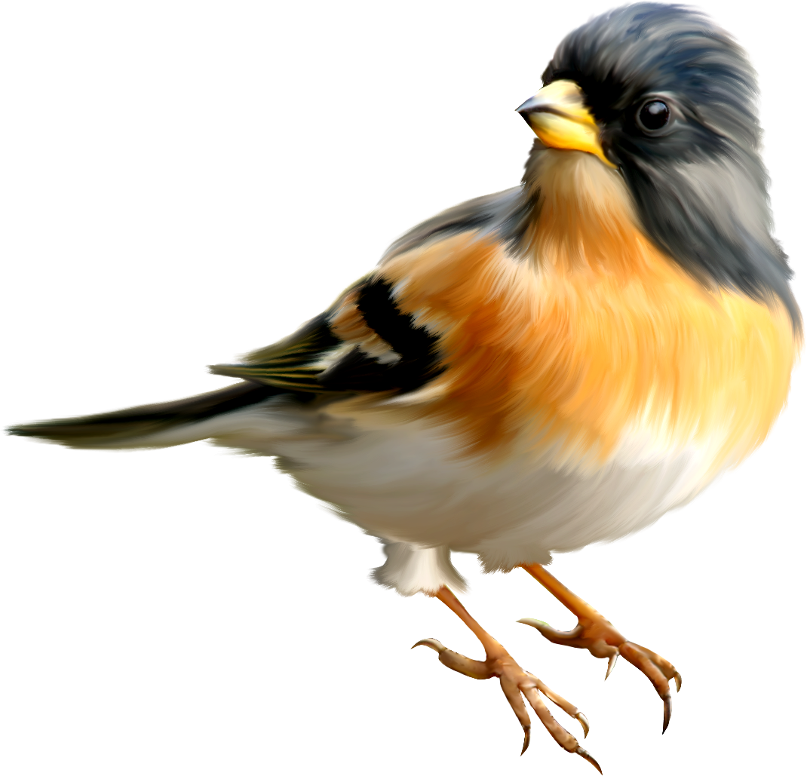


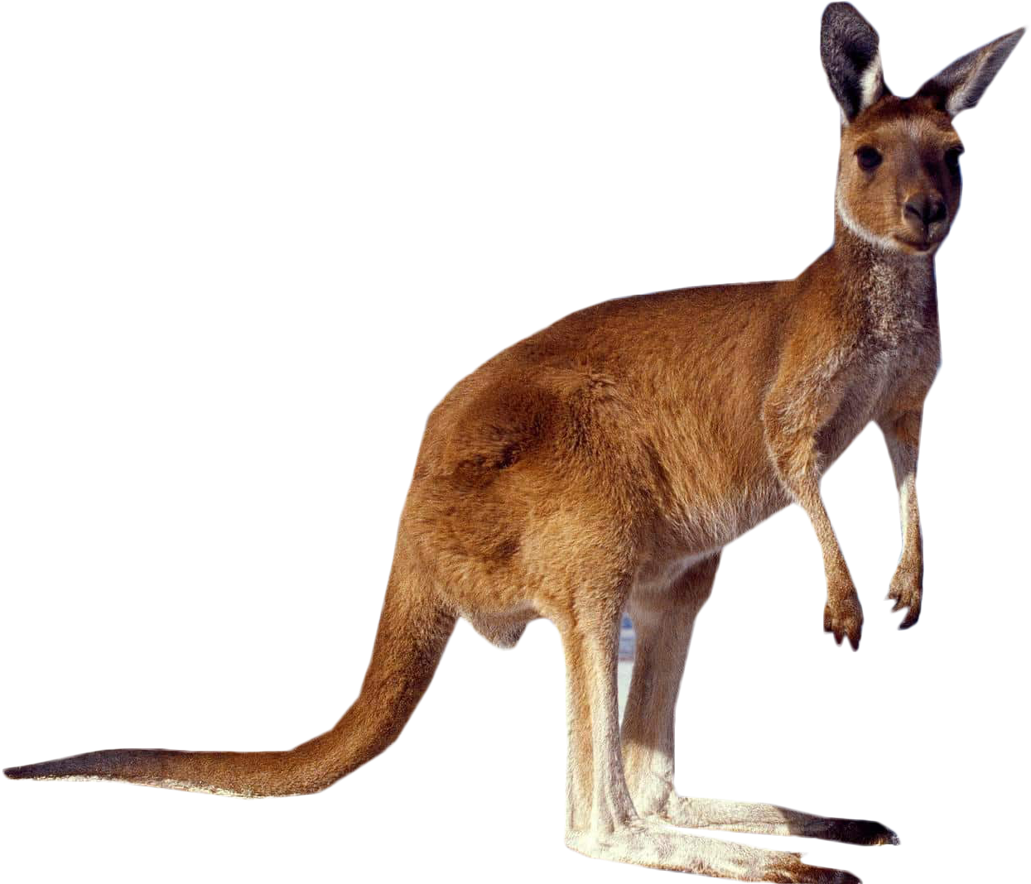
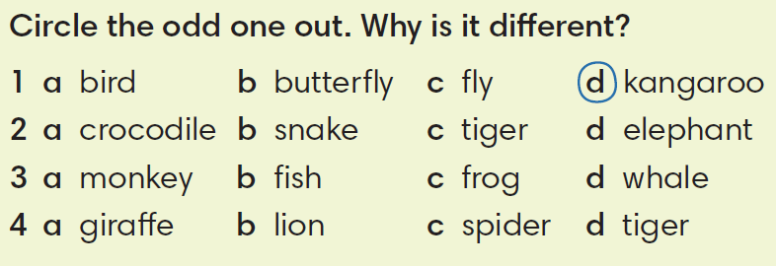
IrinaPapakhinac

Slide 6

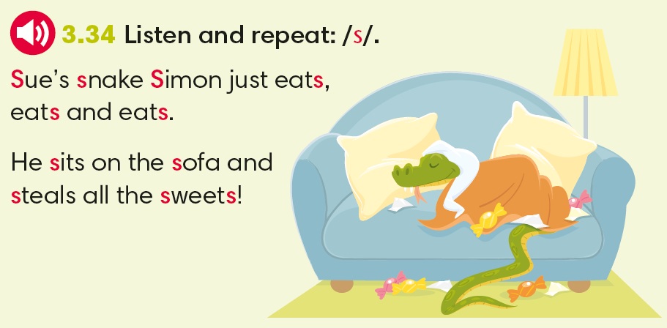
IrinaPapakhinac

Slide 7
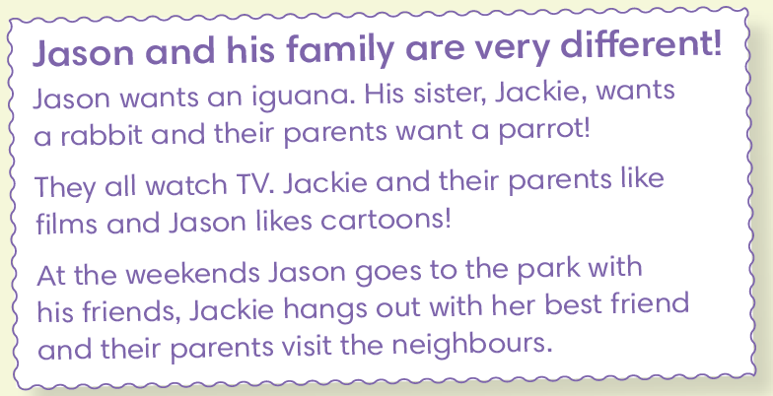
 | want(s) | watch(es) on TV | at the weekend
Jason | an iguana | cartoons | goes to the park
Jackie | a rabbit | films | hangs out with her best friend
Their parents | a parrot | films | visit their neighbours
IrinaPapakhinac

Slide 8
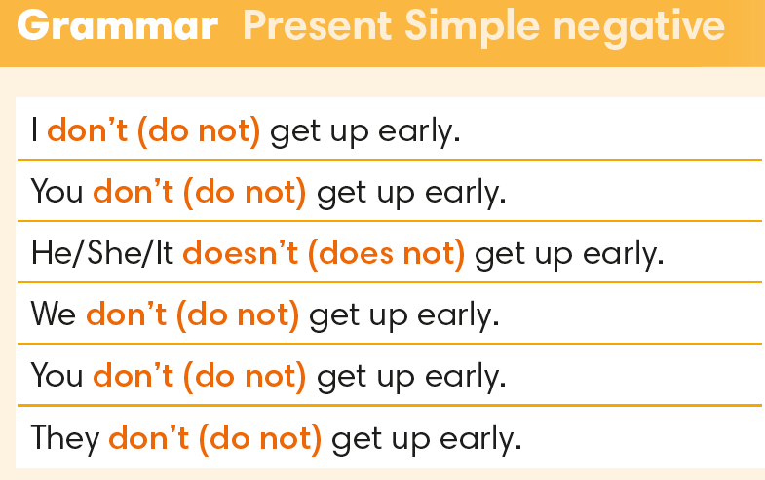
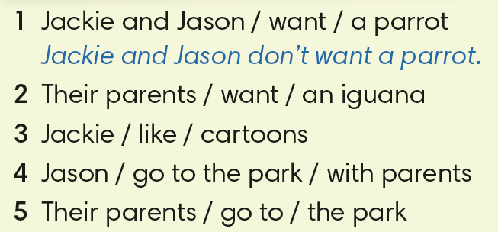
 | want(s) | watch(es) on TV | at the weekend
Jason | an iguana | cartoons | goes to the park
Jackie | a rabbit | films | hangs out with her best friend
Their parents | a parrot | films | visit their neighbours
2. Their parents don’t want an iguana.
3. Jackie doesn’t like cartoons.
4. Jason doesn’t go to the park with his parents.
5. Their parents don’t go to the park.
IrinaPapakhinac

Slide 9
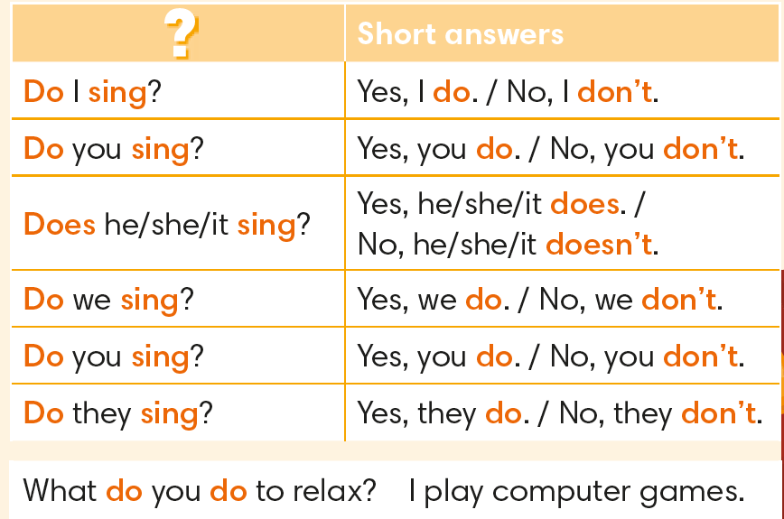
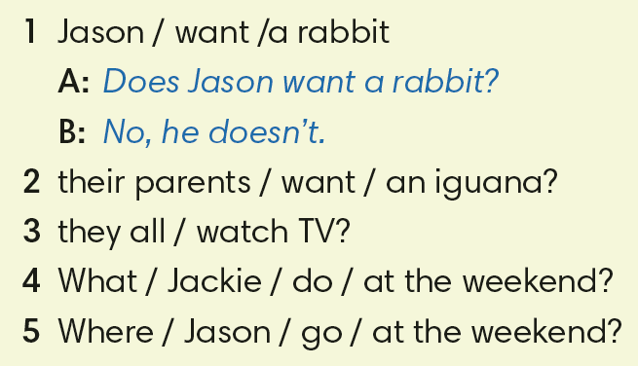
2. Do their parents want an iguana?
No, they don’t.
3.Do they all watch TV?
Yes, they do.
Jackie hangs out
with her best friend.
4. What does Jackie do at the weekend?
5. Where does Jason go at the weekend?
Jason goes to the park.
IrinaPapakhinac

Slide 10
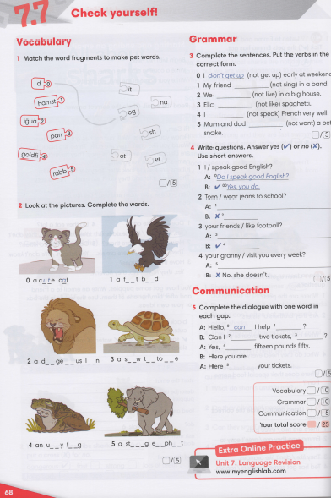
IrinaPapakhinac

Slide 11
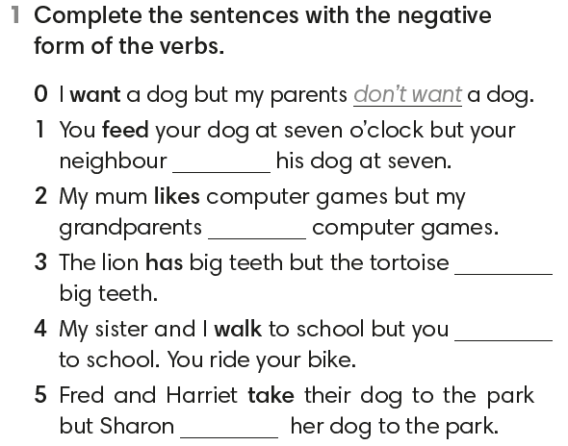
doesn’t feed
don’t like
doesn’t have
don’t walk
doesn’t take
IrinaPapakhinac

Slide 12
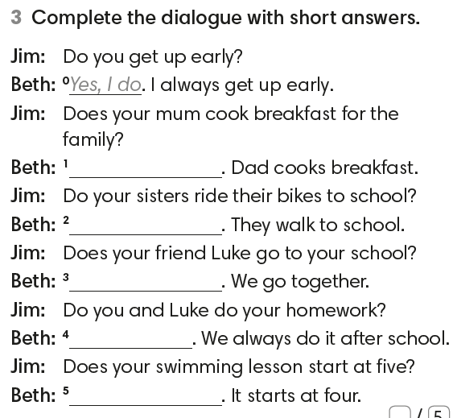
No, she doesn’t
No, they don’t
Yes, he does.
Yes, we do
No, it doesn’t
IrinaPapakhinac

