Slide 1





IrinaPapakhina

Slide 2

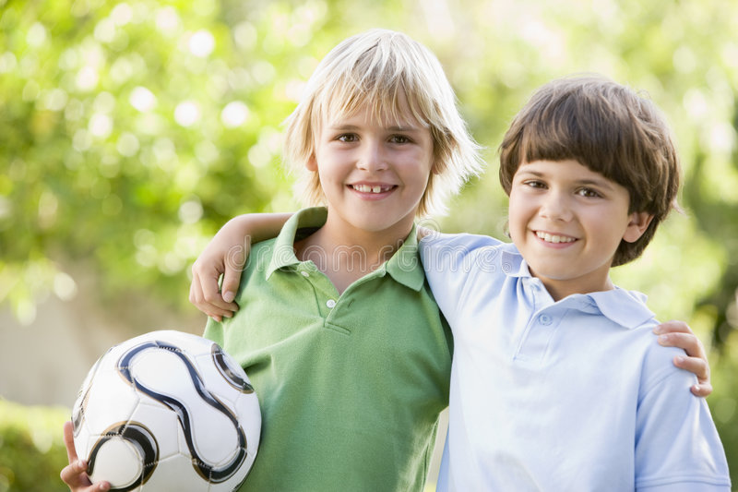

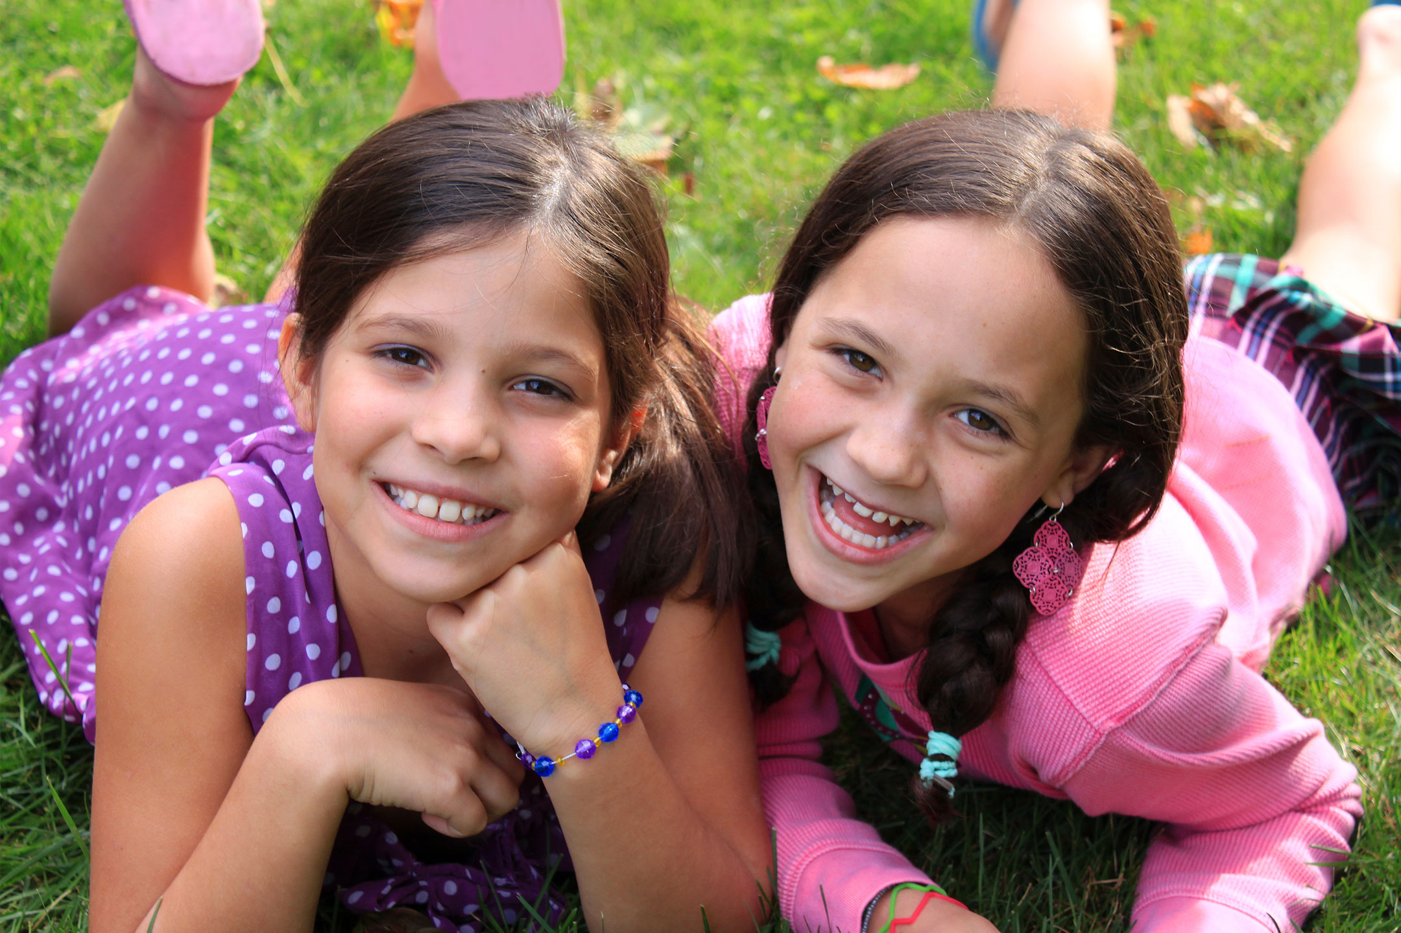
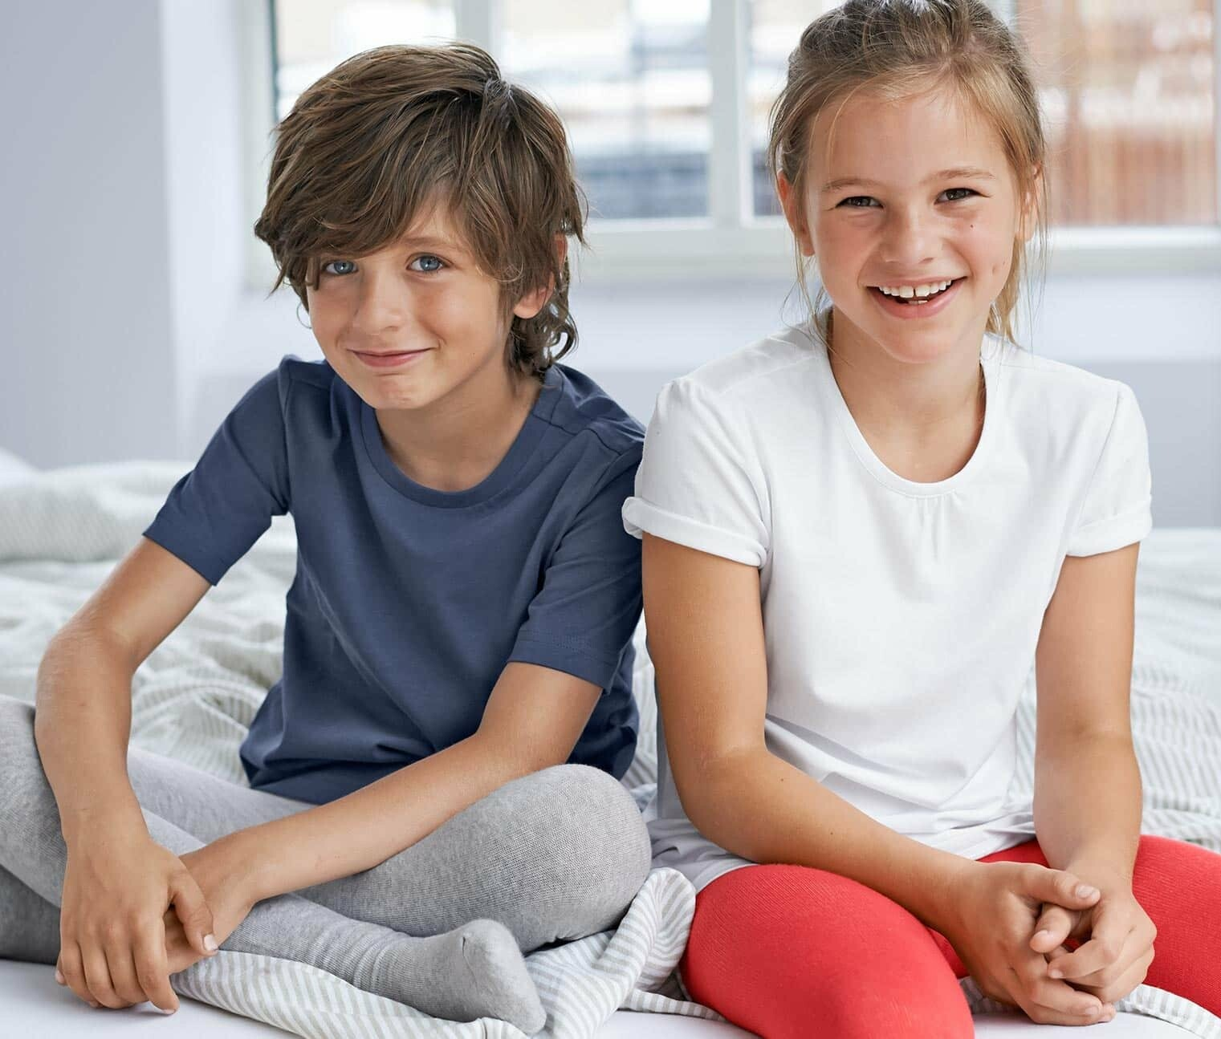
Look at the photos.
1. GUESS!
Are these people friends or family members.
2. Listen to the audio.
Which photo it is about?
1
3
2
IrinaPapakhina

Slide 3
Listen again and complete the sentences.
The boy’s name is __________.
The girl in the picture is his best friend.
She is his ___________ too.
5. The girl’s name is __________.
6. She is __________.
7. She is from __________.
8. Now she is in __________.
IrinaPapakhina

Slide 4
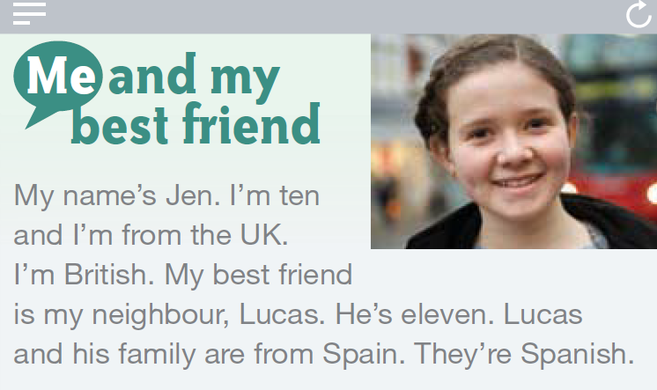
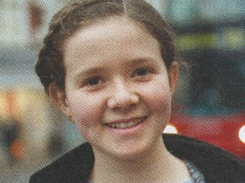
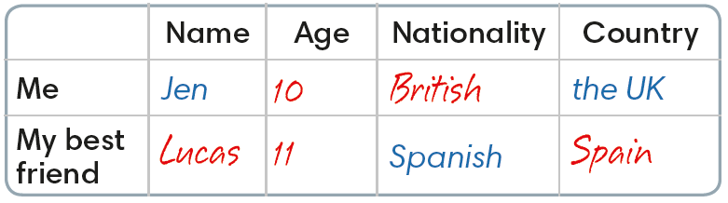
Read Jen’s blog and complete the table.
1
2
3
4
5
IrinaPapakhina

Slide 5
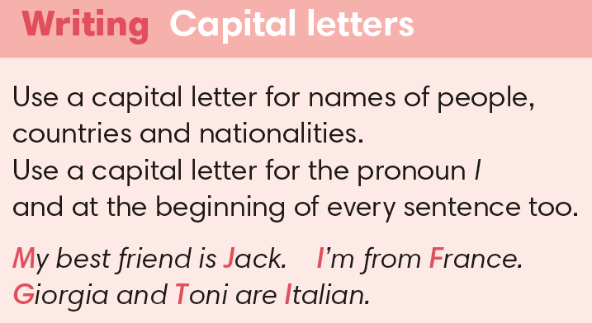
Find and circle
capital letters
in Jen’s blog.
IrinaPapakhina

Slide 6
Look at Jen’s blog again and write about your friend.
IrinaPapakhina

