Slide 1
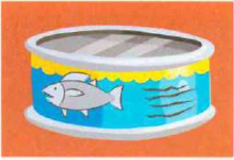
There ____ ____ tuna.
There ____ ____ water.

Slide 2
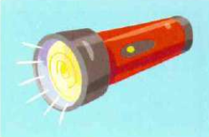
There ____ ____ torches.
There ____ _____ bikes.

Slide 3
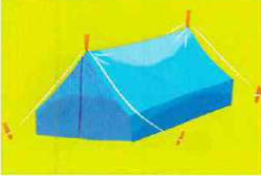
There ____ ____ tent.
There _____ ____ houses.

Slide 4

There ____ ____ milk.
There ____ ____ tea.

Slide 5
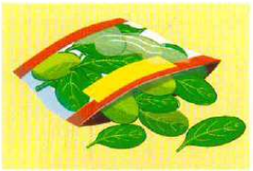
There ____ ____ spinach.
There ____ ____ fruit.

Slide 6
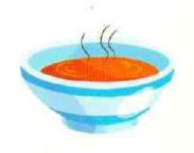
There ____ ____ porridge.
There ____ ____ soup.

Slide 7
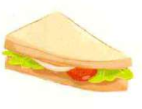
There ____ ____ apple.
There ____ ____ sandwich.

Slide 8
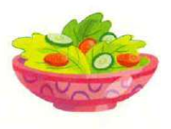
There ____ ____ fruit salad.
There ____ ____ vegetable salad.

Slide 9
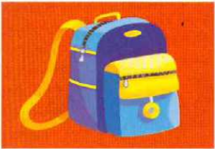
There ____ ____ backpack.
There ____ ____ pencil case.

Slide 10
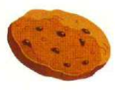
There ____ ____ biscuits.
There _____ ____ bananas.

Slide 11

There ____ ____ bottles.
There ____ ____ cup.

Slide 12
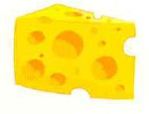
There ____ ____ potatoes.
There ____ ____ cheese.

Slide 13

There ____ ____ cups.
There ____ ____ plates.

Slide 14
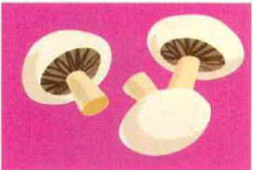
There ____ ____ oranges.
There ____ ____ mushrooms.

Slide 15
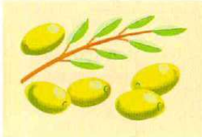
There ____ ____ olives.
There ____ ____ lemons.

Slide 16
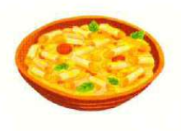
There ____ ____ pasta.
There ____ ____ rice.

Slide 17
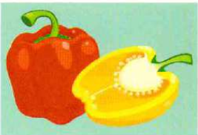
There ____ ____ peppers.
There ____ ____ onions.

Slide 18
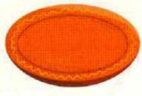
There ____ ____ plates.
There ____ ____ bottles.

