Slide 1
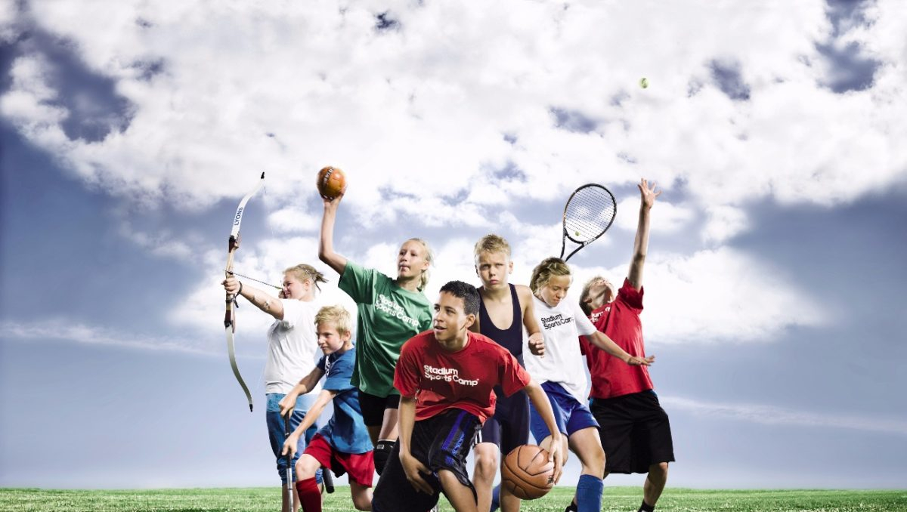



IrinaPapakhinac

Slide 2

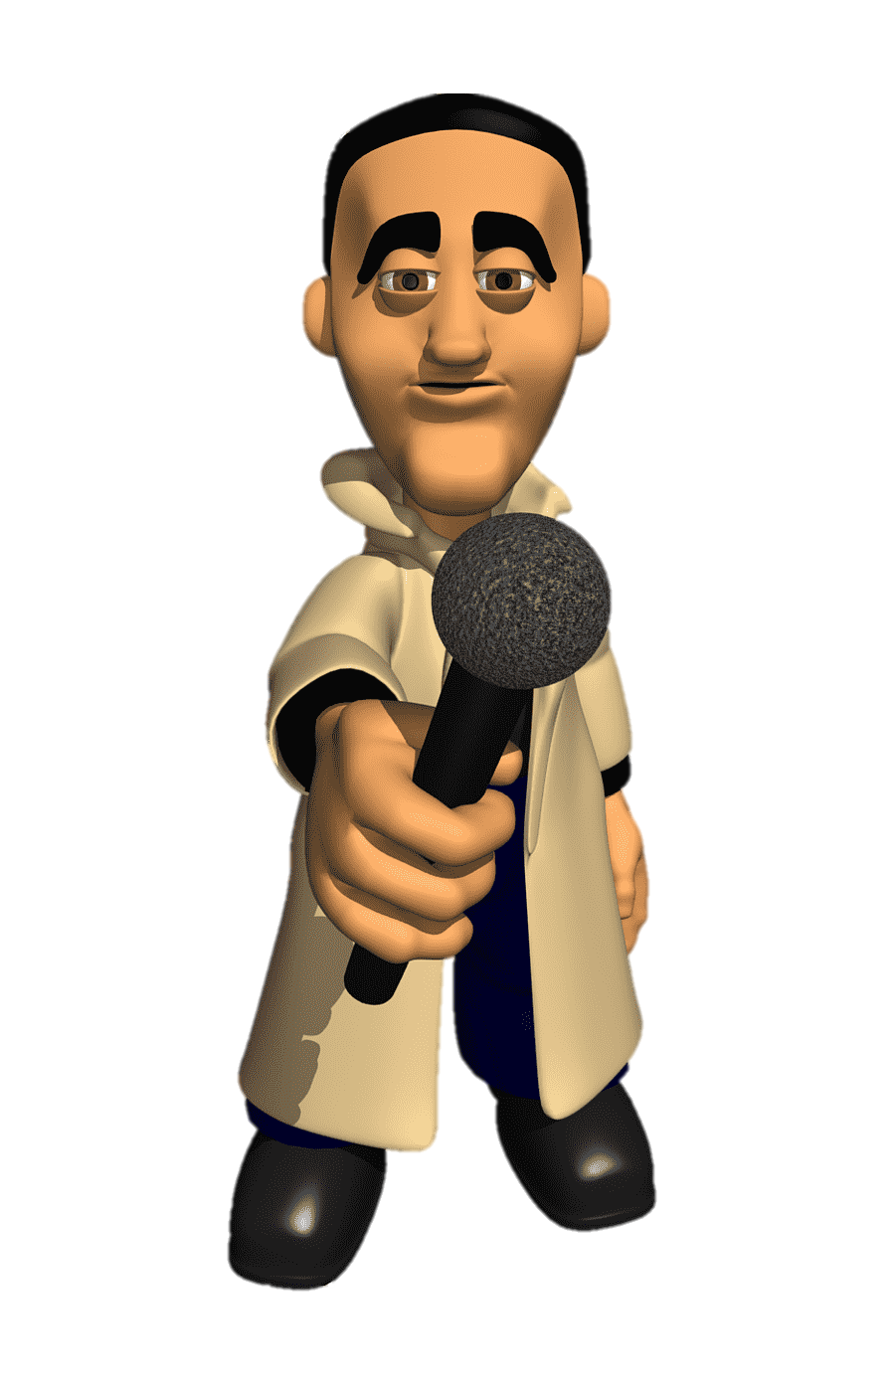
1. What after-school clubs has your school got?
2. What after-school club do you attend?
IrinaPapakhinac

Slide 3

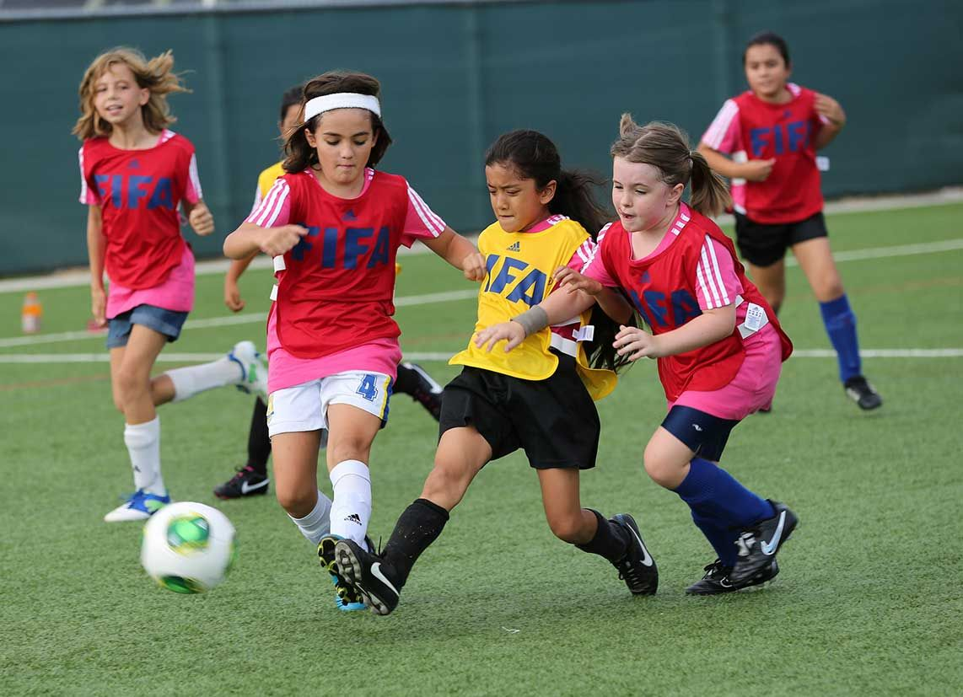
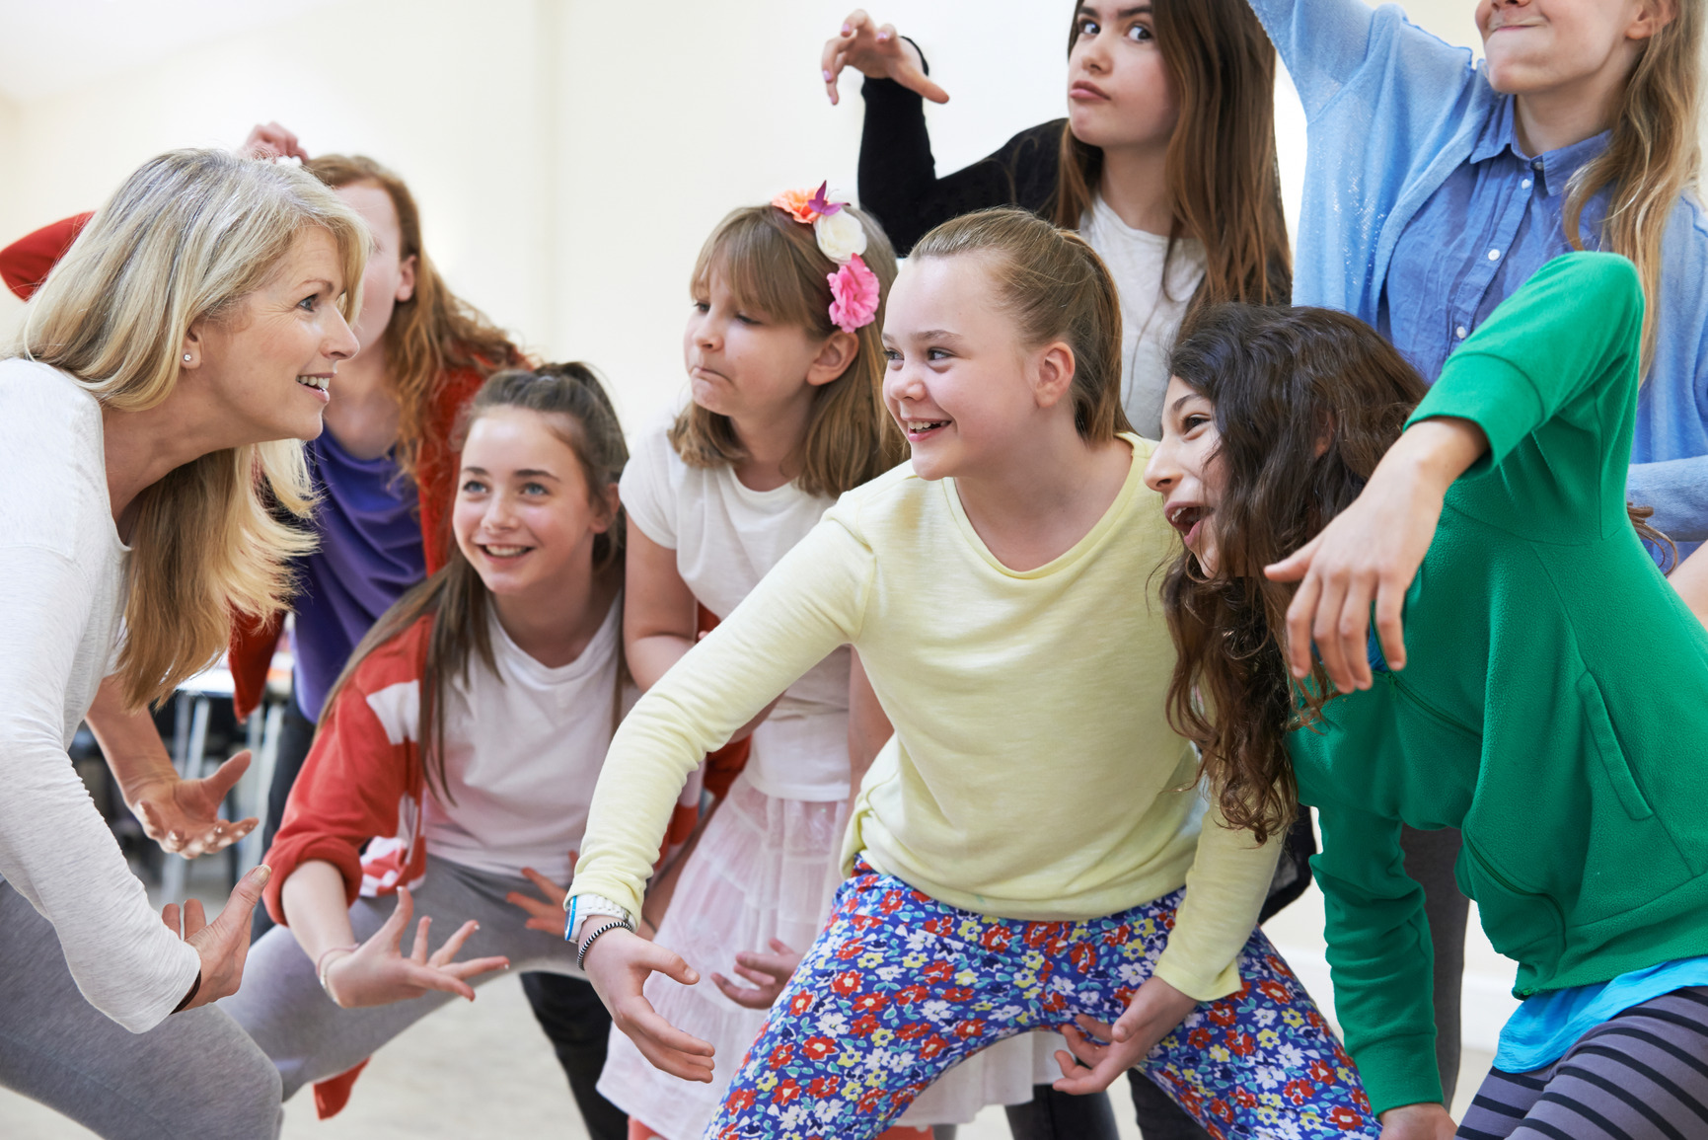
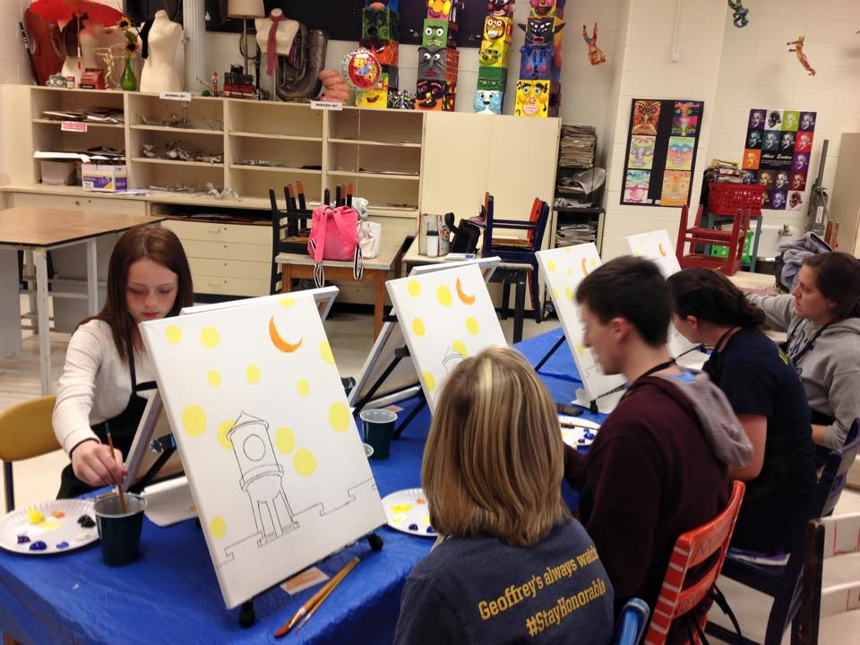
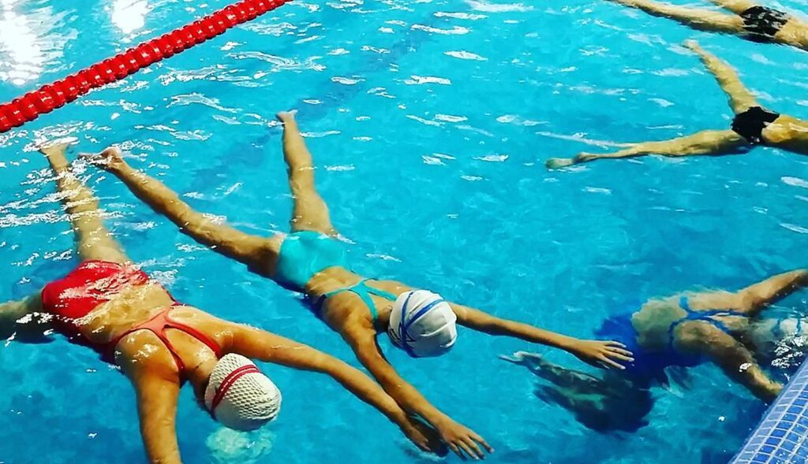
1. Match photos a – d to after-school clubs 1 – 4.
d
a
Swimming club 3. Football club
Art club 4. Drama club
b
c
a
c
b
d
2. What can you do in these clubs?
IrinaPapakhinac

Slide 4

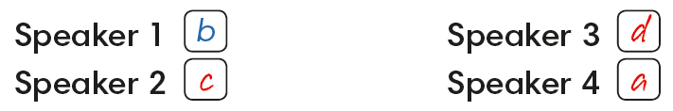
Listen to four children.
Match speakers 1 – 4 to after-school clubs a – d.
1
3
2
4
IrinaPapakhinac

Slide 5

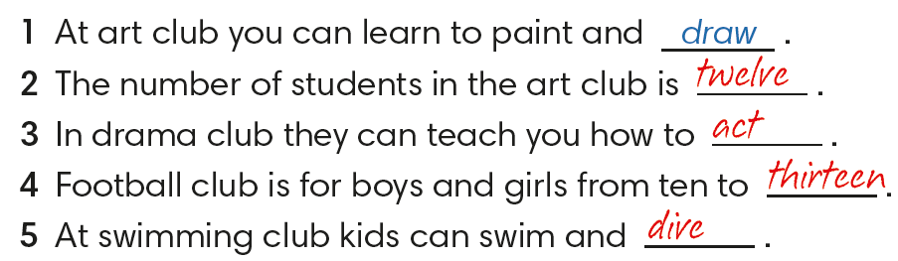
IrinaPapakhinac

Slide 6

Read an add for an after-school club.
What can you learn to do in this club?
IrinaPapakhinac

Slide 7
Can you remember the words?
What is the difference between these words?
IrinaPapakhinac

Slide 8
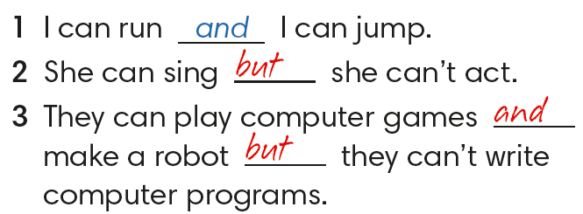
IrinaPapakhinac

Slide 9

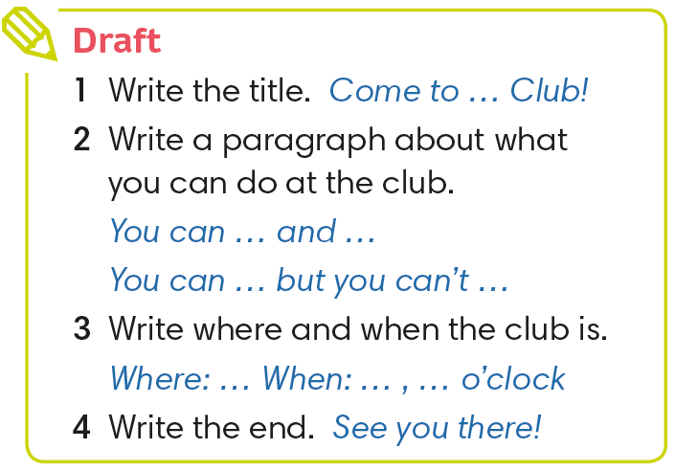
IrinaPapakhinac

Slide 10

Look at the example of an add for an after-school club.
Write an add for your club.
IrinaPapakhinac

Slide 11
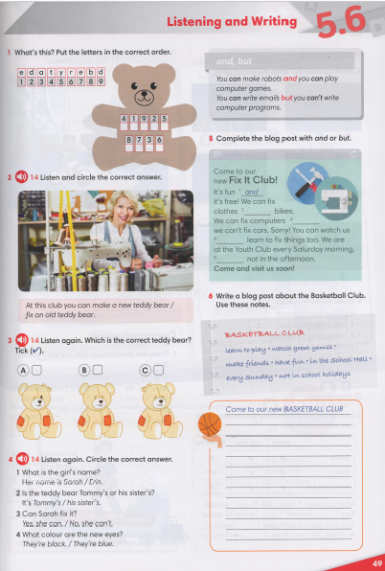


IrinaPapakhinac

