Slide 1
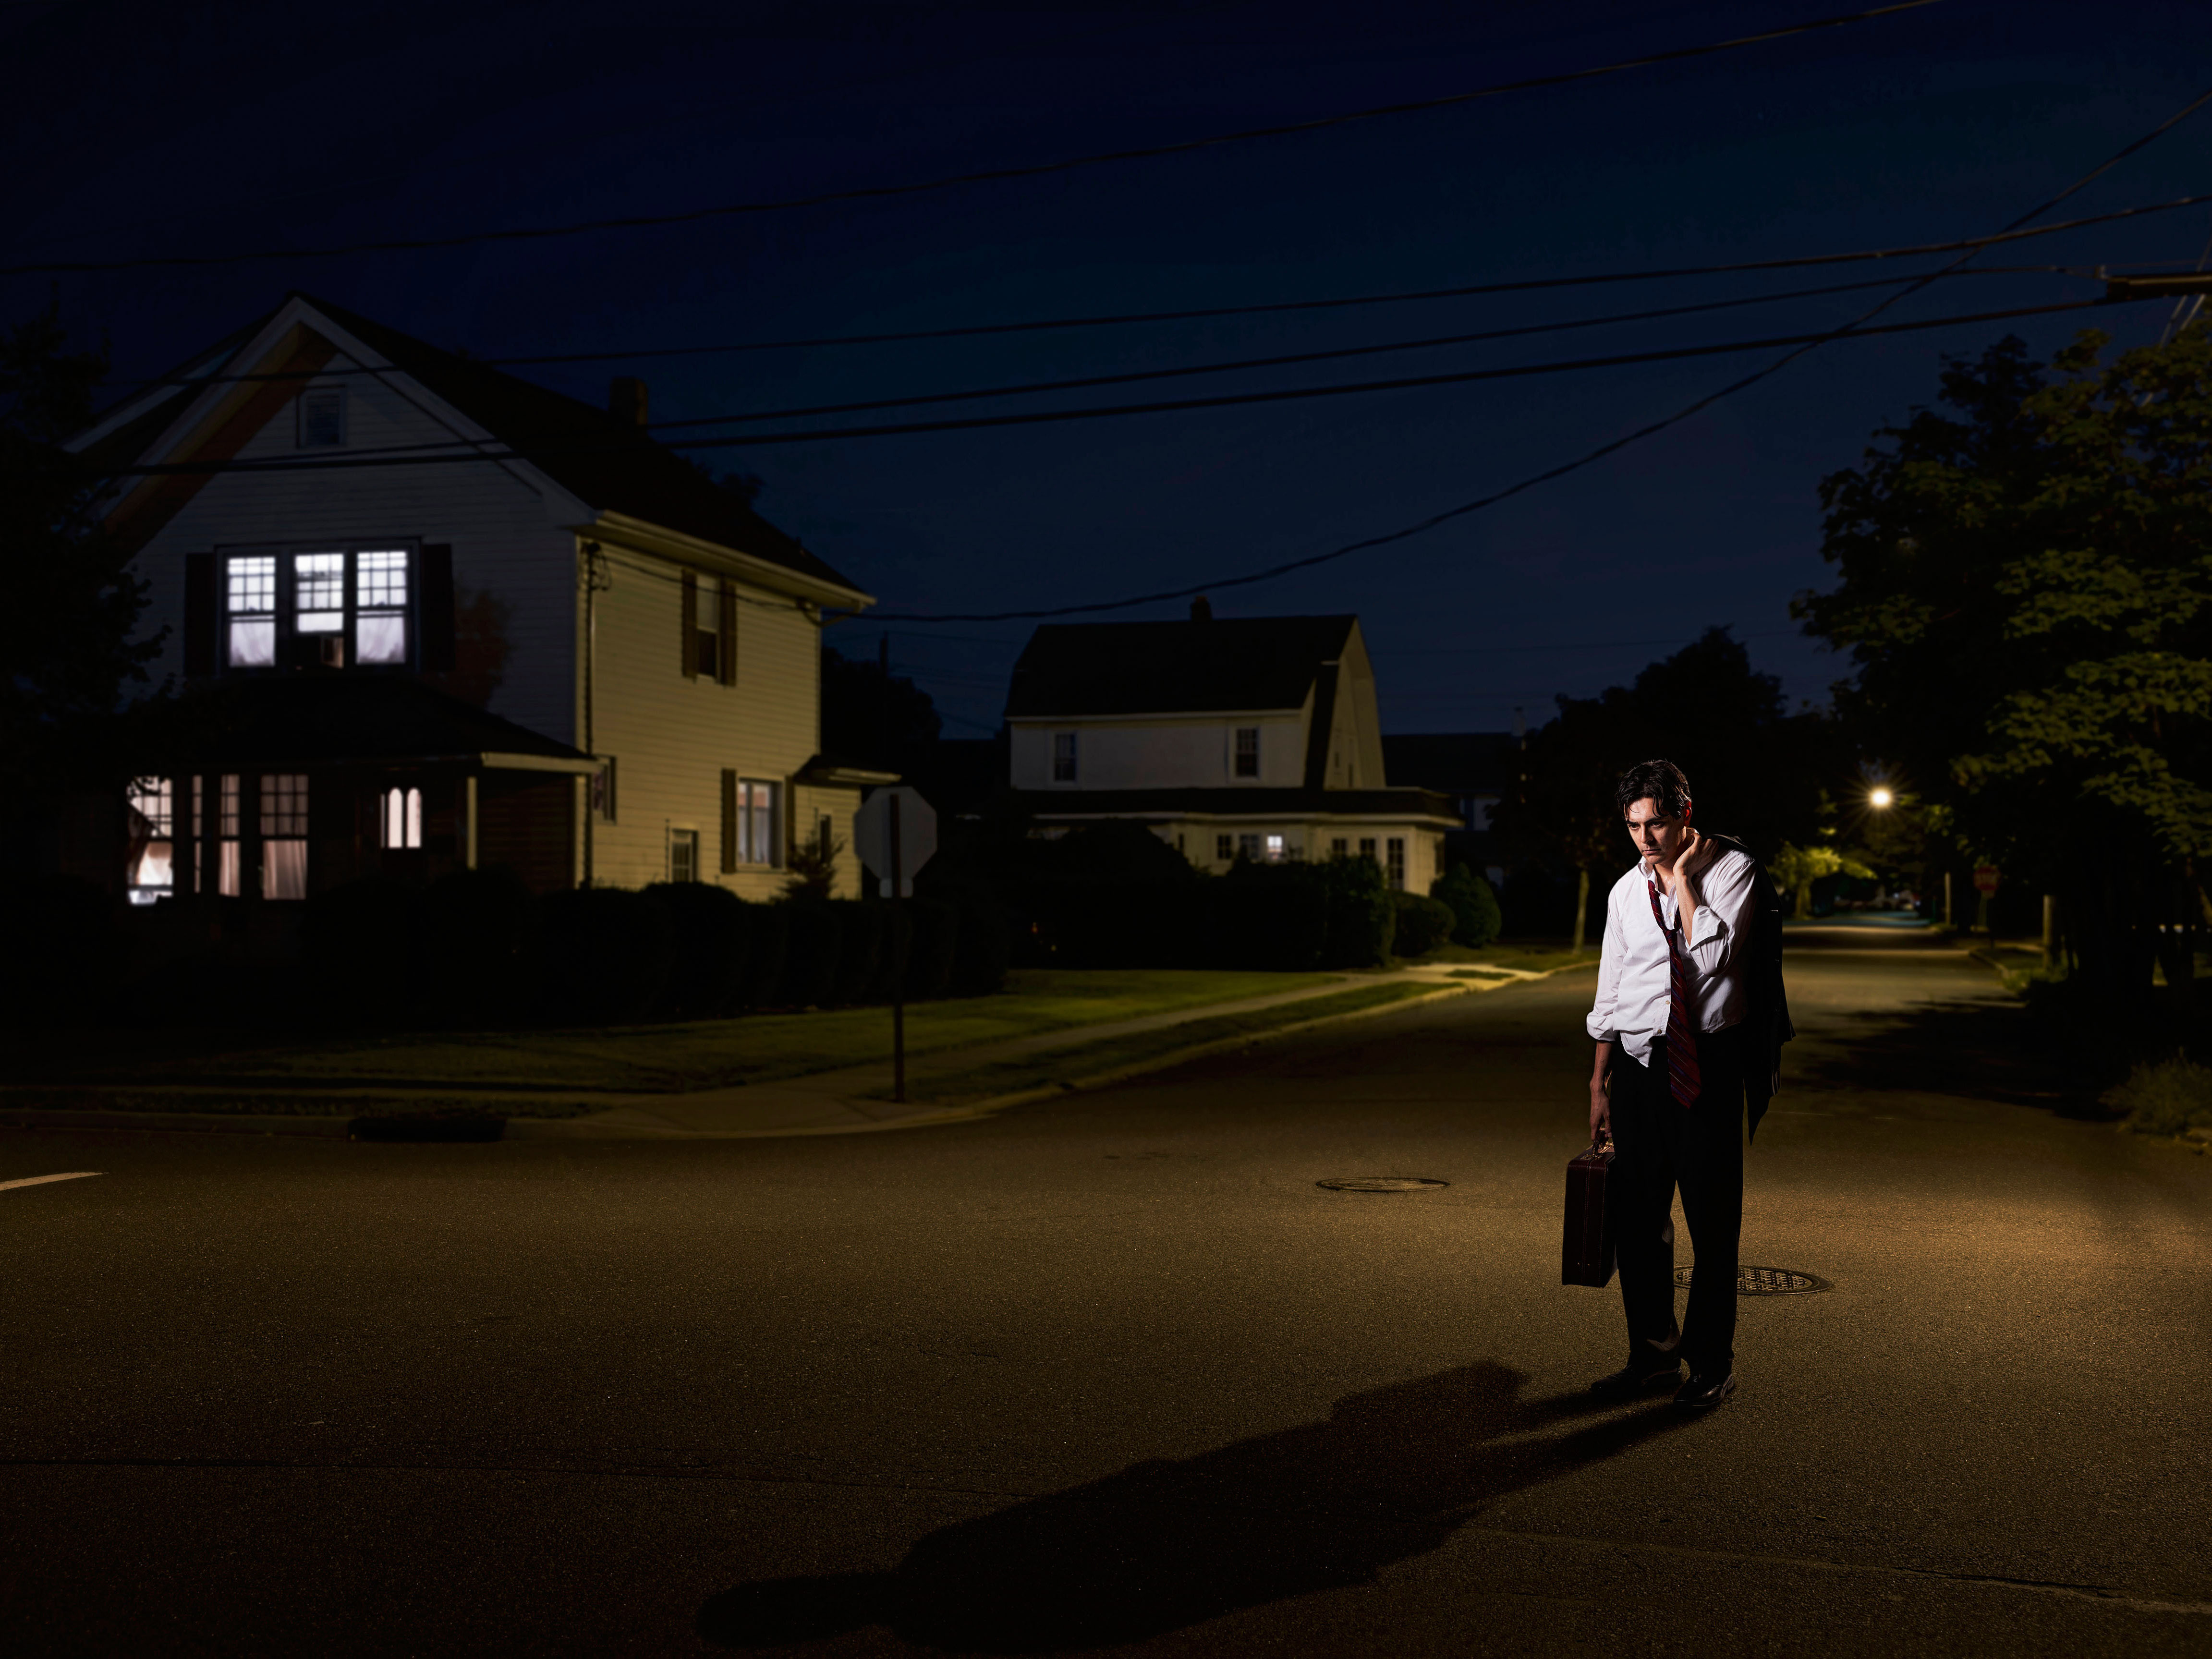
Mike ____ (not come) home late yesterday.

Slide 2

We ___ (not go) travelling around the world last year.

Slide 3
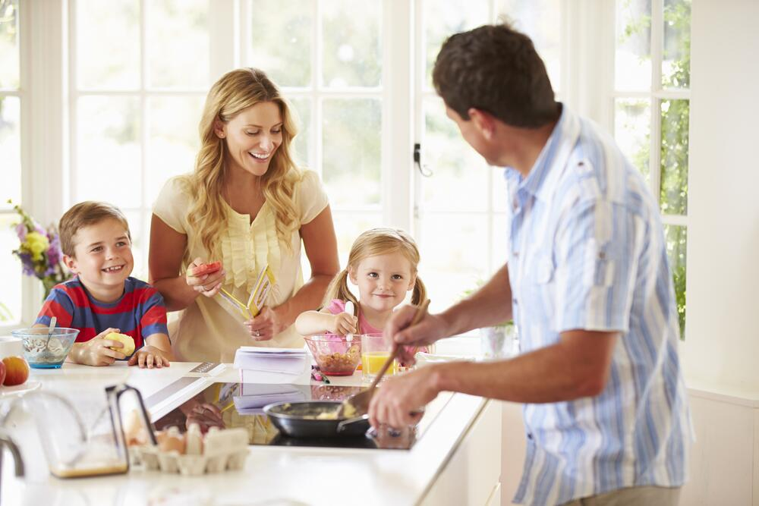
They ___ (not have) breakfast at 8 yesterday.

Slide 4
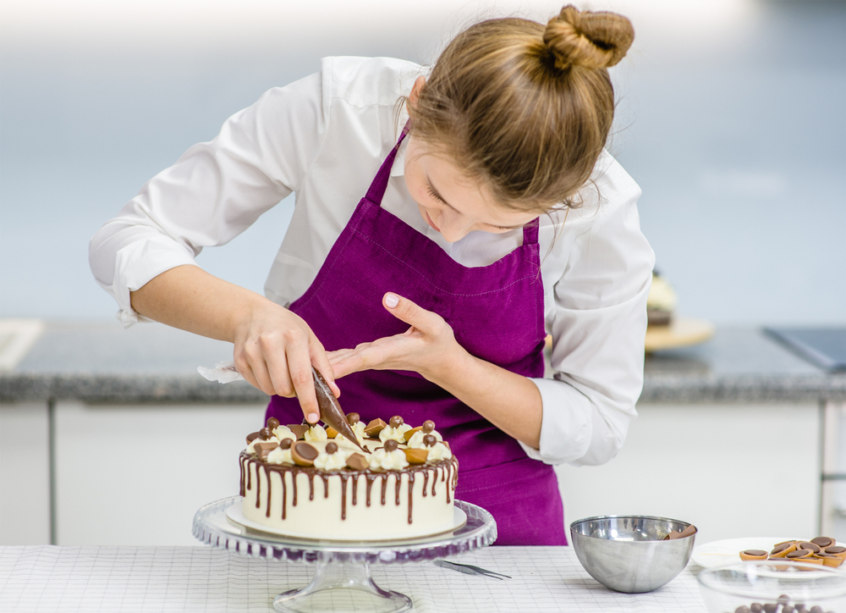
Mum ___ (not make) a cake for my birthday.

Slide 5
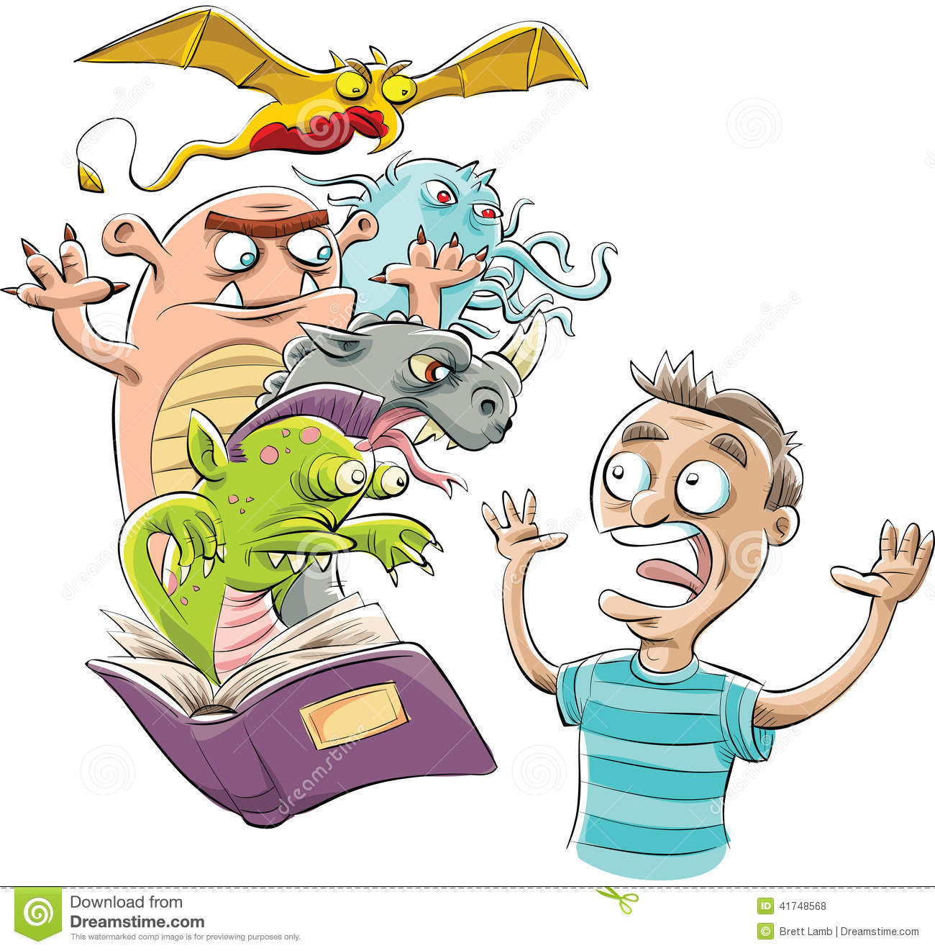
Sam ___ (not read) a horror story last night.

Slide 6
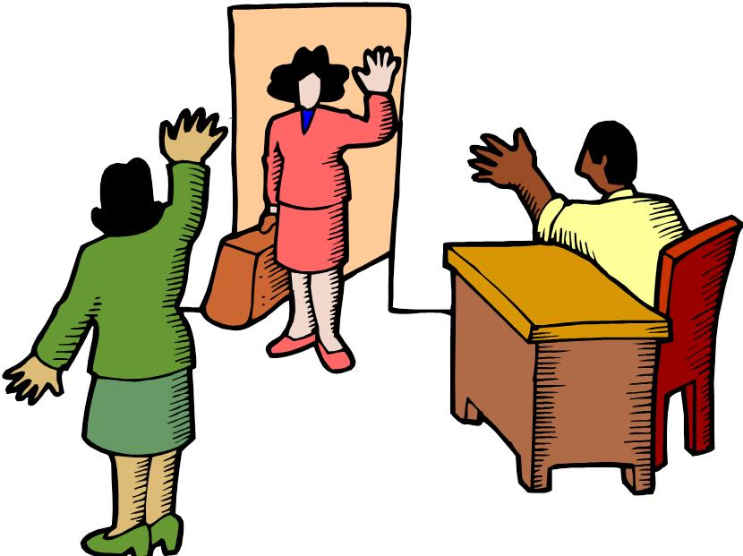
Linda ___ (not say) goodbye and __ (go) home.

Slide 7
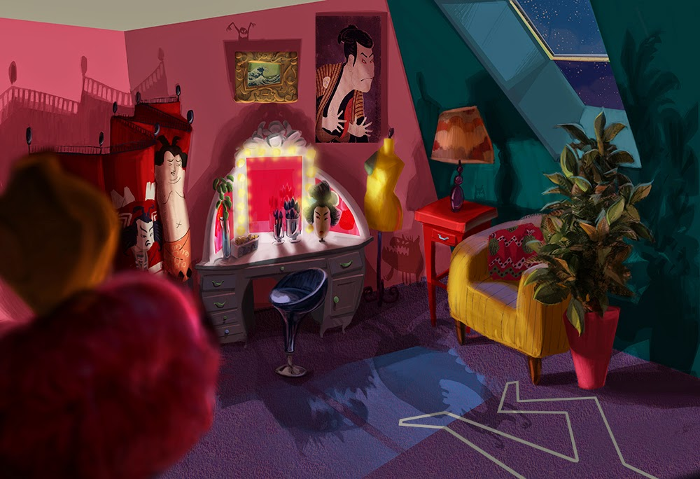
I ___ (not see) a monster in my room last night.

Slide 8
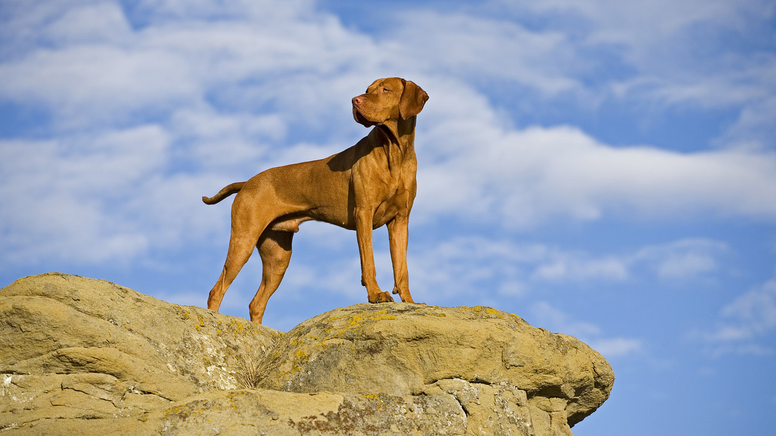
My dog ___ (not stand) on the rock.

Slide 9
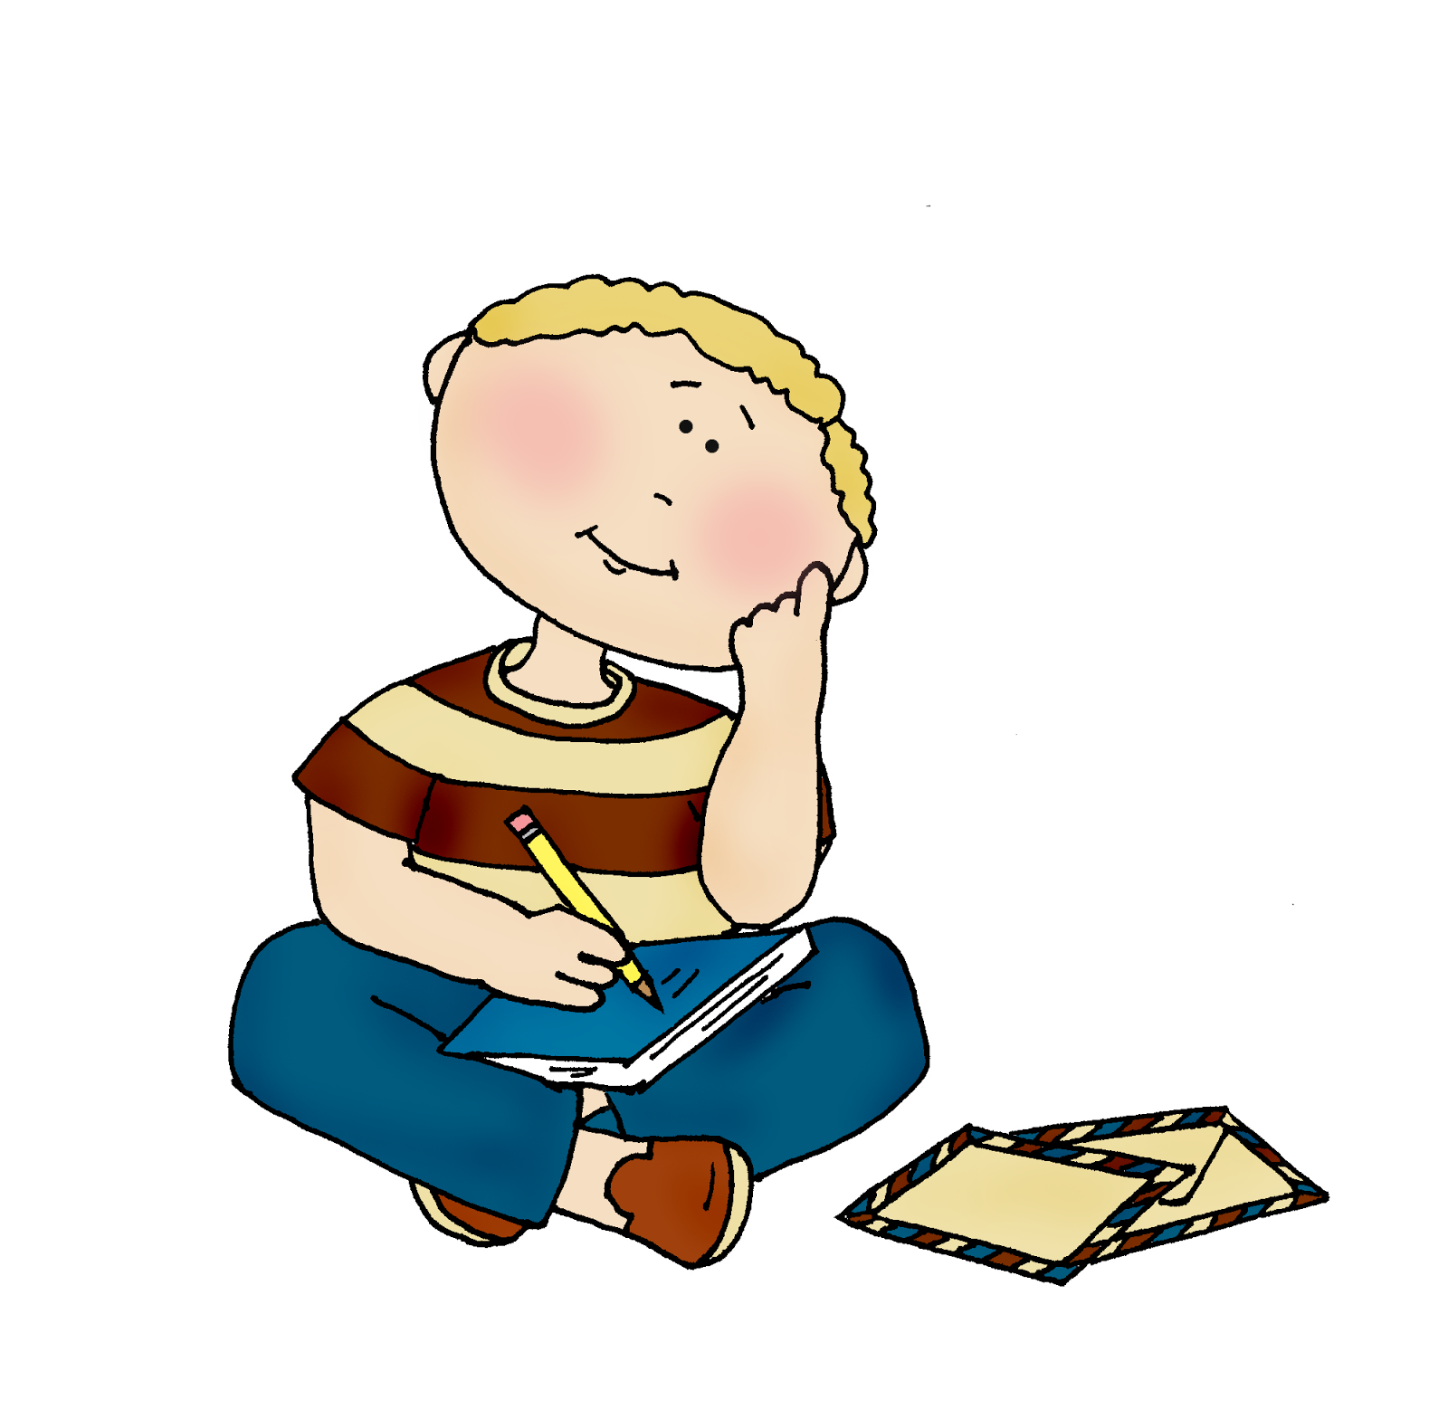
He ___ (not think) about his friends.

Slide 10
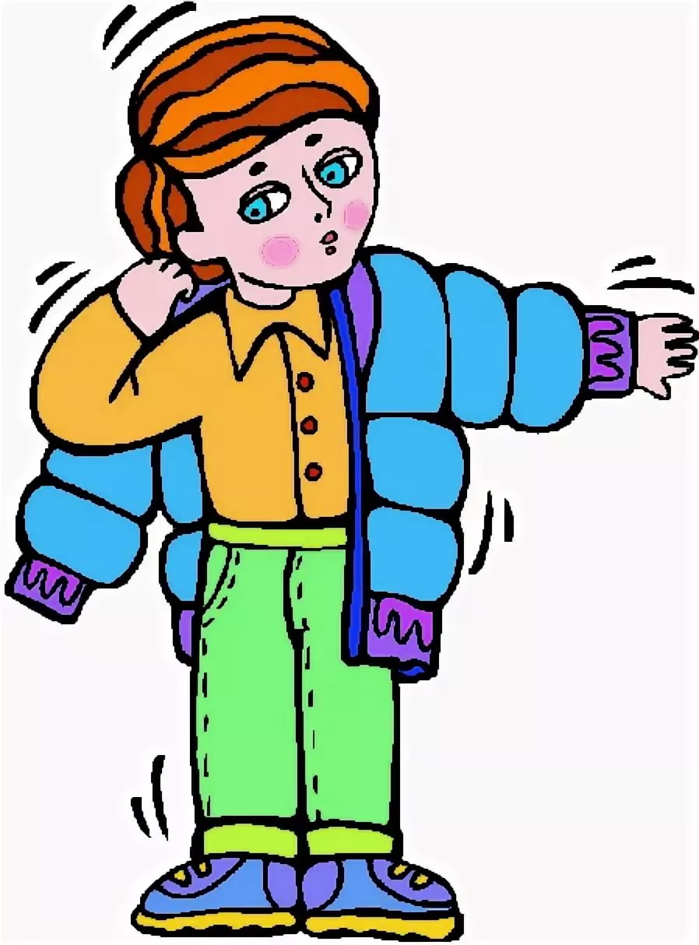
He ___ (not wear) a coat because it was cold.

Slide 11
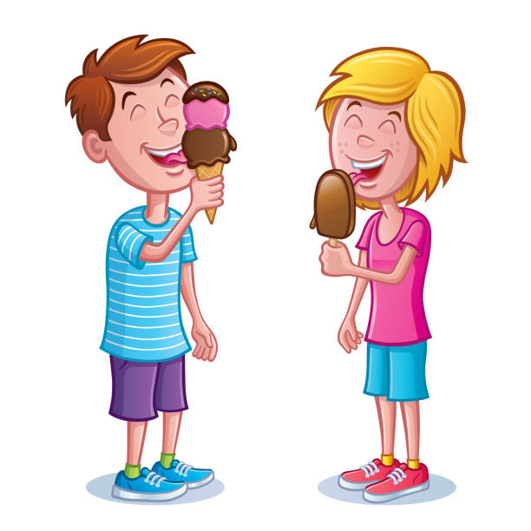
We ___ (not eat) ice cream last weekend.

Slide 12
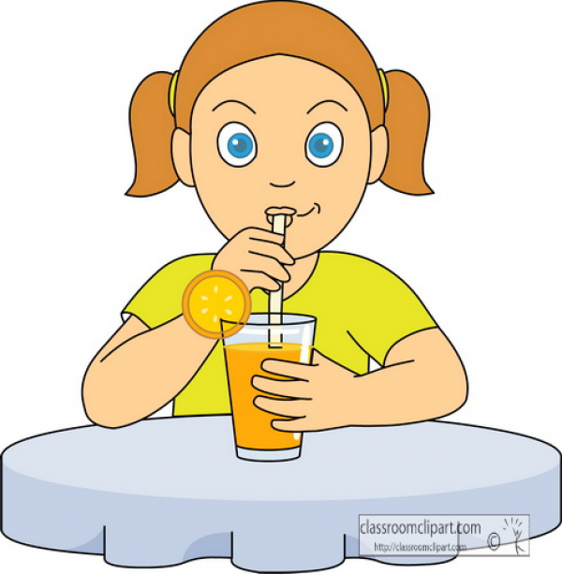
She ___ (not drink) lemonade at the party.

