Slide 1
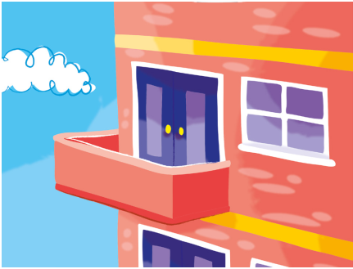
1. He _______ in a flat.

Slide 2
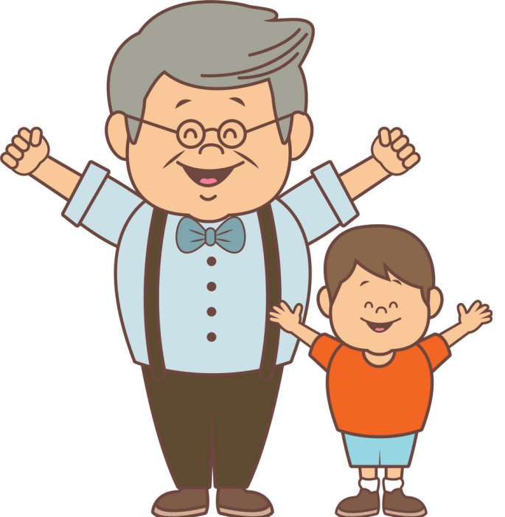
2. He _______ his Grandpa on Friday.

Slide 3
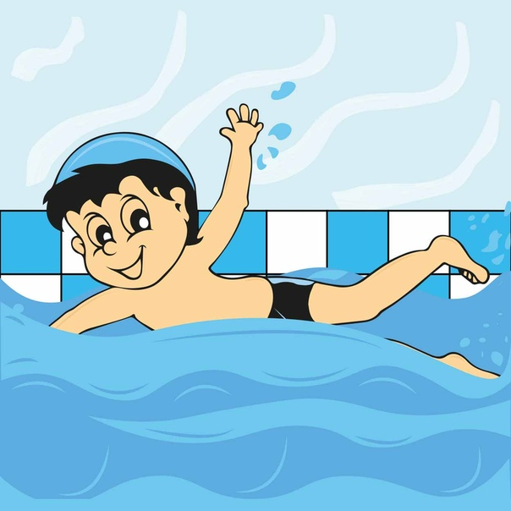
3. He _______ in the swimming pool.

Slide 4
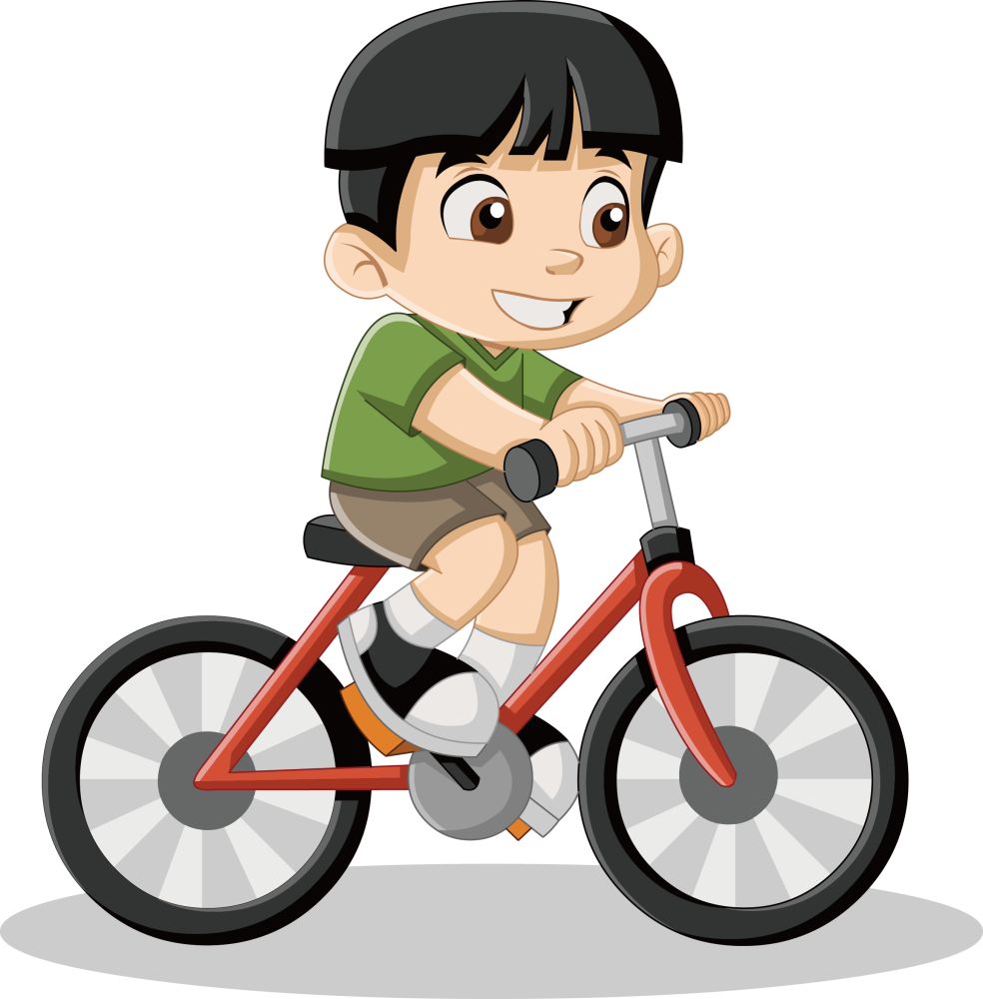
4. He _______ a bike.

Slide 5
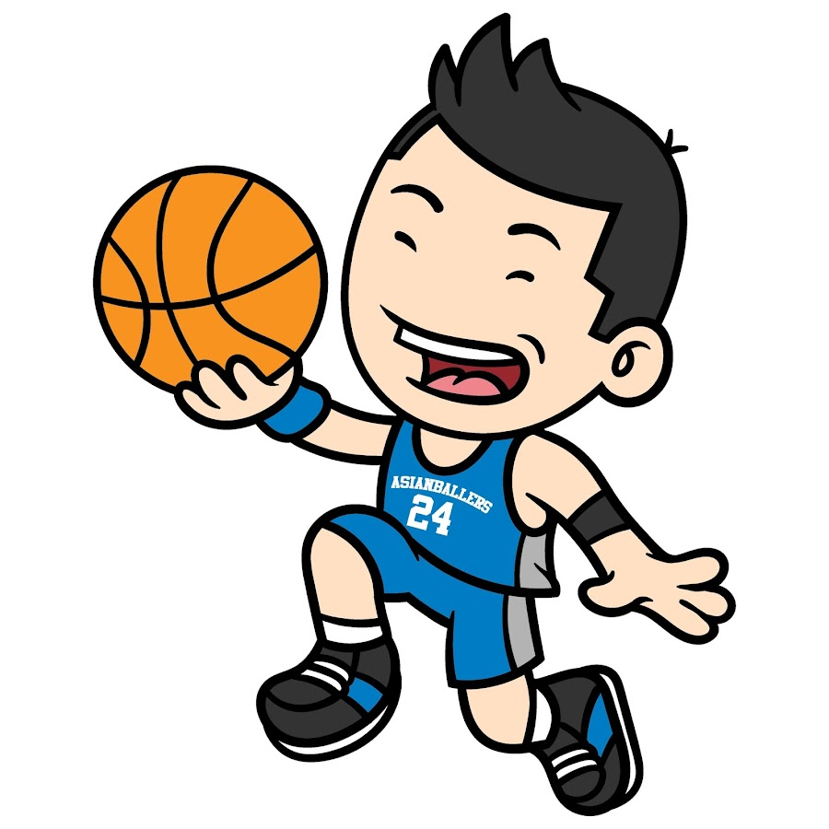
5. He _______ basketball.

Slide 6
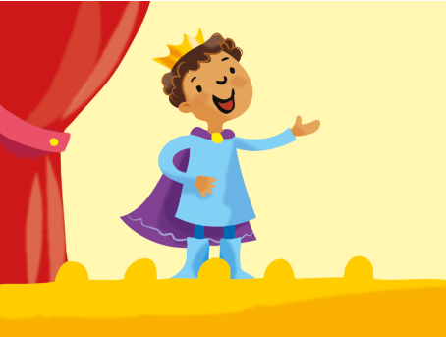
6. He _______ drama.

Slide 7
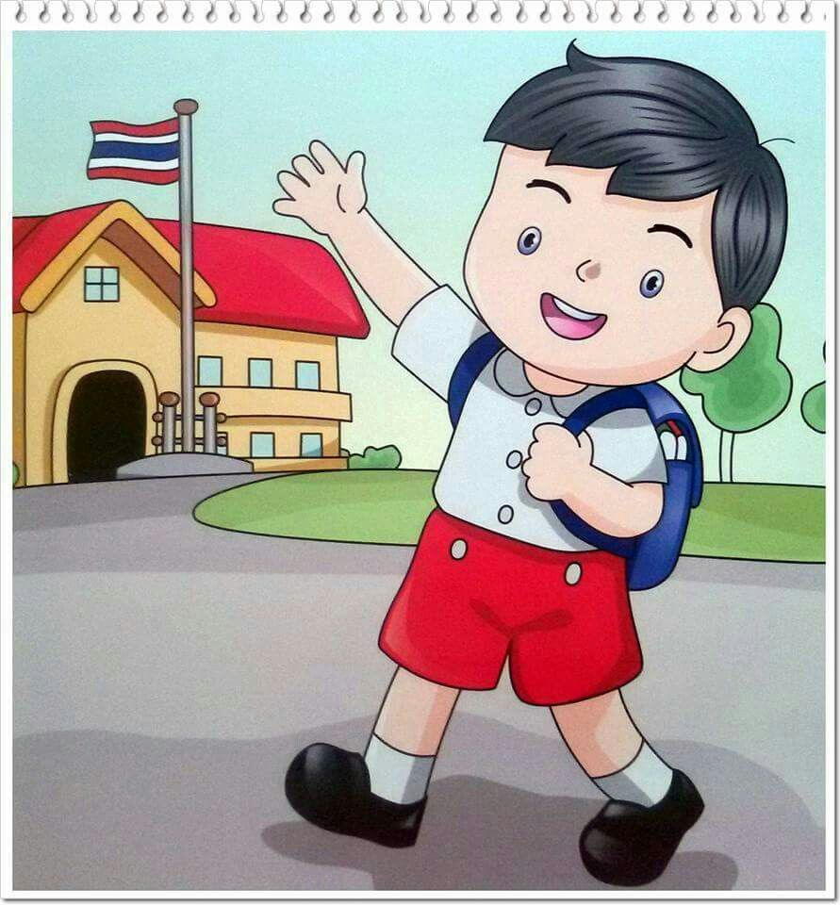
7. He _______ to my school.

