Slide 1
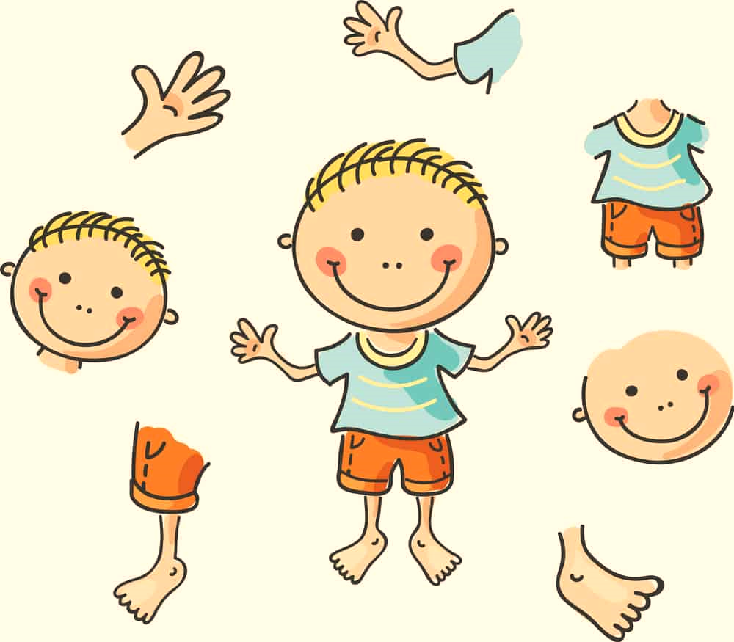




IrinaPapakhinac

Slide 2

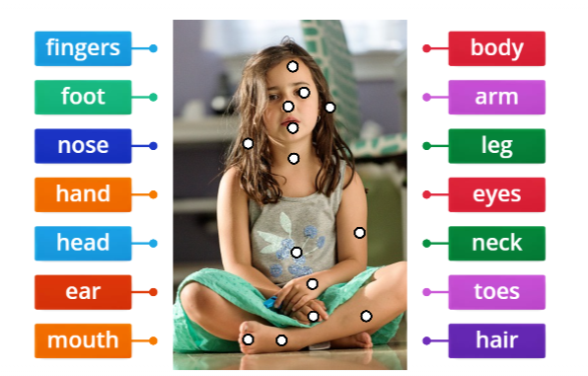
IrinaPapakhinac

Slide 3
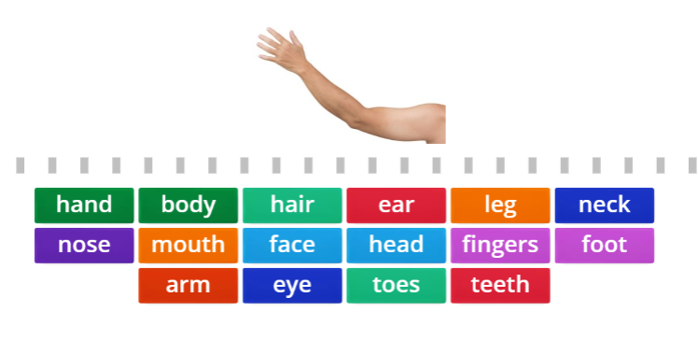
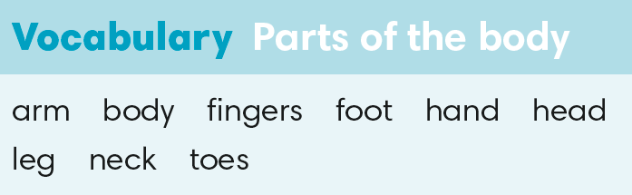

IrinaPapakhinac

Slide 4
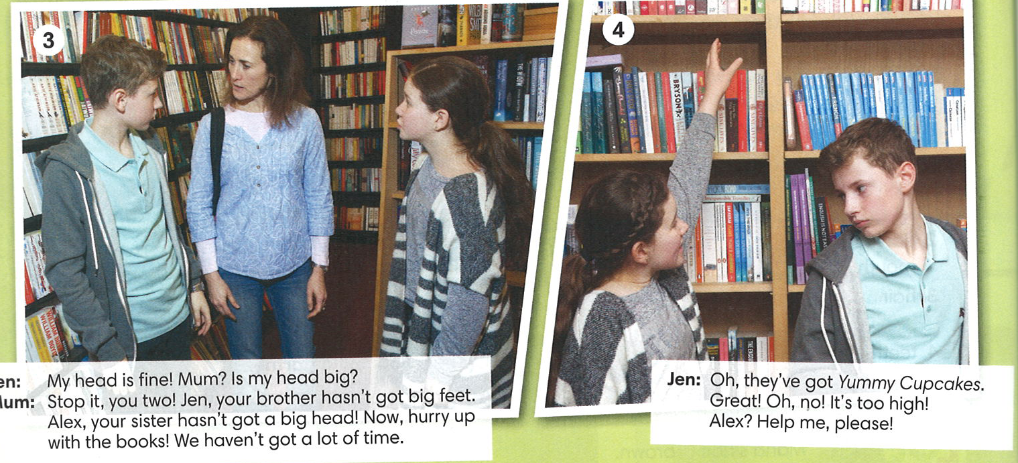

Look at the photo.
Where are Alex and Jen?
Who are they with?
What kind of books does Jen like?
Watch the video and check your answers.
IrinaPapakhinac

Slide 5
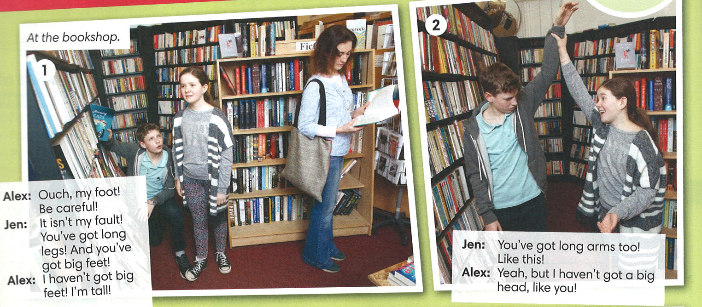
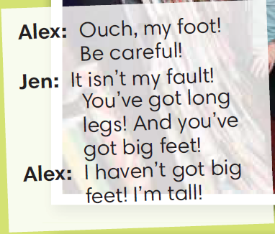
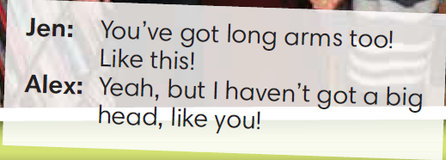
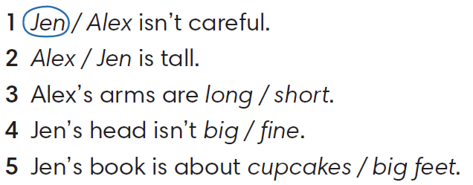
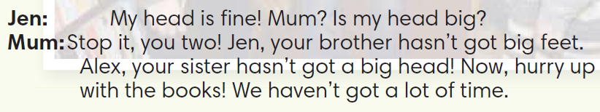
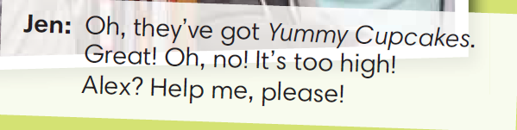
Circle the correct answer.
IrinaPapakhinac

Slide 6

Find these expressions in the story.
IrinaPapakhinac

Slide 7

Why does Jen ask Alex for help?
Will he help her?
Watch the video and check your answers.
IrinaPapakhinac

Slide 8
Complete the sentences.
‘ve got
1. You __________ long legs.
2. And you __________ big feet.
3. I __________ big feet. I’m tall.
4. Yeah, but I __________
a big head, like you!
5. Jen, your brother __________
big feet.
6. Alex, your sister __________
a big head.
7. We __________ a lot of time.
‘ve got
haven’t got
haven’t got
hasn’t got
hasn’t got
haven’t got
IrinaPapakhinac

Slide 9
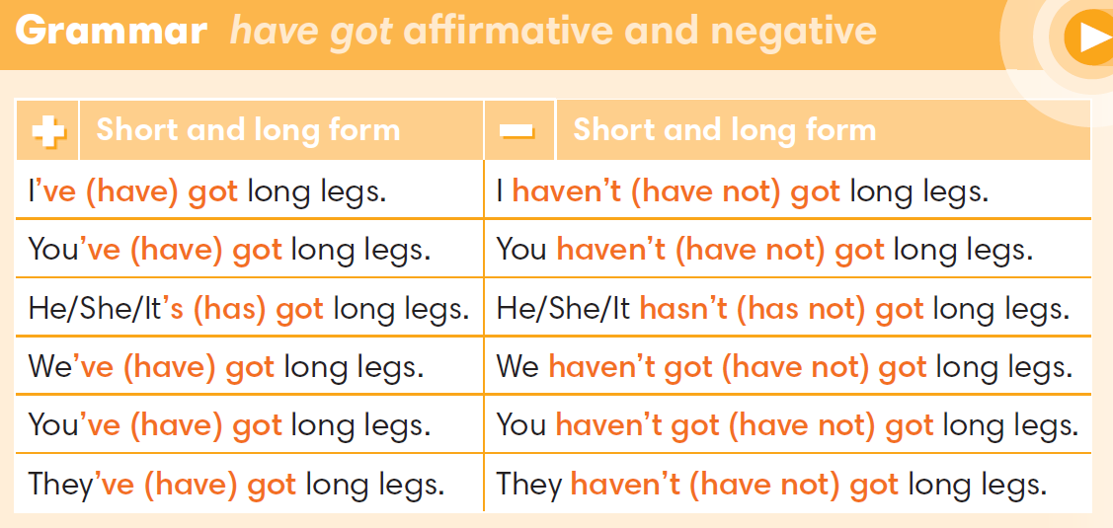
IrinaPapakhinac

Slide 10
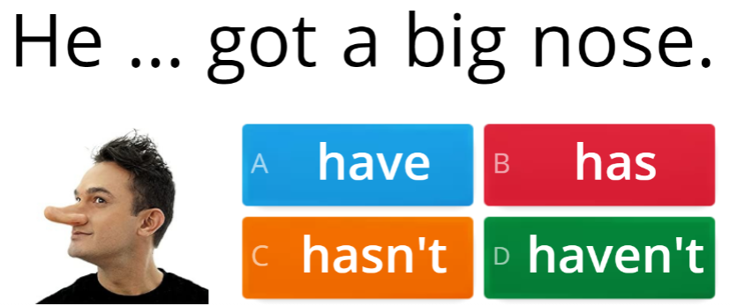
IrinaPapakhinac

Slide 11
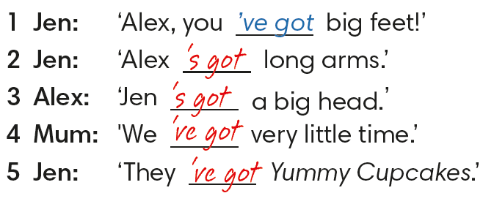
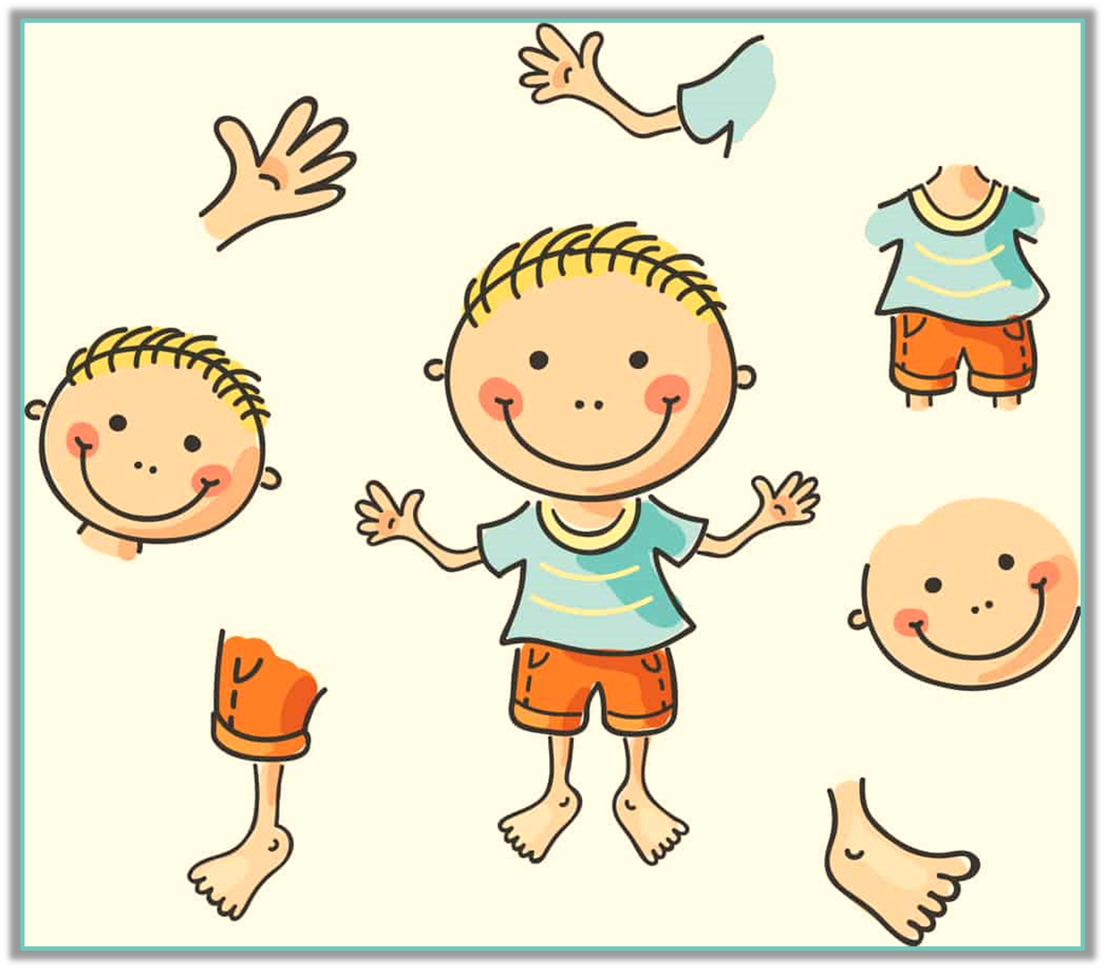
Complete the sentences with ‘ve got or ‘s got.
IrinaPapakhinac

Slide 12
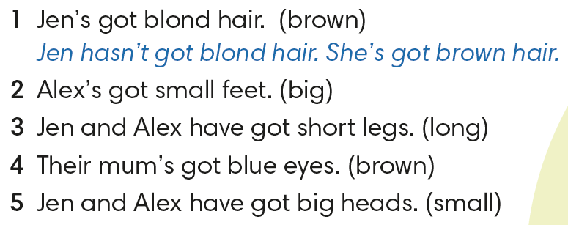
Correct the sentences.
2. Alex hasn’t got small feet. He’s got big feet.
3. Jen and Alex haven’t got short legs. They’ve got long legs.
4. Their mumu hasn’t got blue eyes. She’s got brown eyes.
Jen and Alex haven’t got big heads. They’ve got small heads.
IrinaPapakhinac

Slide 13

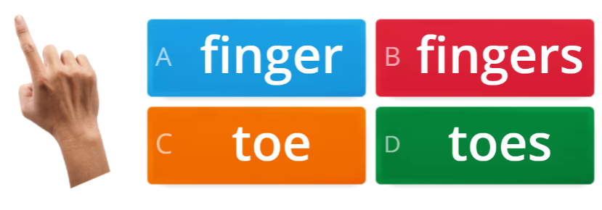
IrinaPapakhinac

Slide 14
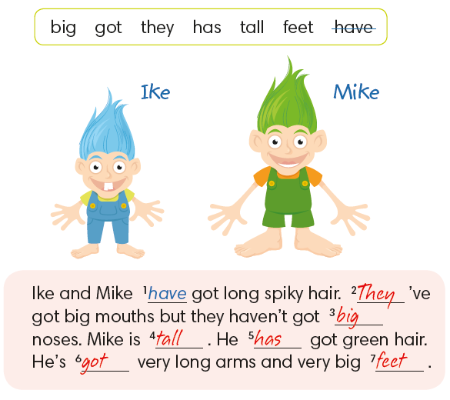
Complete the sentences with the words in the box.
IrinaPapakhinac

Slide 15
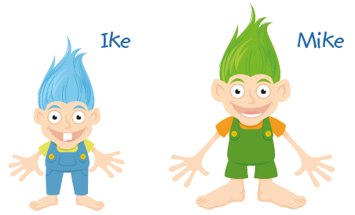
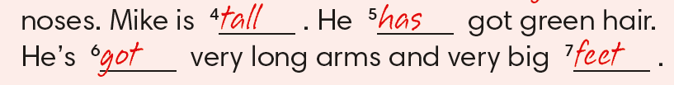
Make the story about Ike.
short
Mike isn’t tall. He’s __________.
He __________ green hair. He __________ blue hair.
He __________ very long arm’s. He __________ very __________ arms.
He __________ very big feet. He __________ very __________ feet.
hasn’t got
‘s got
hasn’t got
‘s got
short
hasn’t got
‘s got
small
IrinaPapakhinac

Slide 16
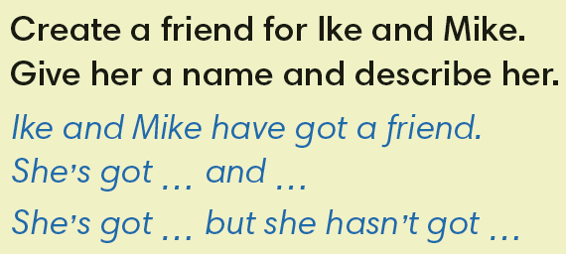
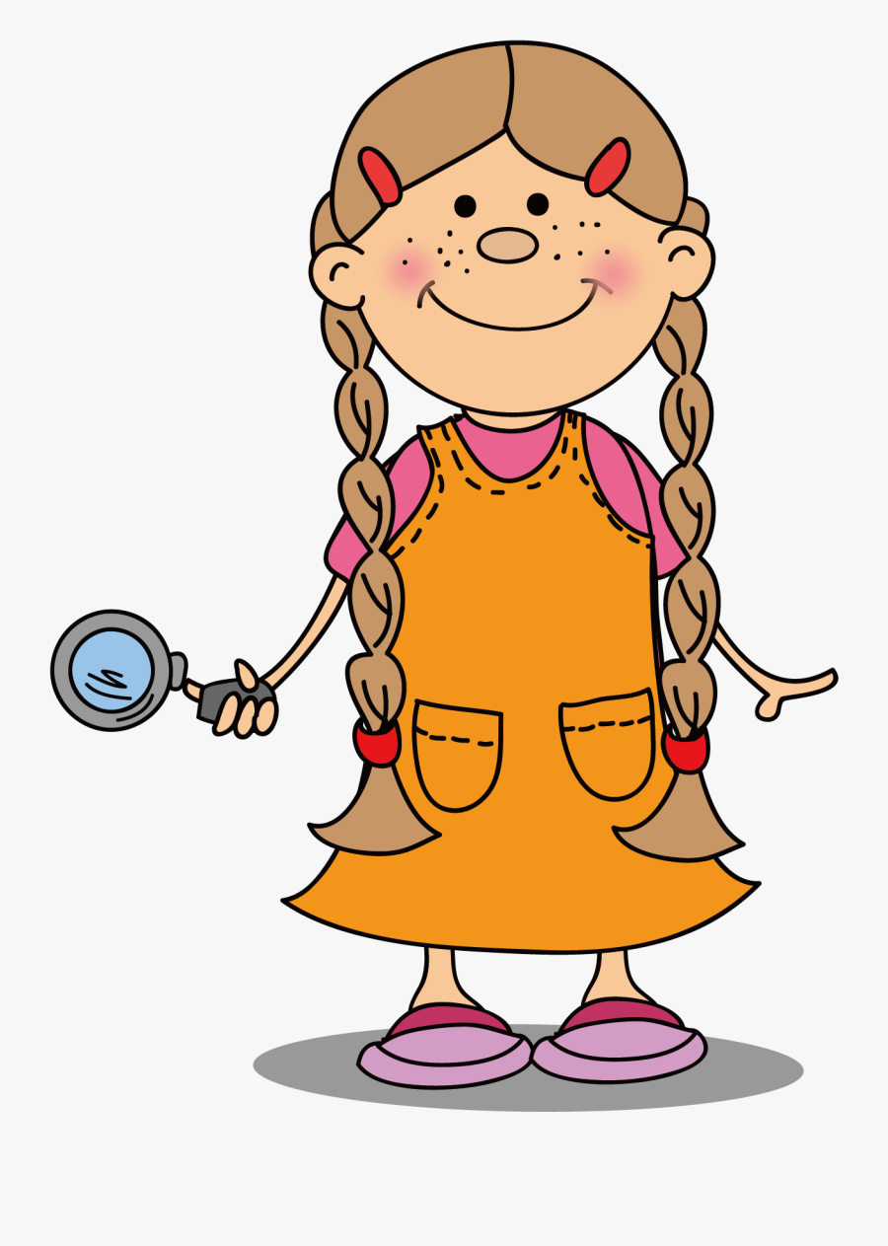
IrinaPapakhinac

Slide 17
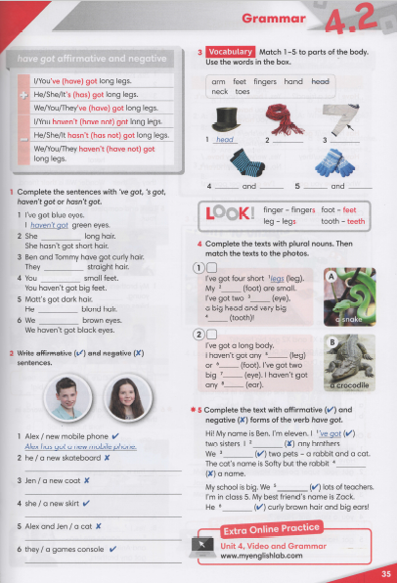


IrinaPapakhinac

Slide 18
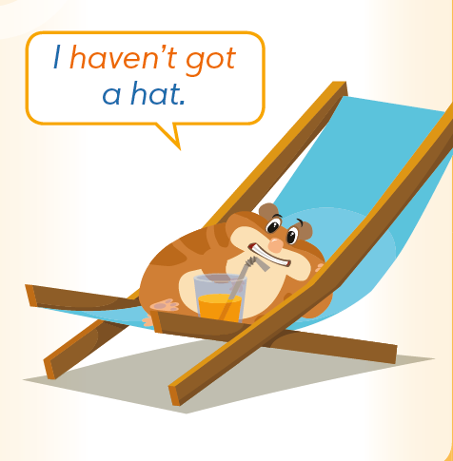

What else hasn’t Hammy got?
IrinaPapakhinac

Slide 19
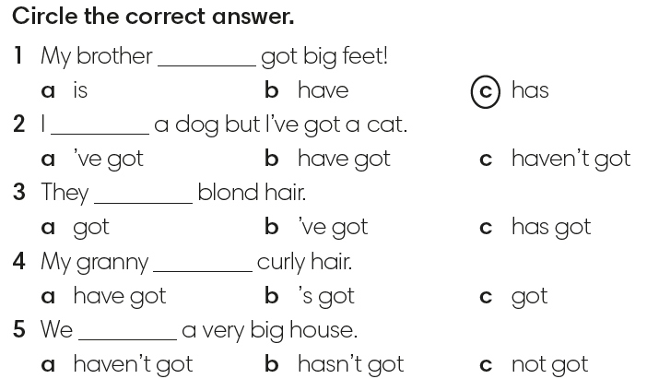
IrinaPapakhinac

Slide 20
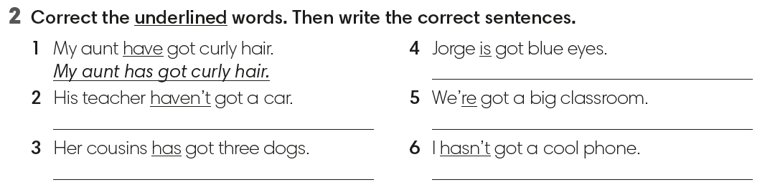
IrinaPapakhinac

Slide 21
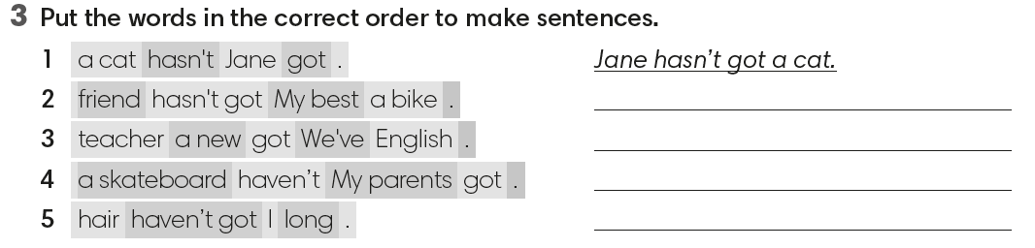

IrinaPapakhinac

Slide 22
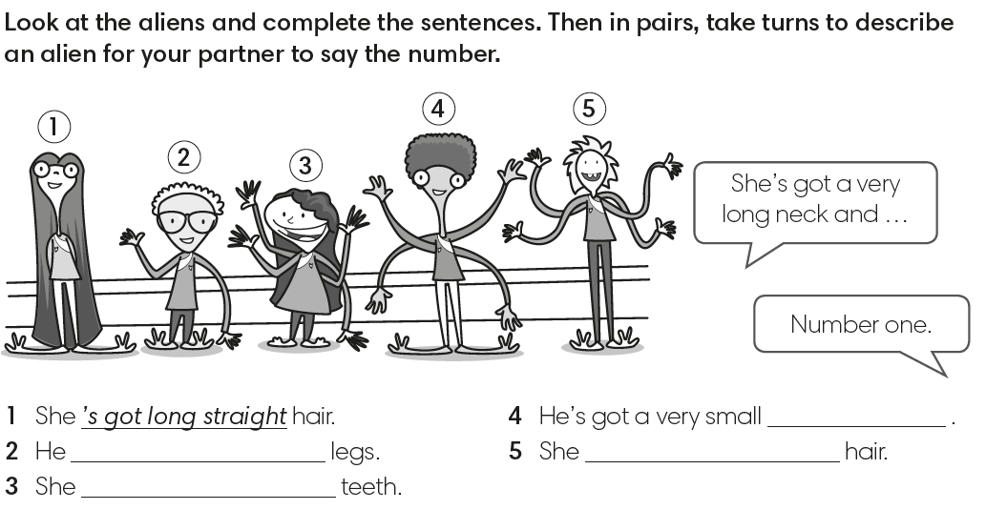
IrinaPapakhinac

