Slide 1
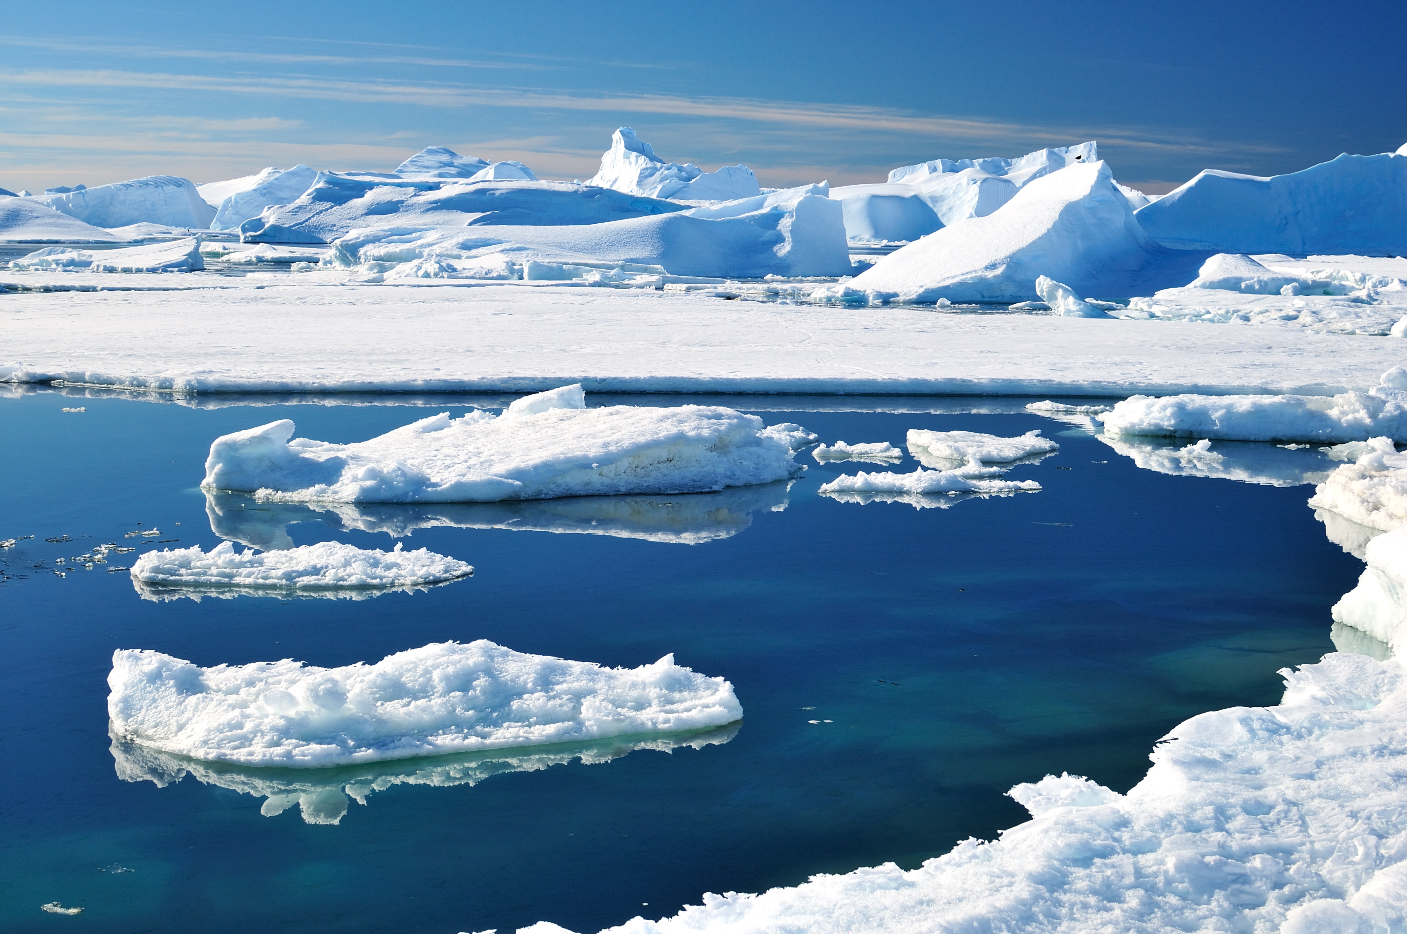

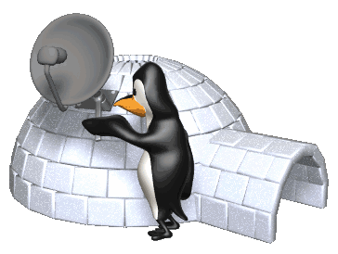
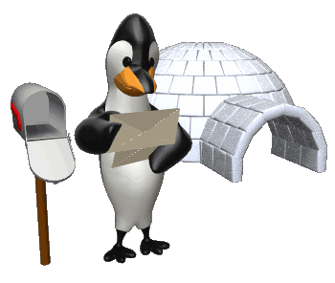
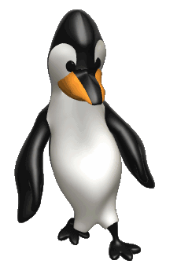
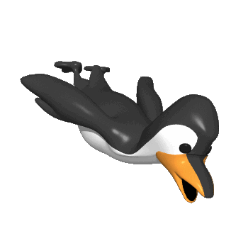
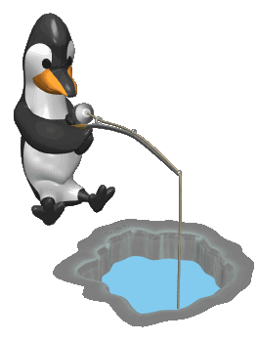
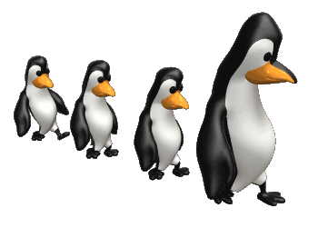
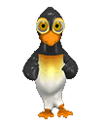
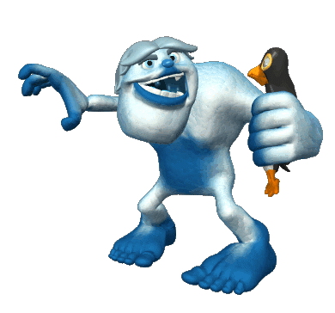
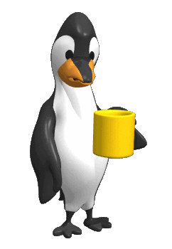
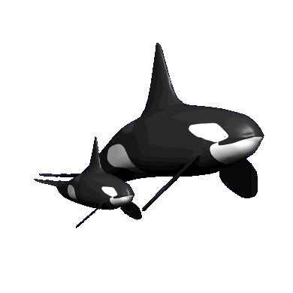

www.vk.com/egppt
Past Simple vs. Past Continuous
South Pole
by helgabel
NEXT

Slide 2
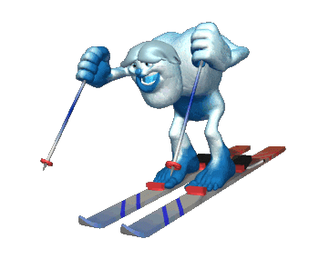
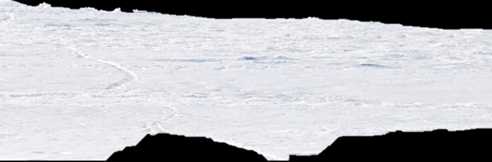
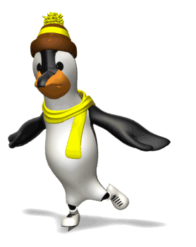
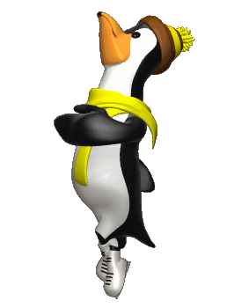

www.vk.com/egppt
saw
1. He _______________ (see) a penguin when he _______________ (ski).
was skiing
was seeing / was skiing
saw /
was skying
saw / skied
saw / was skiing
NEXT

Slide 3
www.vk.com/egppt
was reading
2. She _______________ (read) a letter when her friend _______________ (come).
came
read / was coming
read /
came
was reading / came
was reading / was coming
NEXT

Slide 4
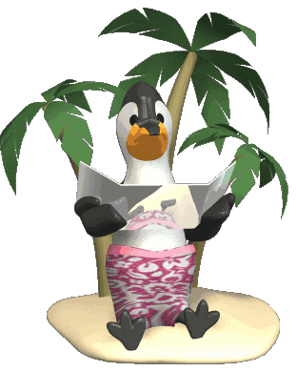
www.vk.com/egppt
was repairing
3. He _______________ (repair ) their satellite dish while she _______________ (sunbath).
was sunbathing
was repairing / was sunbathing
repaired /
sunbathed
repaired / was sunbathing
was repairing / sunbathed
NEXT

Slide 5
www.vk.com/egppt
drank
4. He _______________ (drink) a cup of chamomile tea and _______________ (fall) asleep.
fell
drank / was falling
drank /
fell
drank / falled
was drinking/ was falling
NEXT

Slide 6
www.vk.com/egppt
were having
didn’t want
5. They _______________ (have) such a good time that they _______________ (not want) to go home.
were having / weren’t wanting
had /
didn’t want
had / weren’t wanting
were having / didn’t want
NEXT

Slide 7
www.vk.com/egppt
was dancing
6. Who _______________ (dance) and _______________ (sing) loudly
while we _______________ (try) to sleep?
singing
were trying
danced /
sung / tried
was dancing / singing / were trying
danced / sang / were trying
was dancing / sang / tried
NEXT

Slide 8

www.vk.com/egppt
was fishing
7. He _______________ (fish) when it _______________ (start) to snow.
started
was fishing / was starting
fished /
were starting
fished / started
was fishing / started
NEXT

Slide 9
www.vk.com/egppt
was ice skating
8. While he _______________ (ice skate)
he _______________ (fall) on the ice and _______________ (hurt) his ankle.
fell
hurt
was ice skating / was falling / hurt
ice skated /
fell / hurt
was ice skating / fell / hurt
was ice skating / fell / hurted
NEXT

Slide 10
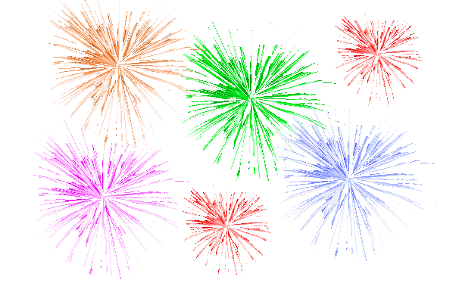
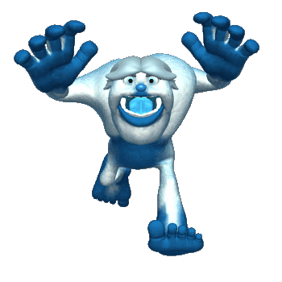
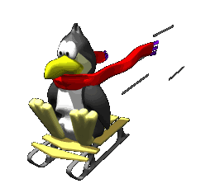
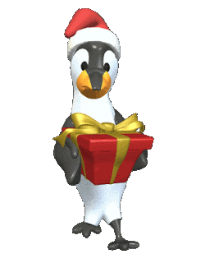
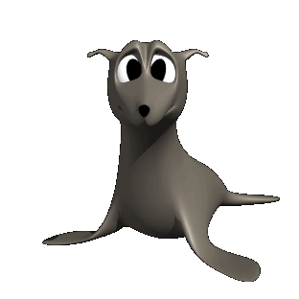


www.vk.com/egppt
THANK YOU!
South Pole
by helgabel

