Slide 1
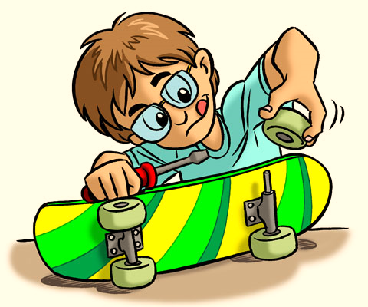




IrinaPapakhinac

Slide 2

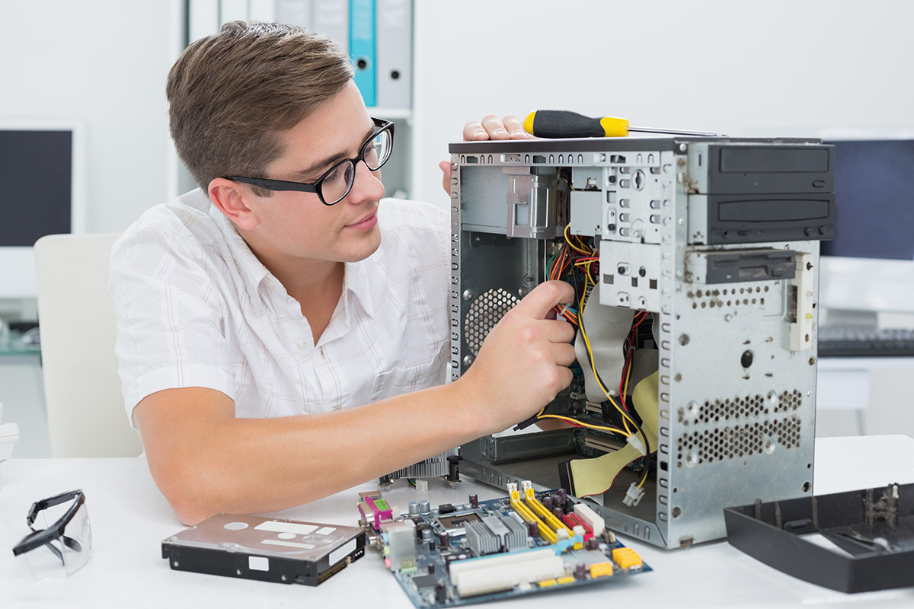
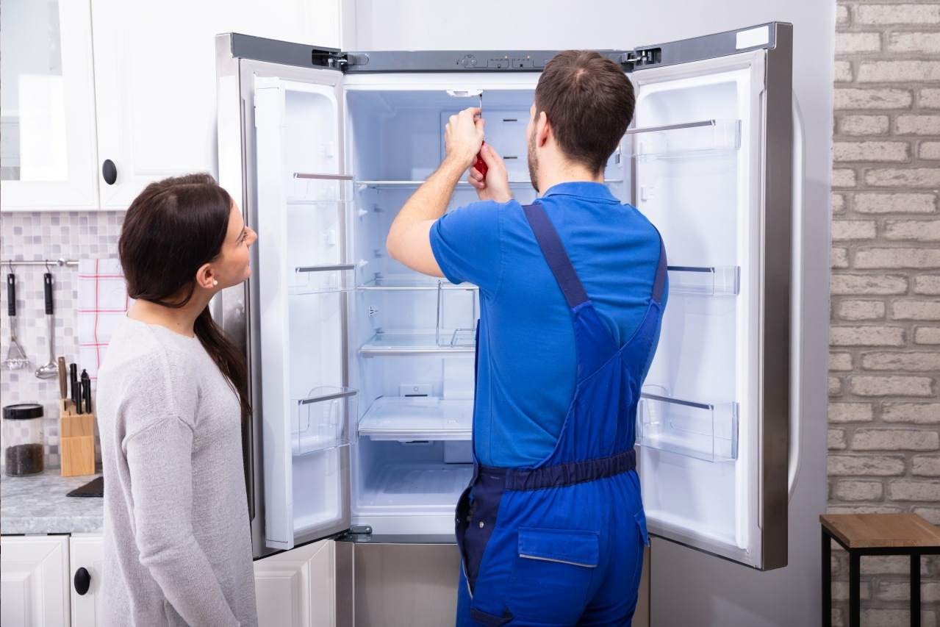
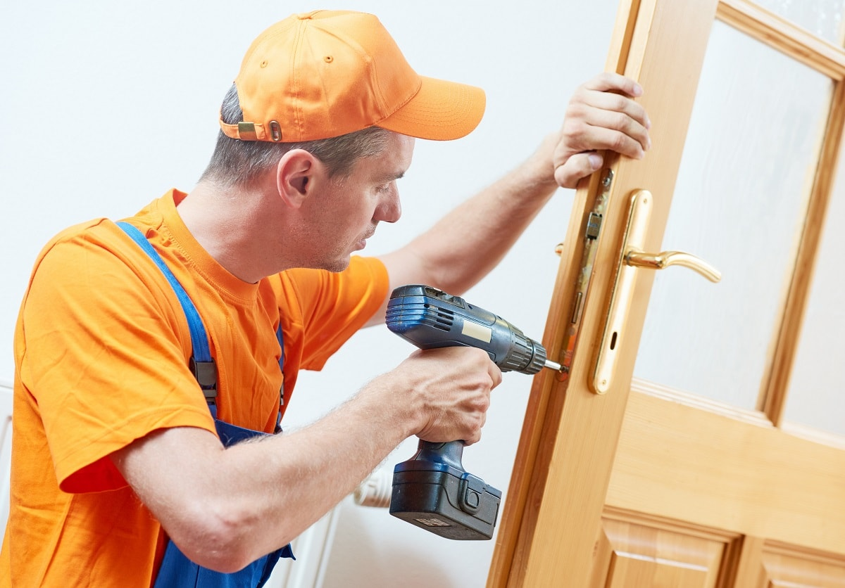
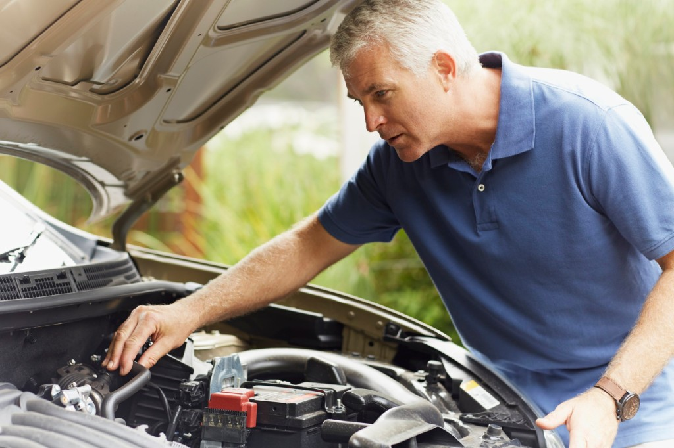
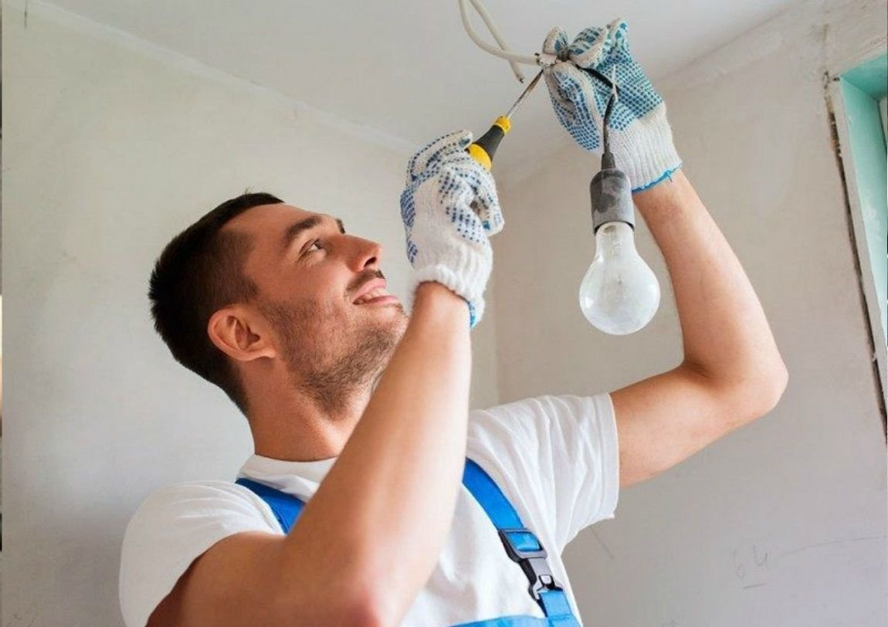
What can people fix?
IrinaPapakhinac

Slide 3
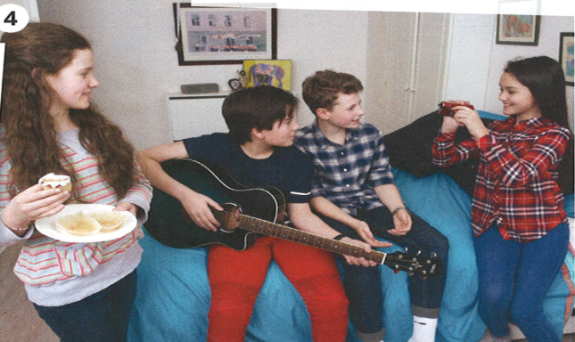

Look at the photo.
What has Jen got?
What has Lucas got?
What has Lian got?
GUESS
4. What is broken?
5. Who can fix it?
Watch the video and check your answers.
IrinaPapakhinac

Slide 4
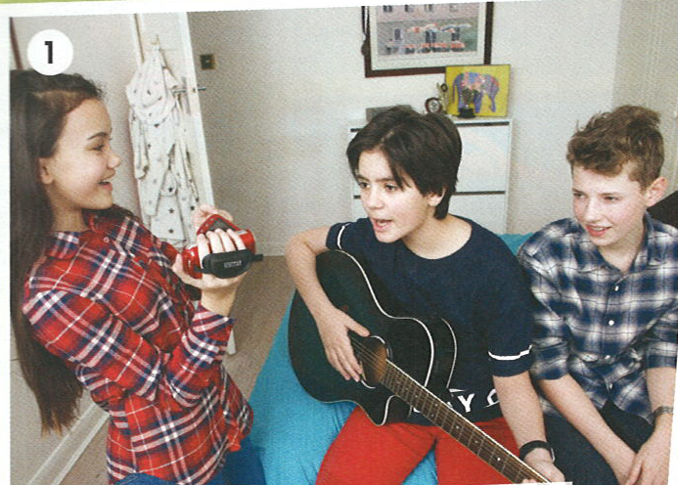
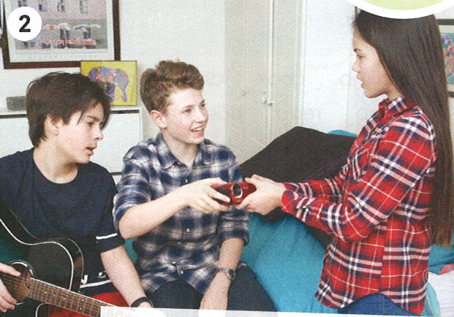
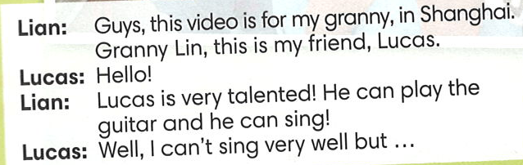
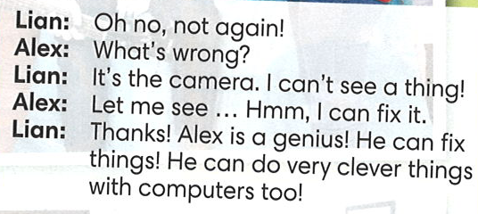
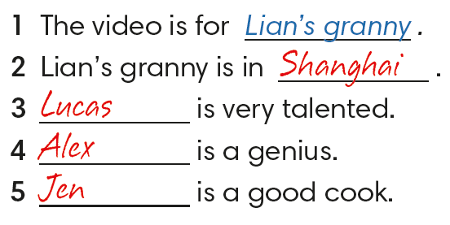
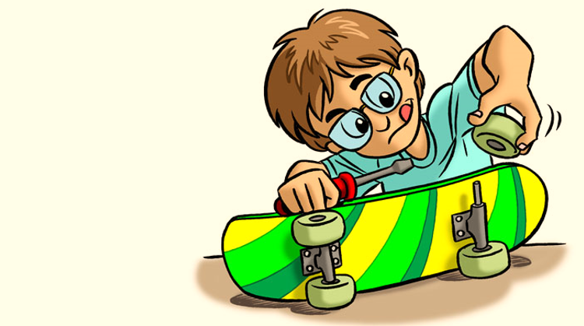
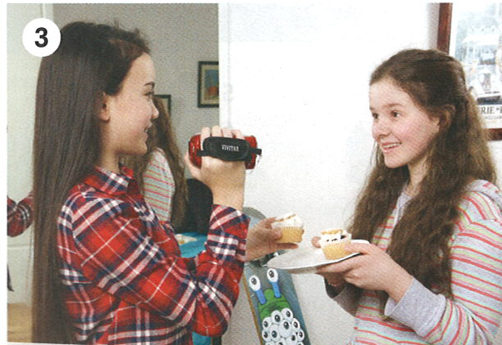
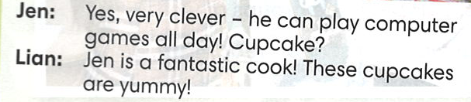

IrinaPapakhinac

Slide 5


Find these expressions in the story.
IrinaPapakhinac

Slide 6

GUESS
What can Lian do?
Watch the video and check your answers.
IrinaPapakhinac

Slide 7
Complete the sentences.
Lucas is very talented!
He ________ play the guitar
and he ________sing!
2. Well, I ________ sing very well but …
can
can
can’t
IrinaPapakhinac

Slide 8
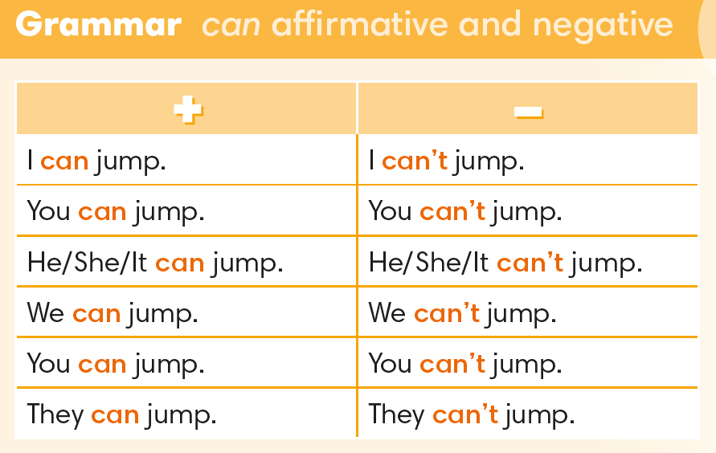
IrinaPapakhinac

Slide 9

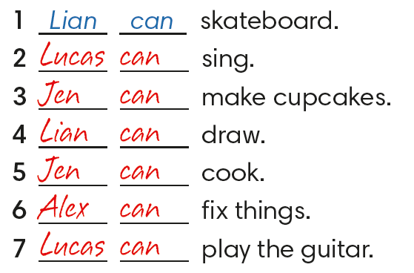
IrinaPapakhinac

Slide 10
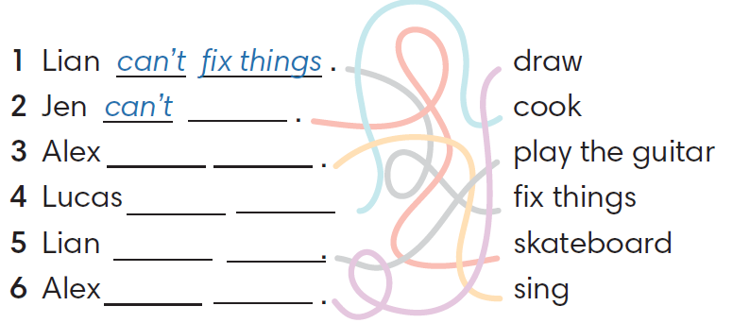
skateboard
can’t sing
can’t cook
can’t play the guitar
can’t draw
IrinaPapakhinac

Slide 11

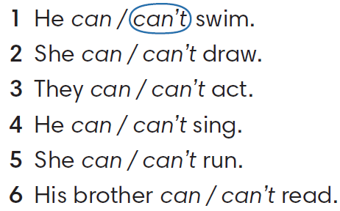
IrinaPapakhinac

Slide 12
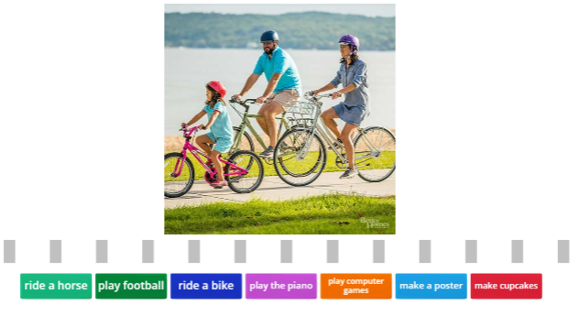
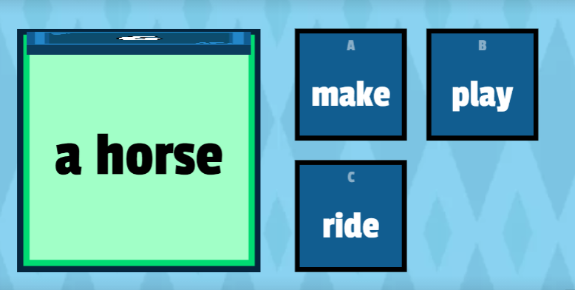
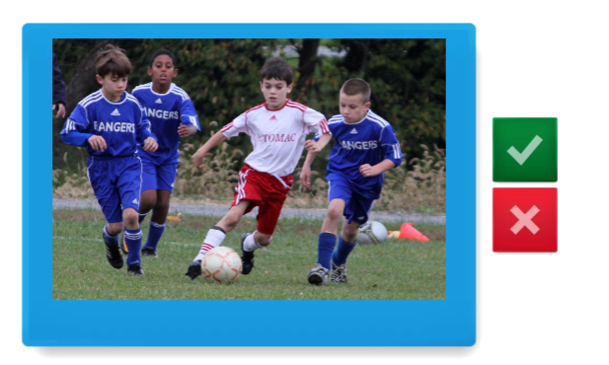
IrinaPapakhinac

Slide 13
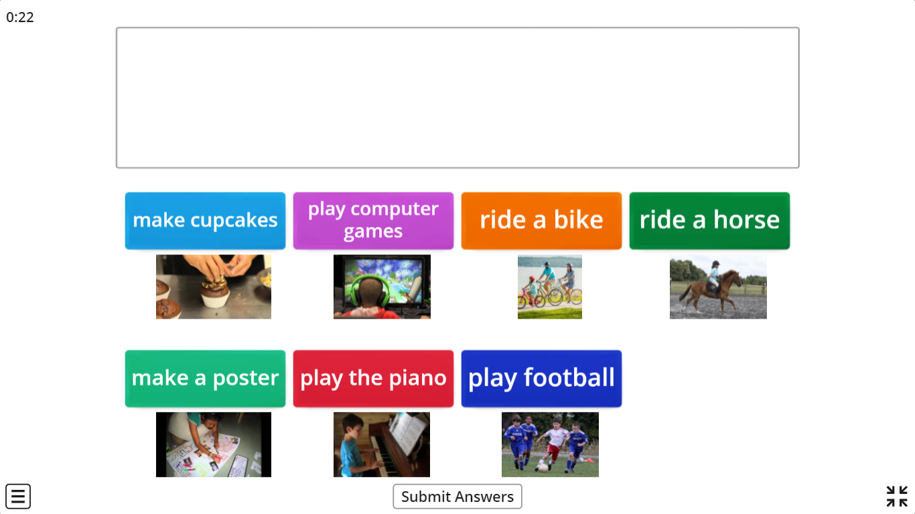

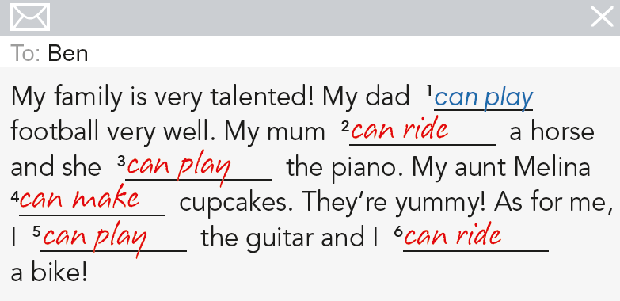
IrinaPapakhinac

Slide 14

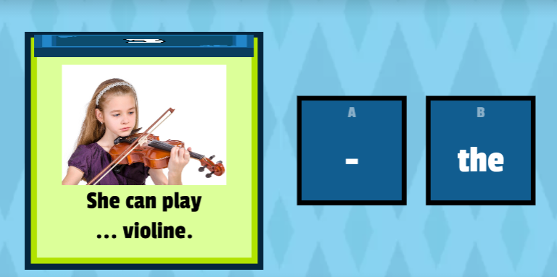
IrinaPapakhinac

Slide 15


GUESS what they can do.
I think they can / can’t cook.
 | cook | dive | ride a horse | run fast | swim
Mark
Tom
Ann
Mary
IrinaPapakhinac

Slide 16
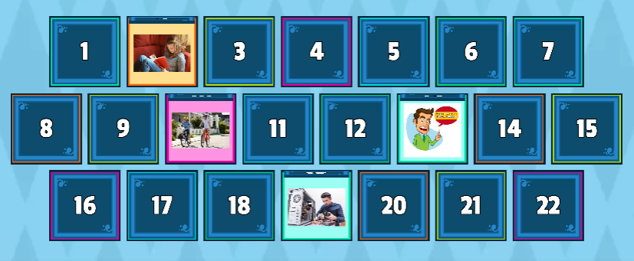
What can / can’t you do?
IrinaPapakhinac

Slide 17
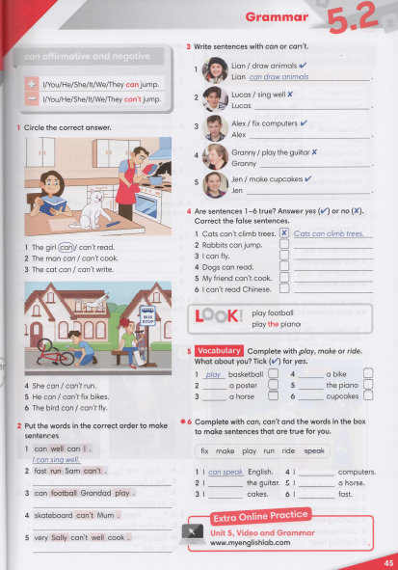


IrinaPapakhinac

Slide 18

What can Hammy do?
Watch the video and check your answers.
IrinaPapakhinac

Slide 19
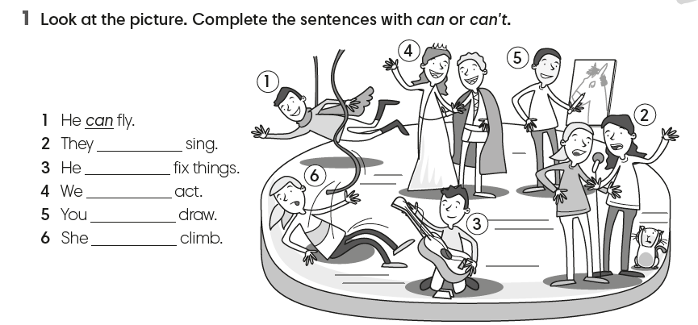
IrinaPapakhinac

Slide 20
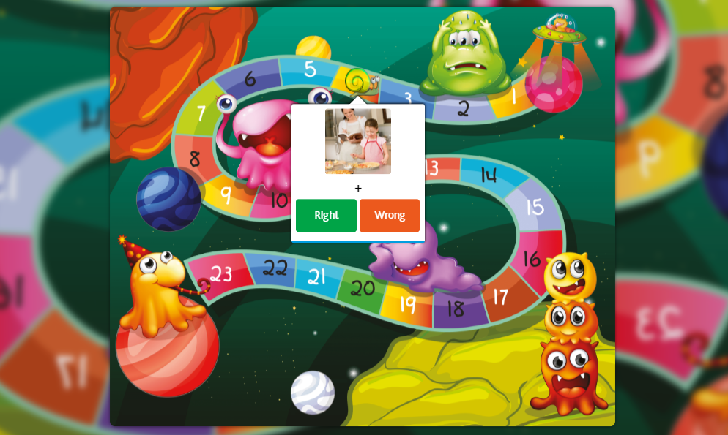
IrinaPapakhinac

