Slide 1
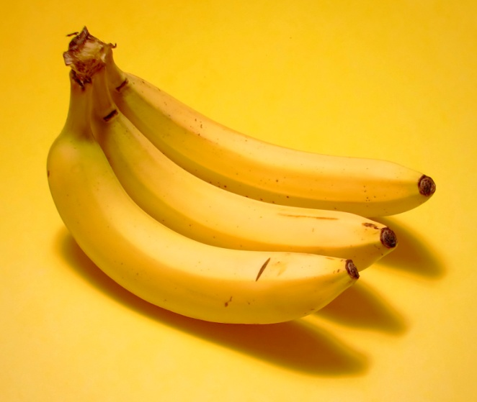
- Can I have some….?
- How many?
- …
- OK. Here you are.
- Thank you.
- Anything else?
- No, thank you.

Slide 2
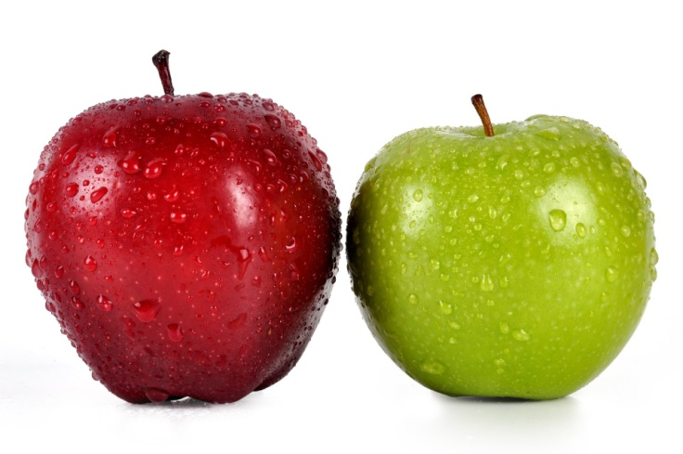
- Can I have some….?
- How many?
- …
- OK. Here you are.
- Thank you.
- Anything else?
- No, thank you.

Slide 3
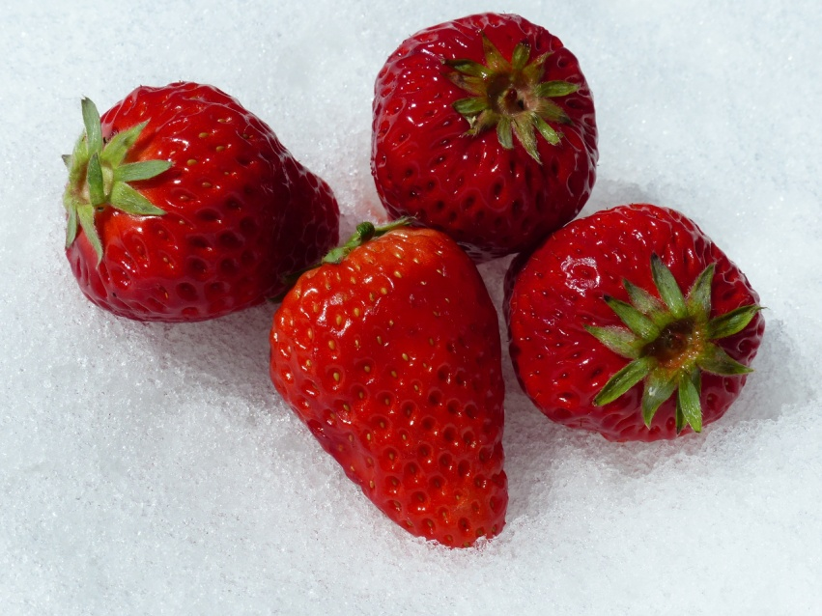
- Can I have some….?
- How many?
- …
- OK. Here you are.
- Thank you.
- Anything else?
- No, thank you.

Slide 4
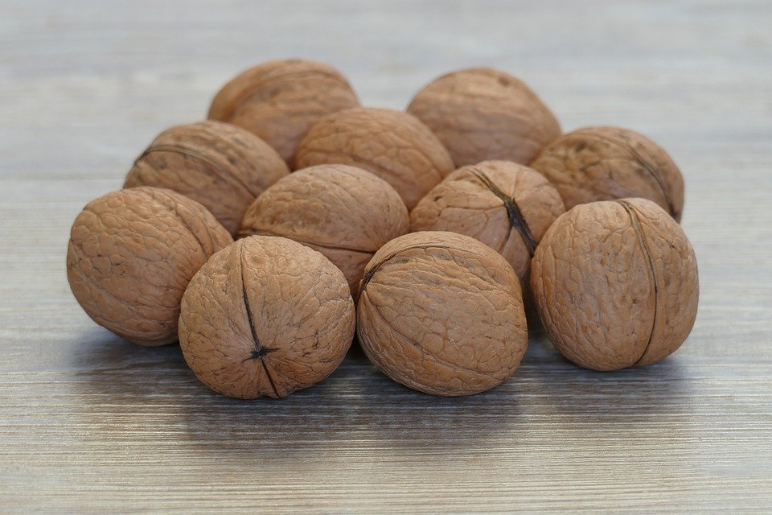
- Can I have some….?
- How many?
- …
- OK. Here you are.
- Thank you.
- Anything else?
- No, thank you.

Slide 5
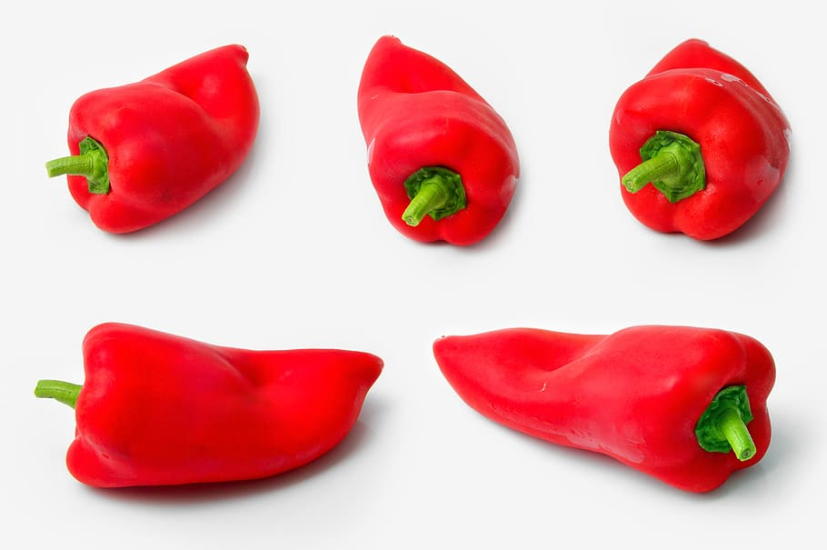
- Can I have some….?
- How many?
- …
- OK. Here you are.
- Thank you.
- Anything else?
- No, thank you.

Slide 6
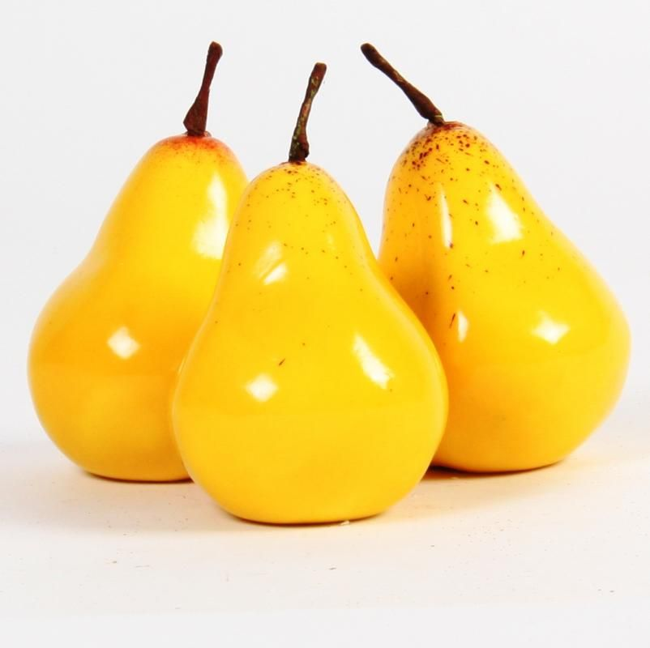
- Can I have some….?
- How many?
- …
- OK. Here you are.
- Thank you.
- Anything else?
- No, thank you.

Slide 7
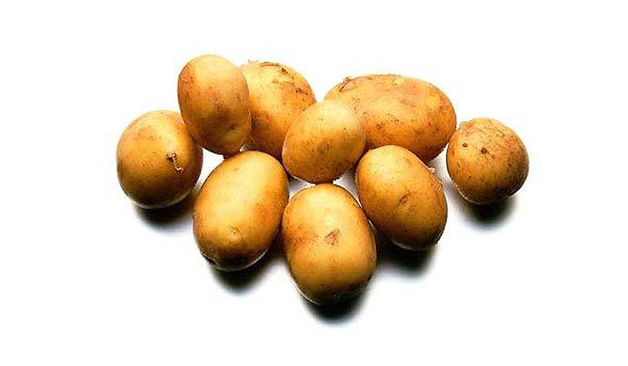
- Can I have some….?
- How many?
- …
- OK. Here you are.
- Thank you.
- Anything else?
- No, thank you.

Slide 8
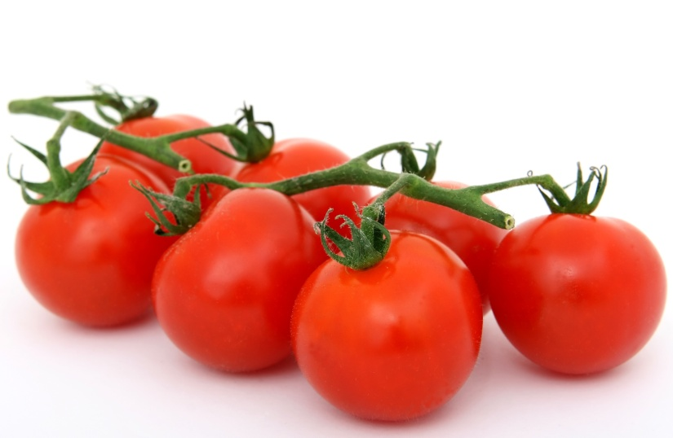
- Can I have some….?
- How many?
- …
- OK. Here you are.
- Thank you.
- Anything else?
- No, thank you.

Slide 9
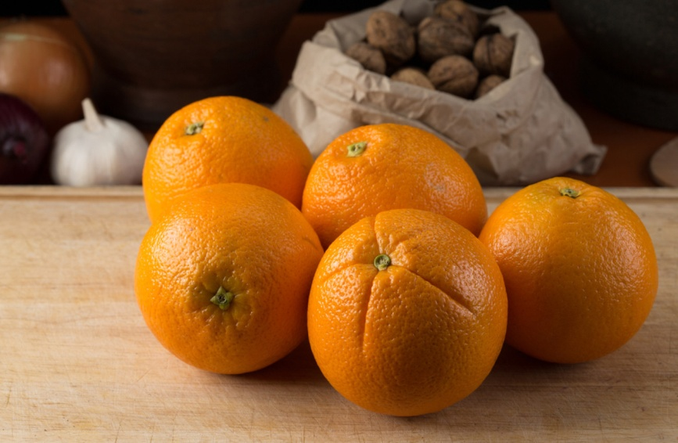
- Can I have some….?
- How many?
- …
- OK. Here you are.
- Thank you.
- Anything else?
- No, thank you.

Slide 10
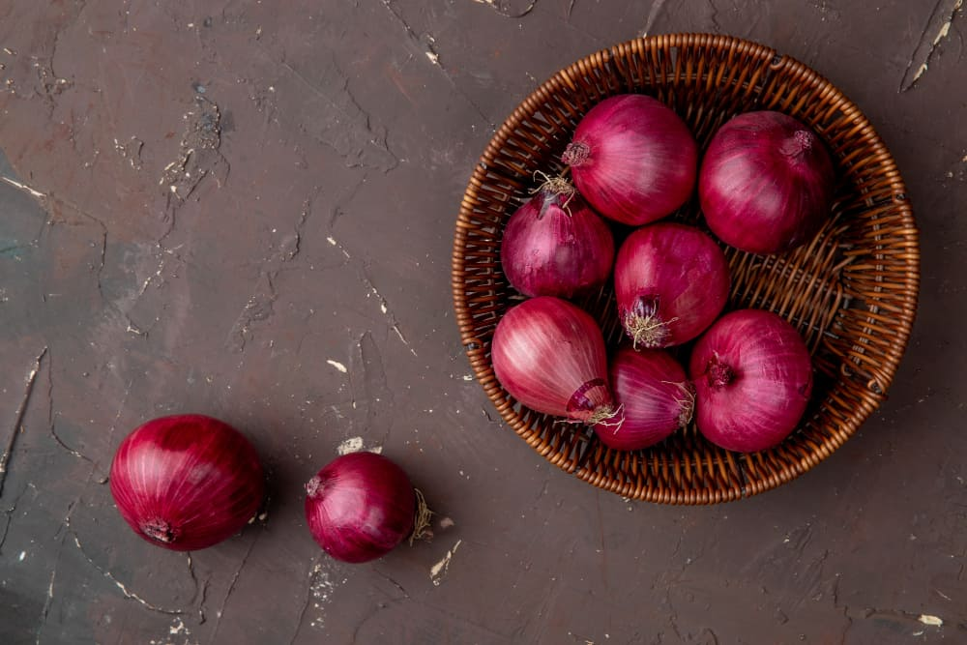
- Can I have some….?
- How many?
- …
- OK. Here you are.
- Thank you.
- Anything else?
- No, thank you.

