Slide 1
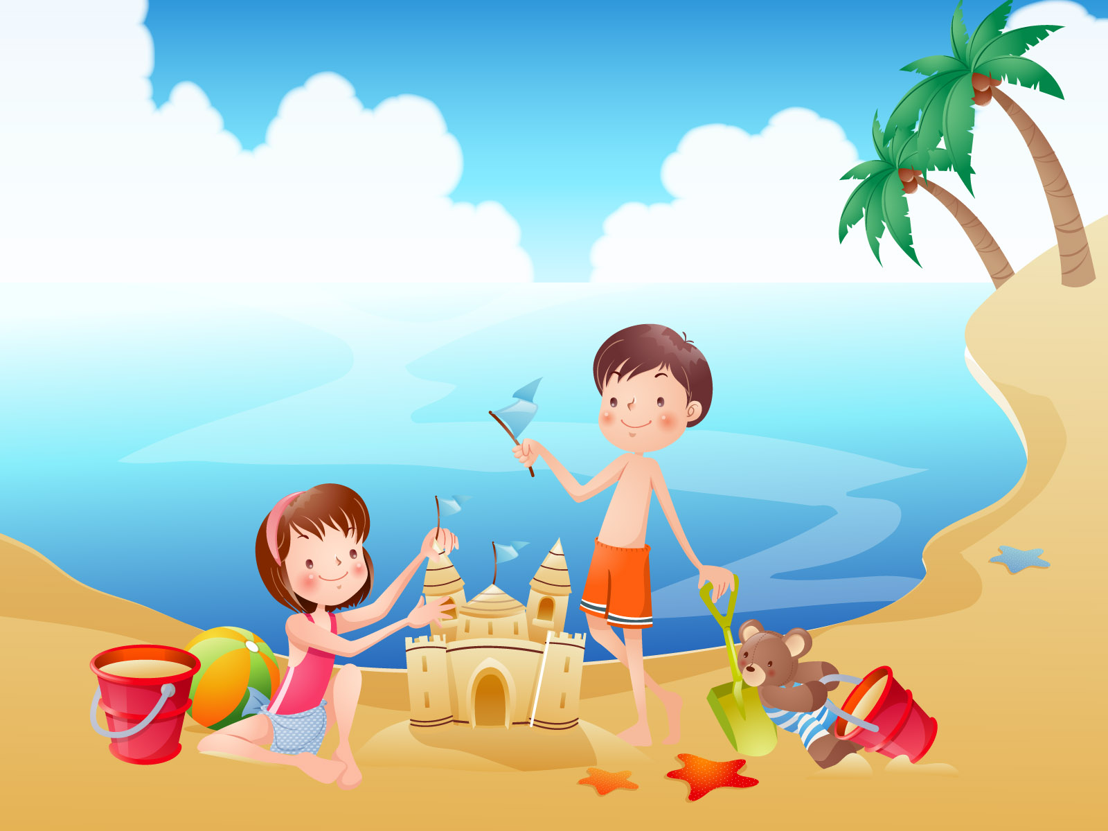
I’m playing on the beach.
Notes:
Make negative sentences: I’m not playing on the beach.

Slide 2
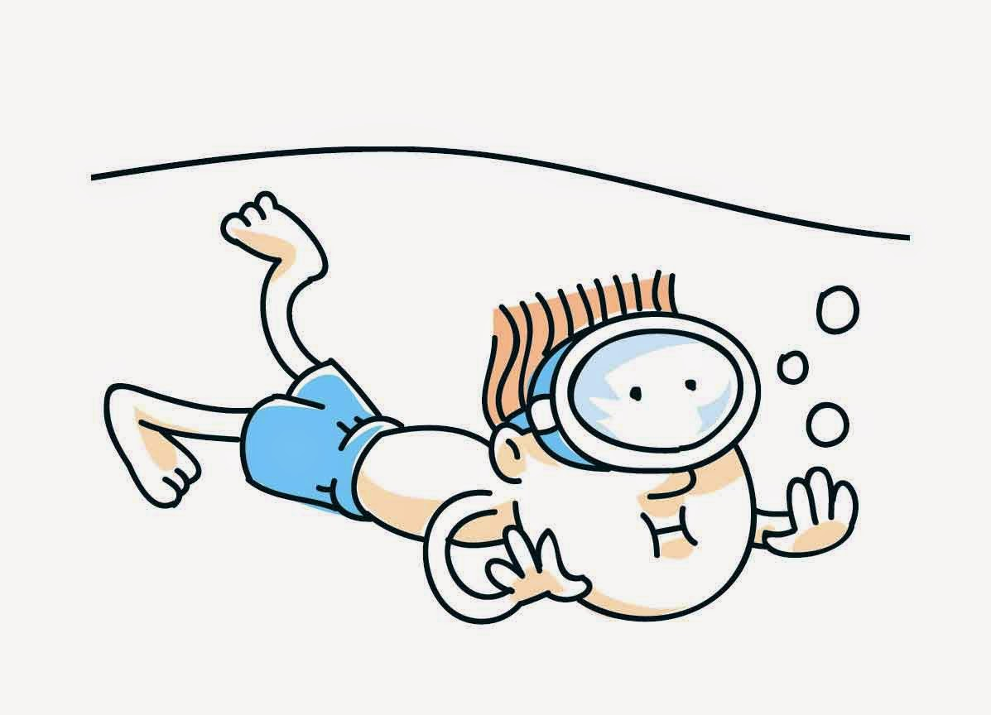
He’s swimming in the sea.

Slide 3

She’s working.

Slide 4
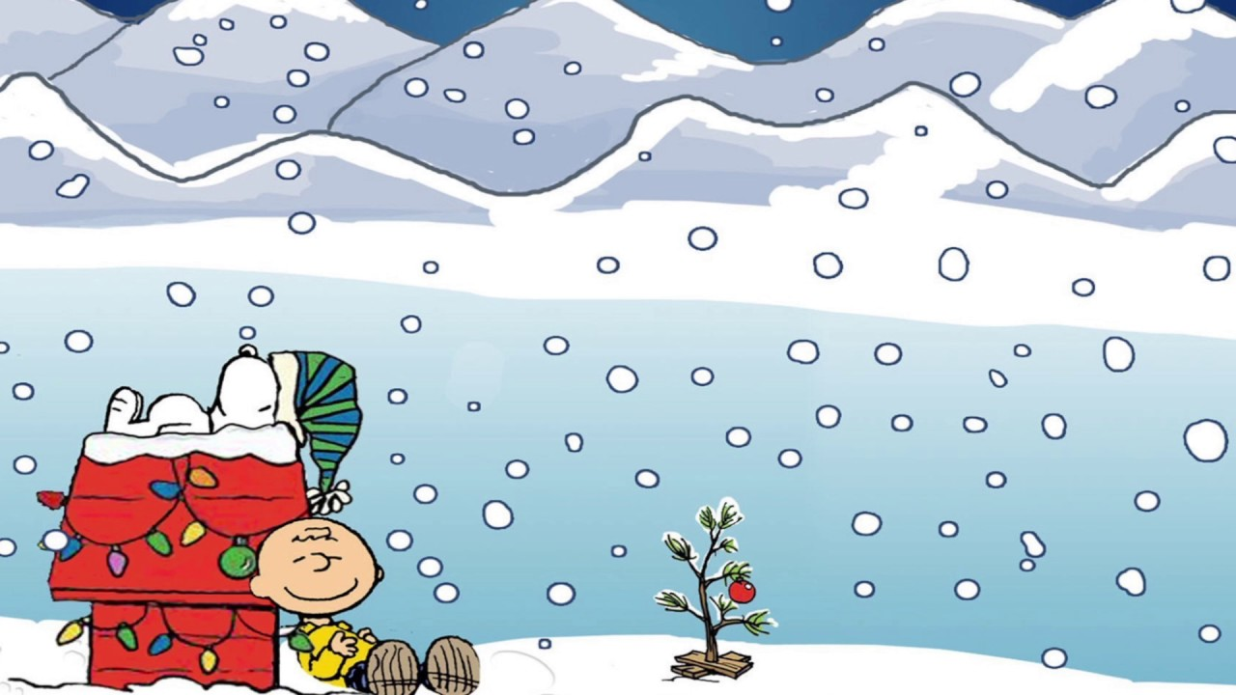
It’s snowing.

Slide 5
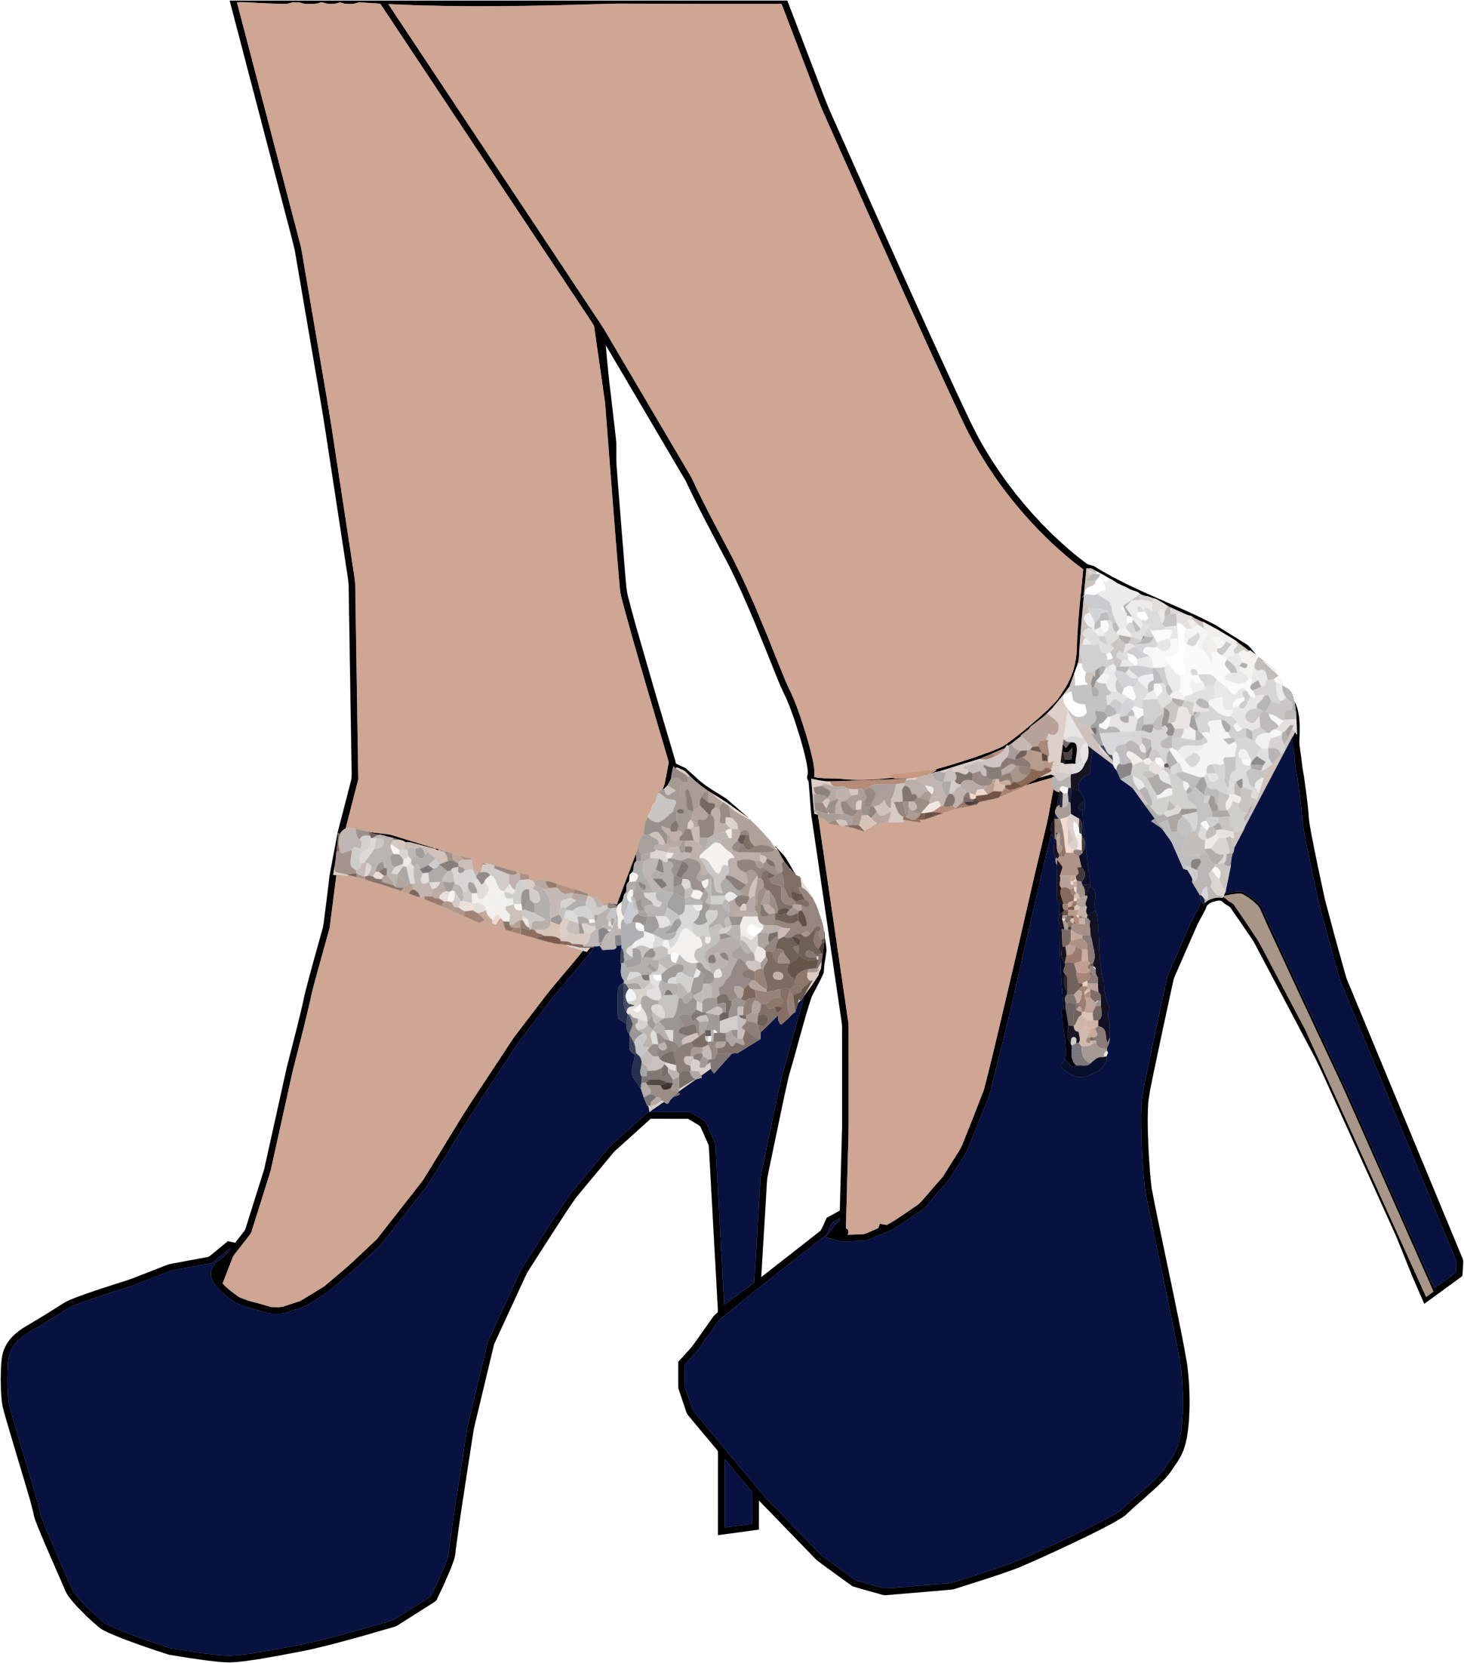
We’re wearing shoes.

Slide 6

You’re going around the world.

Slide 7

They’re having fun.

