Slide 1
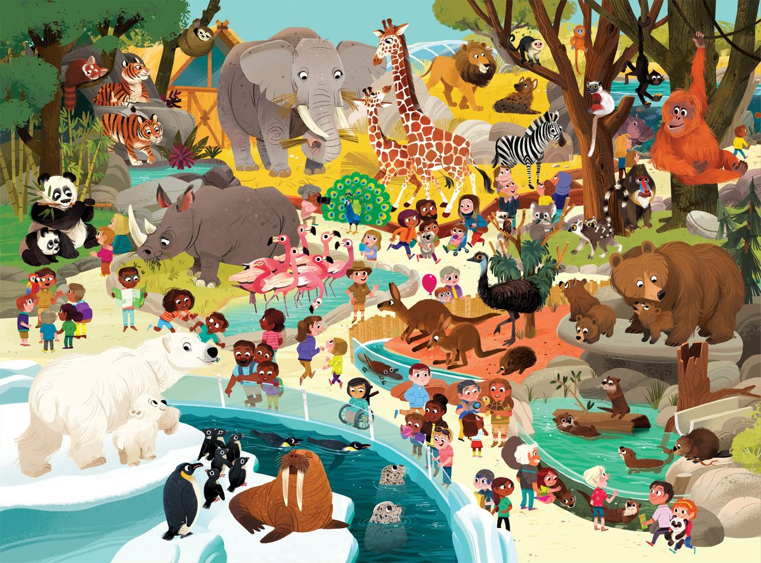
How many giraffes are there?
There are …

Slide 2
How many elephants are there?
There is …

Slide 3
How many tigers are there?
There are …

Slide 4
How many pandas are there?
There are …

Slide 5
How many rhinos are there?
There is …

Slide 6
How many flamingos are there?
There are …

Slide 7
How many polar bears are there?
There are …

Slide 8
How many penguins are there?
There are …

Slide 9
How many walruses are there?
There is ...

Slide 10
How many seals are there?
There are ...

Slide 11
How many beavers are there?
There are ...

Slide 12
How many bears are there?
There are ...

Slide 13
How many kangaroos are there?
There are ...

Slide 14
How many ostriches are there?
There is ...

Slide 15
How many monkeys are there?
There are ...

Slide 16
How many lemurs are there?
There are ...

Slide 17
How many zebras are there?
There is ...

Slide 18
How many echidnas are there?
There is ...

Slide 19
How many hyenas are there?
There is ...

