Slide 1
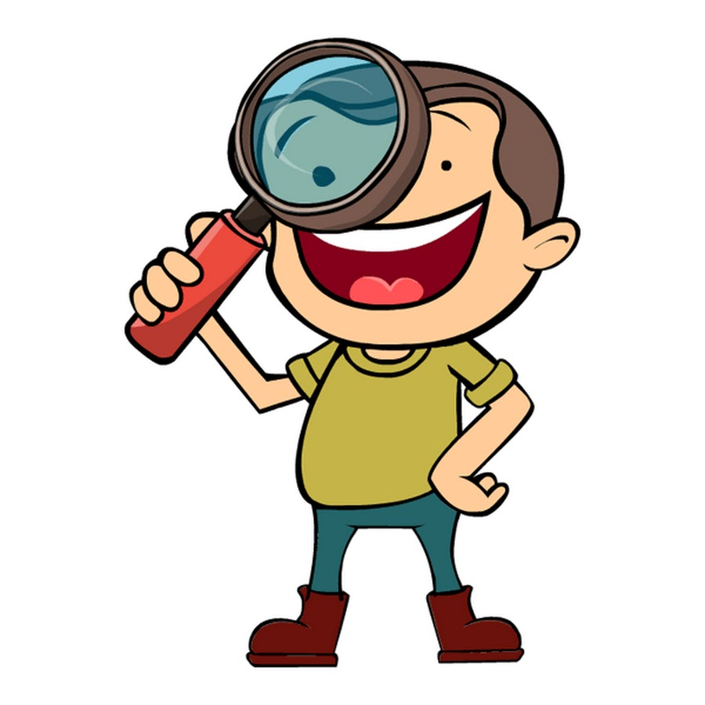
you / what / doing / are /? for / looking / I / brother / my / am /.

Slide 2
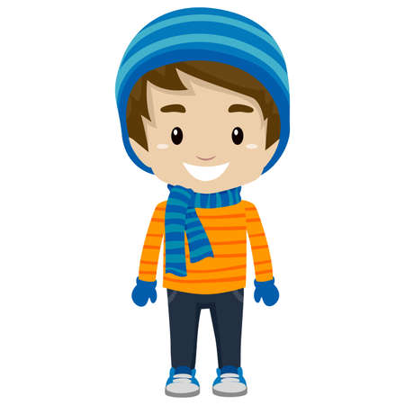
wearing / he / is / what / ? scarf / a / blue / is / wearing / he / .

Slide 3
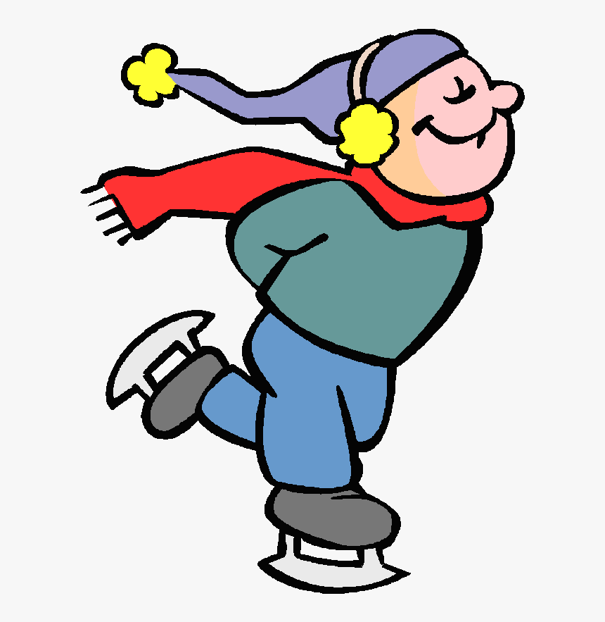
he / what / doing / is / ? skating / is / he / .

Slide 4
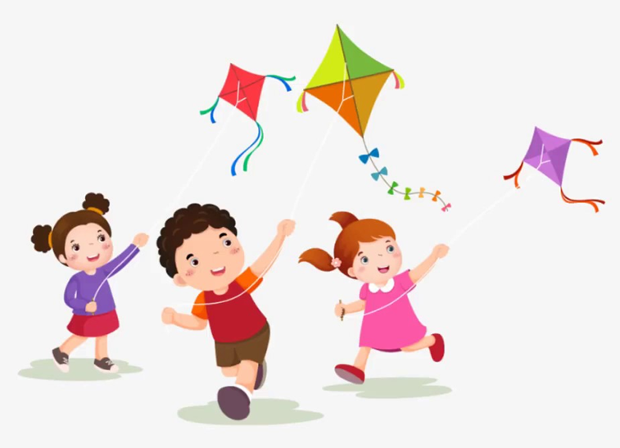
your / friends / what / are / doing / ? a / kite / they / flying / are / .

