Slide 1

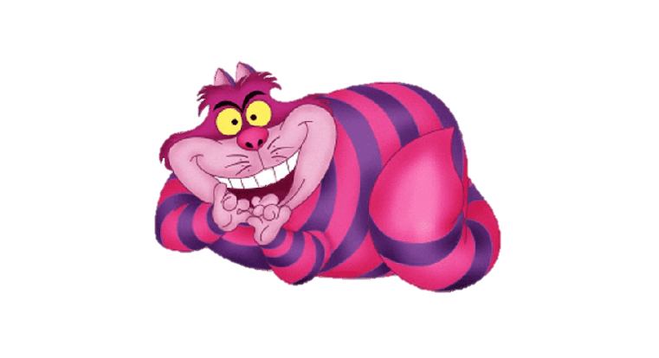
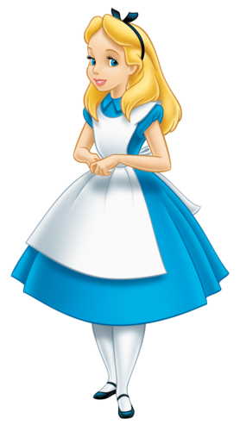
PREPOSITIONS OF PLACE
with Alice in Wonderland
By yellowflicker

Slide 2

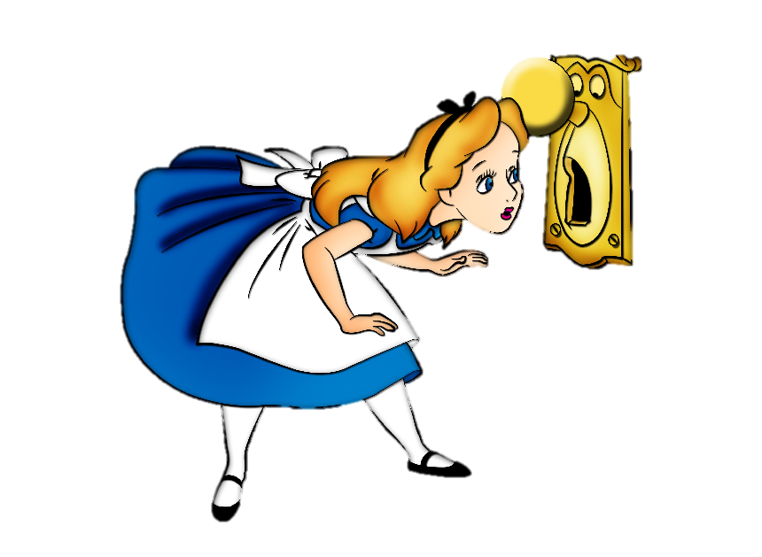
HI! I AM ALICE. CAN YOU FIND ME?

Slide 3

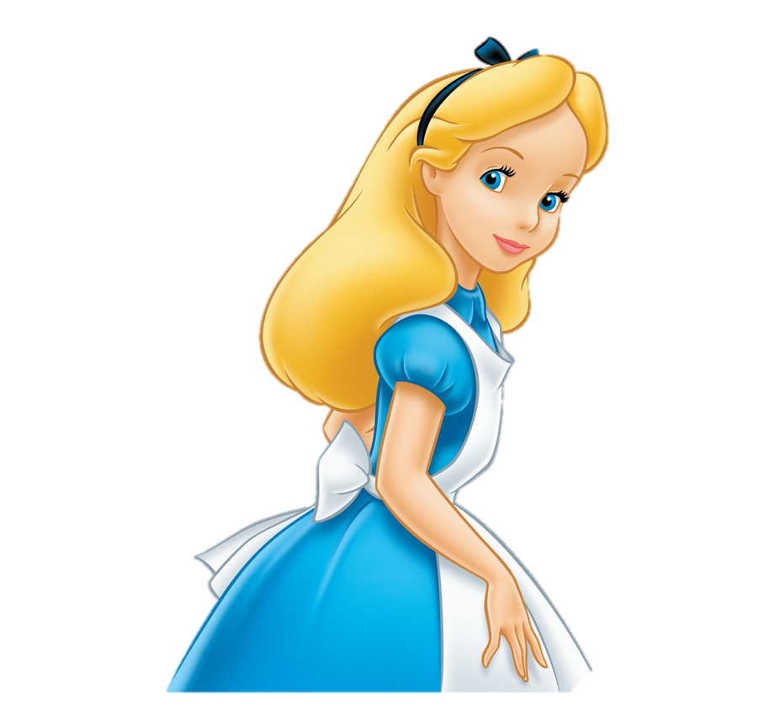
Where is Alice?
She is in front of the box.

Slide 4
Where is Alice?
She is behind the box.

Slide 5
Where is Alice?
She is next to the box.

Slide 6
Where is Alice?
She is between the boxes.

Slide 7

Where is Alice?
She is in the box.

Slide 8
Where is Alice?
She is on the box.

Slide 9
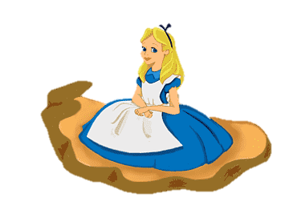
Where is Alice?
She is under the box.

Slide 10
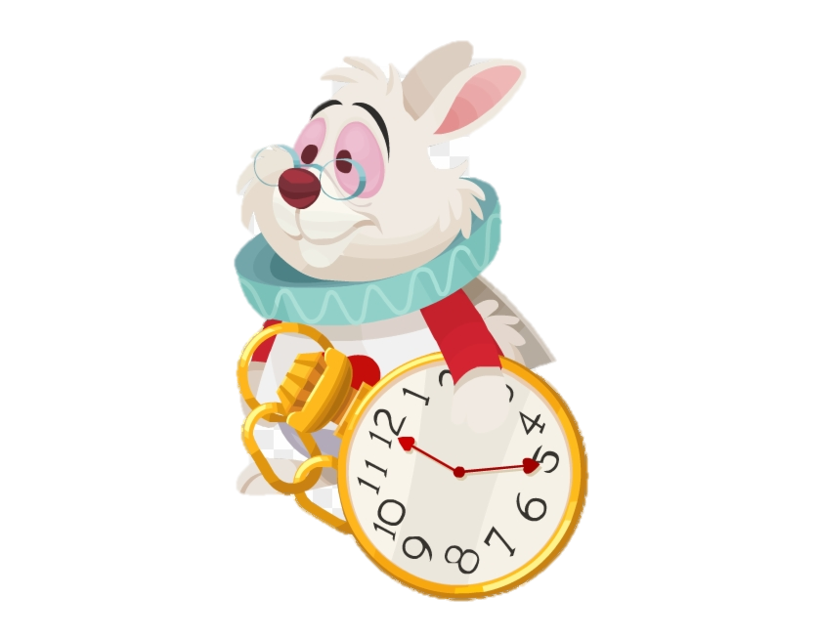
GOOD JOB!

