Slide 1
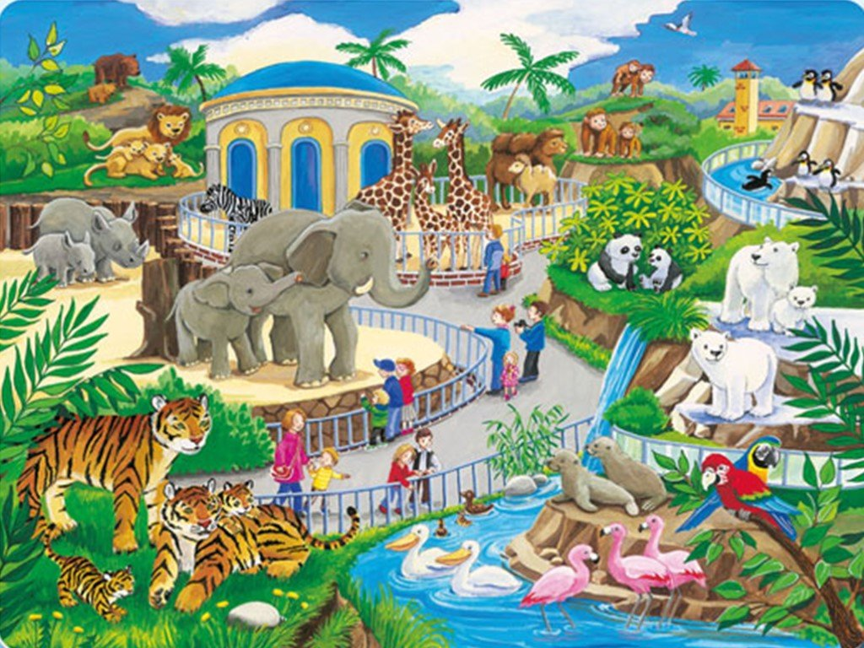
elephants?

Slide 2
rhinos?

Slide 3
tigers?

Slide 4
lions?

Slide 5
bears?

Slide 6
zebras?

Slide 7
giraffes?

Slide 8
camels?

Slide 9
monkeys?

Slide 10
penguins?

Slide 11
pandas?

Slide 12
polar bears?

Slide 13
seals?

Slide 14
parrots?

Slide 15
pelicans?

Slide 16
flamingos?

Slide 17
ducks?

