Slide 1
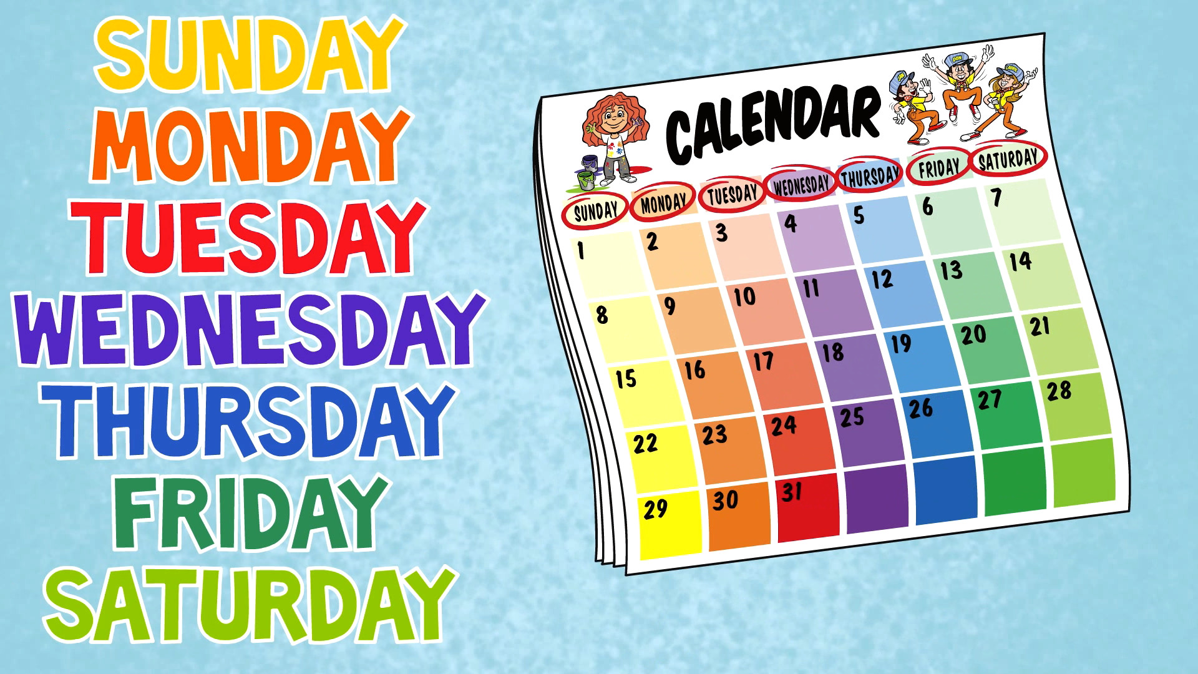




IrinaPapakhinac

Slide 2


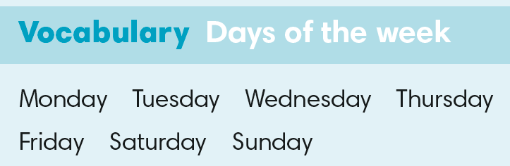

Slide 3
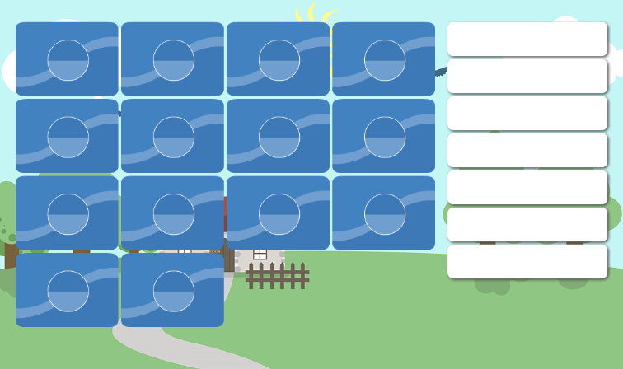
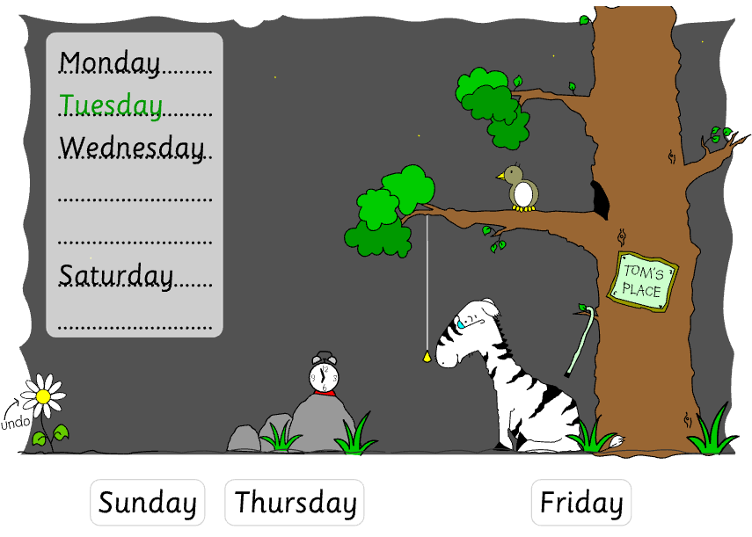

Slide 4
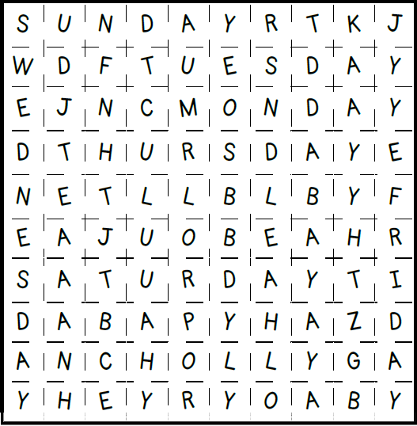
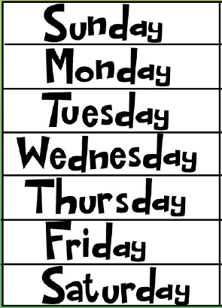

Slide 5
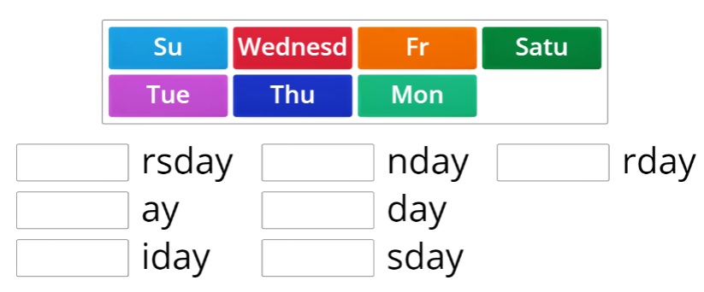
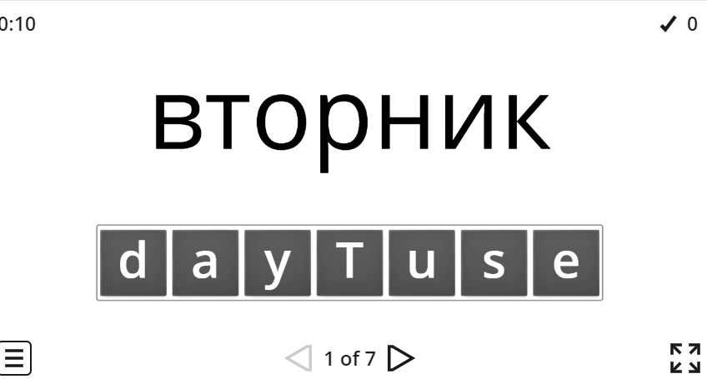

Slide 6


1. What do you do on Monday?
2. What do you do on Tuesday?
3. What do you do on Wednesday?
4. What do you do on Thursday?
5. What do you do on Friday?
6. What do you do on Saturday?
7. What do you do on Sunday?

Slide 7
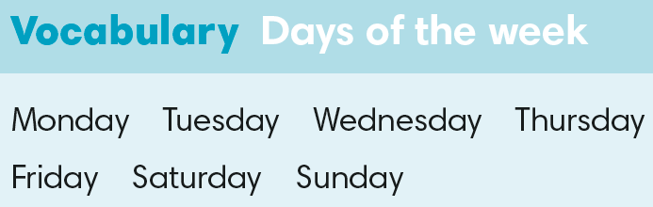
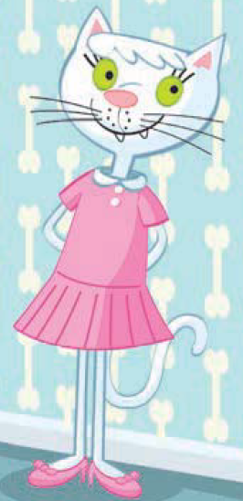
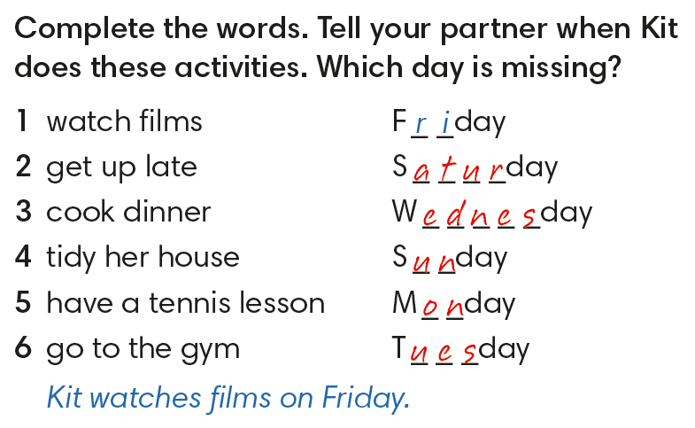
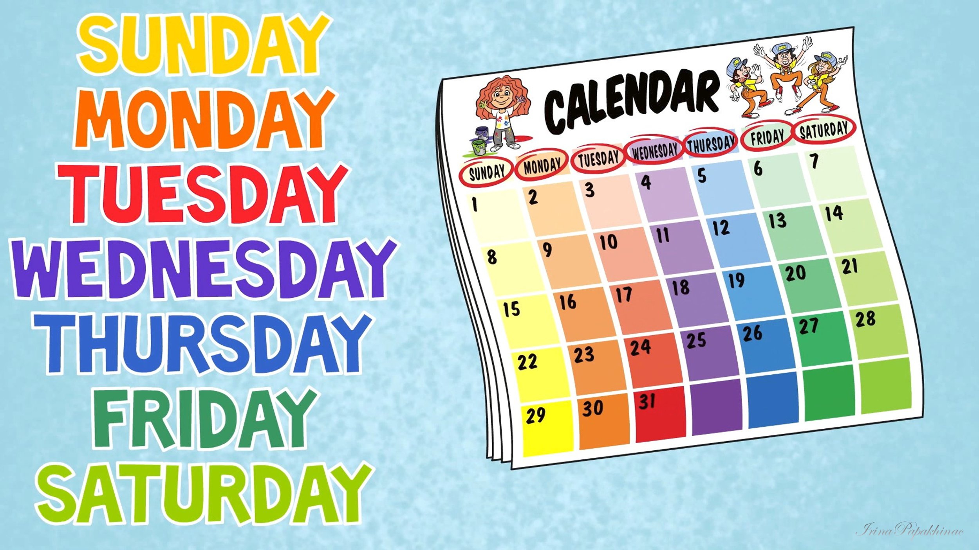

Slide 8
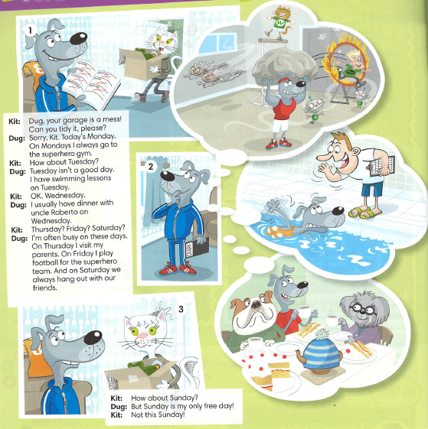

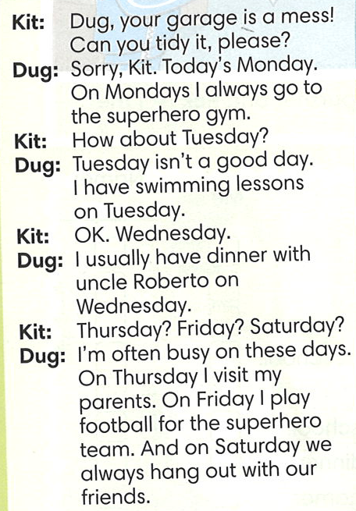
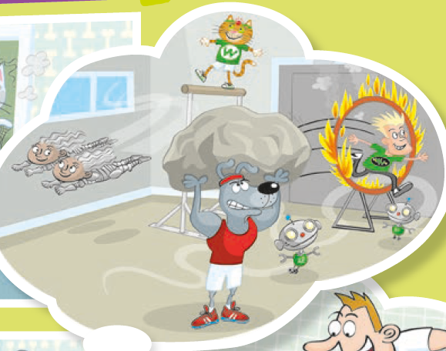
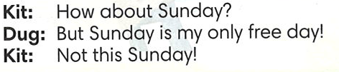
Look at the picture.
GUESS
Where is Dug?
When does he go there?
2. Read and check your answers.

Slide 9
Match the days to activities.
Monday
Tuesday
Wednesday
Thursday
Friday
Saturday
Sunday
Day off
Hang out with friends
Have dinner with Uncle Roberto
Have swimming lessons
Go to superhero gym
Play football
Visit his parents
Tell about Dug’s week.
On Monday Dug goes to the superhero gym.
On Tuesday he …

Slide 10
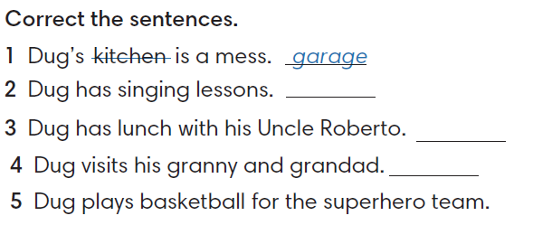
swimming
dinner
parents
football

Slide 11
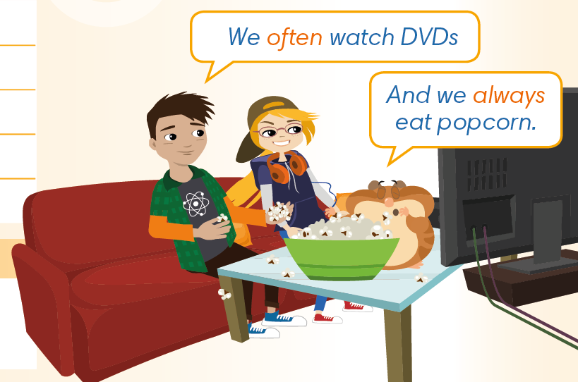

GUESS
What else do they do at weekends?
Watch the video and check your answers.

Slide 12
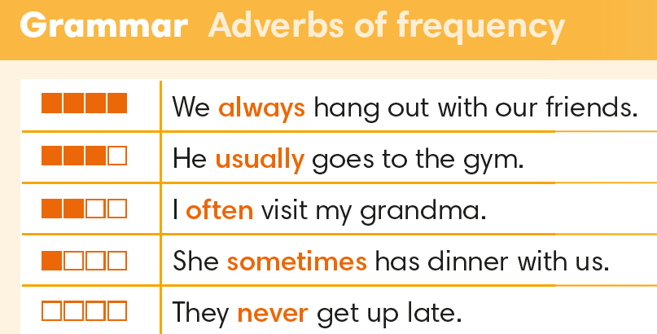

Slide 13
How often do you do these activities on these days?
I often watch TV on Friday.

Slide 14
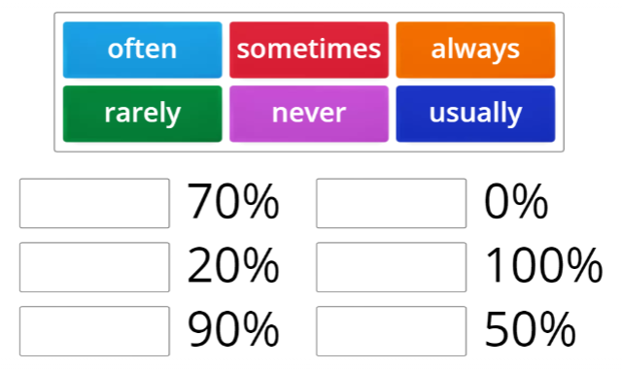
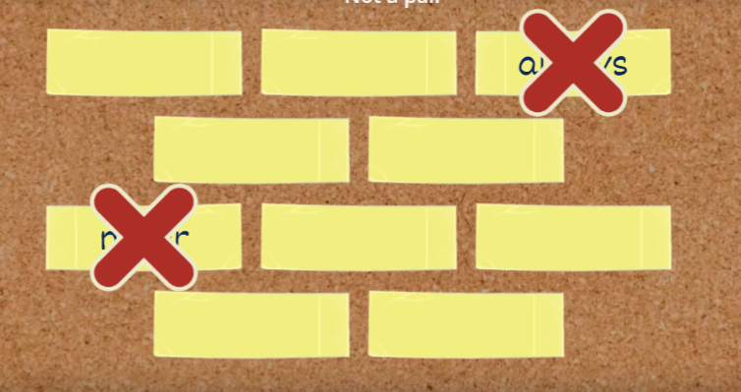

Slide 15
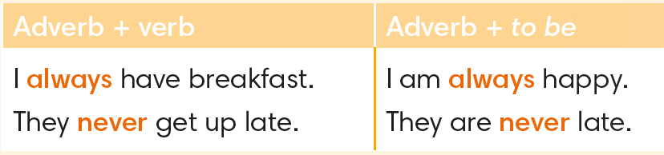


Slide 16
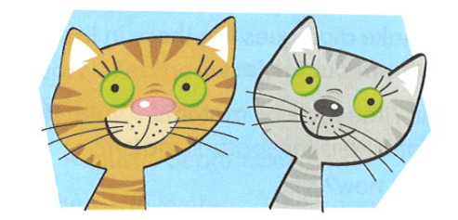
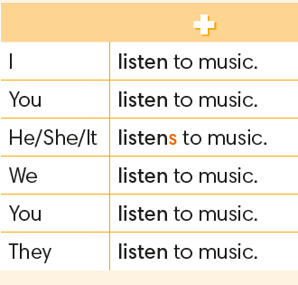

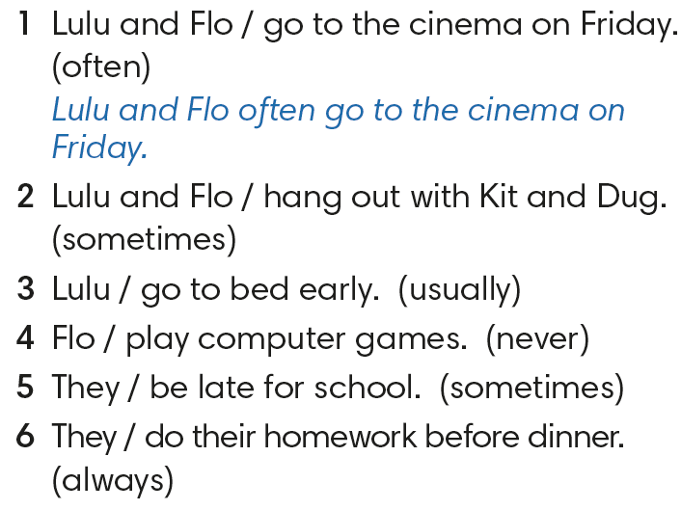
2. Lulu and Flo sometimes hang out with Kit and Dug.
3. Lulu usually goes to bed early.
Flo never plays computer games.
5. They are sometimes late for school.
6. They always do their homework before dinner.

Slide 17
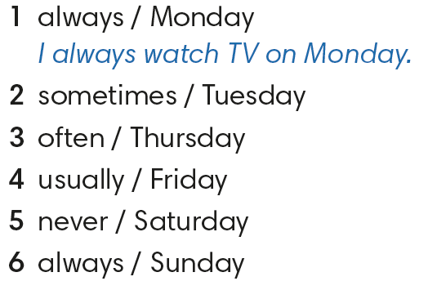
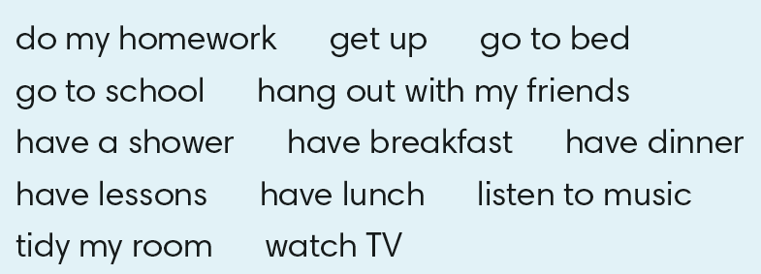
Make sentences that are true for you.

Slide 18
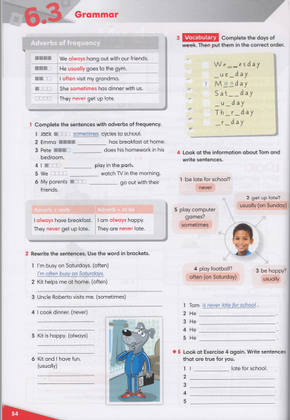



Slide 19
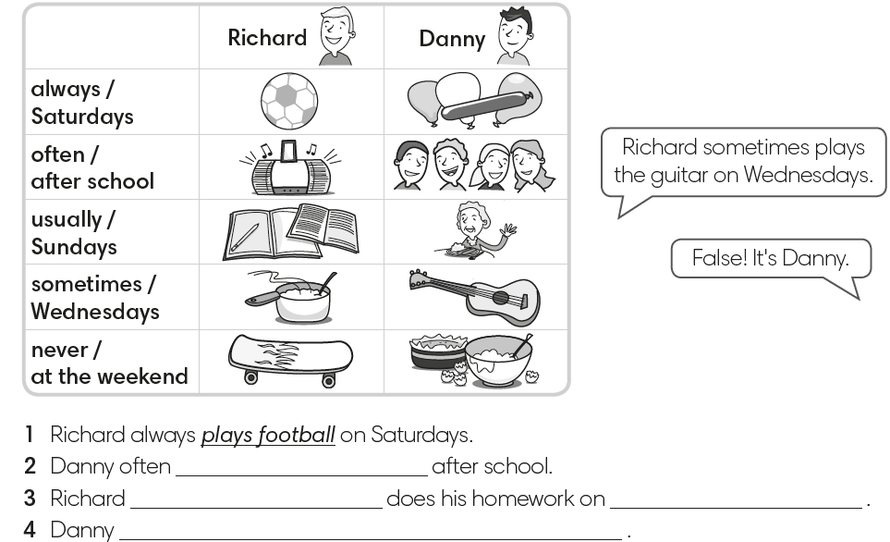
Match the activities to pictures a – j.
a
f
make a cake
do homework
b
g
have dinner with granny
go to a party
c
h
listen to music
make breakfast
d
play football
i
play the guitar
e
skateboard
j
sing songs

Slide 20
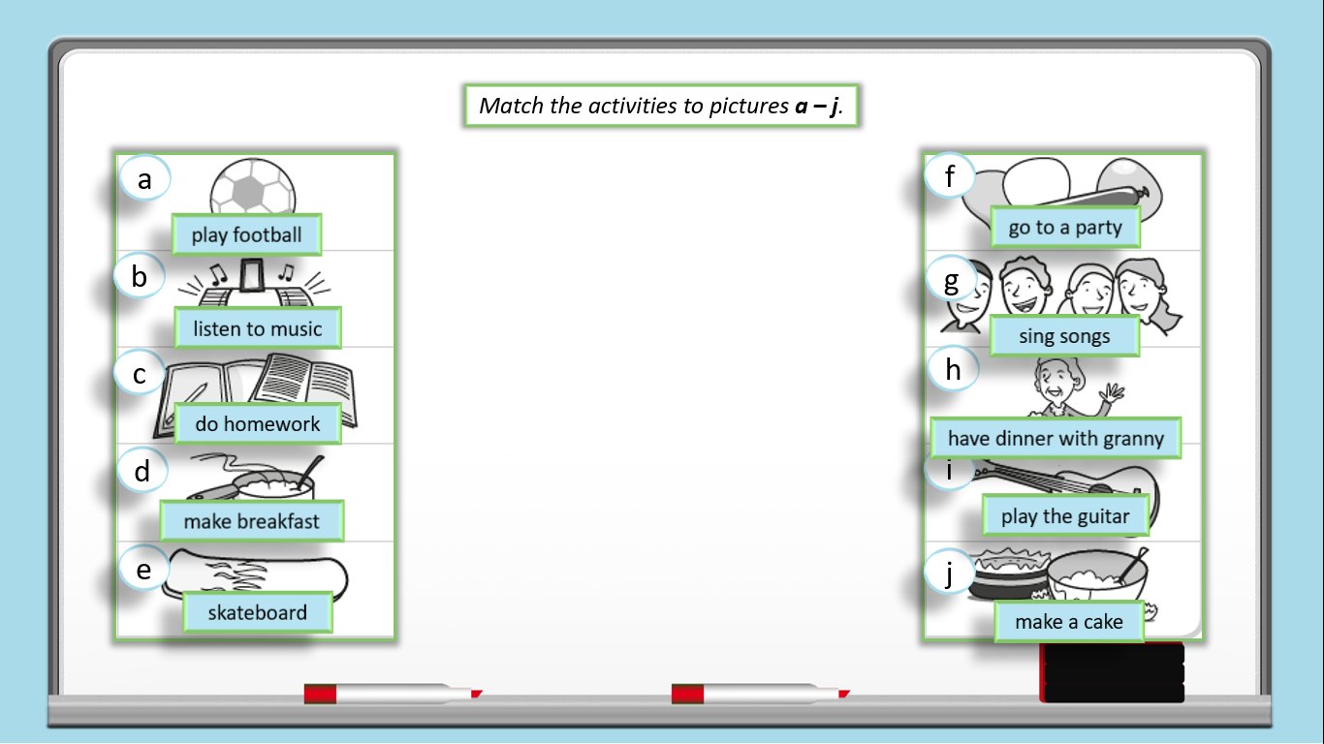
GUESS
What do they do?

