Slide 1
Academy Stars 2
Unit 1
Speaking / Writing

Slide 2
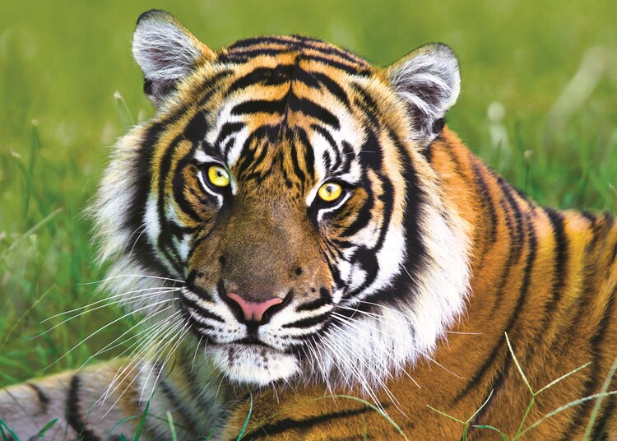
This is a tiger.
There are tigers in China and India.
There aren’t any tigers in Australia.
Tigers are orange, black and white.
They’ve got long tails.
They can jump and swim.

Slide 3
This is a tiger.
There are tigers in China and India.
There aren’t any tigers in Australia.
Tigers are orange, black and white.
They’ve got long tails.
They can jump and swim.

Slide 4
Ex. 2, p. 17

Slide 5
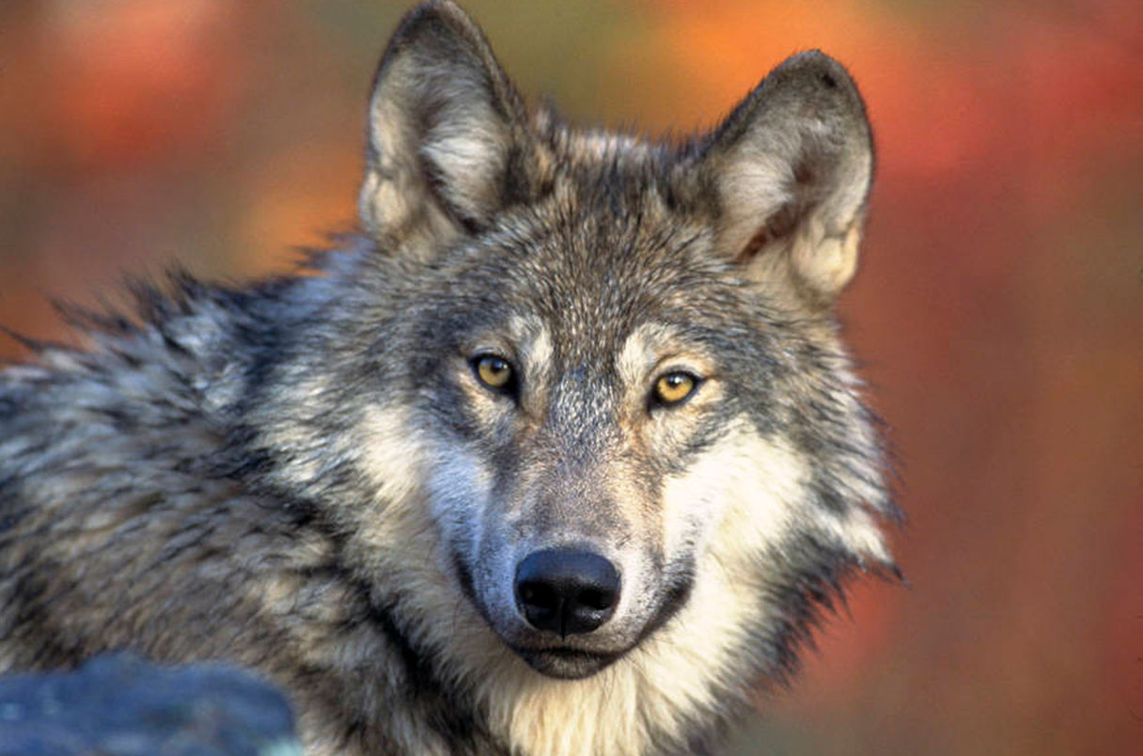
This is a wolf.
There are wolves in Russia, Canada, India and China.
There aren’t any wolves in Australia.
Wolves are grey, black, white and brown.
They’ve got long tails.
They can run very fast.
They eat birds and fish.
Russia, Canada, India and China √
Australia X
grey, black, white, brown √
long tails √
run √
birds and fish √

Slide 6
This is a wolf.
There are wolves in …
There aren’t any wolves in…
Wolves are …
They’ve got …
They can …
They eat …
Russia, Canada, India and China √
Australia X
grey, black, white, brown √
long tails √
run √
birds and fish √

Slide 7
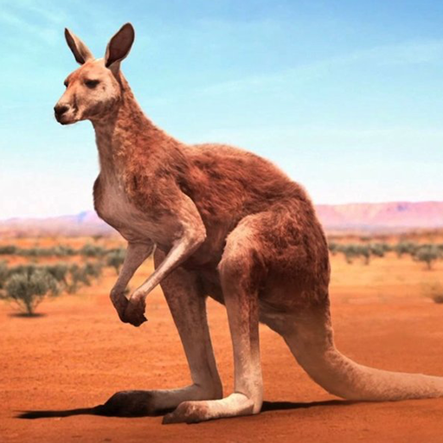
Australia √
Russia X
brown or grey √
long tails and big legs √
jump and run √
plants and leaves √
This is a kangaroo.
There are kangaroos in …
There aren’t any kangaroos in…
Kangaroos are …
They’ve got …
They can …
They eat …

Slide 8
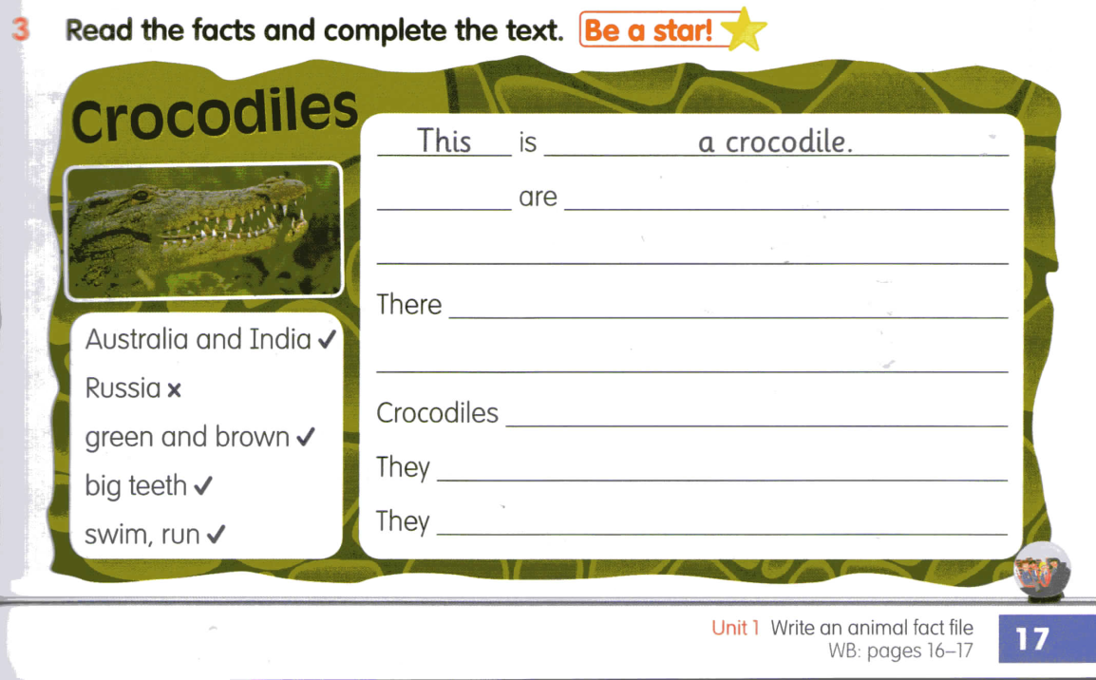
There
crocodiles in Australia and India
aren’t any crocodiles in Russia.
are green and brown.
‘ve got big teeth.
can swim and run.

