Slide 1
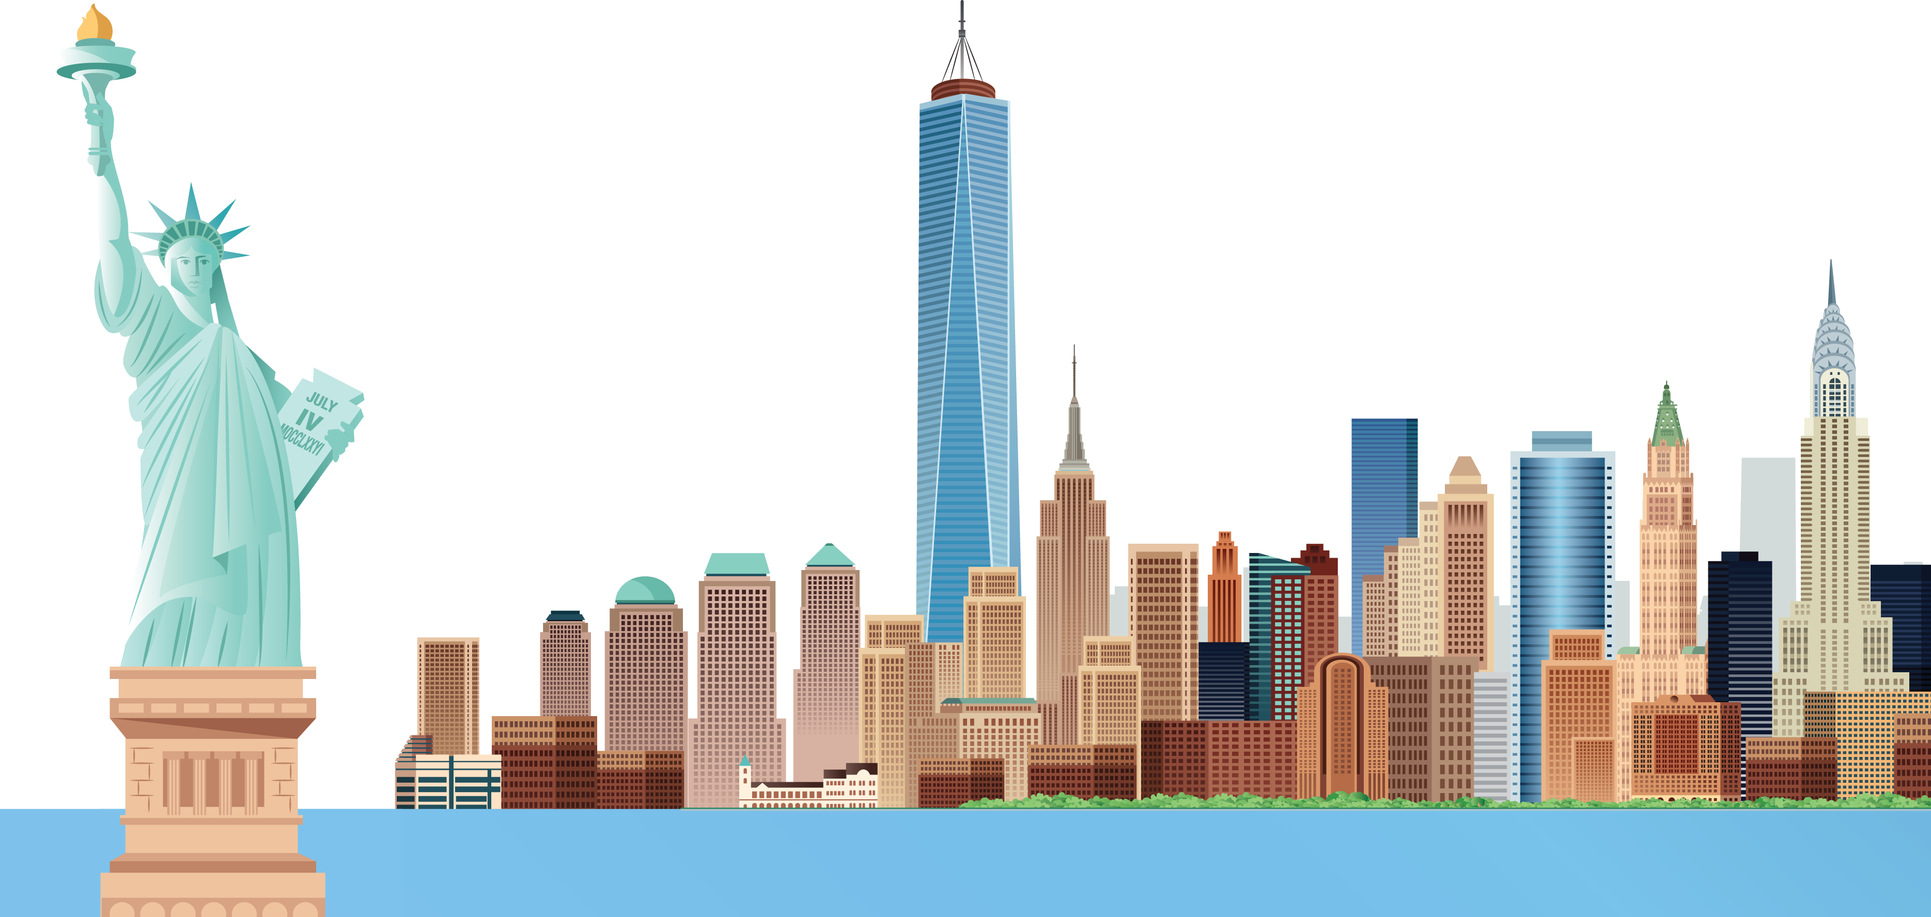
1. He lives in New York. –
Where does he live ?

Slide 2

2. He goes to Big Ben School.

Slide 3
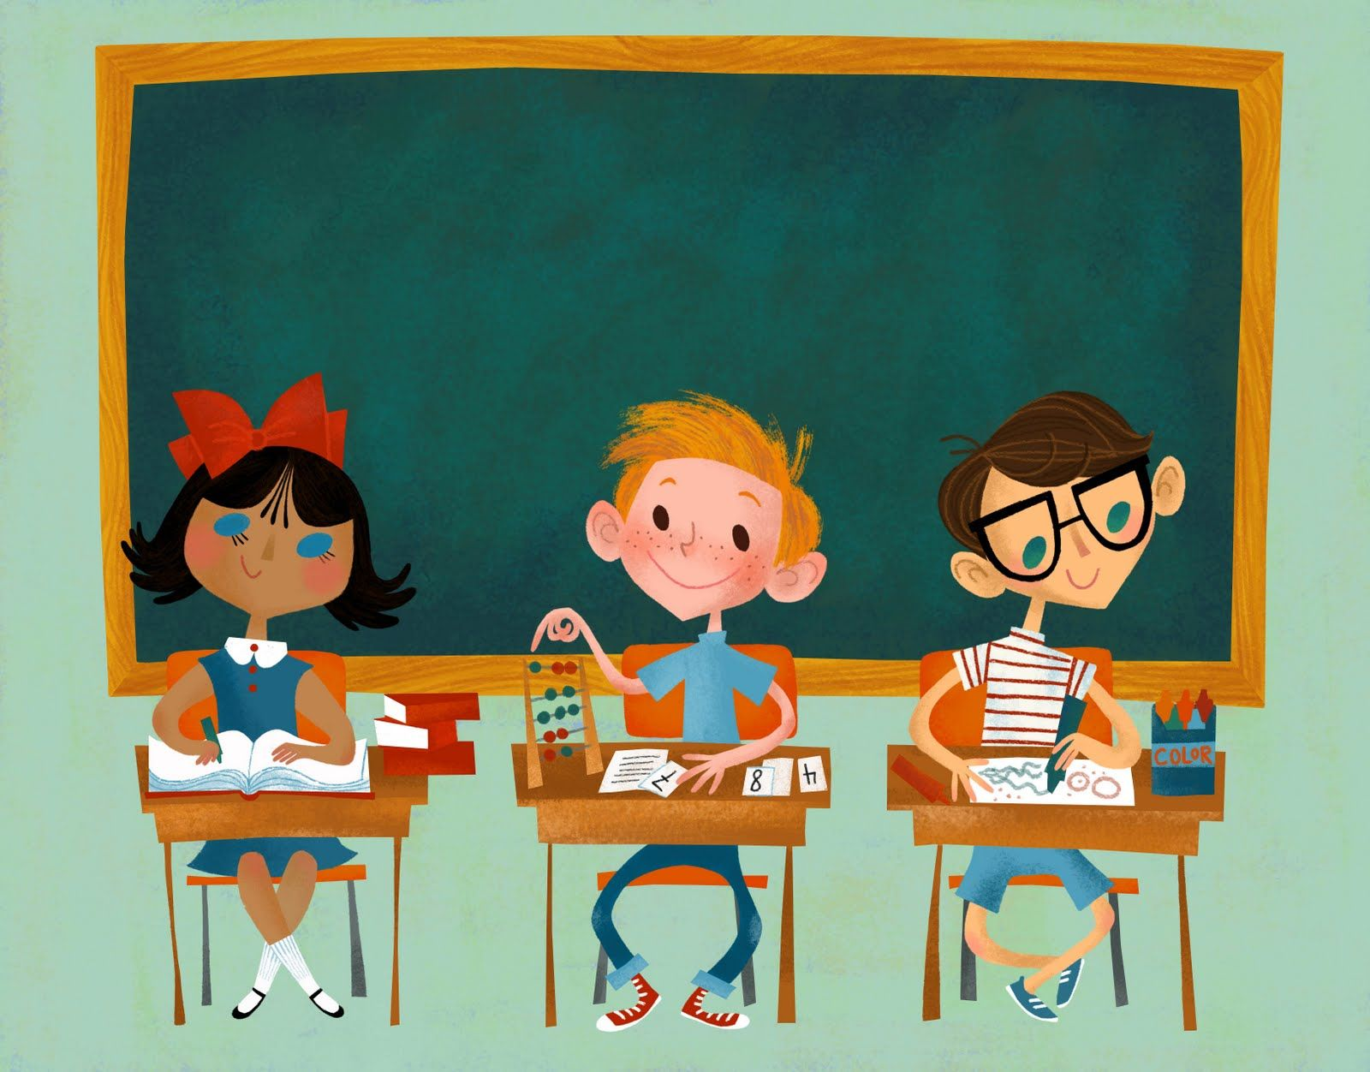
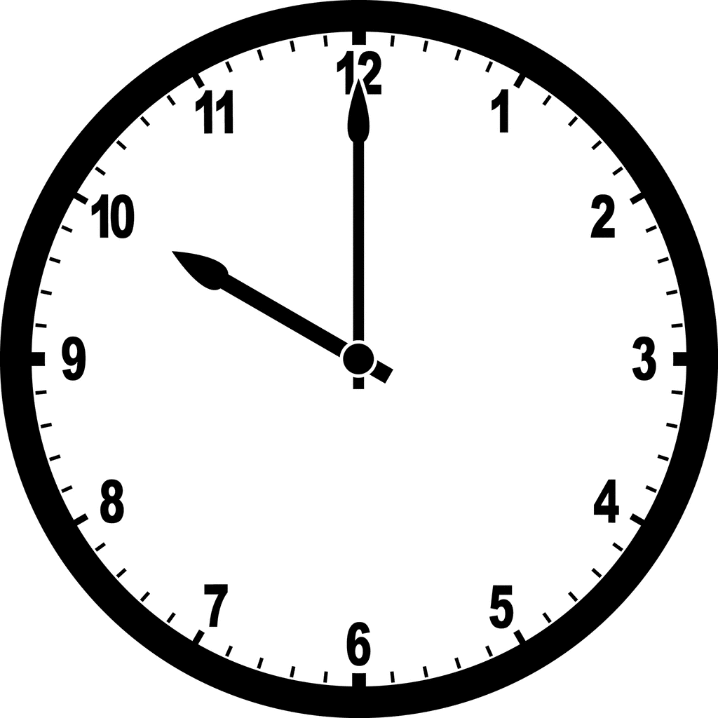
3. He starts at 10 o’clock.

Slide 4
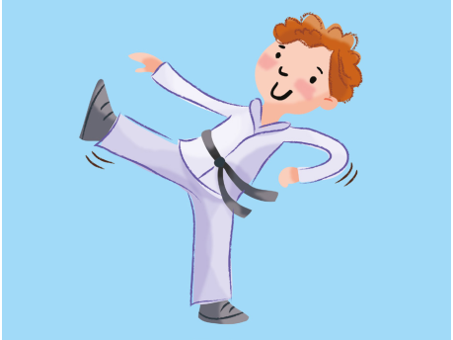
4. He does karate.

Slide 5
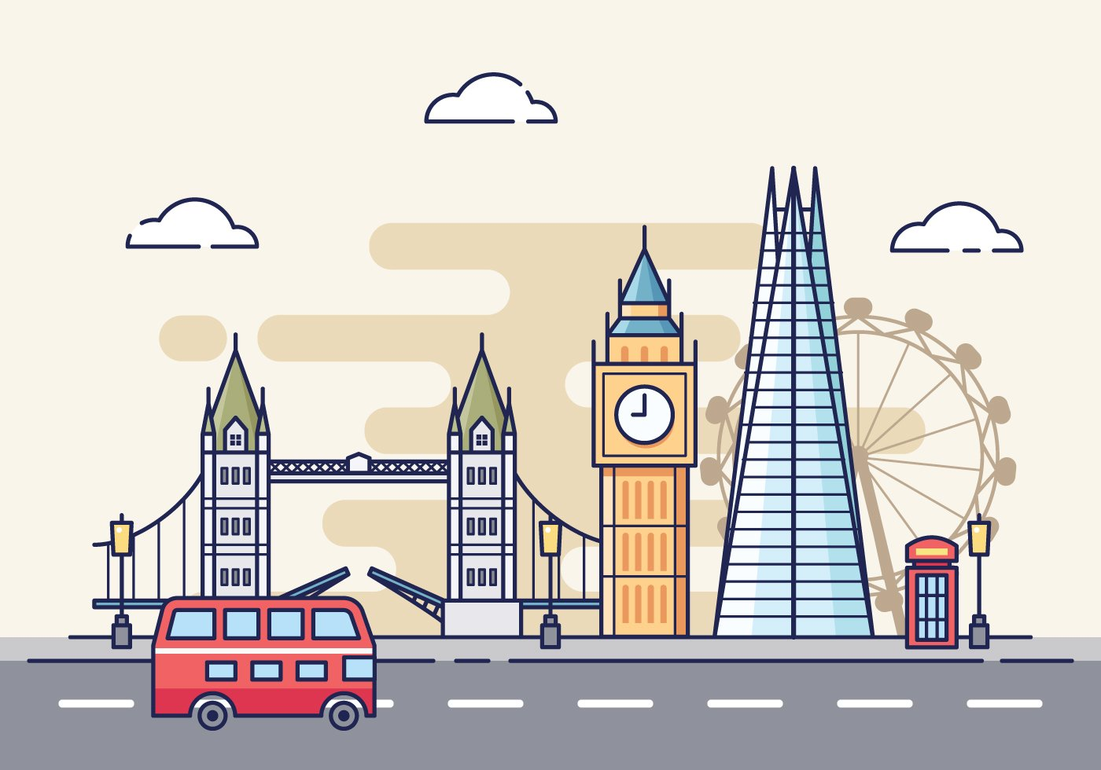
5. She lives in London.

Slide 6
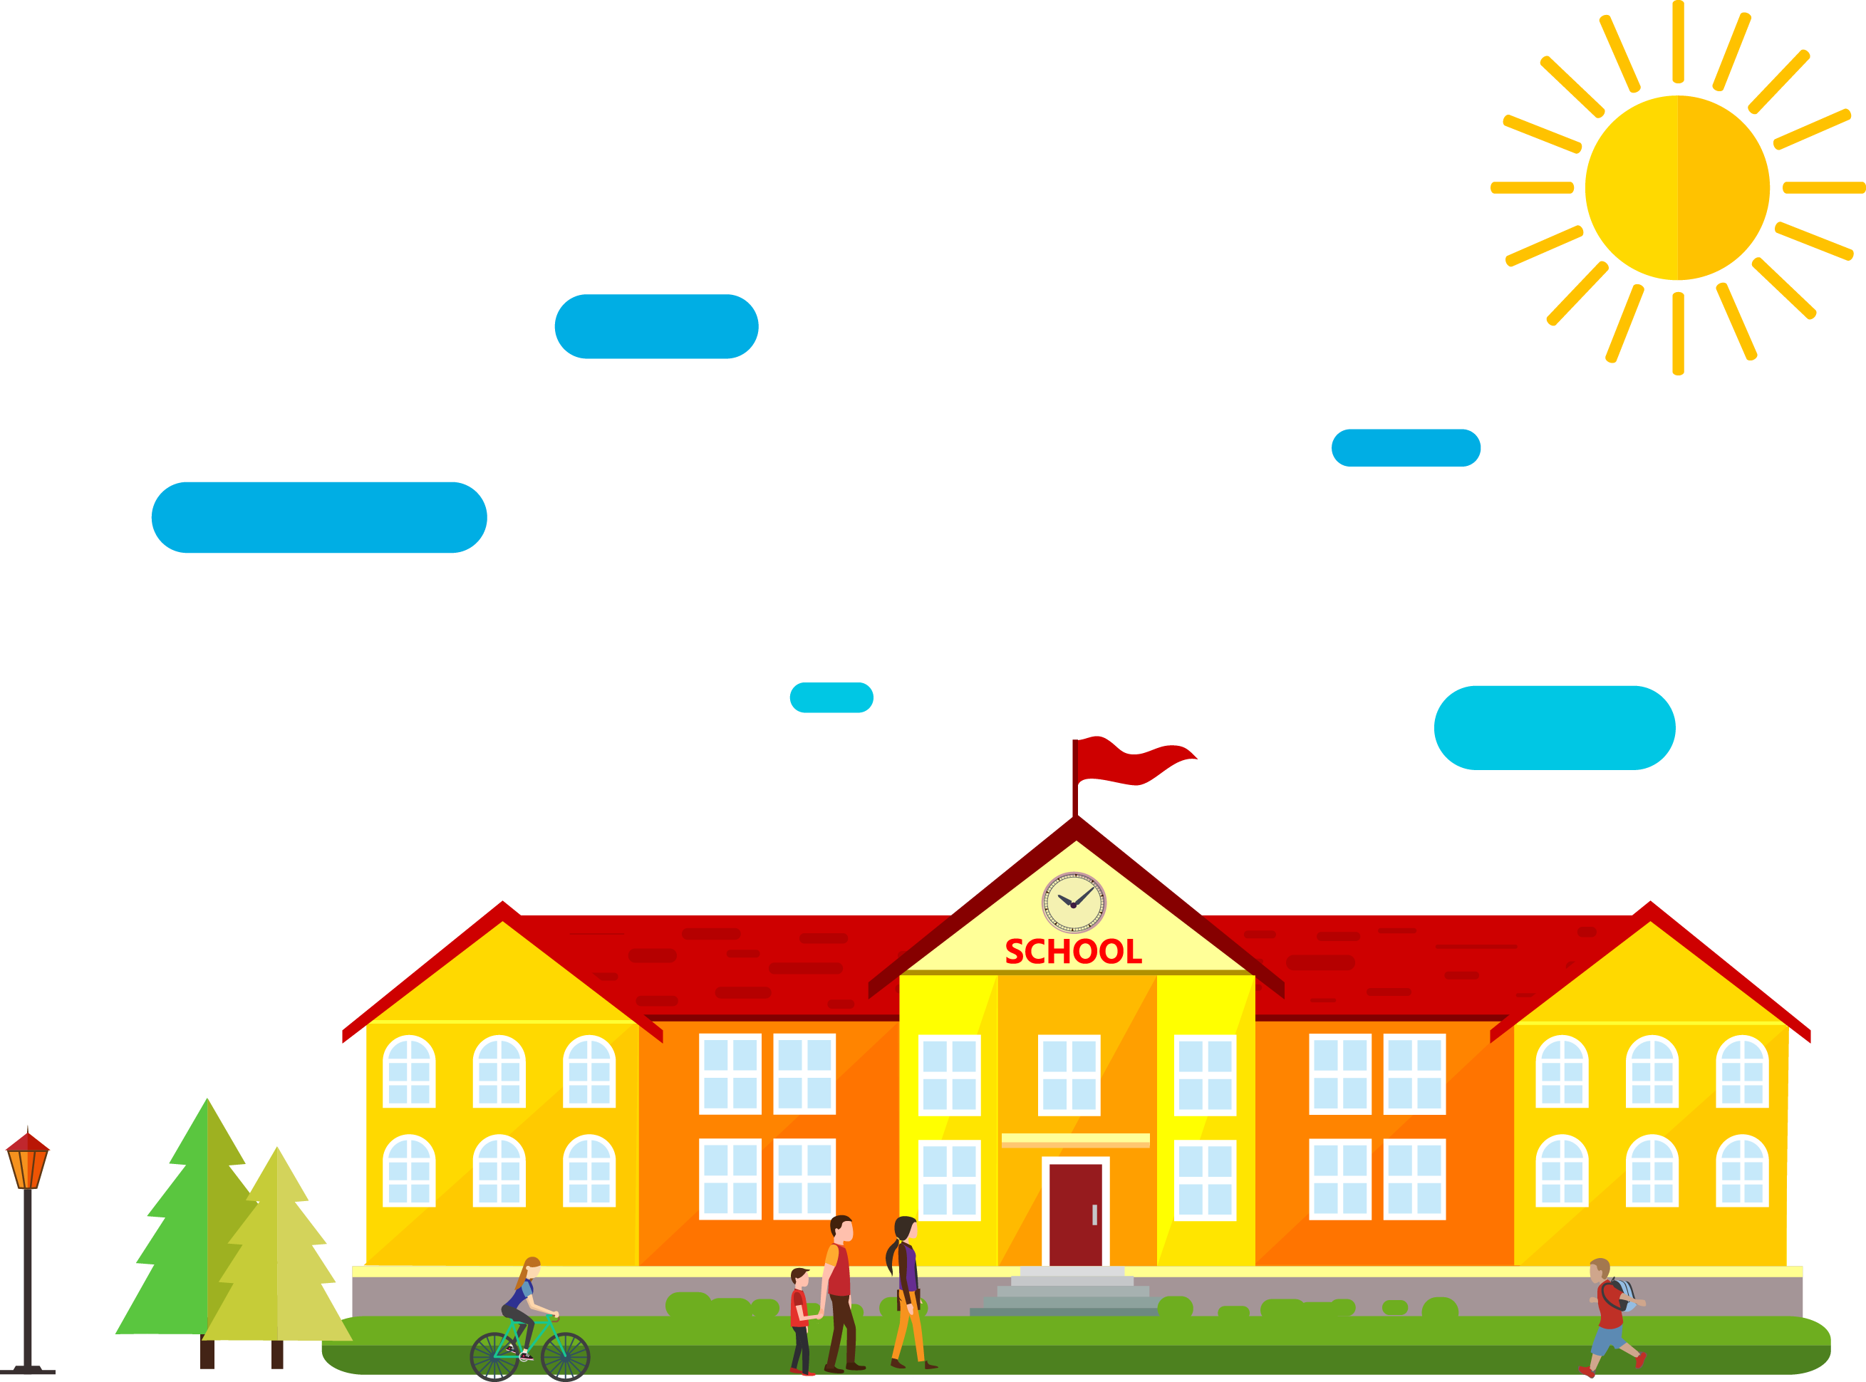
6. She goes to London School.

Slide 7
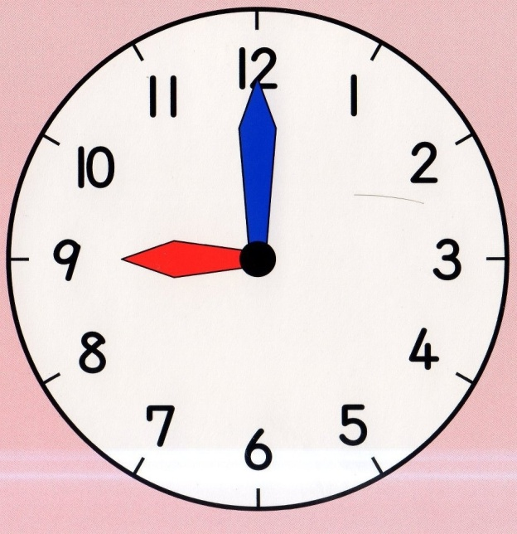
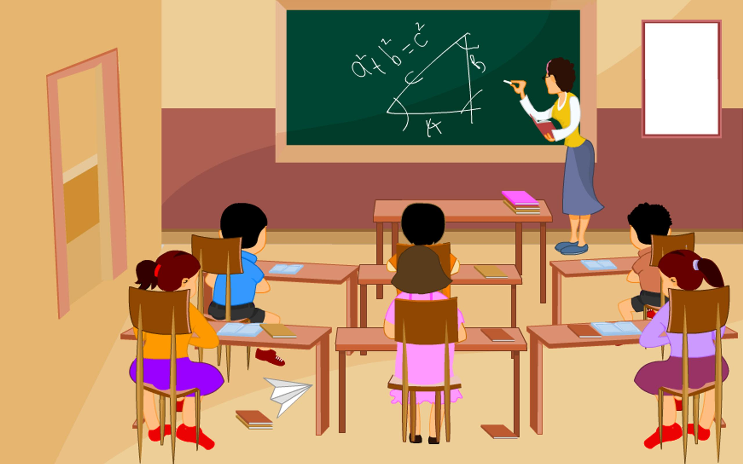
7. She starts at 9 o’clock.

Slide 8
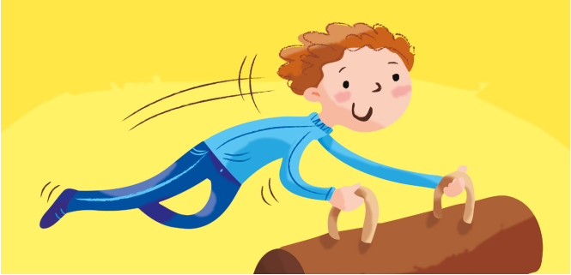
8. She does gymnastics.

Slide 9
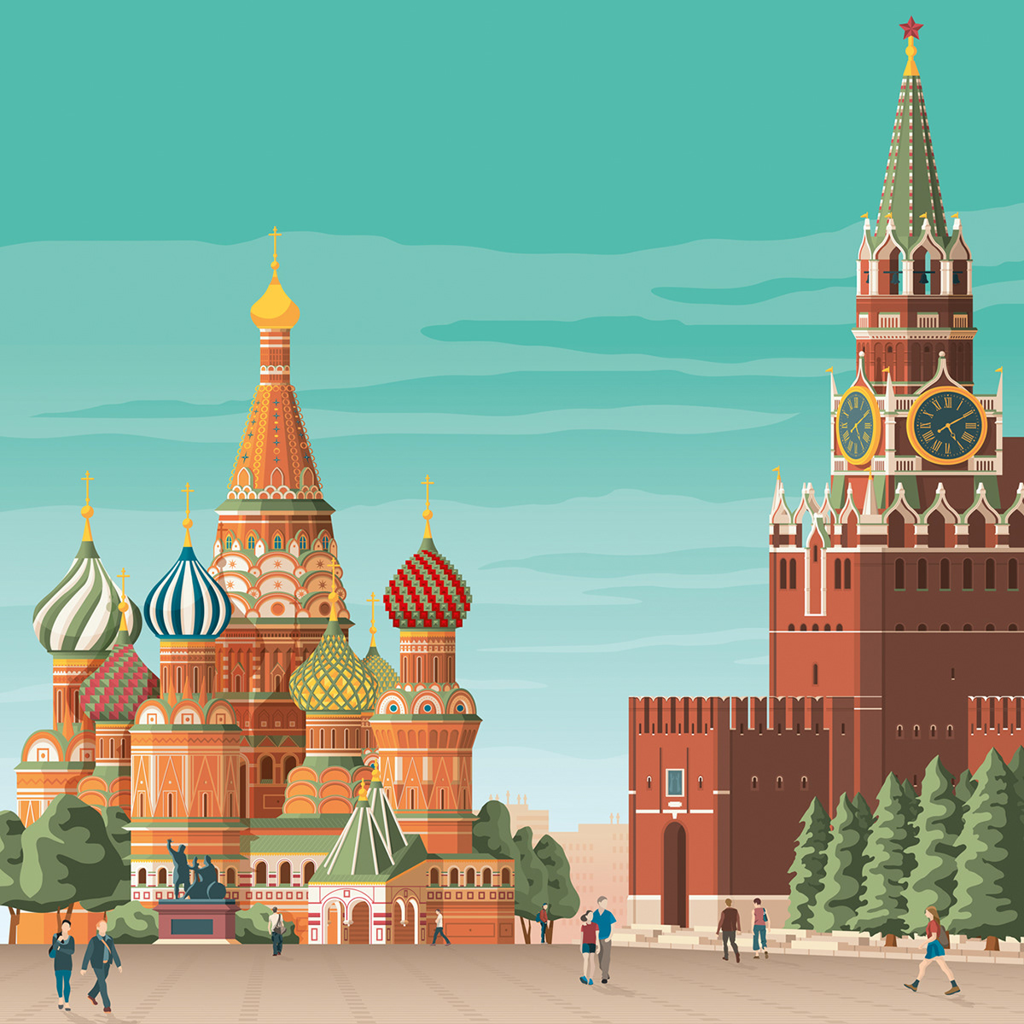
9. He lives in Moscow.

Slide 10
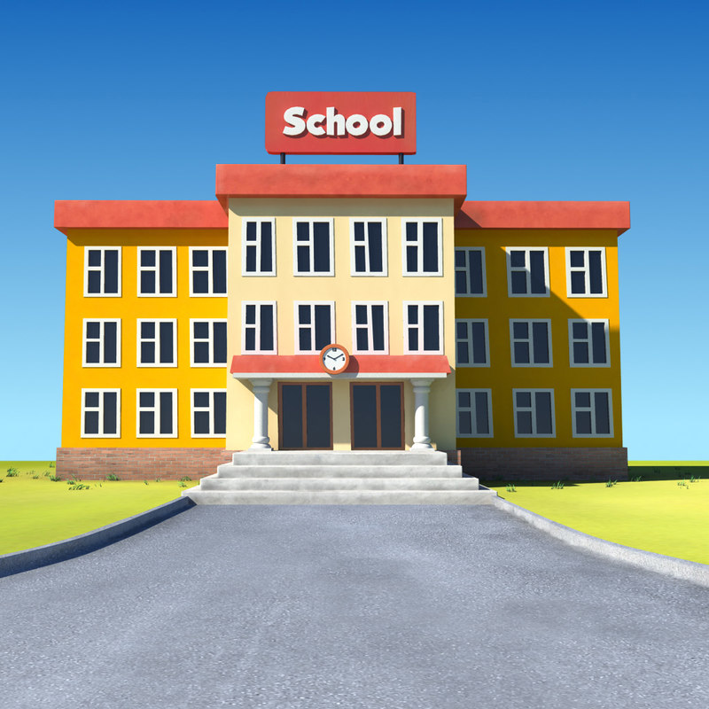
10. He goes to School 134.

Slide 11
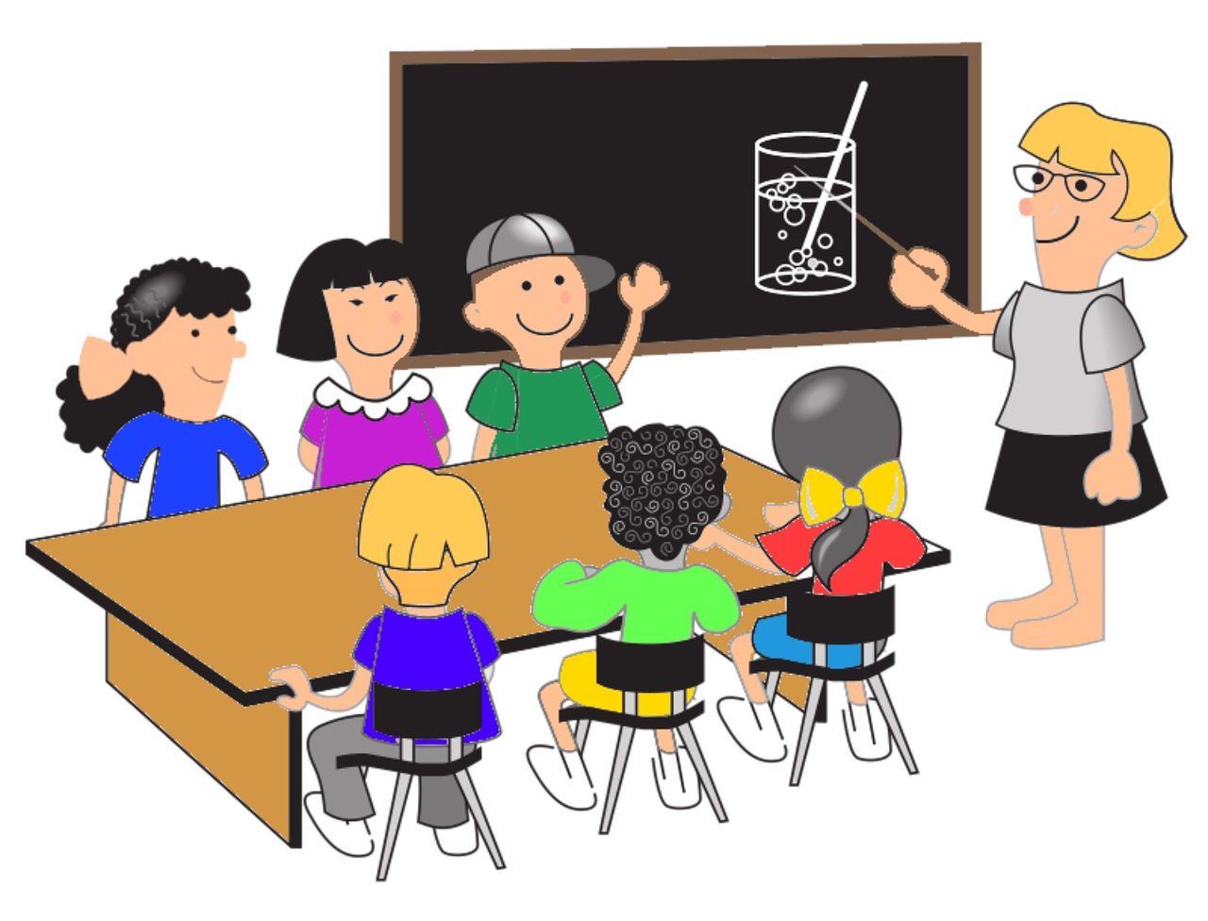
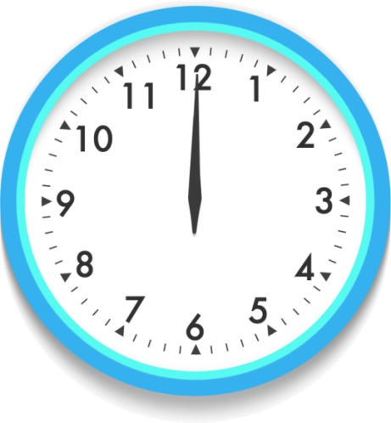
11. He starts at 12 o’clock.

Slide 12
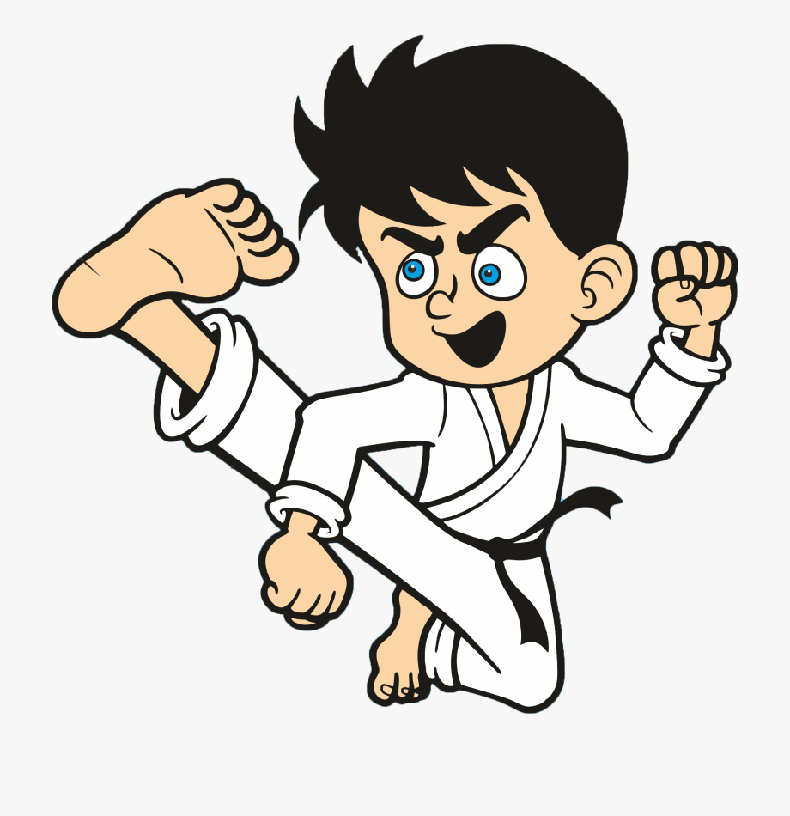
12. He does judo.

