Slide 1
Comparison

Slide 2
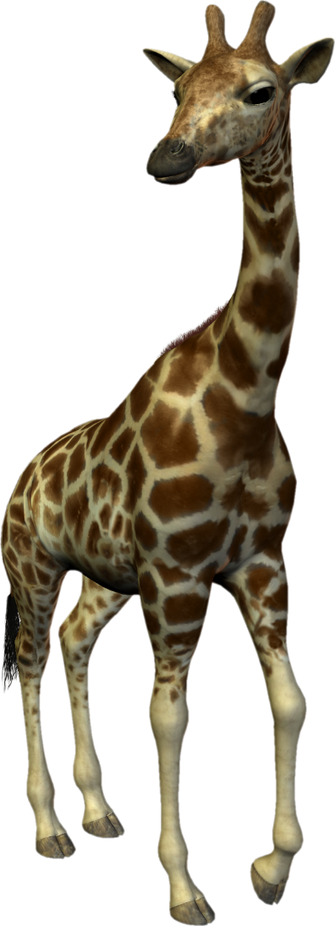
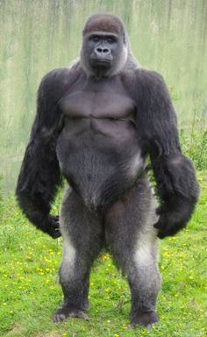
A giraffe is taller than a gorilla.

Slide 3

A gorilla is taller than a chimpanzee.

Slide 4

The giraffe is the tallest of the three animals.

Slide 5
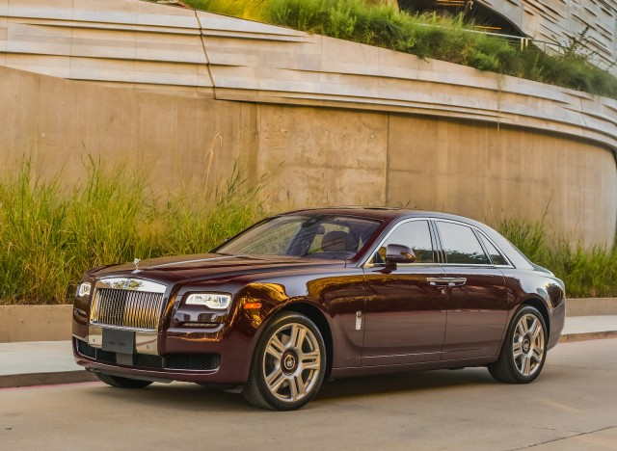
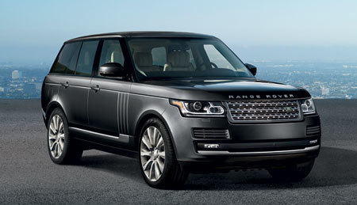

A Rolls Royce is more expensive than a Range Rover.
Ł 74,950

Slide 6
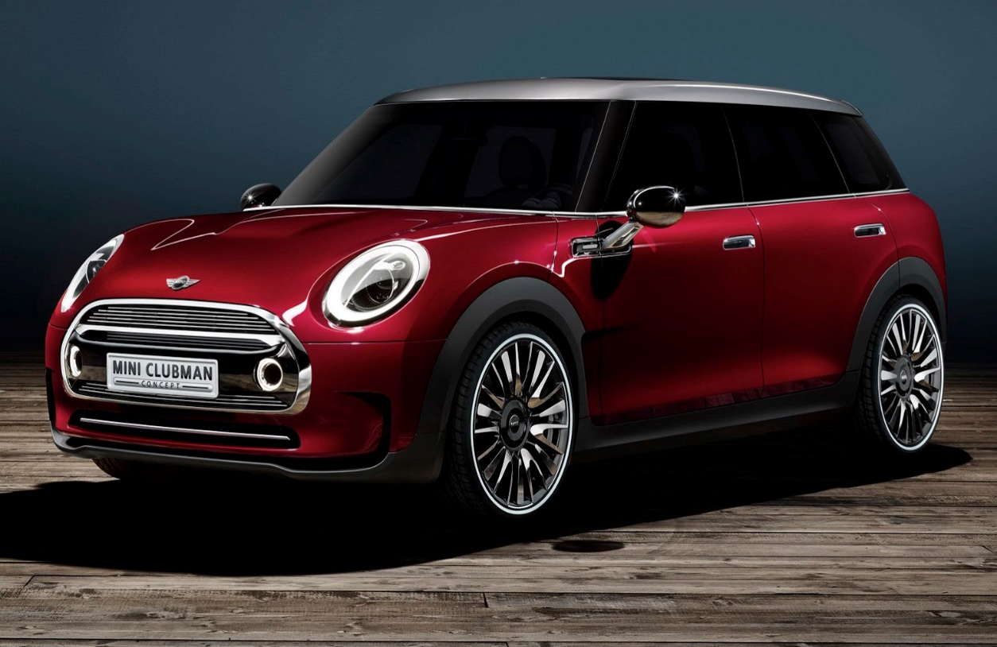

A Range Rover is more expensive than a Mini.
Ł 19,995

Slide 7

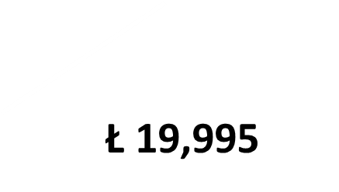


The Rolls Royce is the most expensive of the three cars.

Slide 8
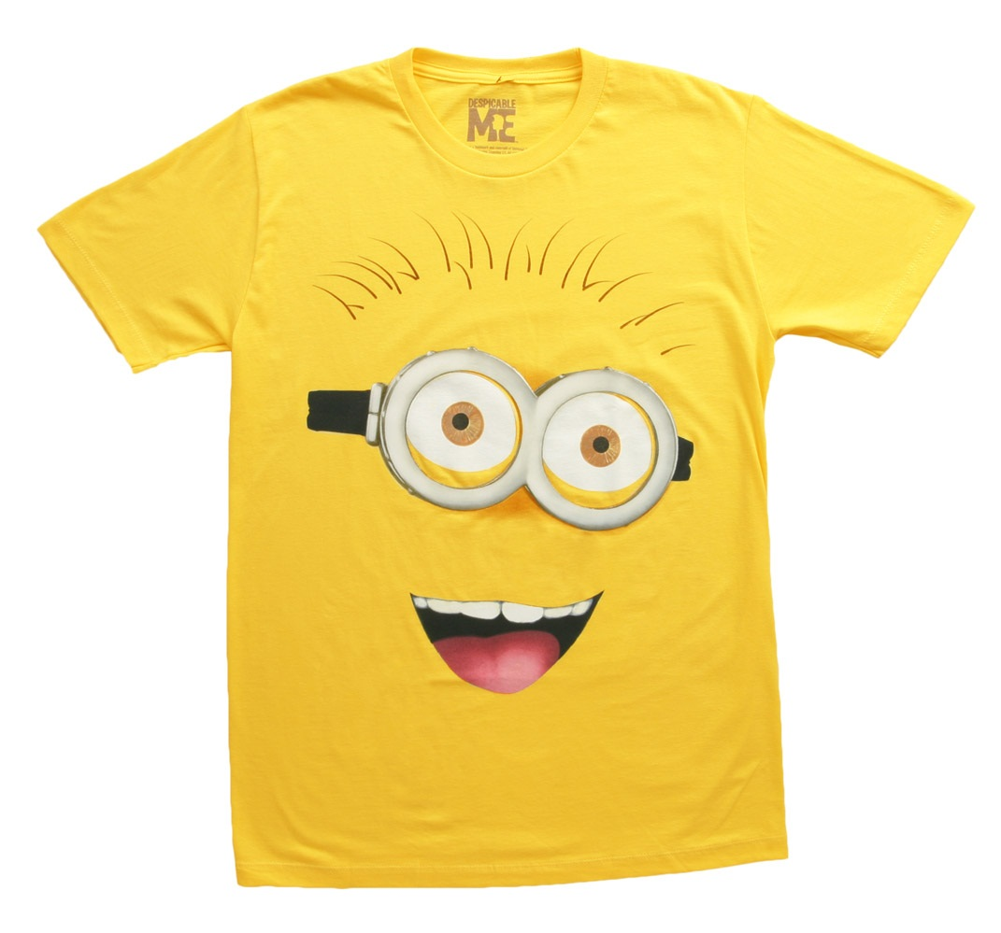
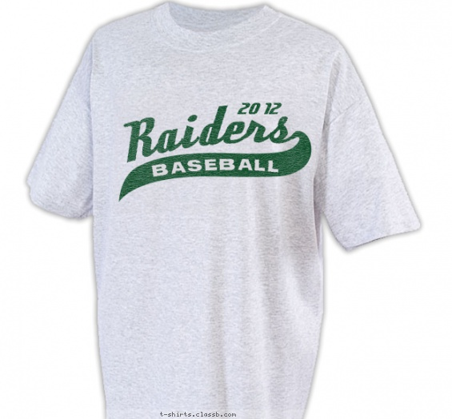

The white T-shirt is a bit cheaper than the yellow one.
Ł10.00
Ł9.50

Slide 9
The yellow T-shirt is a bit more expensive than the white one.
Ł10.00
Ł9.50

Slide 10
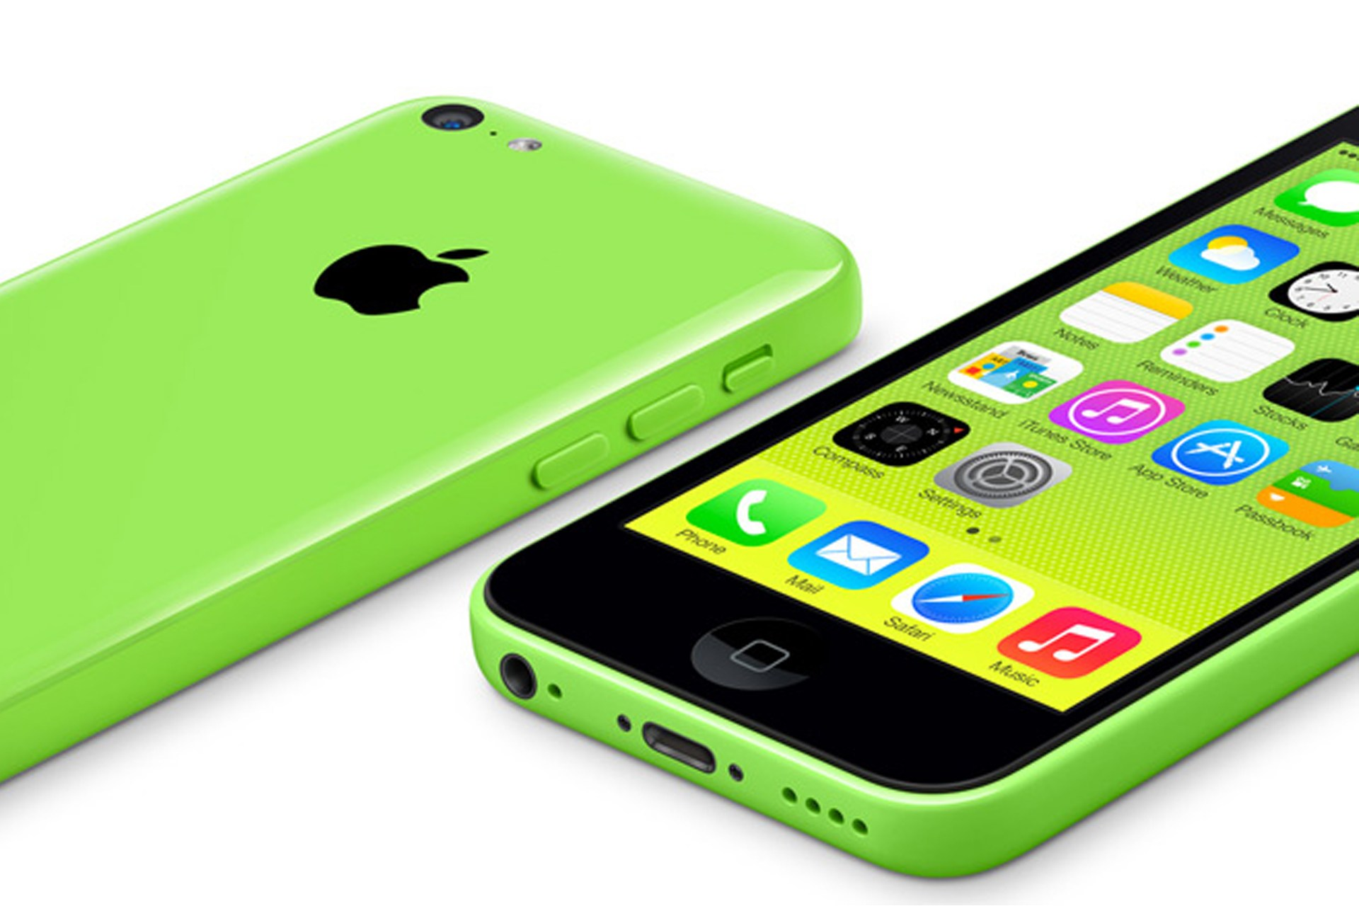
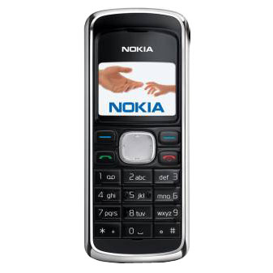
An iphone 6 is a lot more expensive than a
Nokia 2135.
Ł 499
Ł 50

Slide 11
A Nokia 2135 is a lot cheaper than an iphone 6 .
Ł 499
Ł 50

Slide 12
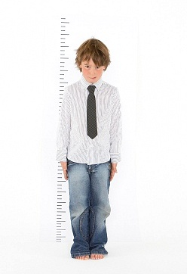
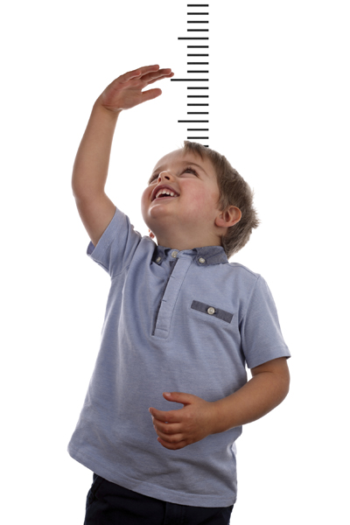
Tim is as tall as Tom.
Tom
Tim
142 cm
142 cm

Slide 13
Similes
As deaf as a post
As difficult as nailing jelly to a tree
As dry as a bone
As dull as dishwater
As easy as ABC
As fit as a fiddle
As flat as a pancake
As free as a bird
As fresh as a daisy
As gentle as a lamb
As good as gold
As happy as a dog with two tails
As hard as nails
As heavy as lead
As helpless as a baby
As honest as the day is long
As hot as blue blazes
As hungry as a bear
As innocent as a lamb
As large as life
As light as a feather
As long as a month of Sundays
As loose as a goose
As mad as a hatter
As mad as a hornet
As nervous as a long tailed cat in a room full of rocking chairs
As straight as an arrow
As strong as an ox
As stubborn as a mule
As nutty as a fruitcake
As old as the hills
As pale as death
As plain as the nose on your face
As playful as a kitten
As pleased as Punch
As proud as a peacock
As quick as lightning
As quiet as a church mouse
As regular as clockwork
As scarce as hen's teeth
As sharp as a razor
As sick as a dog
As silent as the grave
As slippery as an eel
As slow as molasses in January
As sly as a fox
As smooth as a baby's bottom
As snug as a bug in a rug
As solid as the ground we stand on
As sour as vinegar
As steady as a rock
As stiff as a board
As sweet as pie
As tall as a giraffe
As thin as a rake
Read more at http://examples.yourdictionary.com/simile-examples-for-kids.html#SY31GB41YBj6fSxU.99
As American as apple pie
As big as an elephant
As black as coal
As blind as a bat
As bold as brass
As boring as watching paint dry
As brave as a lion
As bright as a button
As busy as a bee
As cheap as dirt
As clean as a whistle
As clear as mud
As clear as crystal
As cold as ice
As cool as a cucumber
As crooked as a dog's hind leg
As cunning as a fox
As cute as a bug's ear
As dead as a doornail
As wise as an owl
As tight as a drum
As timid as a rabbit
As tough as old boots
As useless as a chocolate teapot
As warm as toast
As welcome as a skunk at a lawn party
As white as snow

