Slide 1
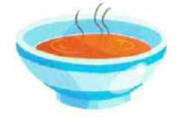
There ____ _____ soup.
Notes:
There is some soup.

Slide 2
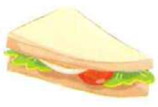
There ____ _____ sandwiches.

Slide 3
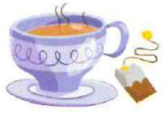
There ____ ____ tea.

Slide 4
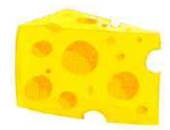
There ____ _____ cheese.

Slide 5
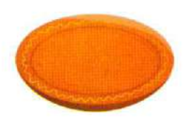
There ____ ____ plates.

Slide 6
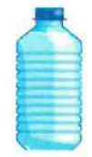
There ____ ____ bottles of water.

Slide 7
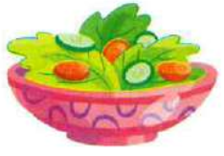
There ____ _____ salad.

Slide 8
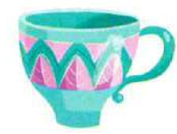
There ____ ____ cups.

Slide 9
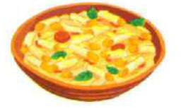
There _____ ______ pasta.

Slide 10
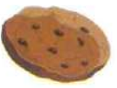
There _____ ____ biscuits.

