Slide 1
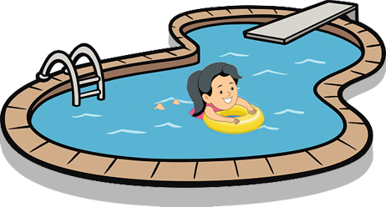
Where / you / swimming / are / ? swimming / in the swimming pool / am / I / .

Slide 2
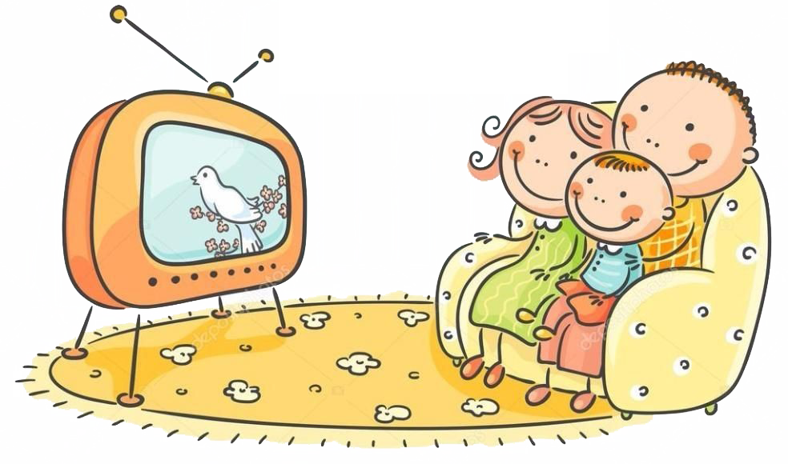
cartoons / watching / they / are / where / ? at home / they / watching / are / cartoons / .

Slide 3
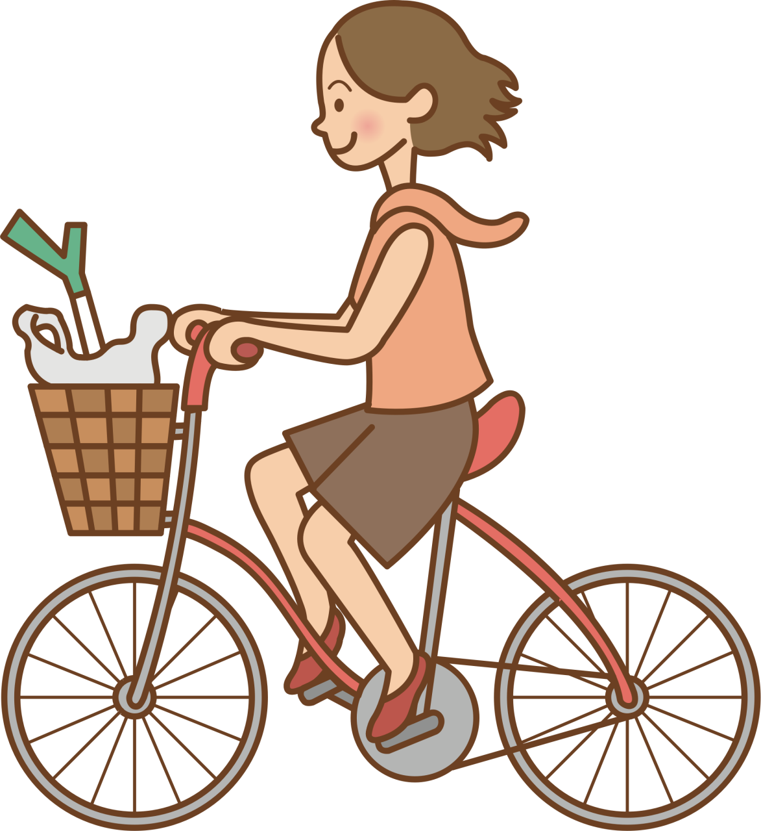
is / where / she / a / riding / bike / ? a / bike / in the park / riding / is / she /

Slide 4
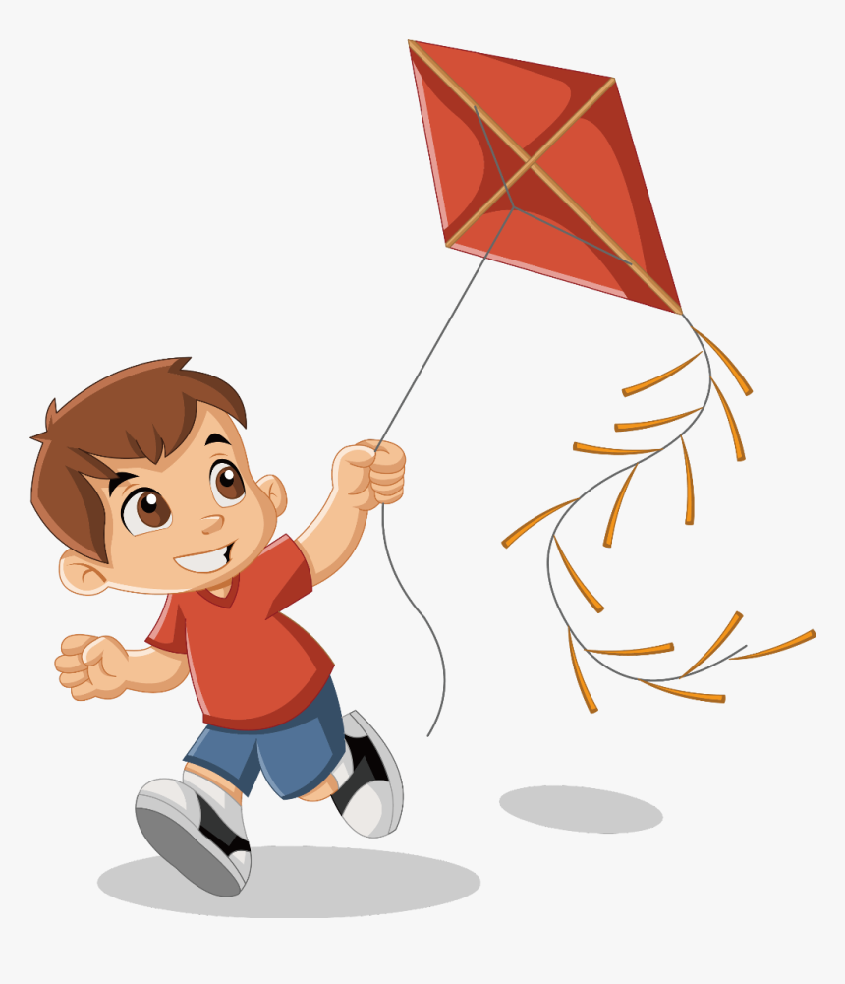
he / flying / where / is / kite / a / ? in the park / he / a / flying / kite / is / .

Slide 5
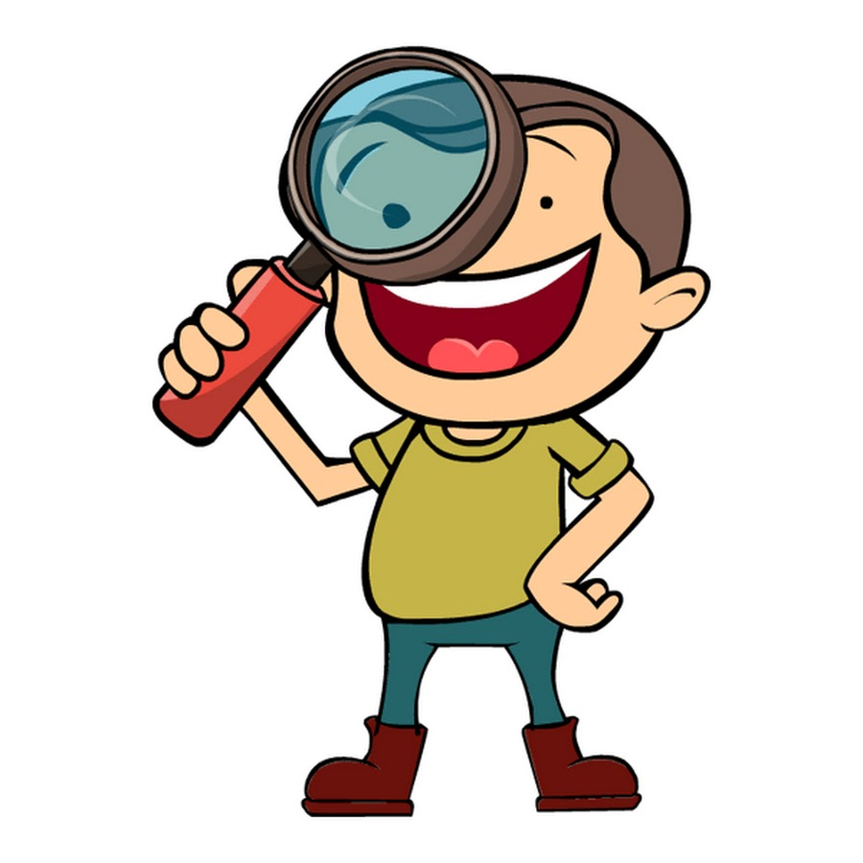
you / looking for / your friends / where/ are/? are/we / our friends / looking for / at school.

