Slide 1
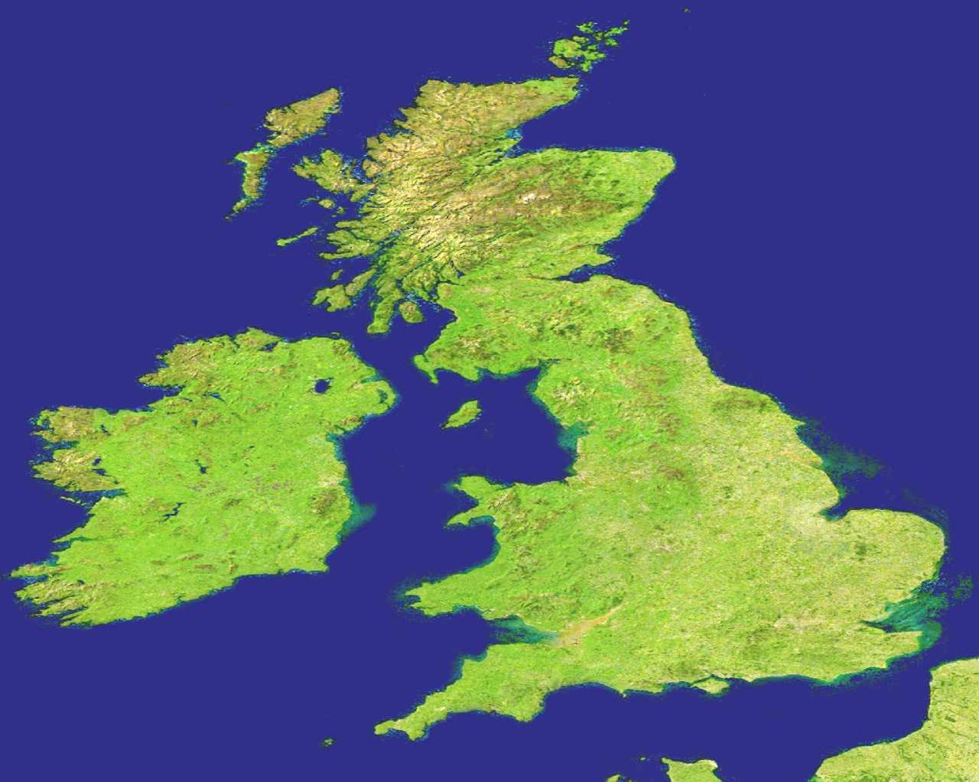

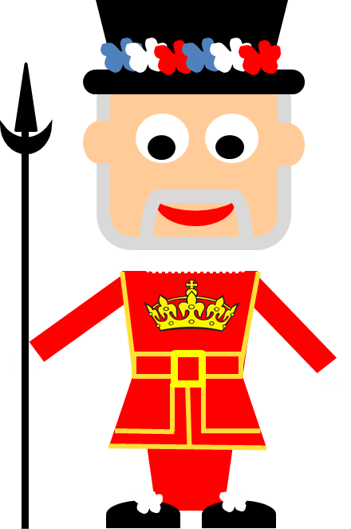

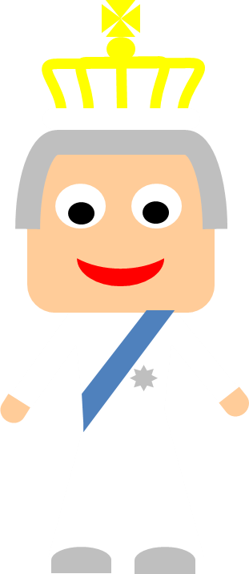
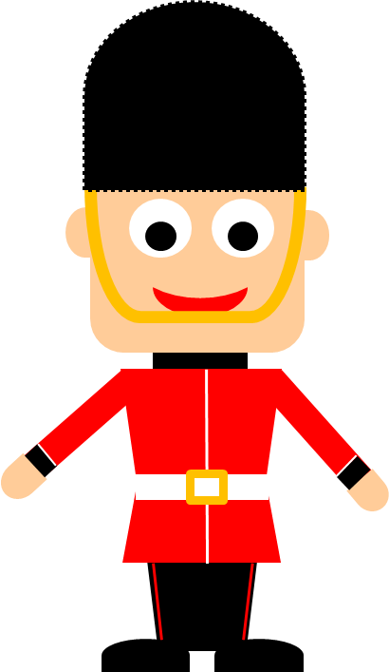
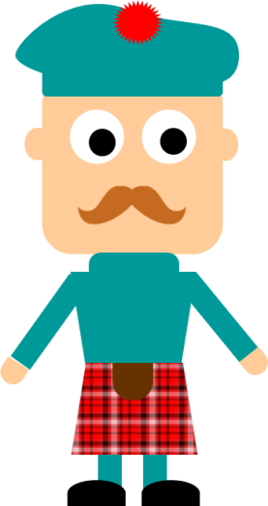
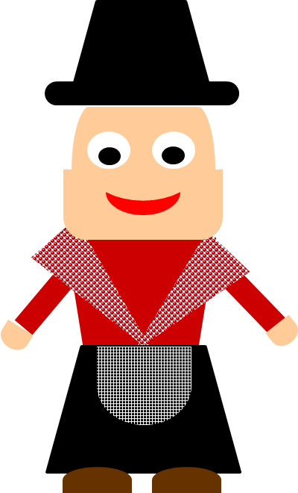
by HERBER
Talking about …

Slide 2
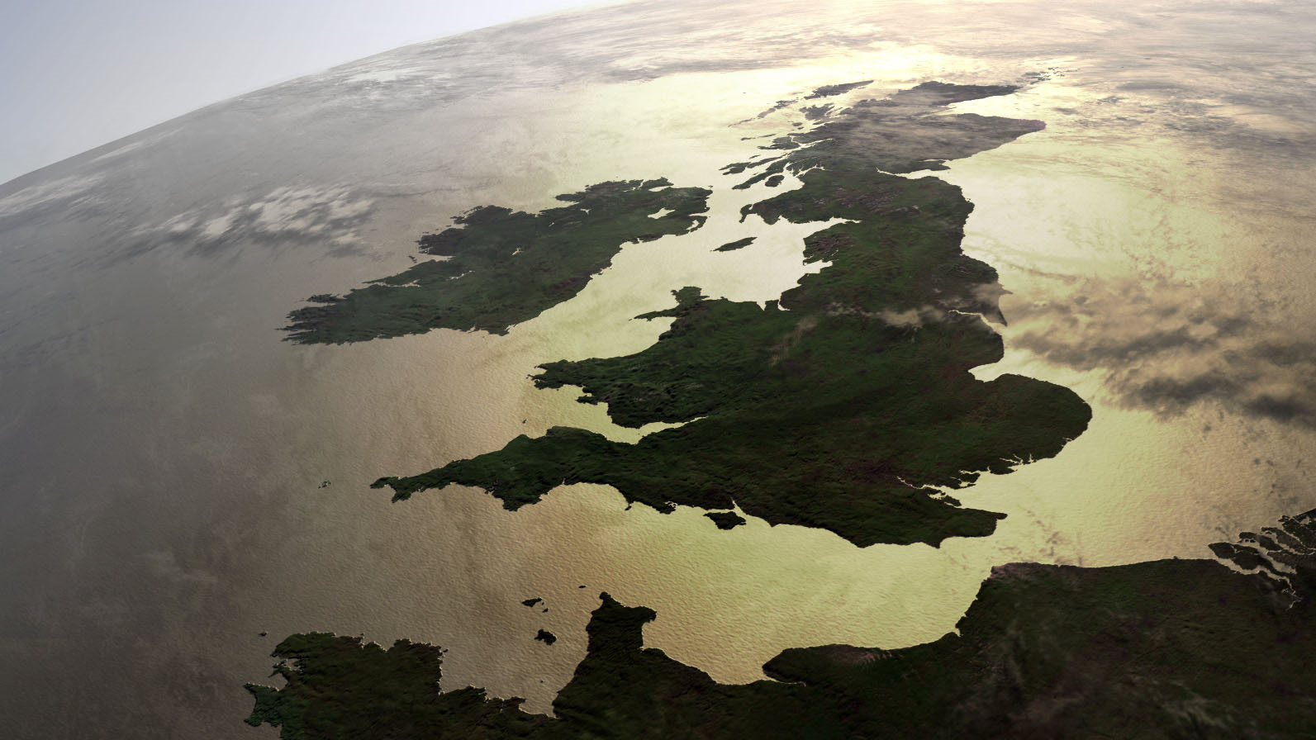
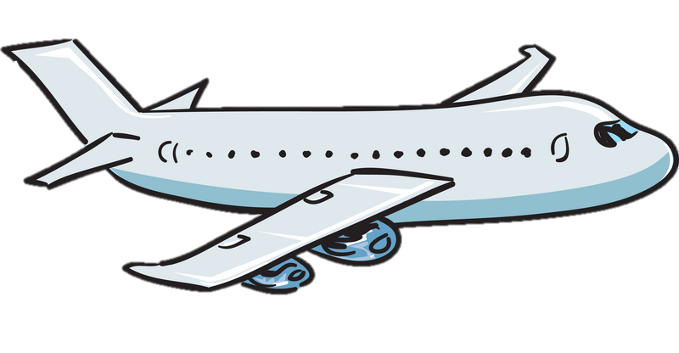
That’s Britain!
That’s Great Britain!
Those are the British Isles!
That’s the UK!
That’s England!
Let’s see what they are talking about

Slide 3
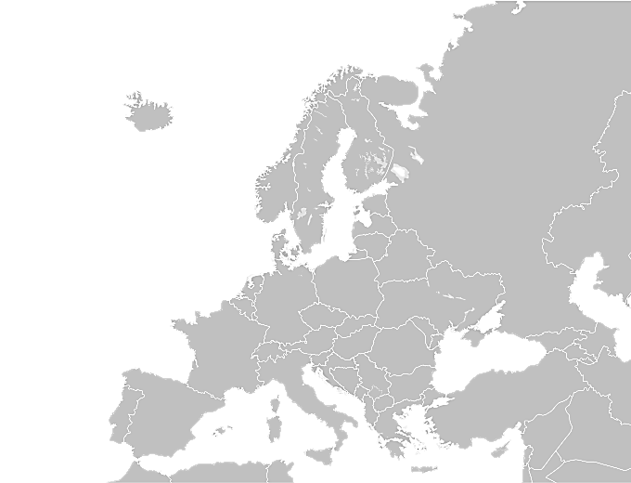


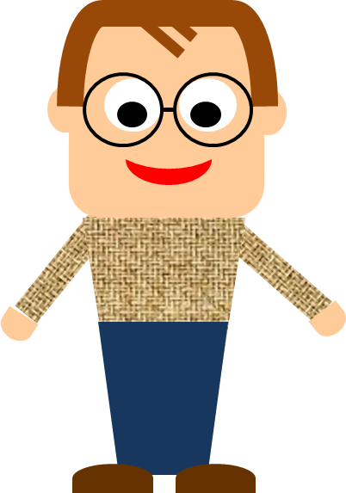
Atlantic Ocean
EUROPE

Slide 4

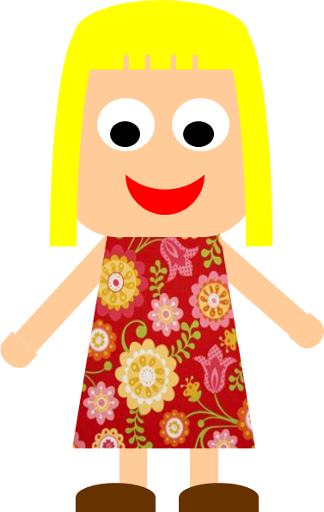

Slide 5
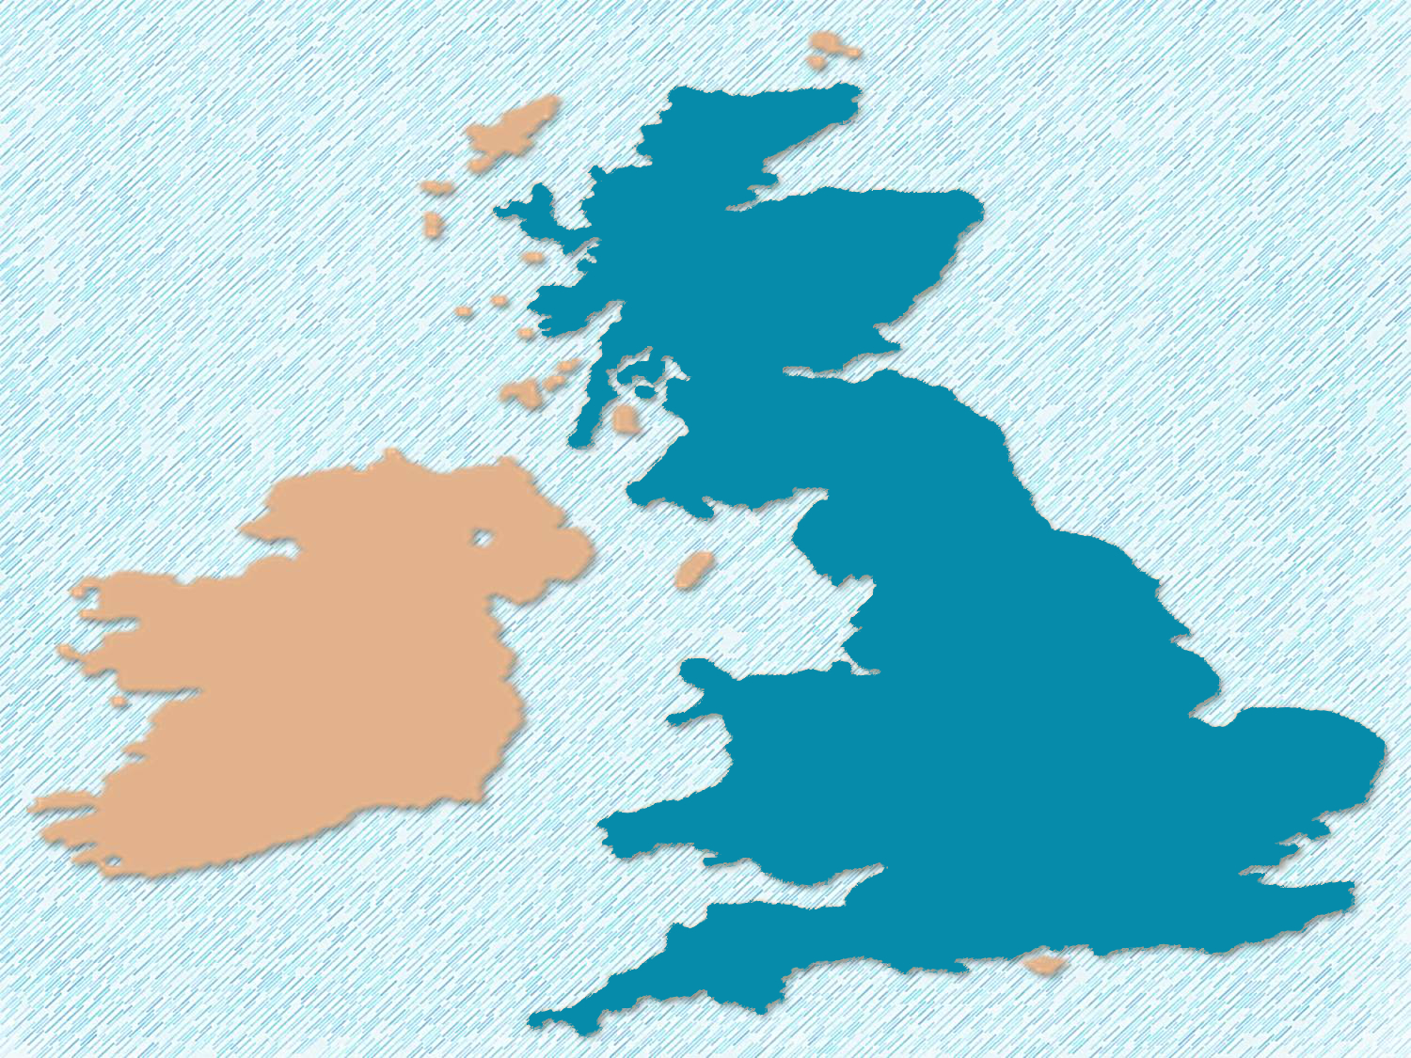

It’s the biggest island of the British Isles.

Slide 6
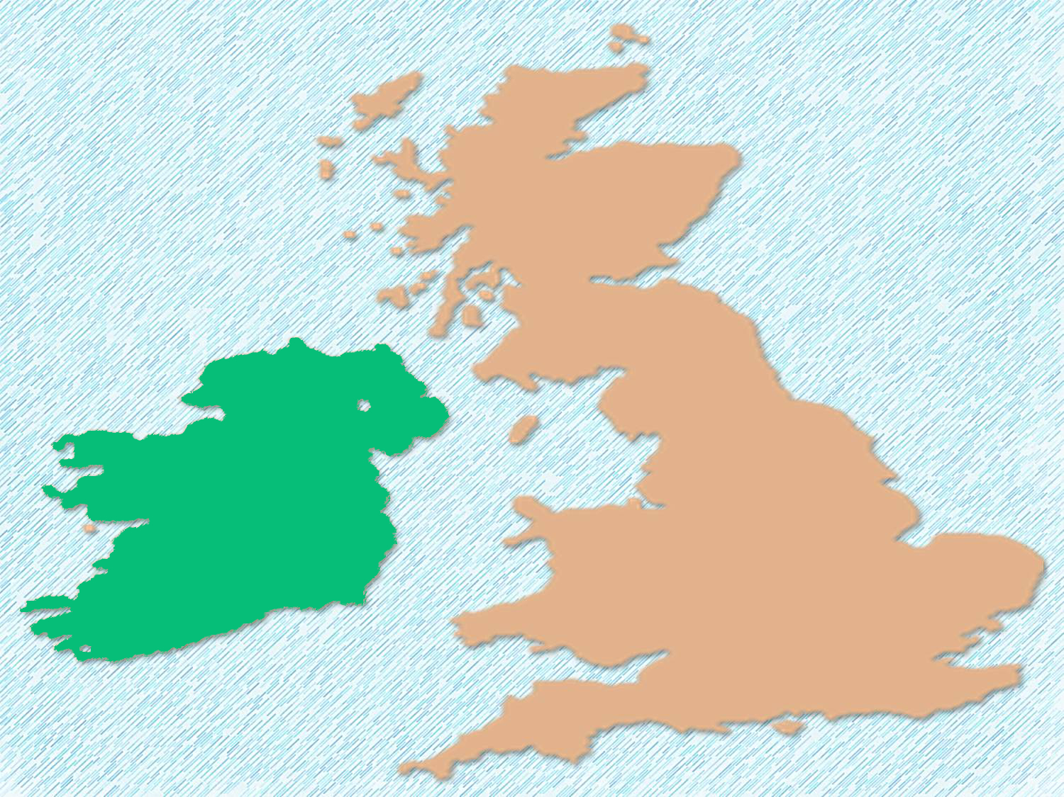

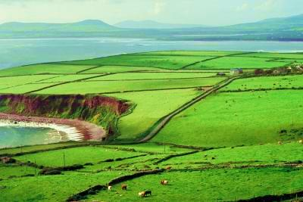
It is also known as the Emerald Isle because of its beautiful green countryside.

Slide 7
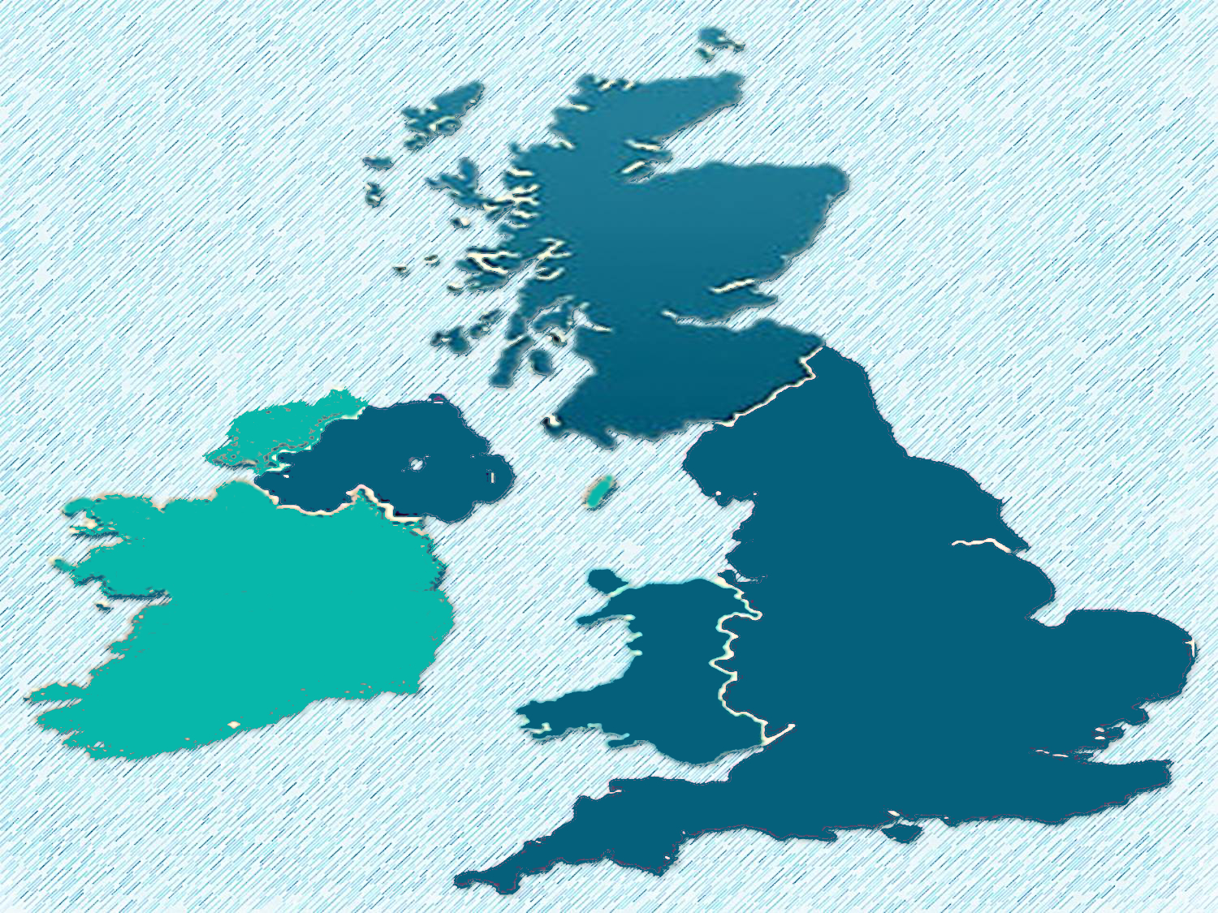


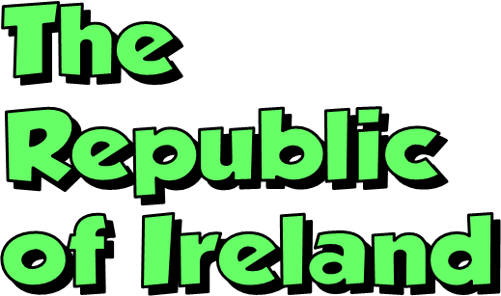
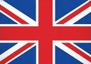
There are two independent states in the British Isles:

Slide 8
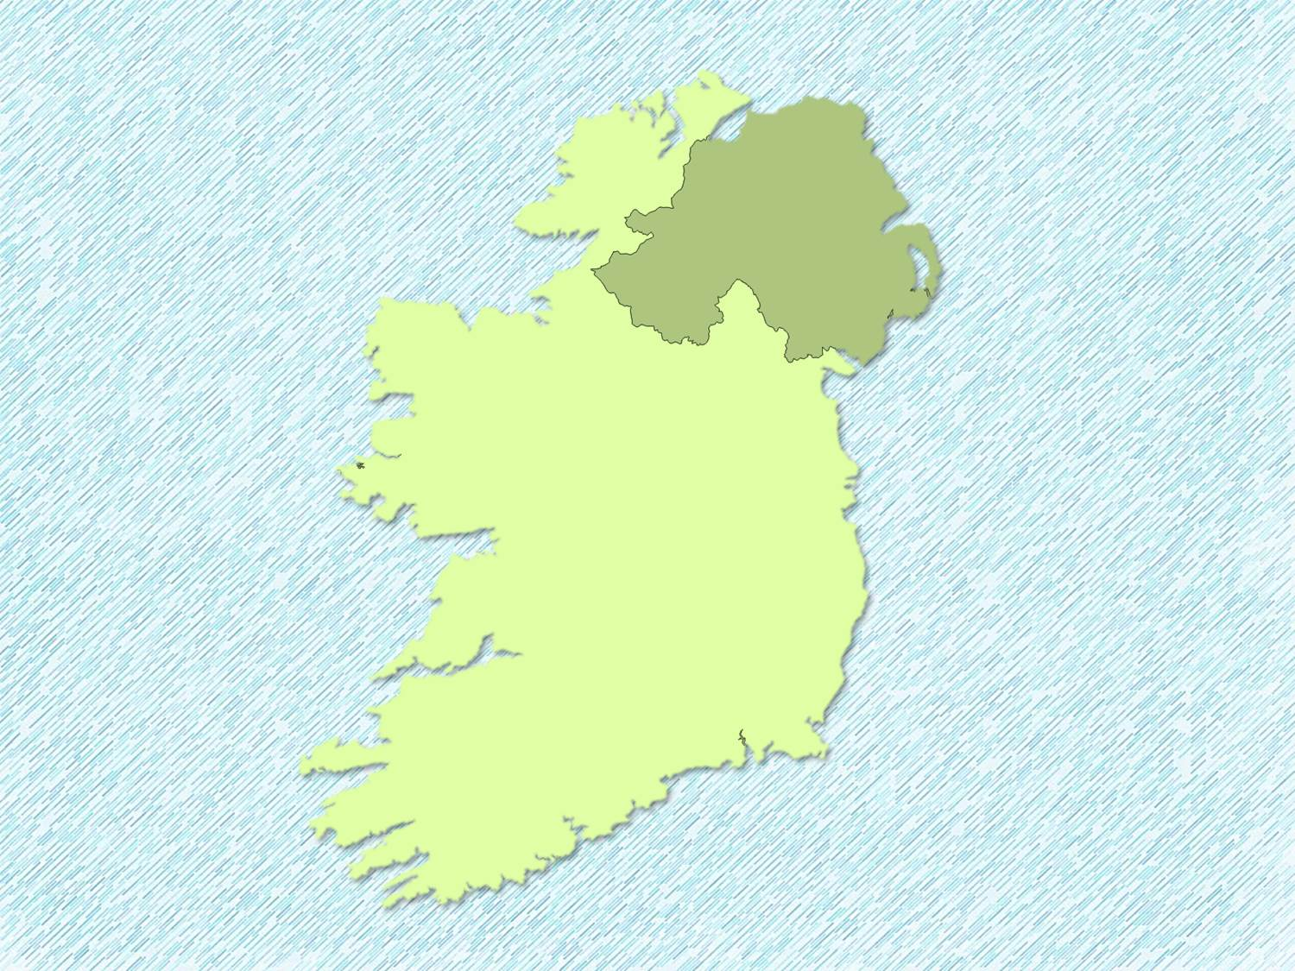
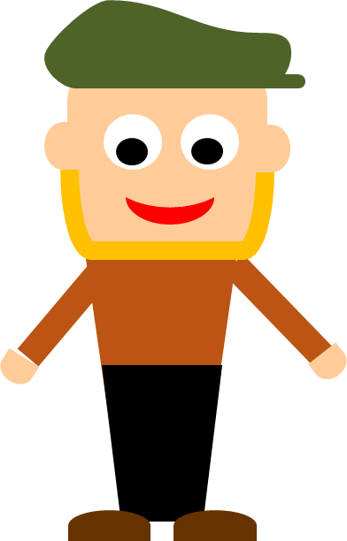
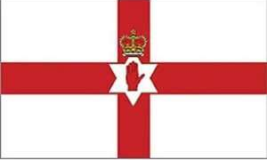
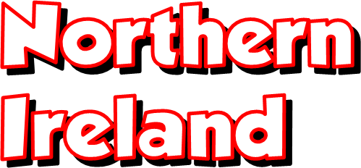
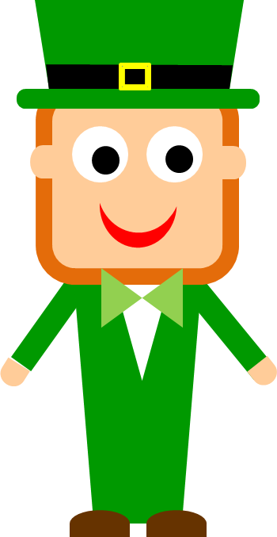
Ireland is divided into two parts:
It’s part of the United Kingdom.
It’s also called EIRE.
It’s an independent state since 1922.

Slide 9
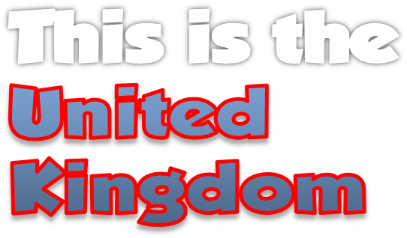
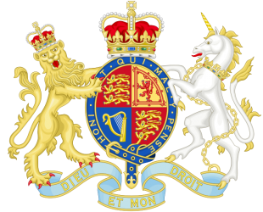
Royal coat of arms
It is also called
the UK or Britain.
People from the UK are British.
LONDON

Slide 10
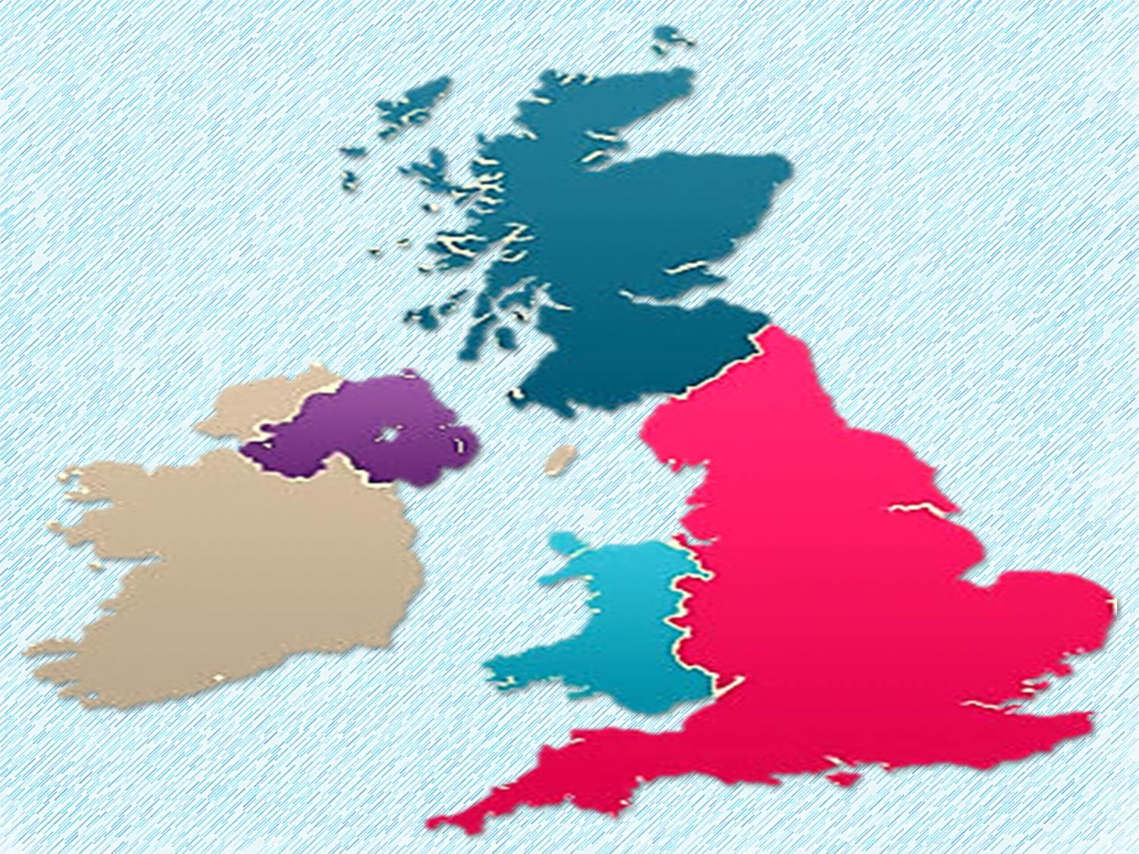
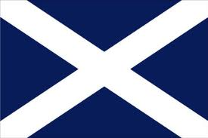
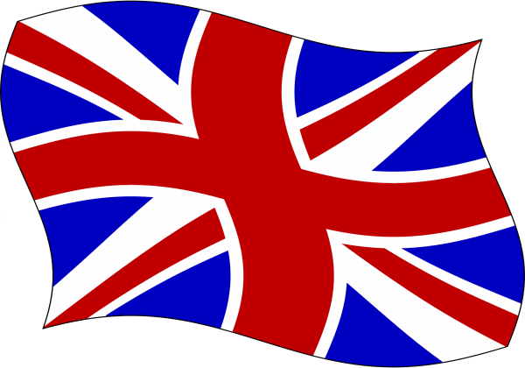

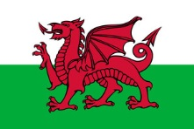
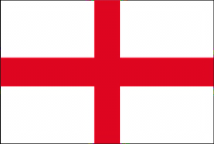


The
It consists
of four countries

Slide 11

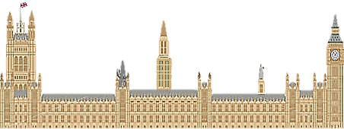
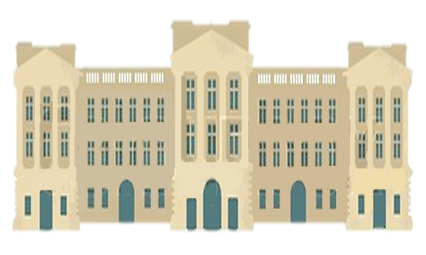
The
It’s a constitutional monarchy
Houses
of Parliament
Buckingham Palace

Slide 12
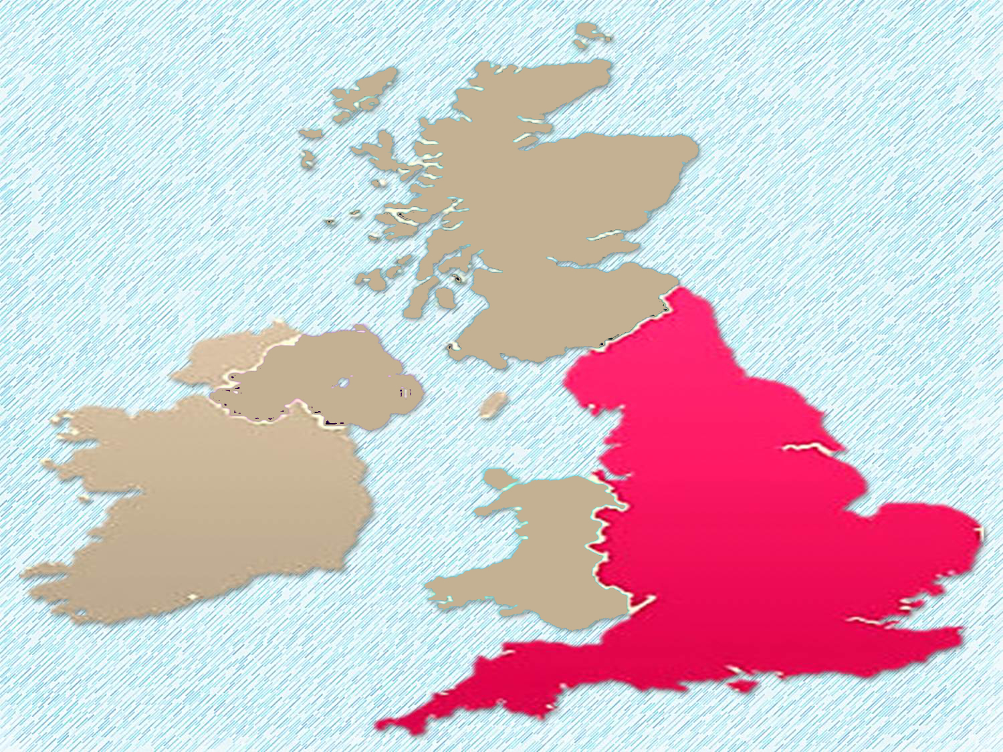
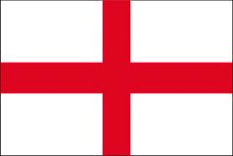
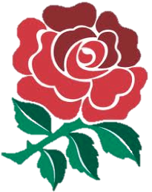
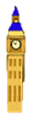
The rose,
symbol of England
I am British and
I am English
LONDON
It´s the biggest and the most populated country of the United Kingdom

Slide 13
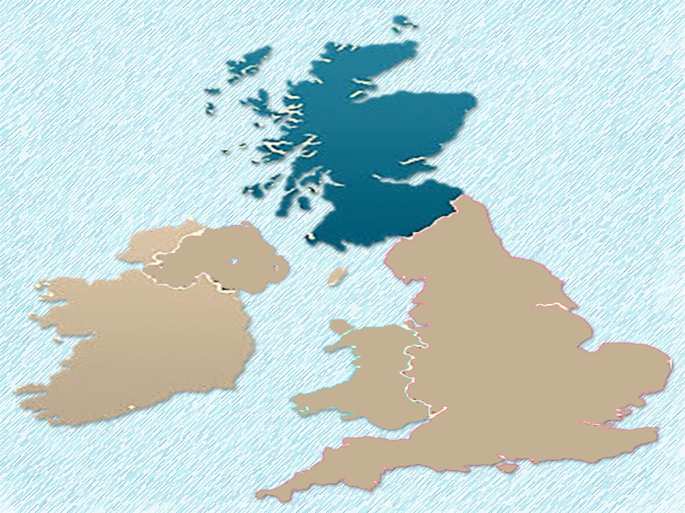
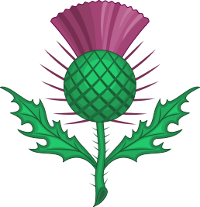
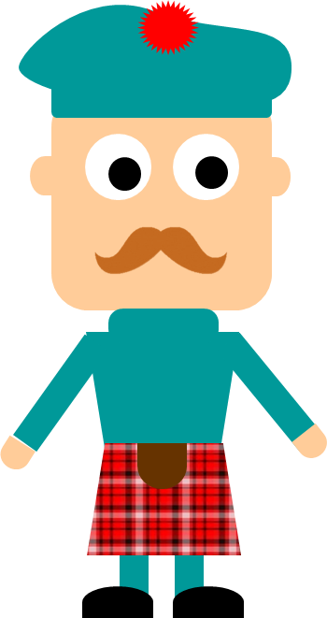
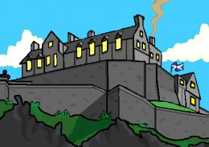
EDINBURGH
The thistle,
symbol of Scotland
I‘m Scottish and
I’m a British citizen, but I’m not English.

Slide 14
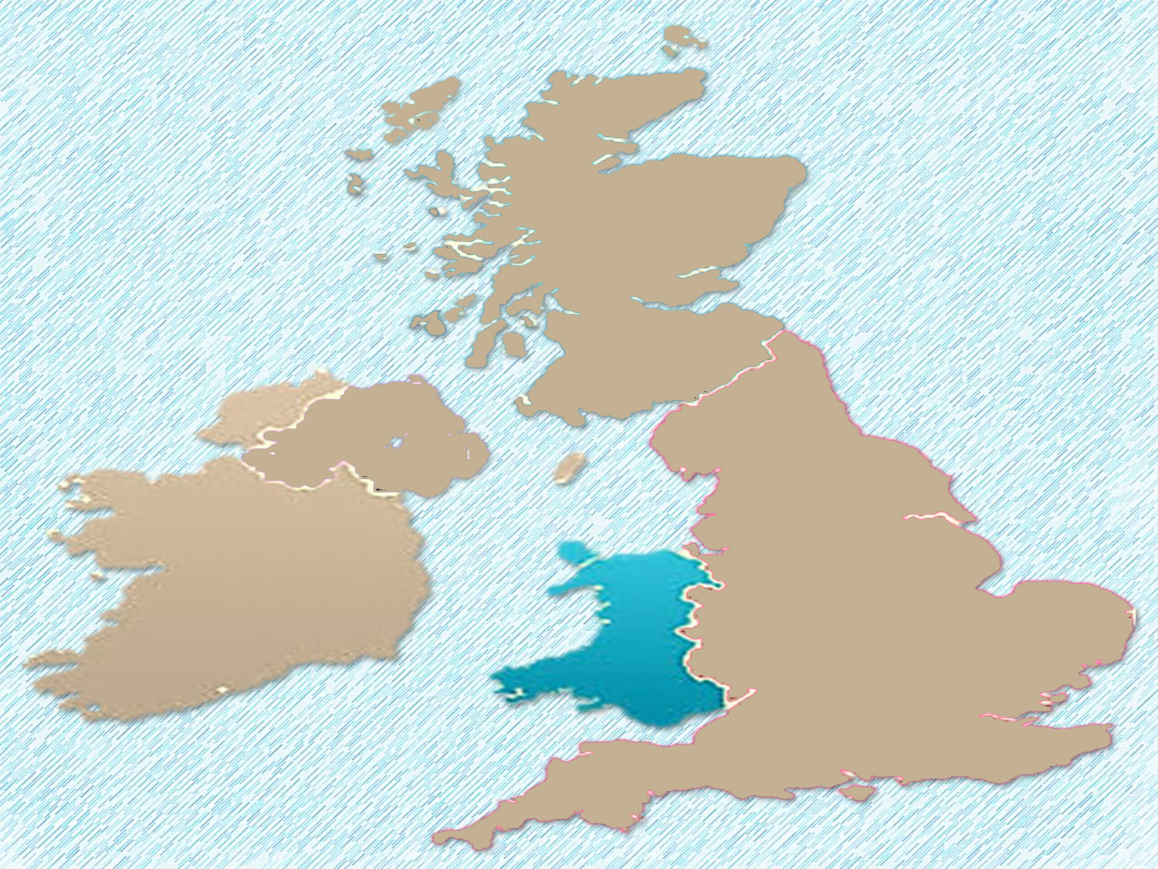

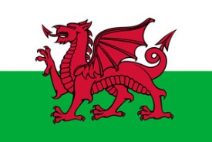
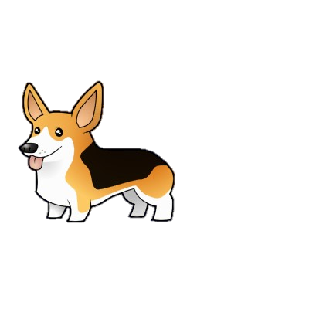
I am Welsh and
I’m a British citizen, but I’m not English.
The daffodil,
symbol of Wales
CARDIFF

Slide 15
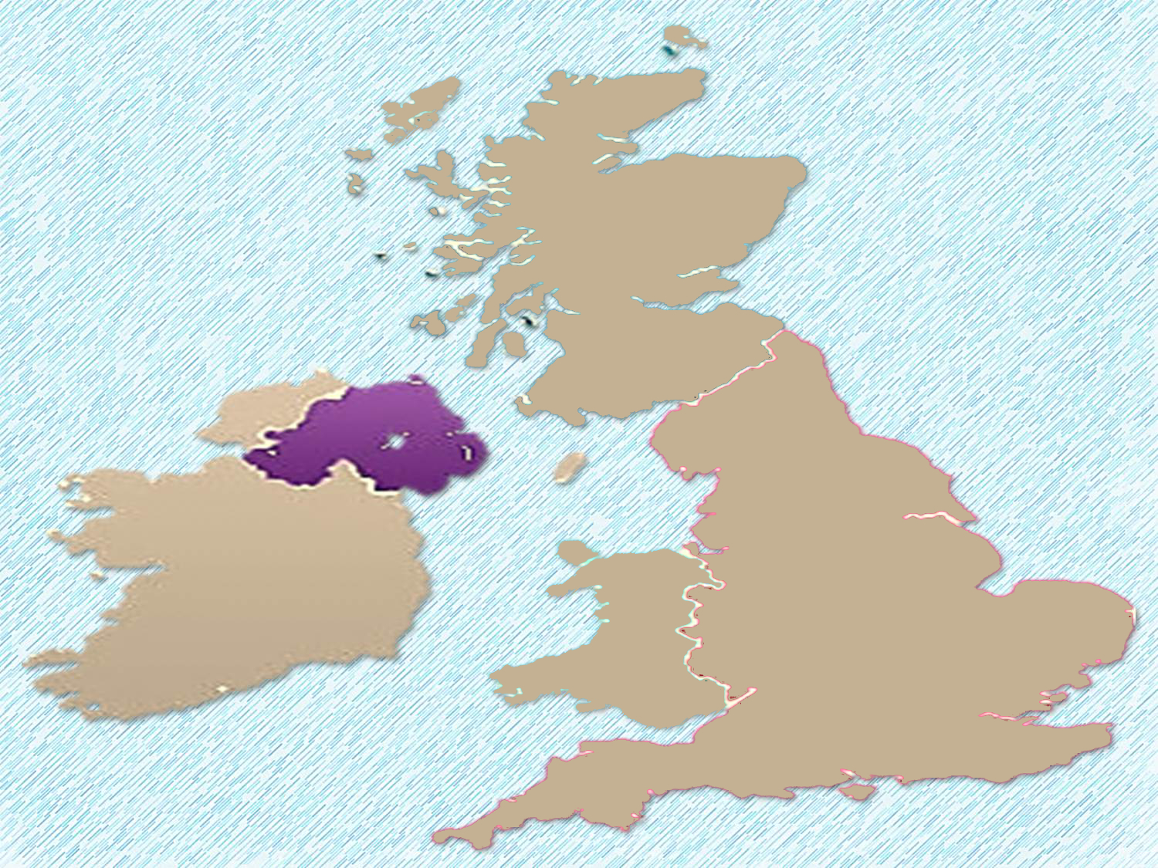
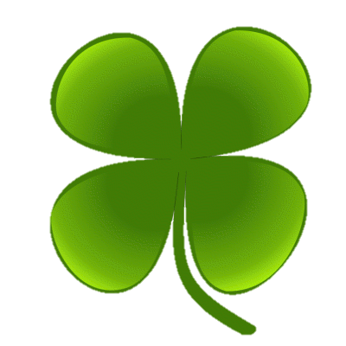
The shamrock,
symbol of Ireland
BELFAST
I am Northern Irish and I’m a British citizen, but I’m not English.

Slide 16
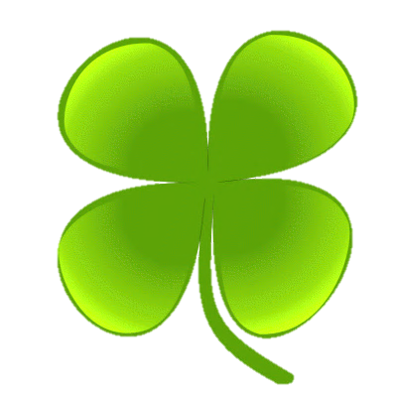
The shamrock,
symbol of Ireland
I am Irish but I’m not British or English.
DUBLIN

Slide 17

This is not the flag of England
This is the “UNION JACK”, the flag of the UNITED KINGDOM.

Slide 18
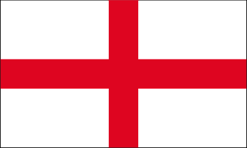
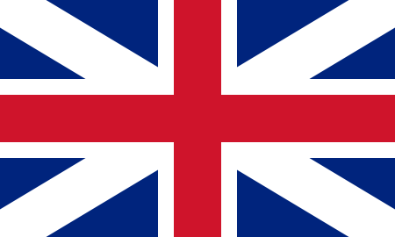
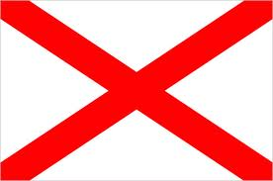
It’s the combination of the flags of England, Scotland and Ireland
+
ENGLAND
SCOTLAND
+
UNION FLAG (1606)
IRELAND
UNION JACK (1801)

Slide 19

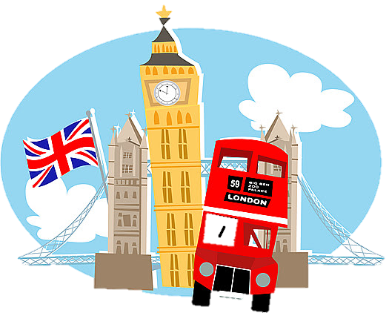
London is the capital of England and the United Kingdom

Slide 20
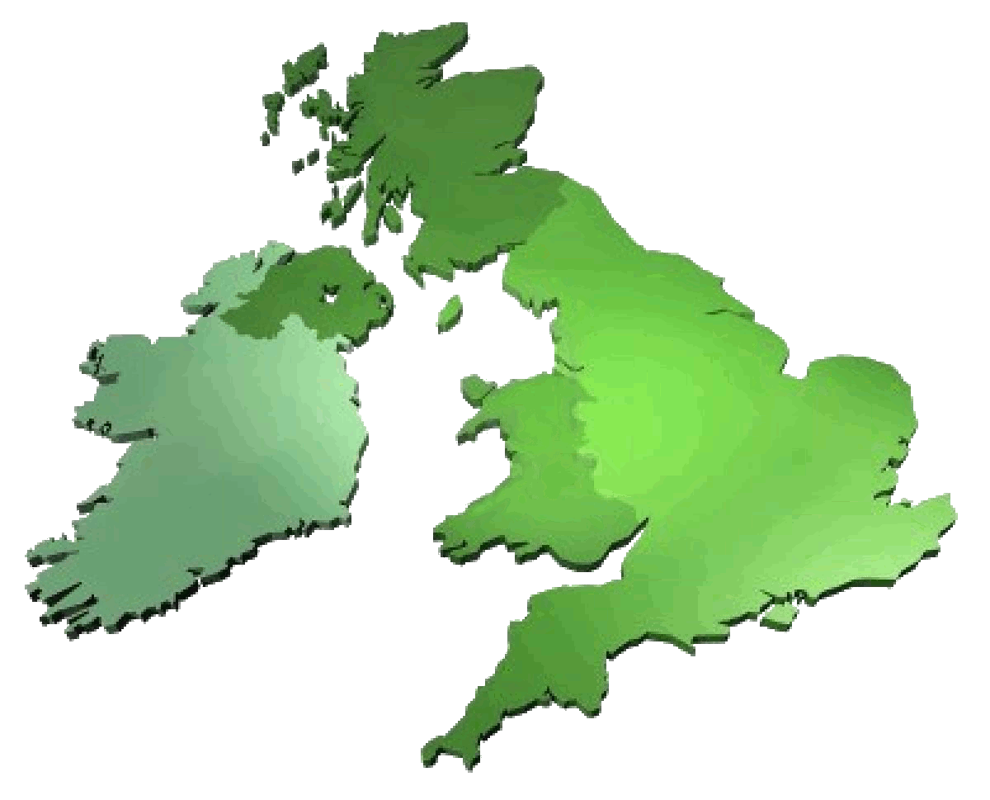
Is everything clear?
Let’s check it!

Slide 21




TRUE OR FALSE?
True False
1. England is the biggest island of the British Isles.
2. There are four countries in the United Kingdom.
3. All the people from the United Kingdom are English.
4. The Republic of Ireland is part of the UK.
5. Northern Ireland is an independent country.
6. People from Wales are English.
7. People from Scotland are British.
8. The “Union Jack” is the flag of England.
9. The British Isles and the UK are the same.
10. Britain is a republic.
T
F
T
F
T
F
T
F
T
F
T
F
T
F
T
F
T
F
T
F

Slide 22
GOODBYE!!

