Slide 1
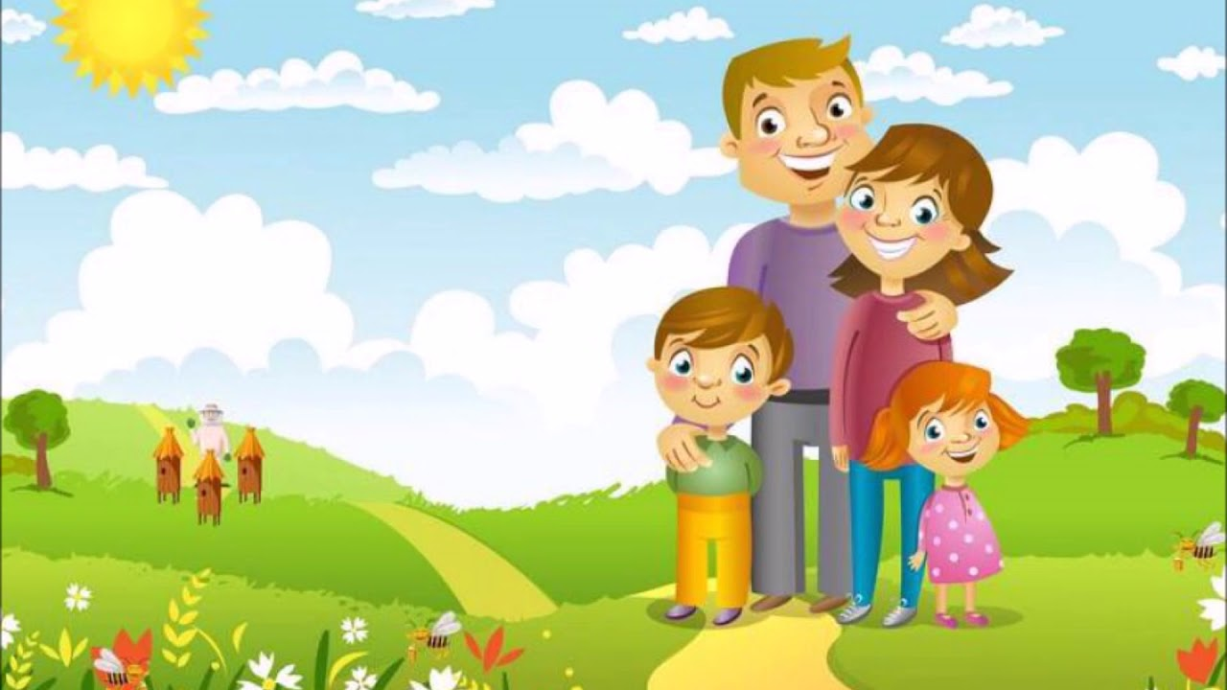


1
IrinaPapakhina

Slide 2


IrinaPapakhina

Slide 3

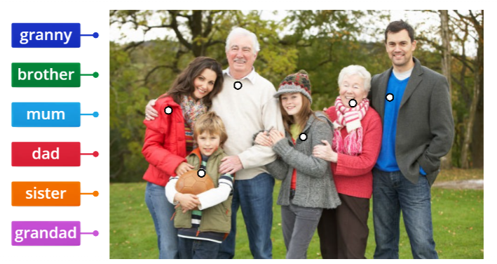
IrinaPapakhina

Slide 4
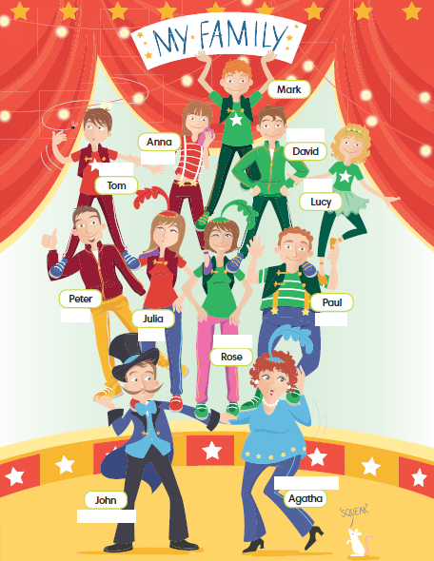
Look at Mark’s family.
Is his family big or small?
Can you see Mark’s brother?
What’s his name?
David
Can you see Mark’s sister?
What’s her name?
Lucy
What’s his mum’s name?
Rose
What’s his dad’s name?
Paul
Who’s John?
grandad
Who’s Agatha?
granny
IrinaPapakhina

Slide 5
brother
Who’s Julia?
aunt
sister
Who’s Peter?
uncle
Who’s Tom?
cousin
mum
dad
Who’s Anna?
cousin
granny
grandad
IrinaPapakhina

Slide 6

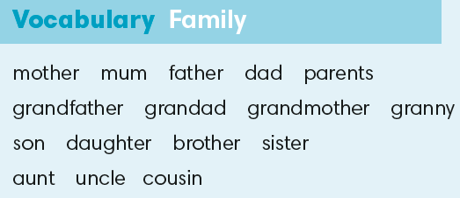
brother
cousin
cousin
sister
uncle
aunt
mum
dad
granny
grandad
IrinaPapakhina

Slide 7
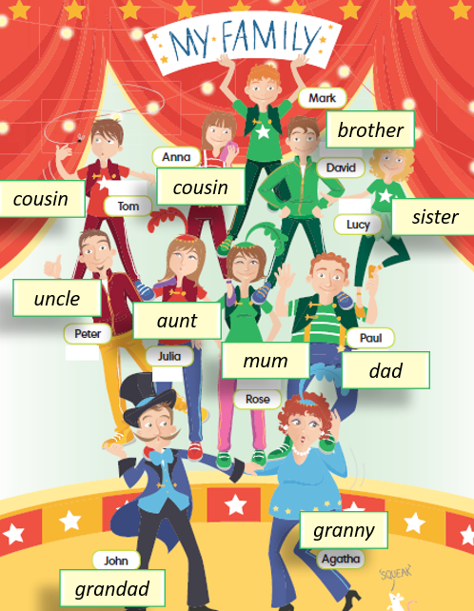
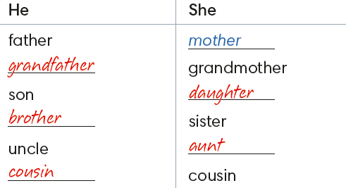

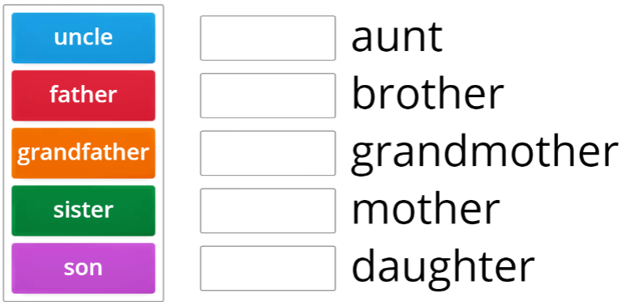
IrinaPapakhina

Slide 8
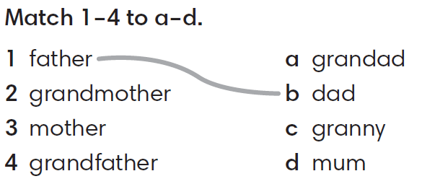
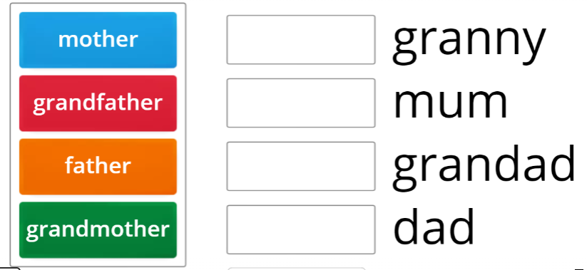
IrinaPapakhina

Slide 9

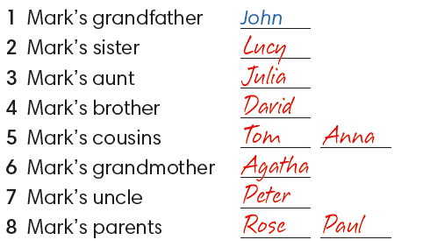
IrinaPapakhina

Slide 10
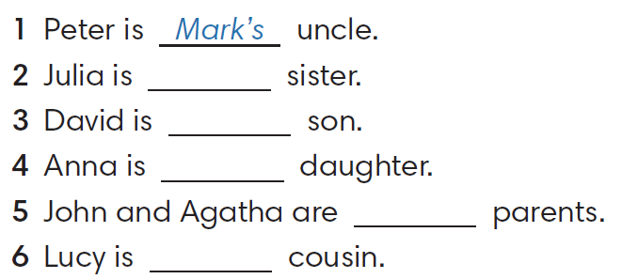
Complete the sentences.
Use the words in the box.
Paul’s
Rose’s / Paul’s
Peter’s / Julia’s
Julia’s / Paul’s
Tom’s / Anna’s
IrinaPapakhina

Slide 11
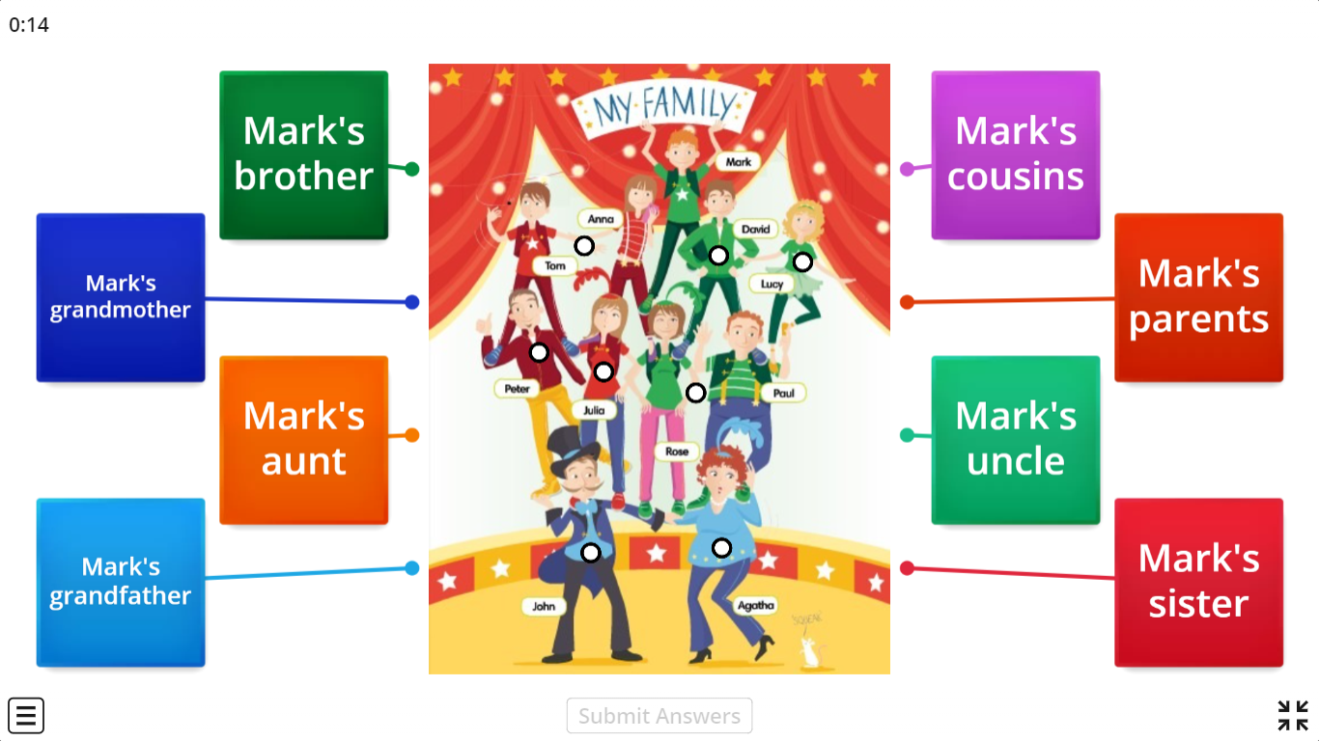
IrinaPapakhina

Slide 12
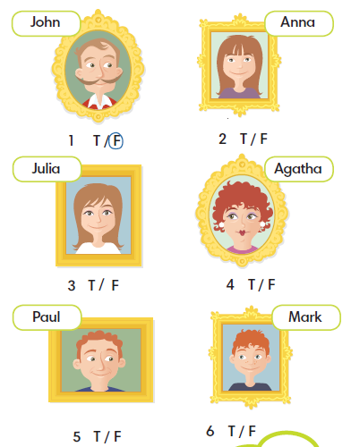
IrinaPapakhina

Slide 13
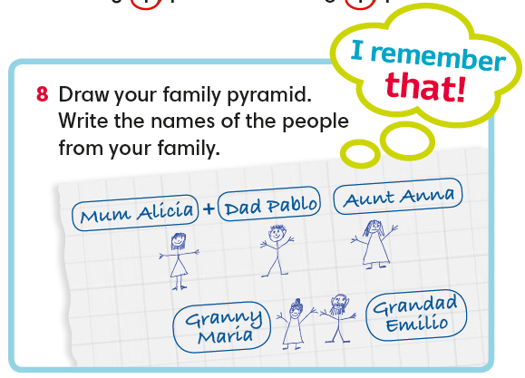
IrinaPapakhina
Notes:
Guess my relative

Slide 14
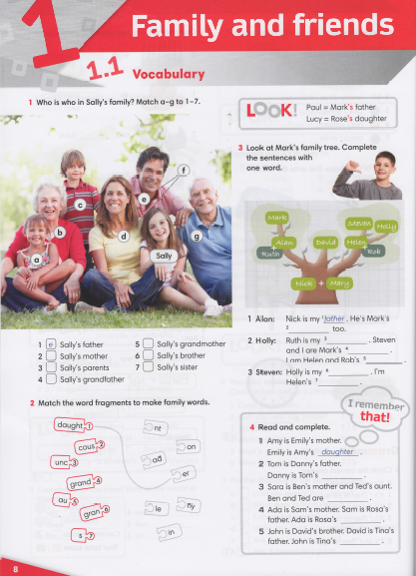


IrinaPapakhina

Slide 15
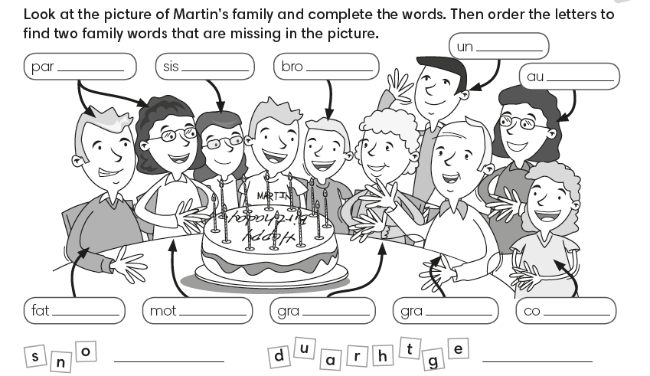
check
IrinaPapakhina

