Slide 1
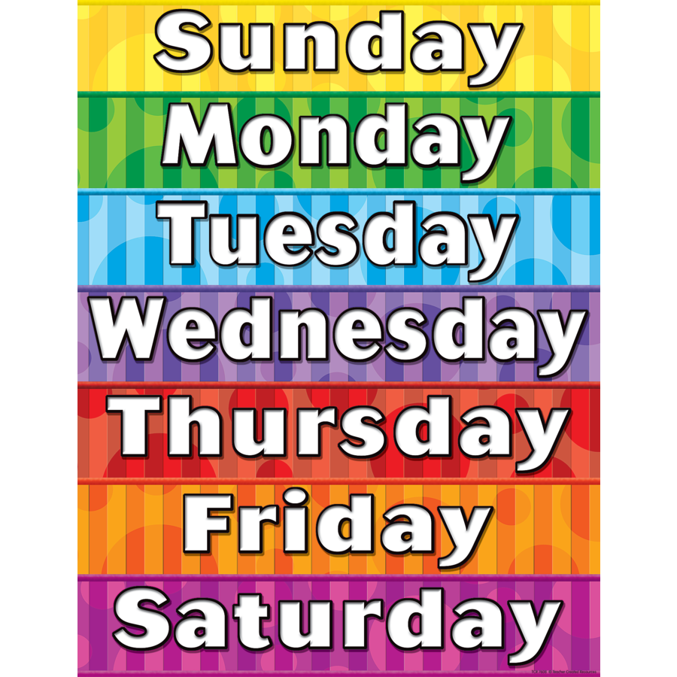



Slide 2
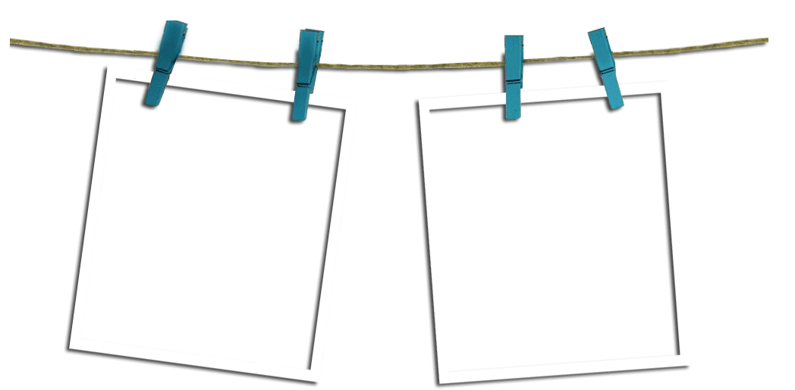

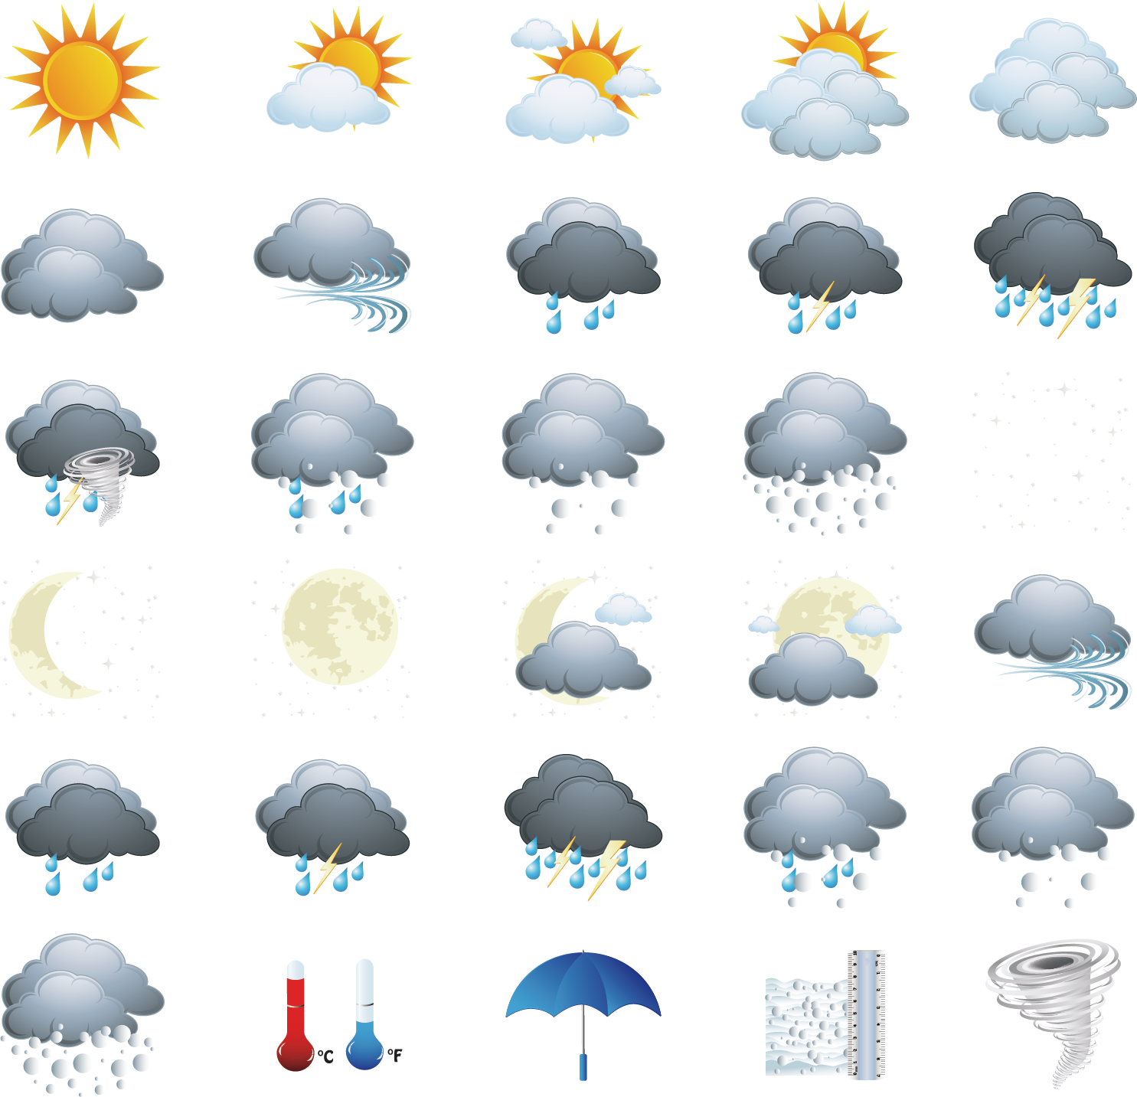

Today is . It’s .
cold and rainy

Slide 3
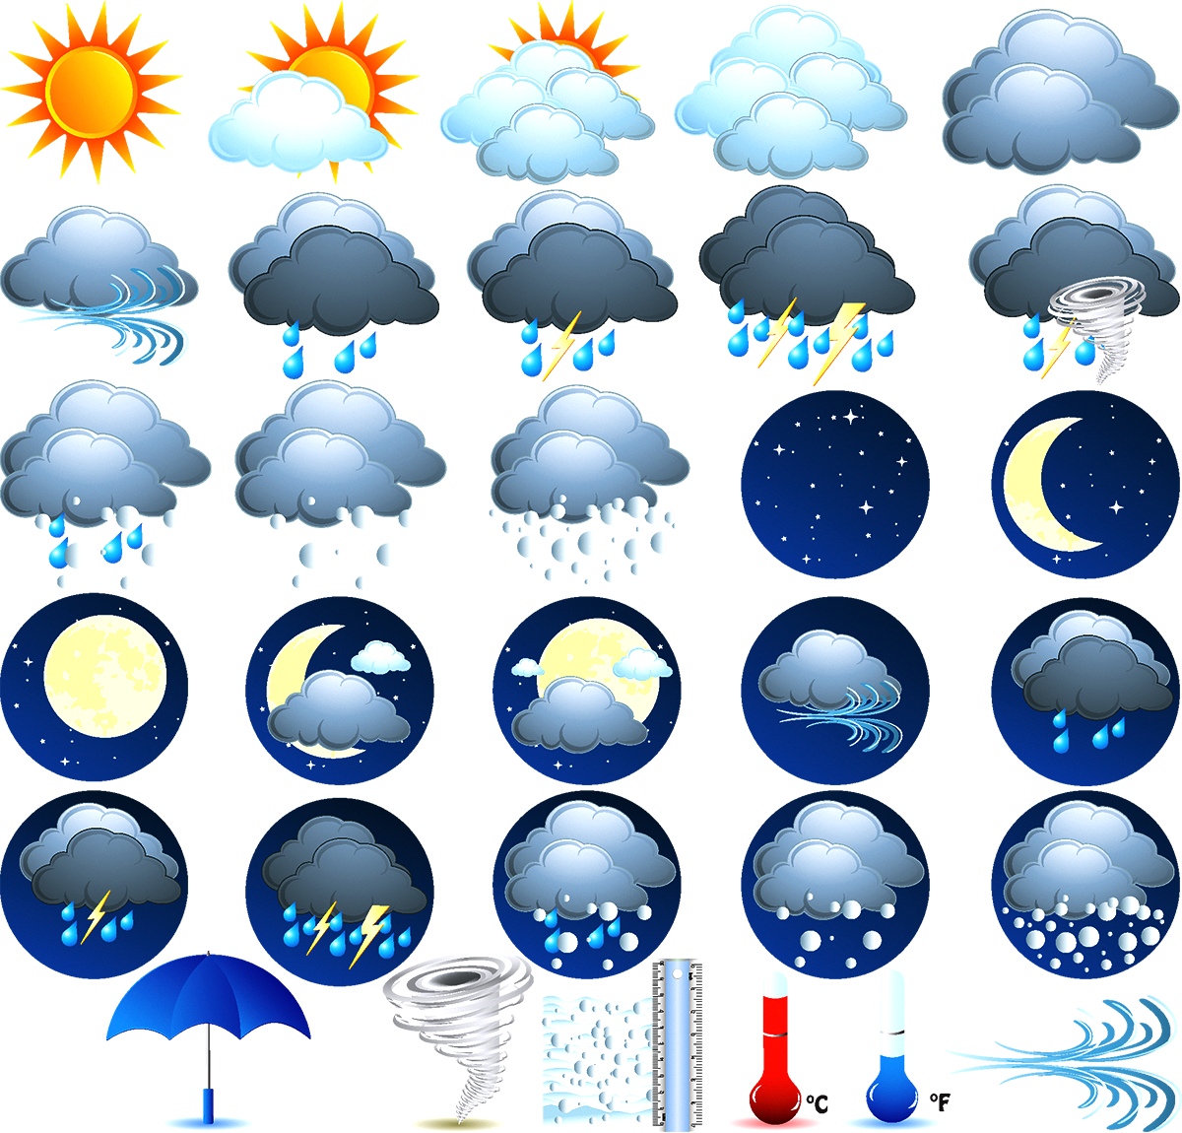
Today is . It’s .
hot and cloudy

Slide 4
cold and snowy
Today is . It’s .

Slide 5
Today is . It’s .
windy and stormy

Slide 6
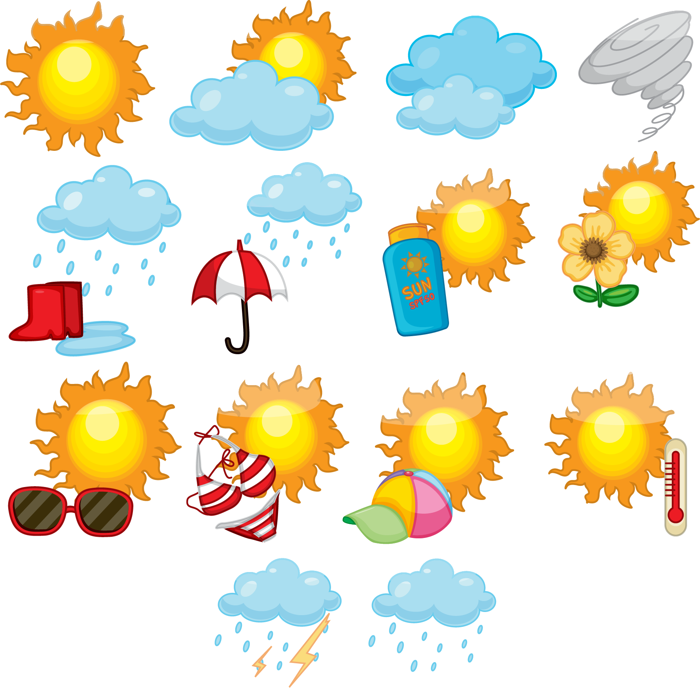
Today is . It’s .
hot and rainy

Slide 7
stormy and cloudy
Today is . It’s .

Slide 8
hot and stormy
Today is . It’s .

