Slide 1

where is the cat?

Slide 2
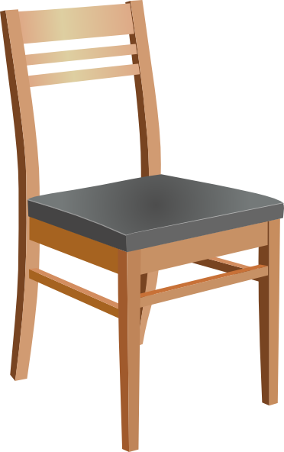
the cat is under the chair

Slide 3
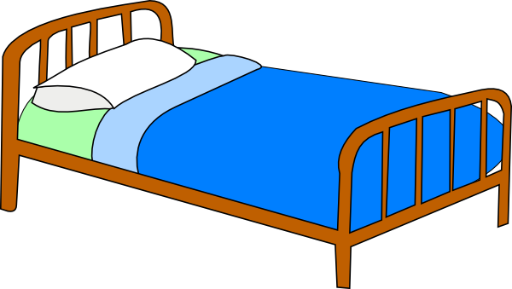
the cat is on the bed

Slide 4

the cat is next to the tree

Slide 5
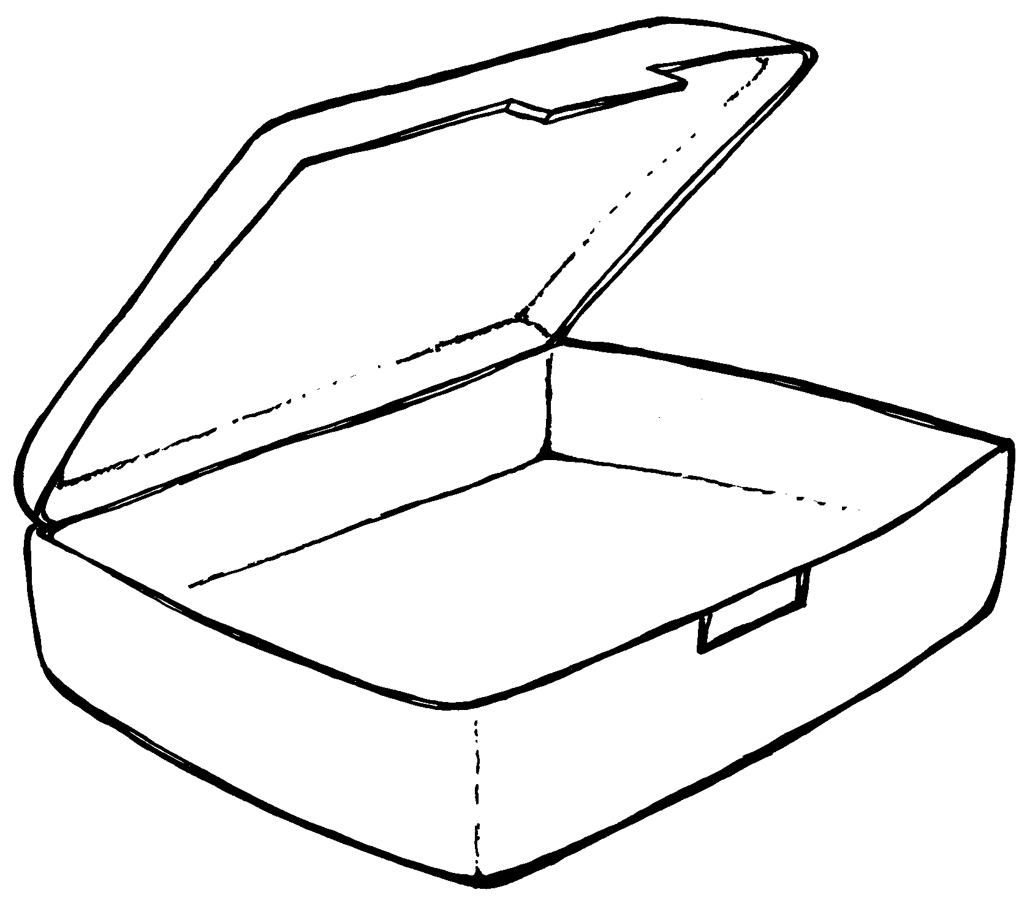
the cat is in the box

Slide 6


the cat is between the dogs

Slide 7

the cat is in front of the tv

Slide 8
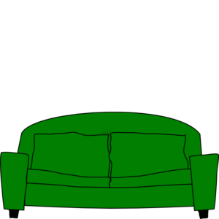
the cat is behind the sofa

Slide 9
the cat is under the bed

Slide 10
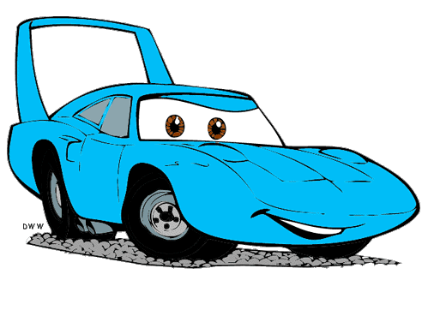
the cat is between the cars

Slide 11
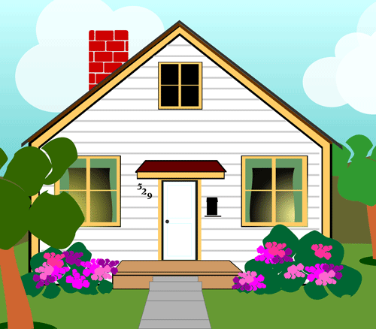
the cat is in front of the house

Slide 12

the cat is behind the box

