Slide 1

Much, many, and a lot of
By yasaman samsami

Slide 2
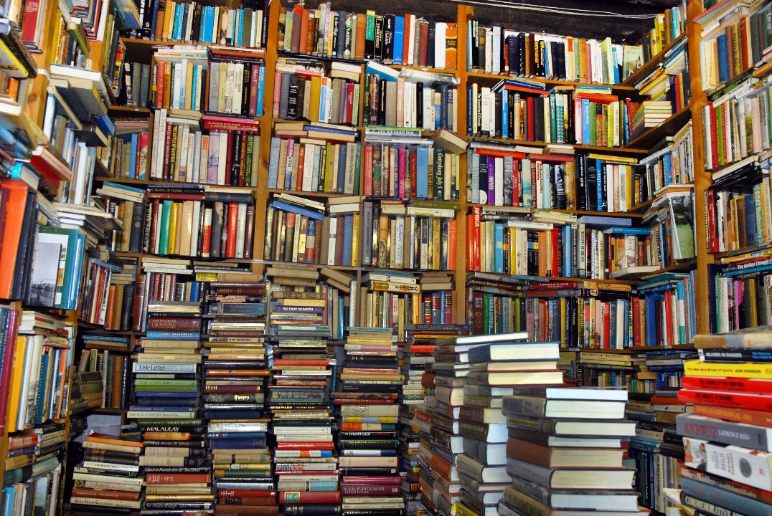
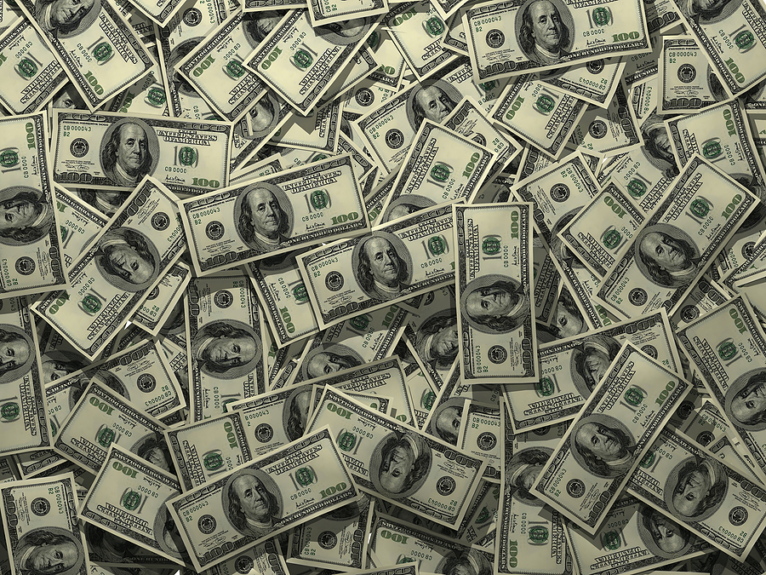
a lot of/ much money
a lot of/ many books

Slide 3
much
much coffee
much milk
much money
much food
much time
much fruit
We use much + uncountable noun.
We use much in negative sentences and questions.

Slide 4
many
many books
many apples
many tomatoes
many animals
many pens
many oranges
We use many with countable nouns.

Slide 5
a lot of
a lot of books
a lot of money
a lot of oranges
a lot of food
a lot of apples
a lot of milk
We use a lot of in positive sentences with countable and uncountable nouns.

Slide 6
countable | uncountable
There are a lot of books. (+) | There’s a lot of coffee. (+)
There aren’t many books. (-) | There isn’t much coffee. (-)
How many books are there? (?) | How much coffee is there? (?)

Slide 7
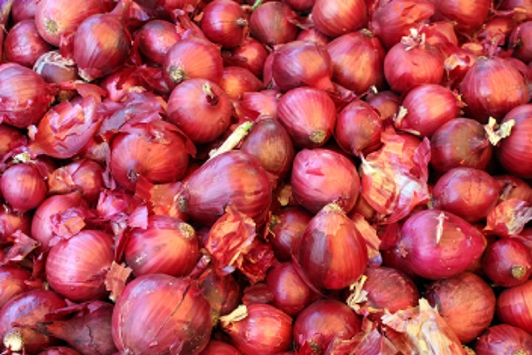
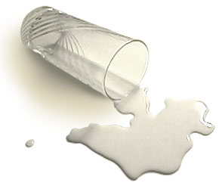
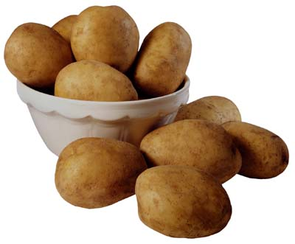
a lot of onions
There are _________________.
There isn’t _________________.
How ___________________ are there?
much milk
many potatoes

Slide 8
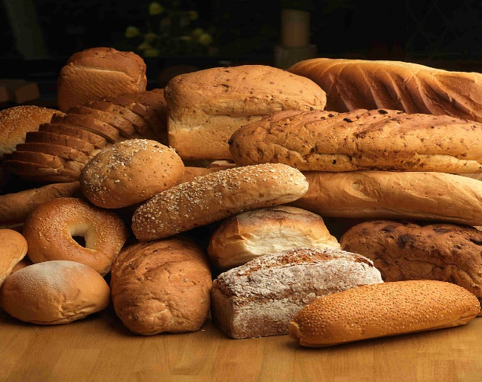
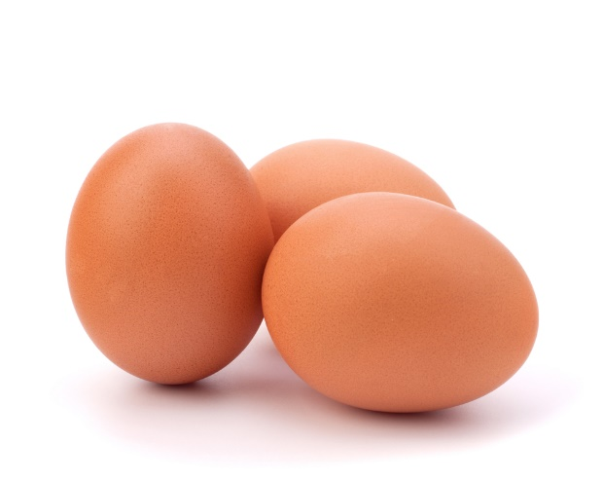
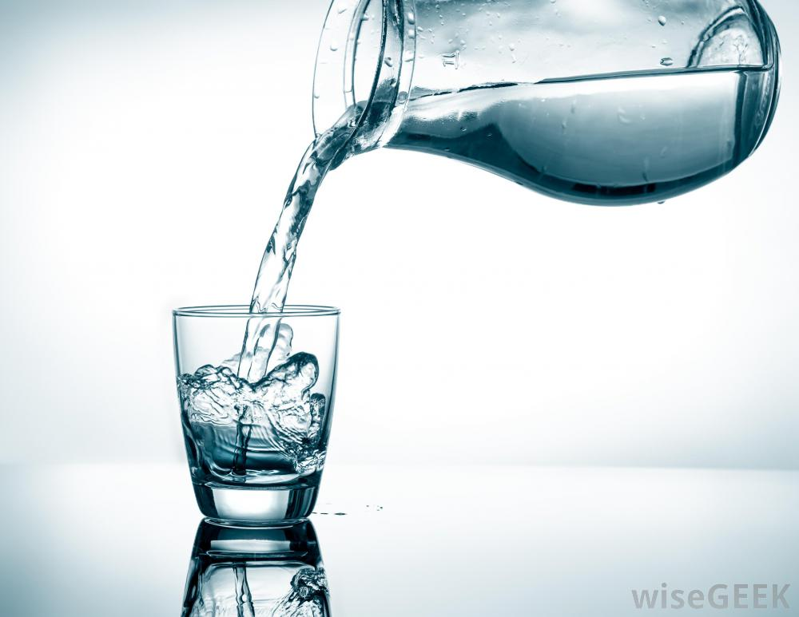
a lot of bread
There is ______________________.
There aren’t ___________________.
How ____________________ is there?
many eggs
much water

Slide 9


Good Luck!

