Slide 1
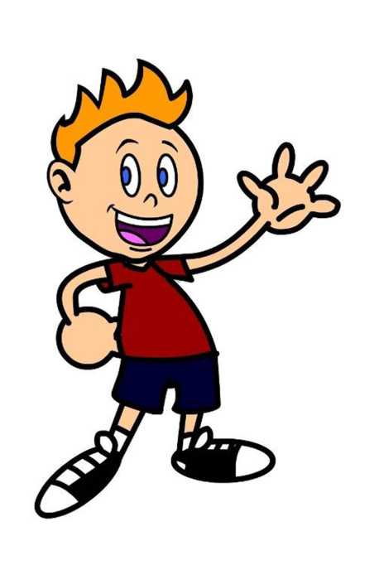
Hello! My name is Mike.
And this is my crazy family.
Read about our life.
Who do you think is the craziest?

Slide 2
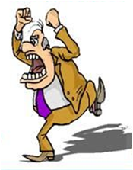
Yesterday my grandpa screamed at a mouse.

Slide 3
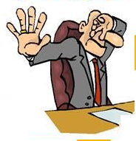
Yesterday I showed my dad an ugly rat.

Slide 4
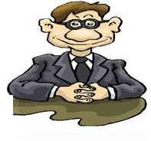
Yesterday my dad smiled at me.

Slide 5
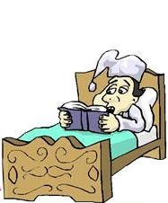
Yesterday my cousin stayed in bed all day.

Slide 6
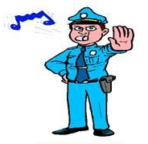
Yesterday the policeman stopped our car.

Slide 7
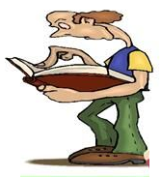
Yesterday my brother studied maths all day.

Slide 8
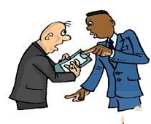
Yesterday my dad talked to my uncle.

Slide 9
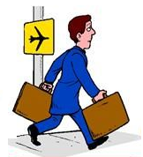
Last year my cousin travelled to London.

Slide 10
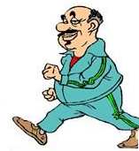
Yesterday my grandpa walked in the park.

Slide 11
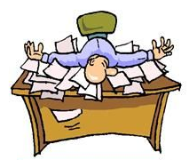
Last week my dad worked every day.

Slide 12
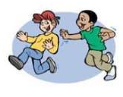
Yesterday I chased after my cousin in the park.

Slide 13
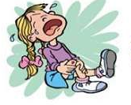
Yesterday my sister cried loudly in the park.

Slide 14
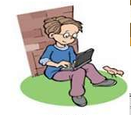
Yesterday my cousin surfed the Internet all night.

Slide 15
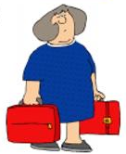
Yesterday my aunt carried two heavy bags.

Slide 16
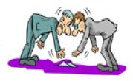
Yesterday my dad and uncle picked up the money in the street.

Slide 17
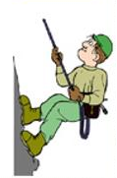
Yesterday my dad climbed the mountain.

Slide 18
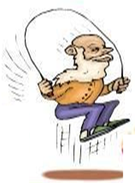
Yesterday my grandpa skipped one hundred times.

Slide 19
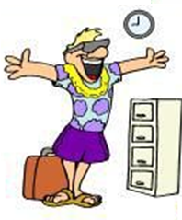
Yesterday my uncle returned from London.

Slide 20
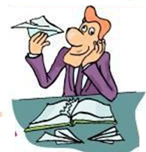
Yesterday my dad played with paper planes at work.

Slide 21
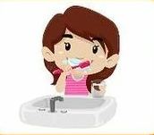
Yesterday morning my sister brushed her teeth.

