Slide 1
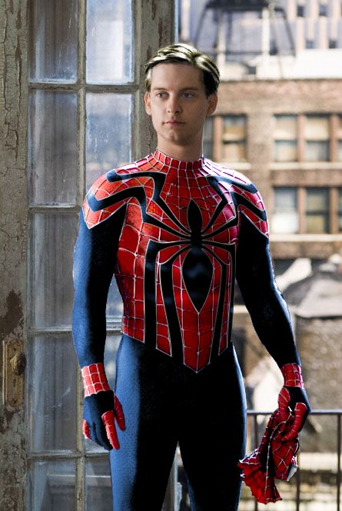

fair
hair
dark
brown
big
eyes
green
small
blue
big
nose
small
a car
brothers or sisters
mother and father
a dog
a house
a cat

Slide 2
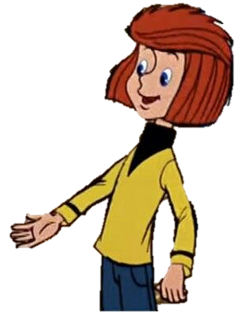

This
is
Fyodor
He
is
9
Fyodor
has got
Fyodor
has got
blue eyes
red hair
Fyodor
has got
a nose and a mouth
Where is he from?
Fyodor
has got
He
is
from
Russia
2 hands

Slide 3
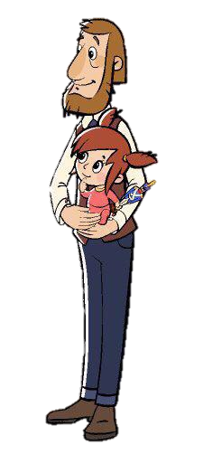
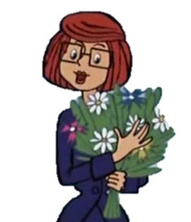
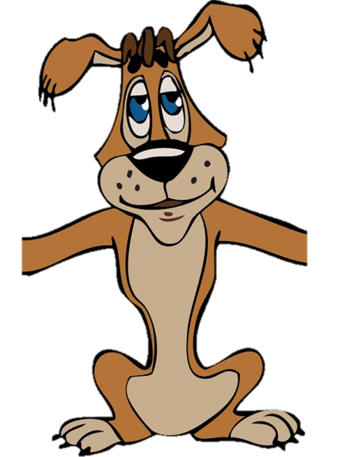
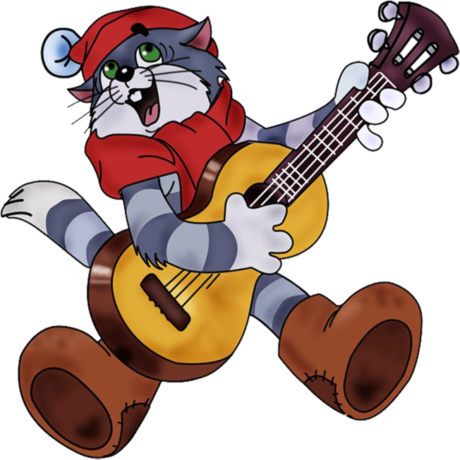
Fyodor
has got
a mother
Fyodor
has got
a cat
and
a dog
Fyodor
has got
A brother?
a father and a sister
Fyodor
hasn`t got
a brother

Slide 4


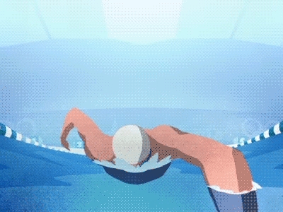

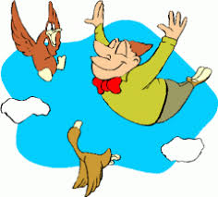
Fyodor can
Fyodor can`t

Slide 5
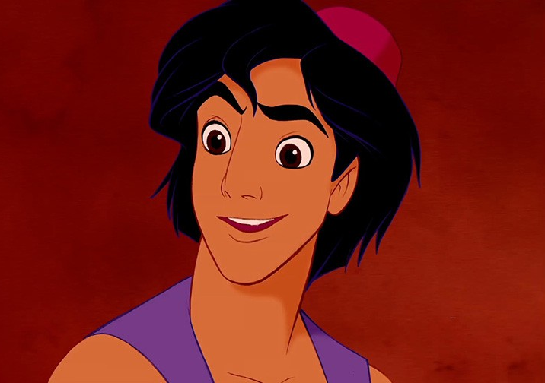


fair
hair
dark
brown
big
eyes
green
small
blue
big
nose
small
a car
brothers or sisters
mother and father
a dog
a house
a cat

Slide 6
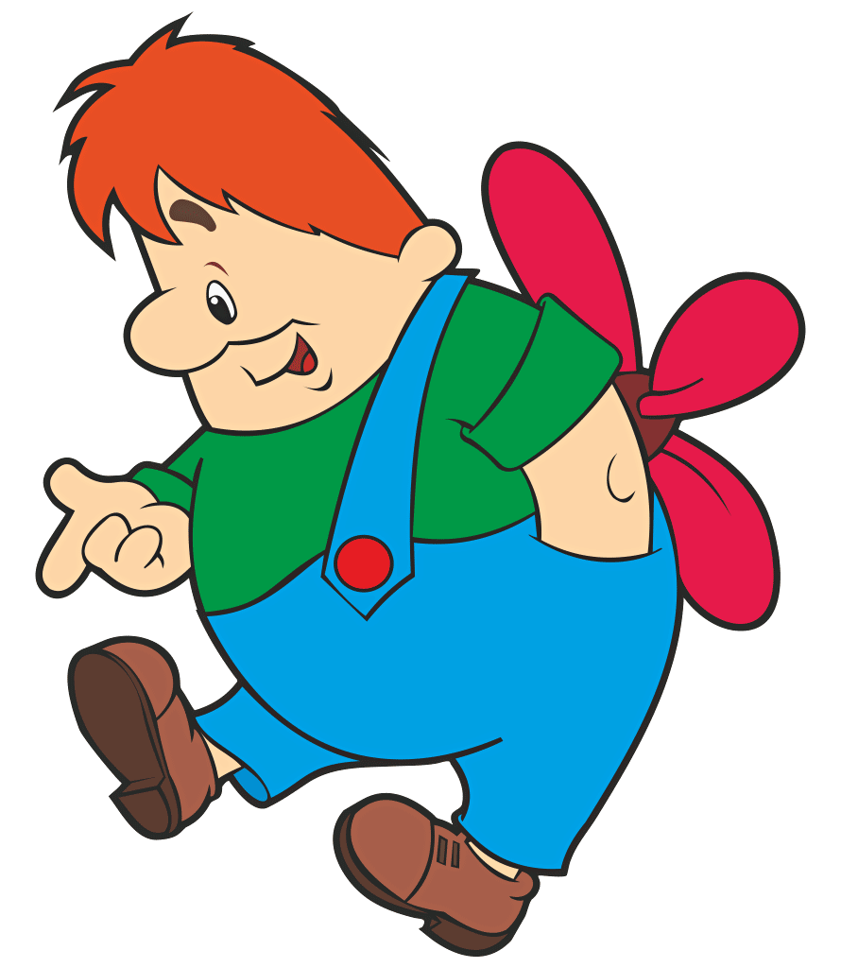
red
fair
hair
red
dark
brown
big
eyes
green
small
blue
big
nose
small
a car
brothers or sisters
mother and father
a dog
a house
a cat

Slide 7
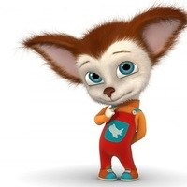
fair
hair
dark
brown
big
eyes
green
small
blue
big
nose
small
a car
brothers or sisters
mother and father
a house
a cat

Slide 8

fair
hair
red
dark
brown
big
eyes
green
small
blue
big
nose
small
a car
brothers or sisters
mother and father
a house
a dog

