Slide 1
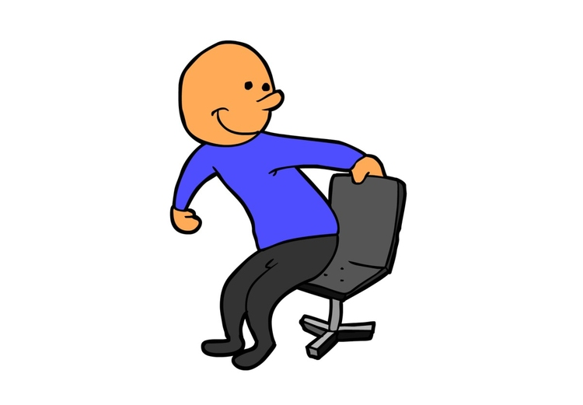
Are you sitting?
Yes, I am. Yes, they are.
Yes, he is. Yes, she is.

Slide 2
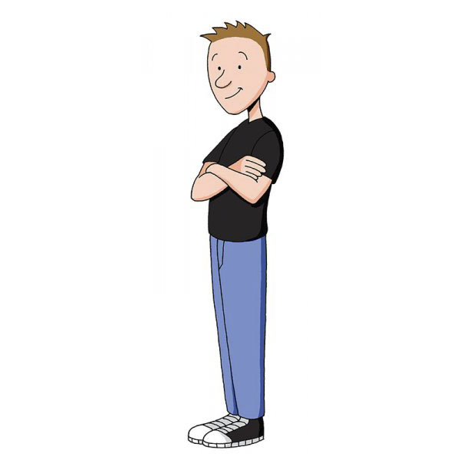
Is he standing?
Yes, I am. Yes, they are.
Yes, he is. Yes, she is.

Slide 3
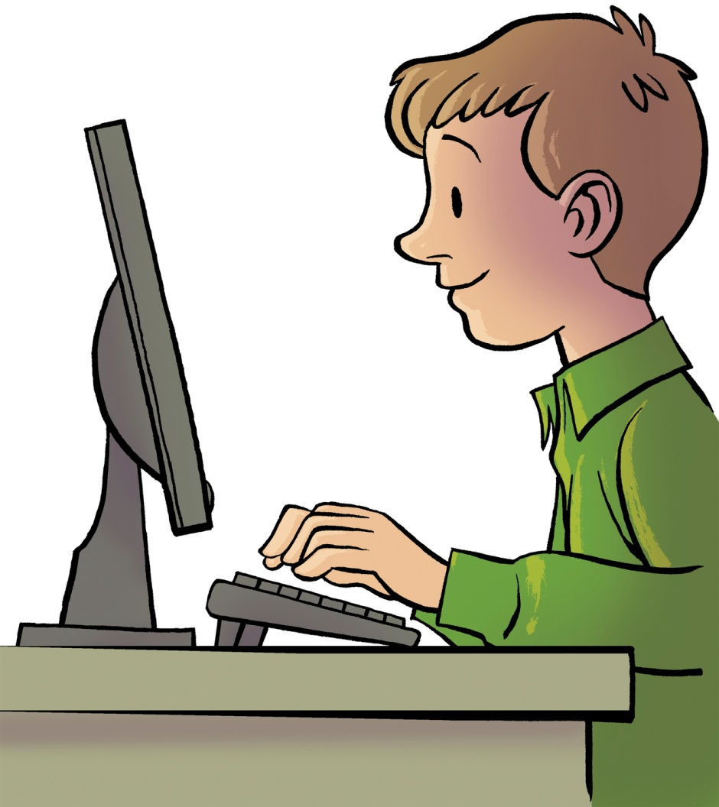
Is he looking at the screen?
Yes, I am. Yes, they are.
Yes, he is. Yes, she is.

Slide 4
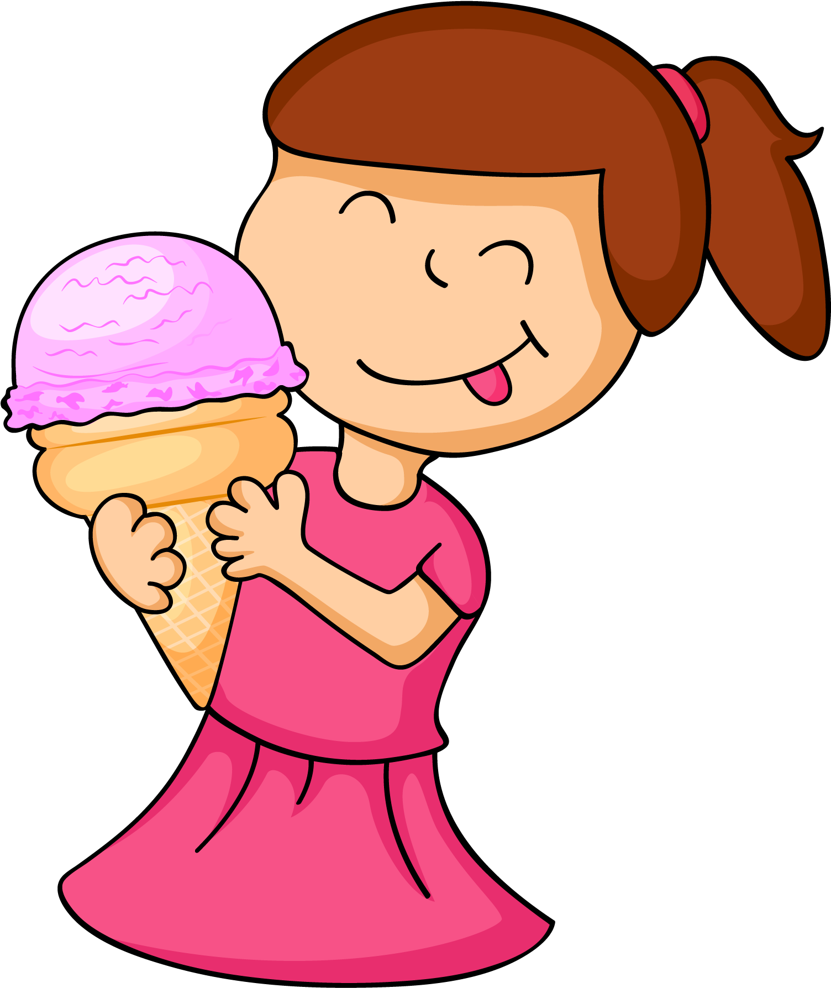
Is she eating ice cream?
Yes, I am. Yes, they are.
Yes, he is. Yes, she is.

Slide 5
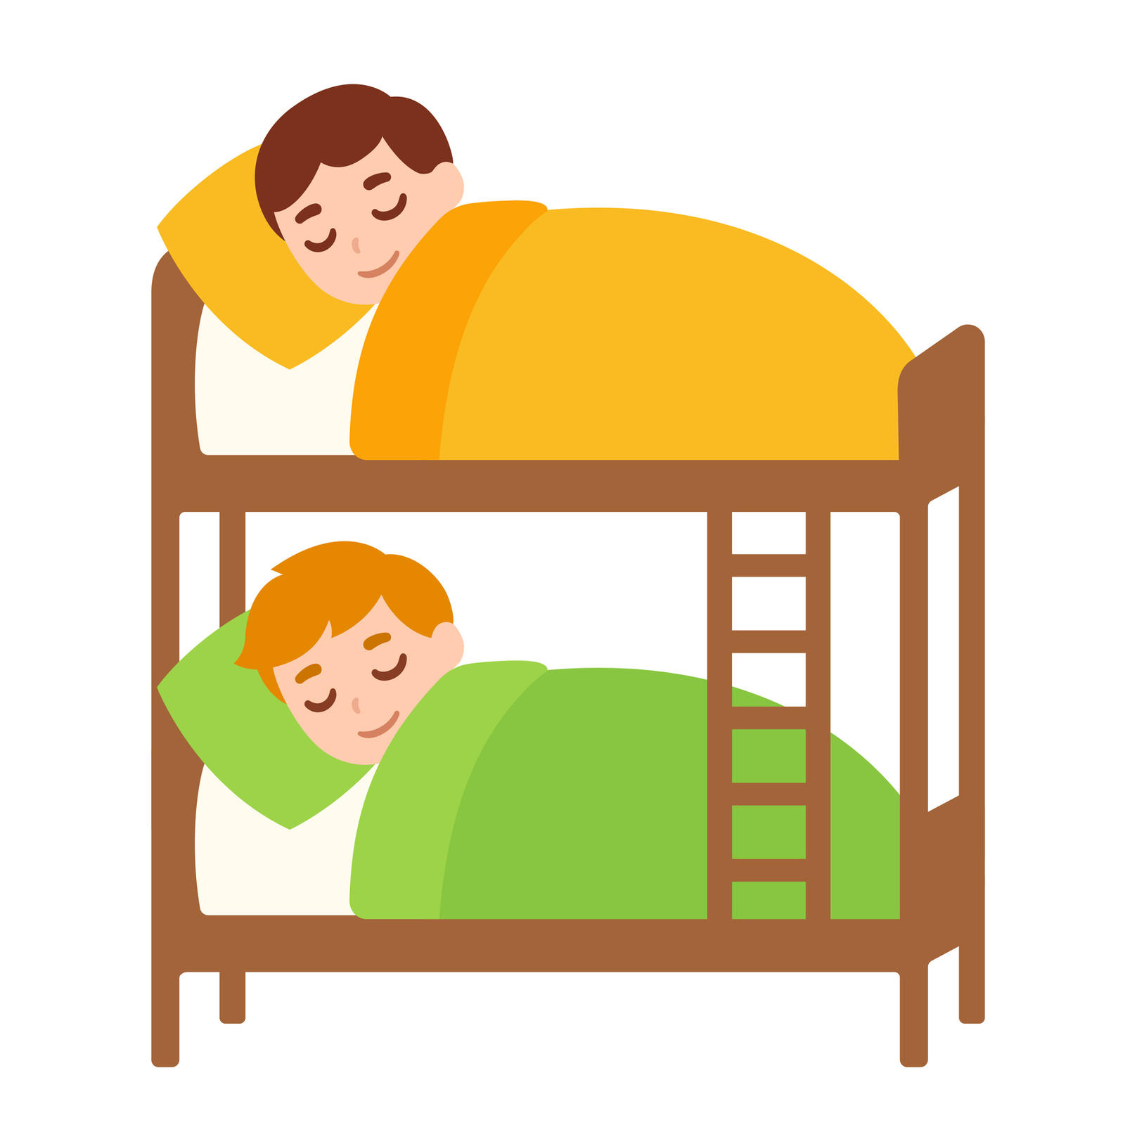
Are they sleeping?
Yes, I am. Yes, they are.
Yes, he is. Yes, she is.

Slide 6
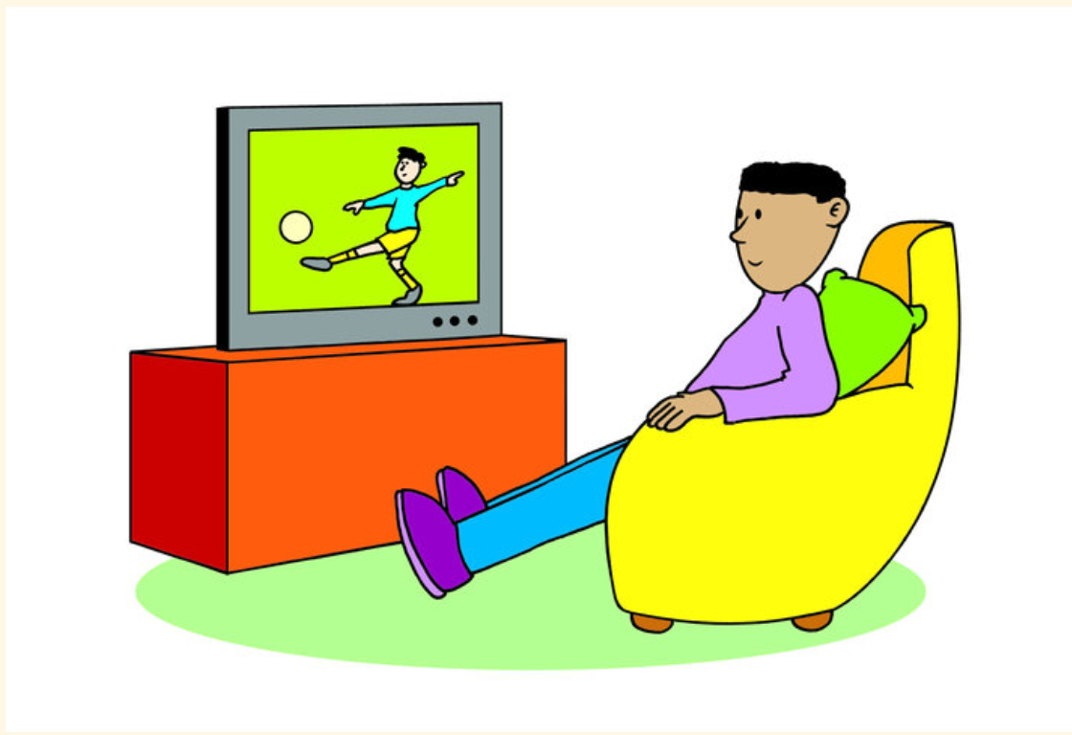
Are you watching cartoons?
No, I’m not. No, they aren’t.
No, he isn’t. No, she isn’t.

Slide 7
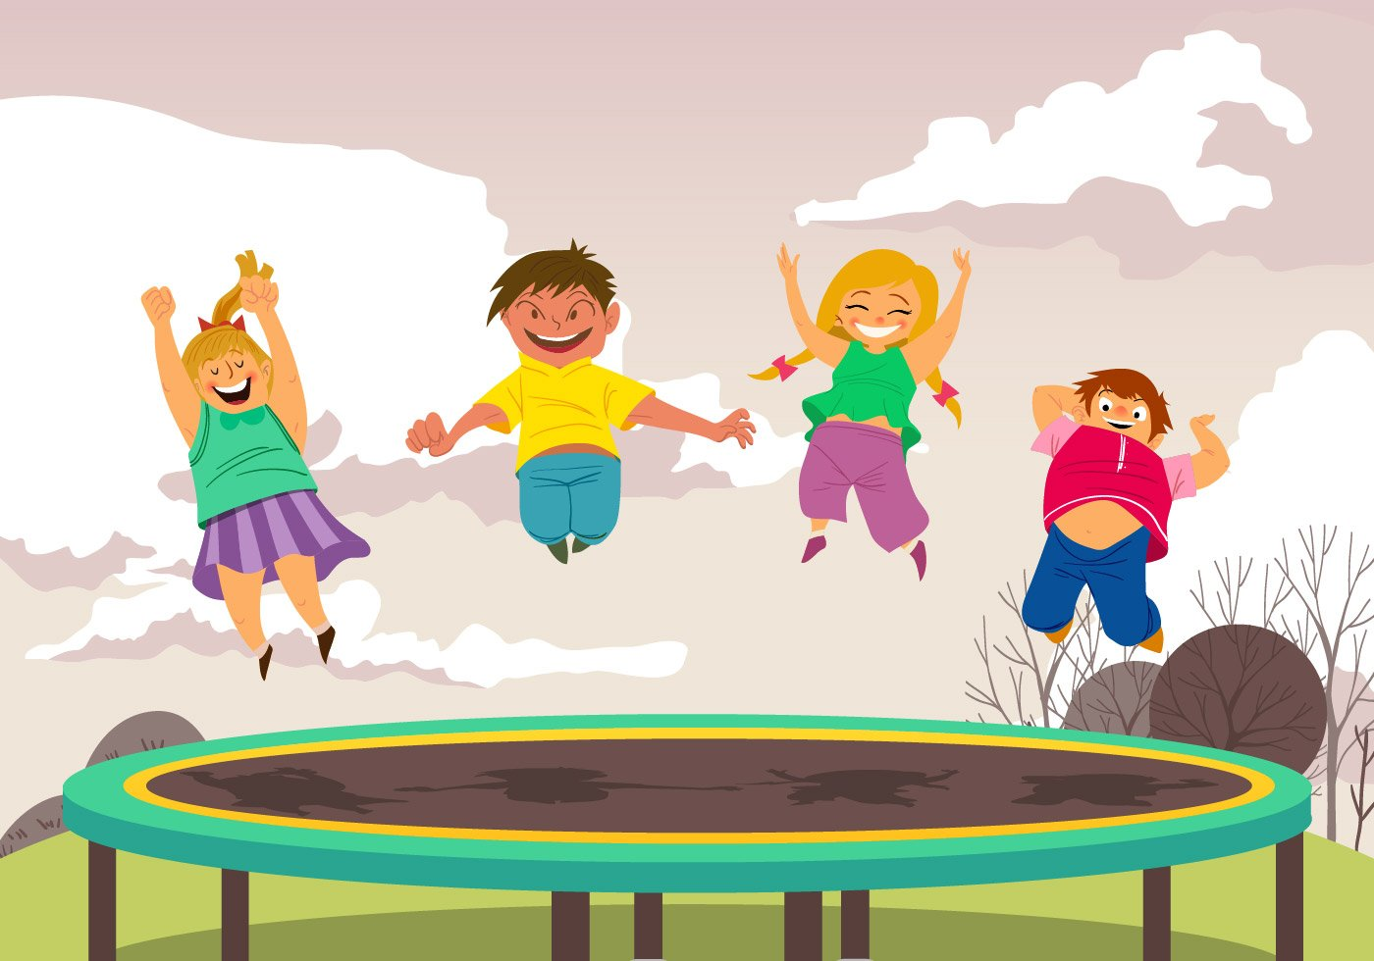
Are they having breakfast?
No, I’m not. No, they aren’t.
No, he isn’t. No, she isn’t.

Slide 8
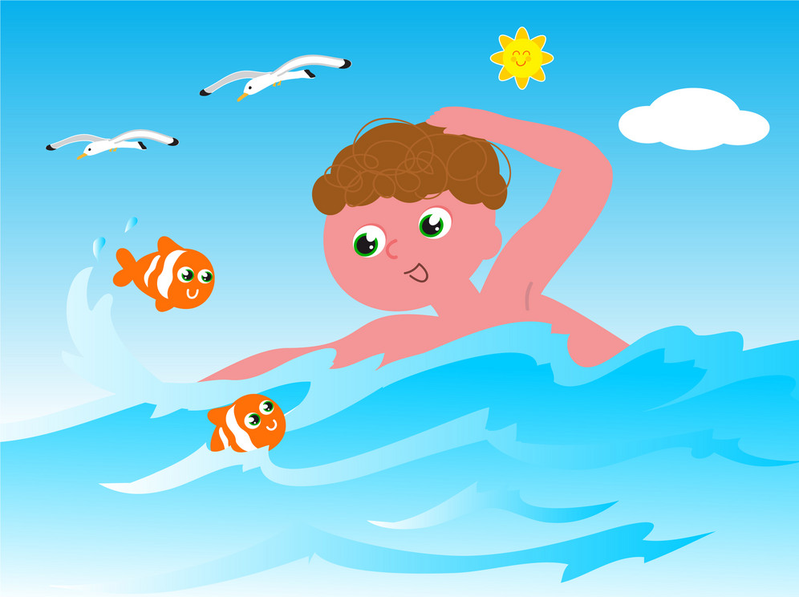
Is he swimming in the pool?
No, I’m not. No, they aren’t.
No, he isn’t. No, she isn’t.

Slide 9

Is she reading a book?
No, I’m not. No, they aren’t.
No, he isn’t. No, she isn’t.

Slide 10
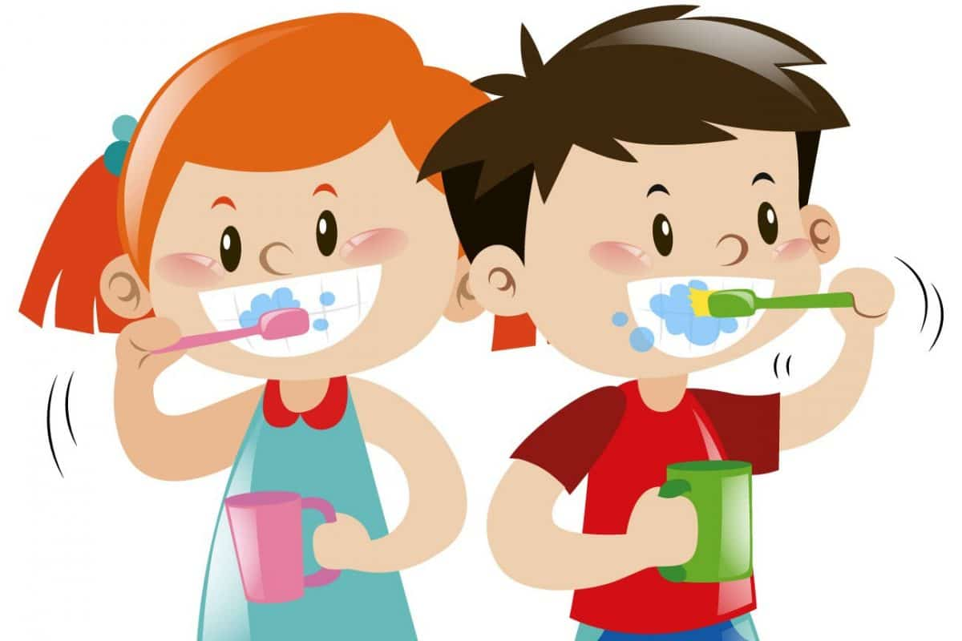
they / brush their teeth?
Notes:
Are they brushing their teeth? Yes, they are. Student make questions and answers in pairs.

Slide 11
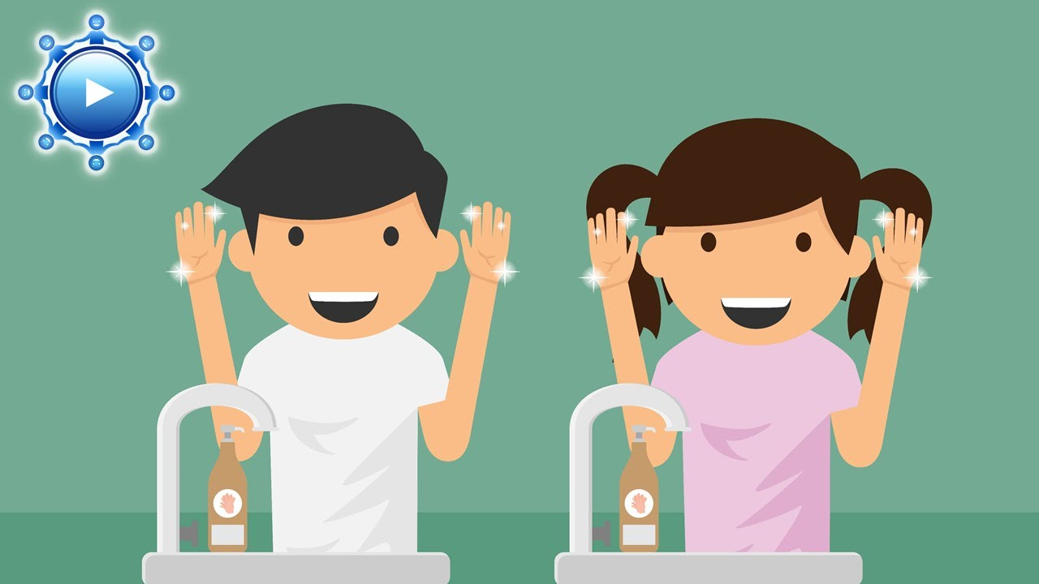
they / wash their faces?

Slide 12

she / sleep?

Slide 13

she / swim in the sea?

Slide 14
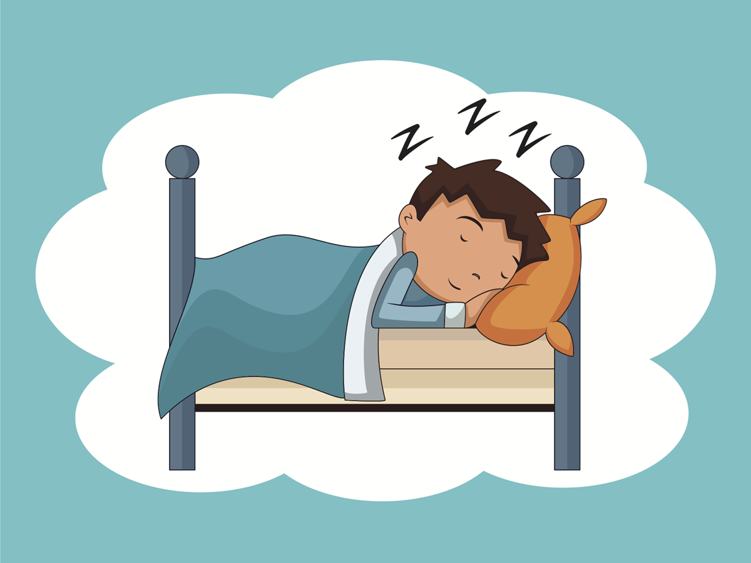
he / sleep?

Slide 15
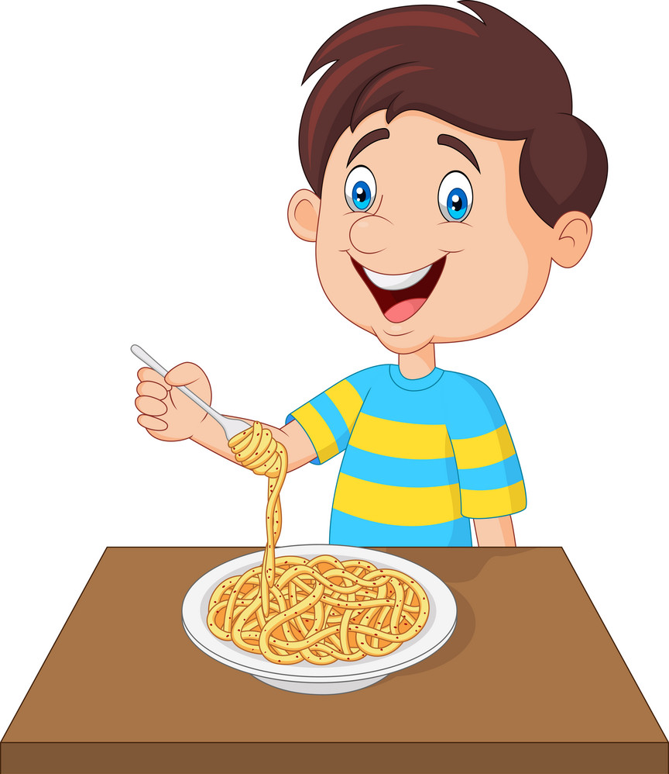
he / eat ice cream?

Slide 16
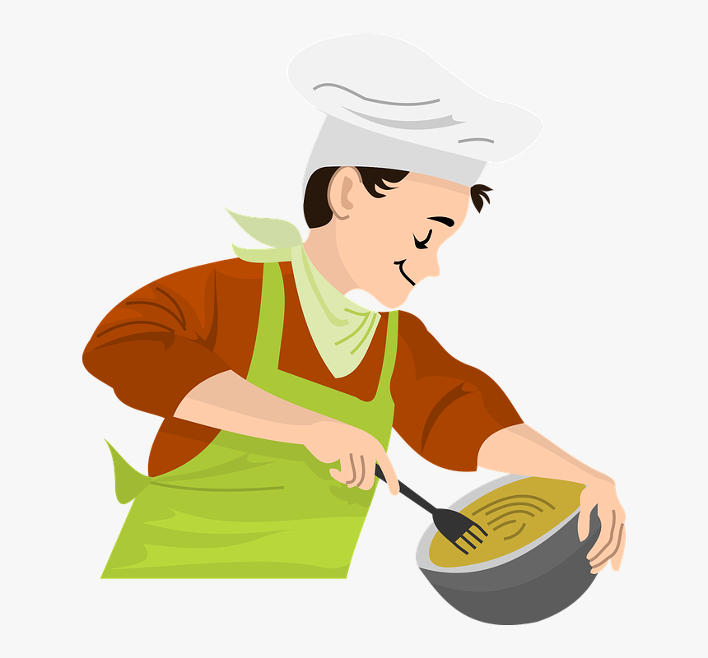
you / cook?

Slide 17
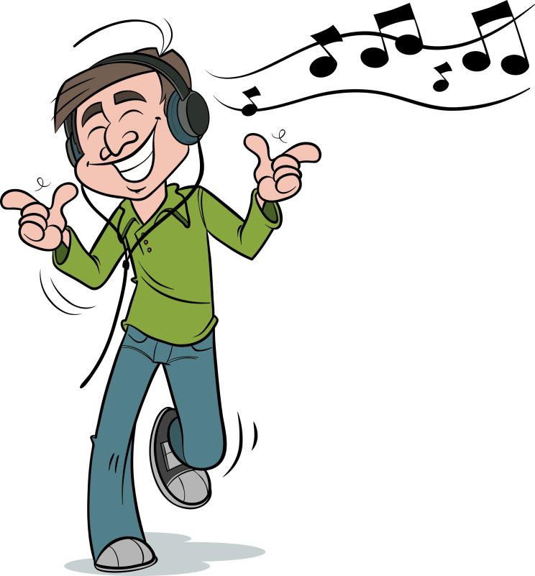
you / ride a bike?

