Slide 1

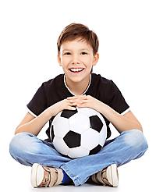
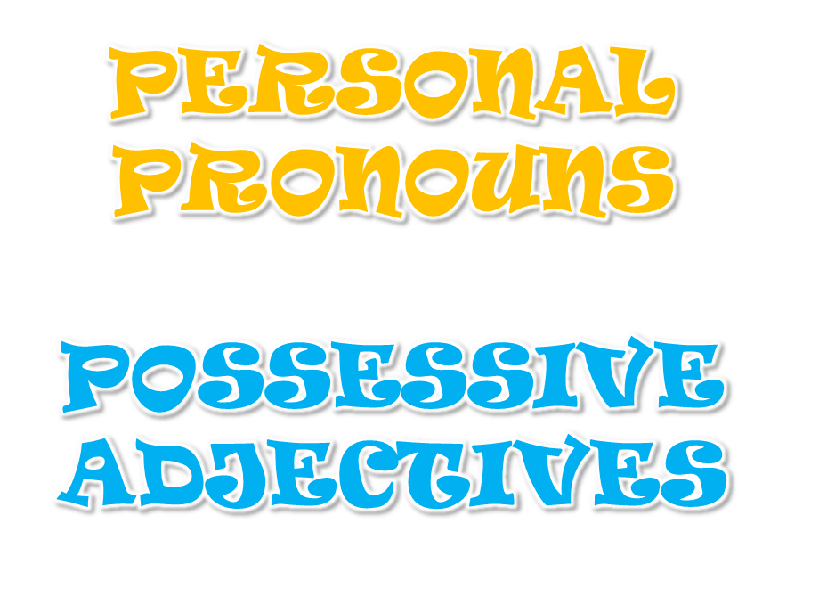
by HERBER

Slide 2
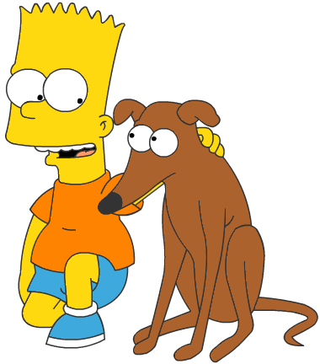
POSSESSIVE ADJECTIVES
This is Bart’s dog.
It’s _________ dog.
my
your
his
her
its
our
Complete the sentences

Slide 3
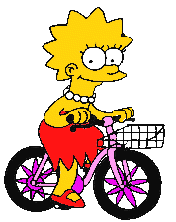
POSSESSIVE ADJECTIVES
This is Lisa’s bike.
It’s _________ bike.
my
your
his
her
its
our
Complete the sentences

Slide 4
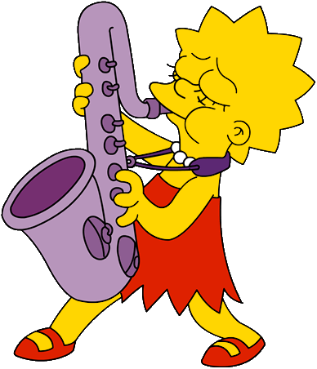
POSSESSIVE ADJECTIVES
I have got a saxophone.
It’s _______ saxophone.
my
your
his
her
its
our
Complete the sentences

Slide 5
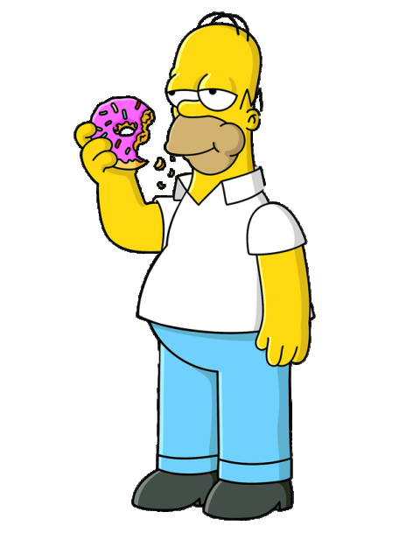

POSSESSIVE ADJECTIVES
Dad, you have got a doughnut.
It’s _______ doughnut.
my
your
his
her
its
our

Slide 6
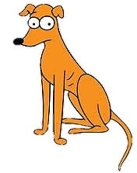
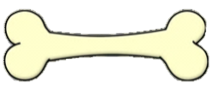
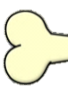
POSSESSIVE ADJECTIVES
The dog has got a bone.
It’s _______ bone.
my
your
his
her
its
our

Slide 7
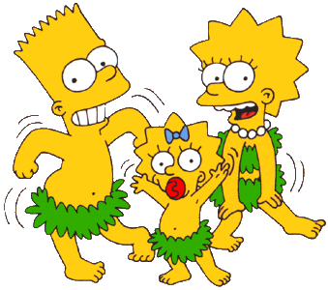
POSSESSIVE ADJECTIVES
Bart and I have got a sister.
It’s _______ sister.
my
your
his
her
its
our

Slide 8
BYE BYE!

