Slide 1
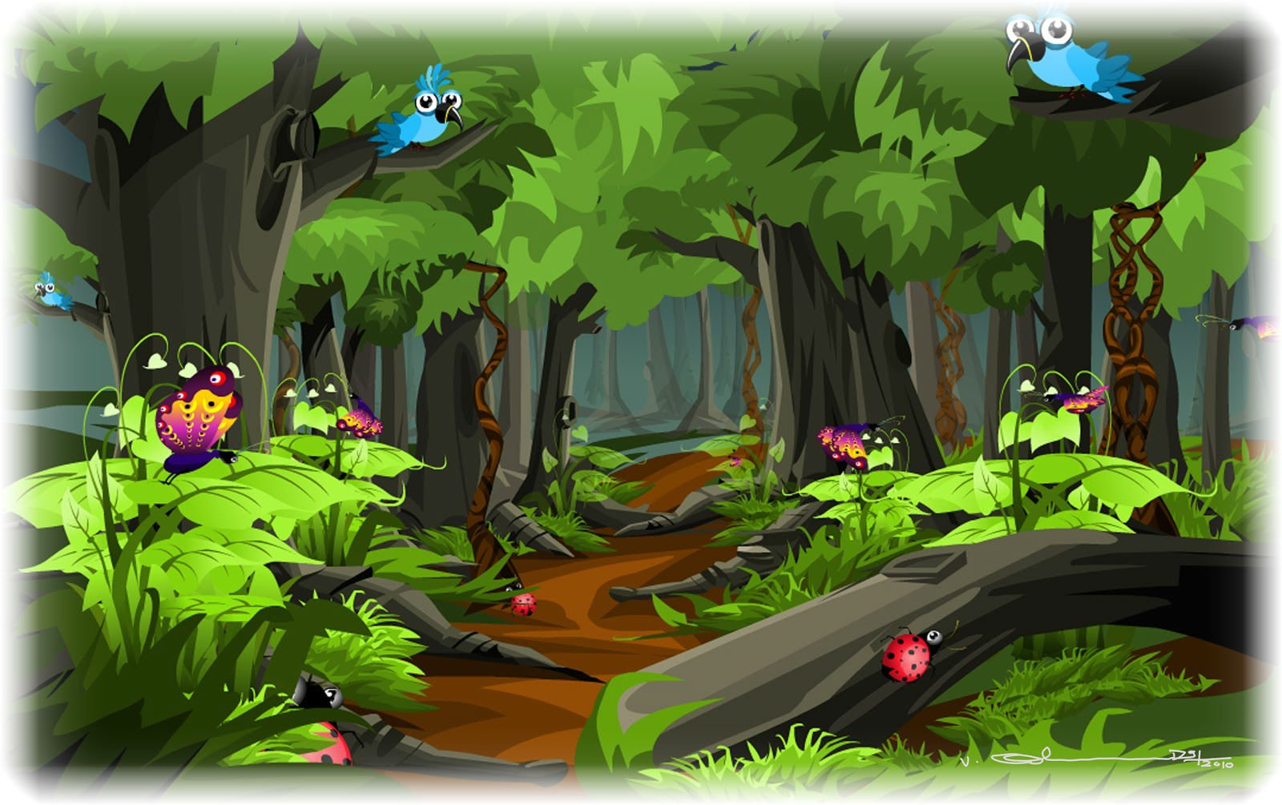
Last Monday we …
in the forest

Slide 2
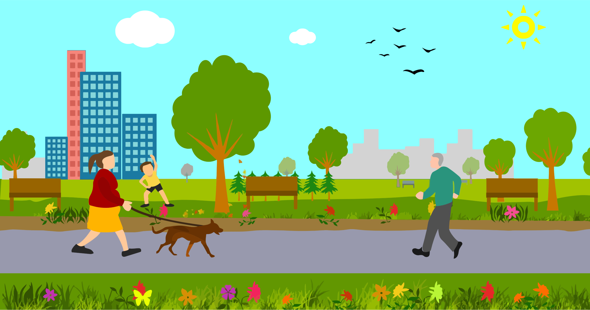
Last Tuesday they … in the park

Slide 3
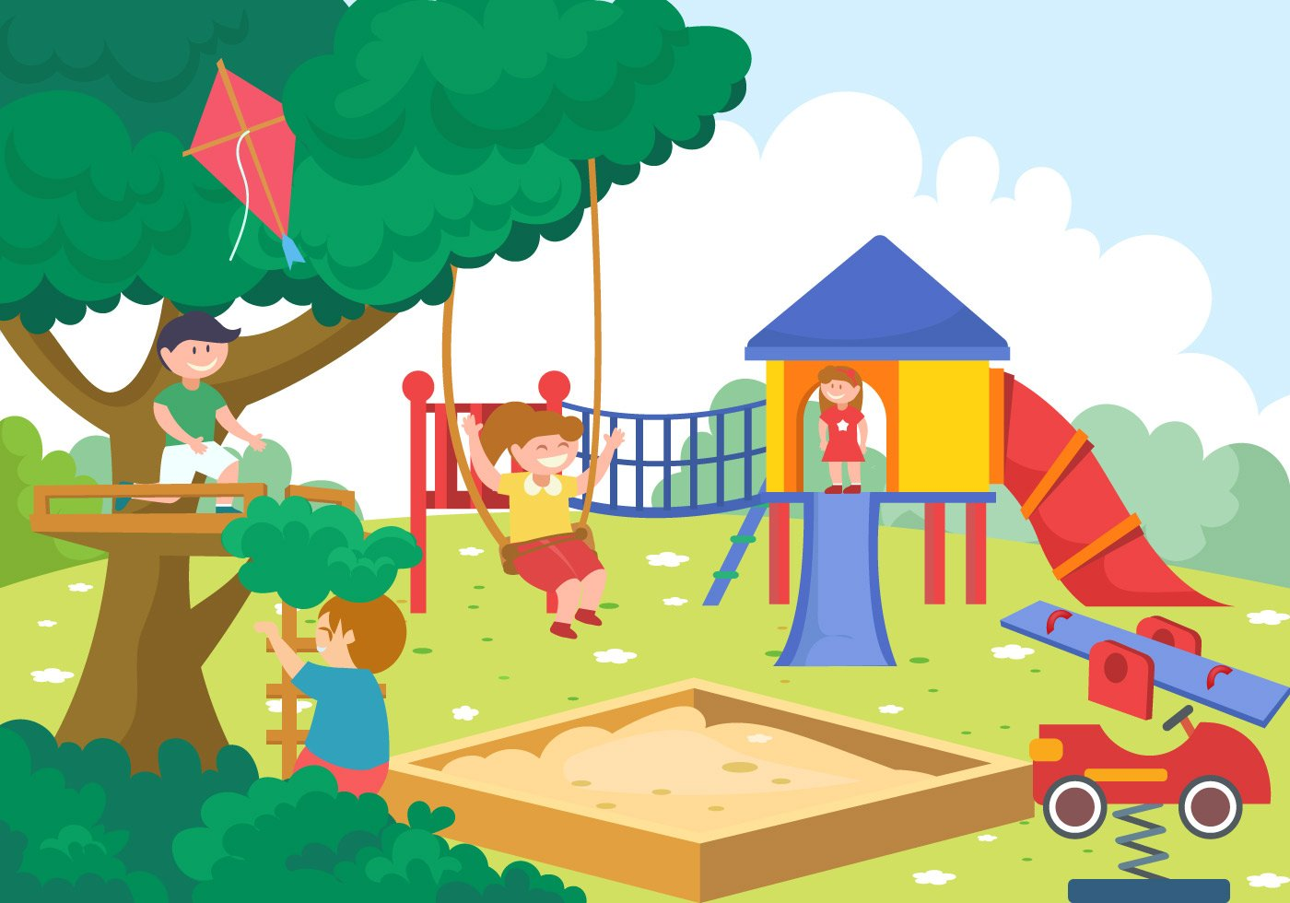
Last Wednesday you … on the playground

Slide 4
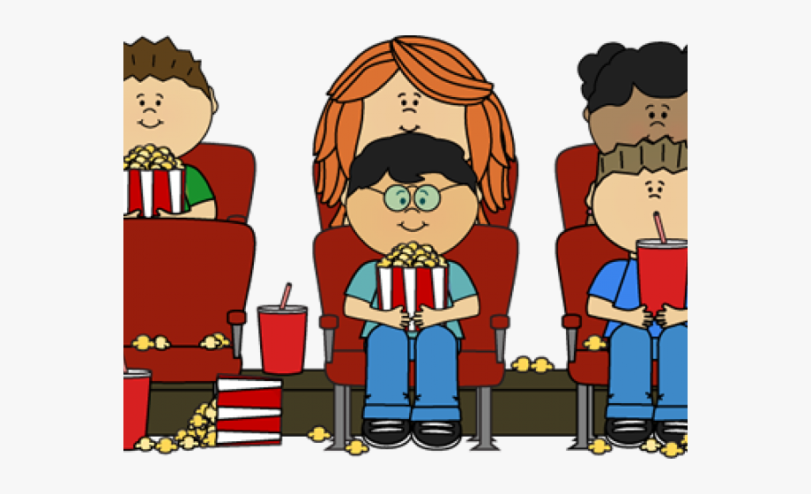
Last Thursday we … at the cinema

Slide 5
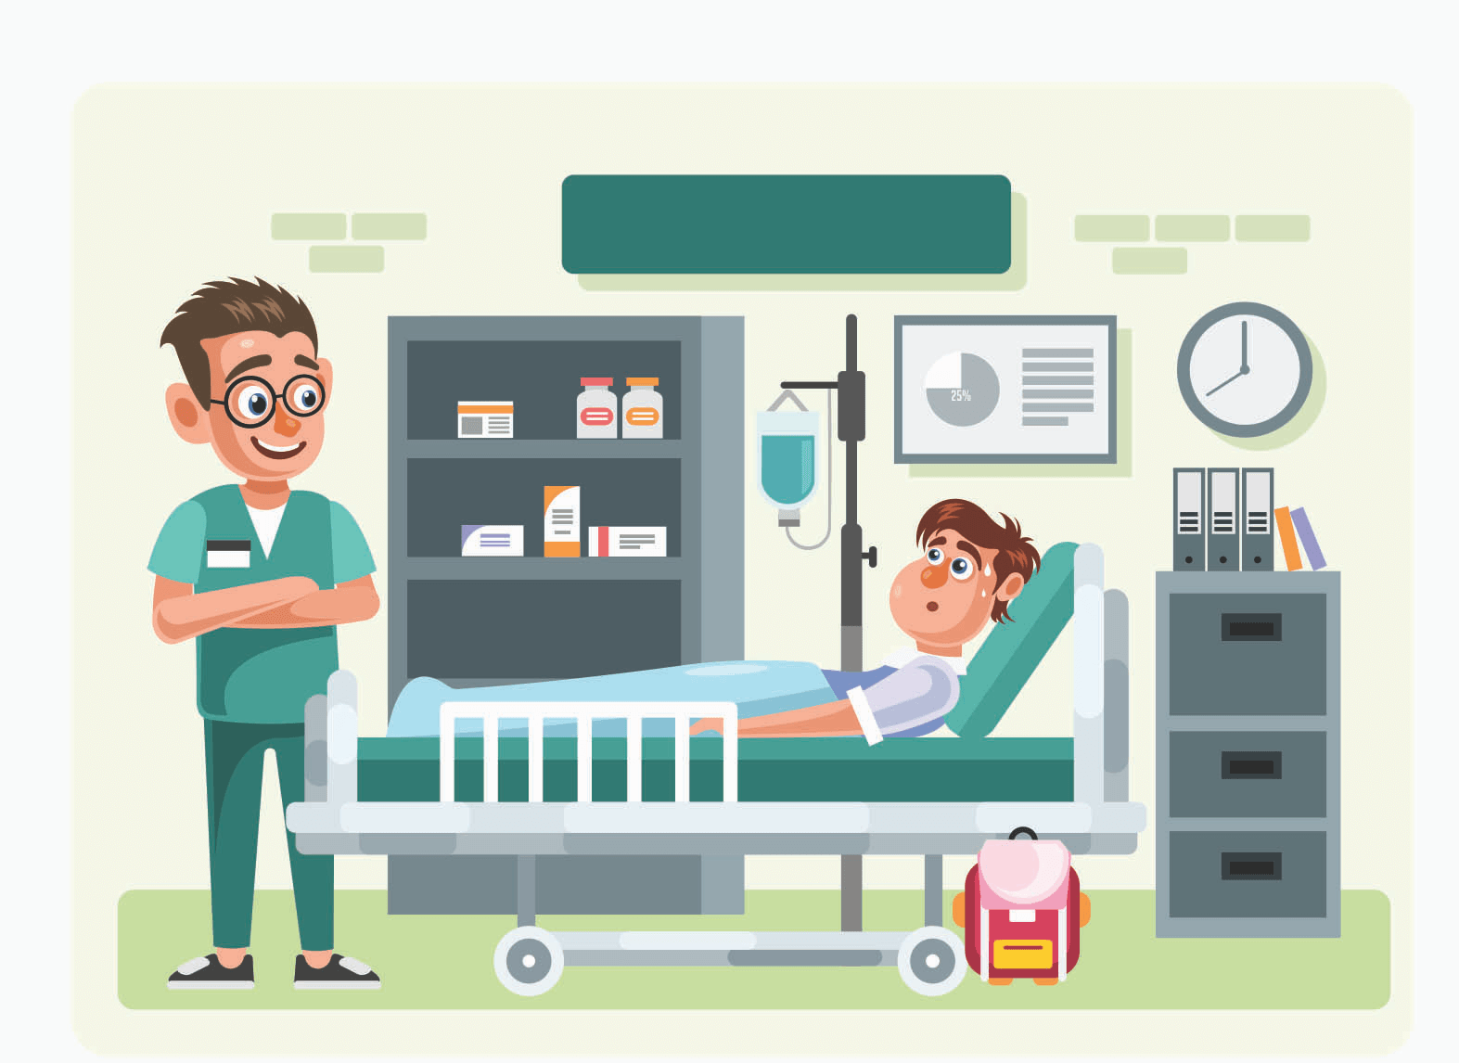
Last Friday they … in hospital

Slide 6
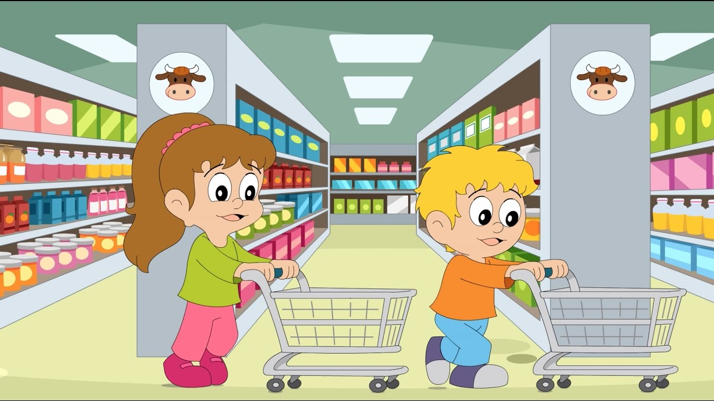
Last Saturday you … in the supermarket

Slide 7
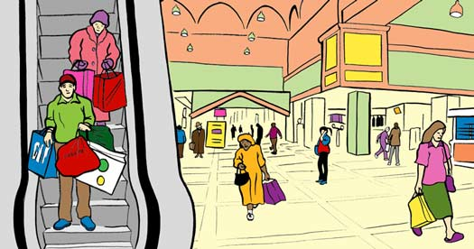
Last Sunday they … in the shopping centre

Slide 8
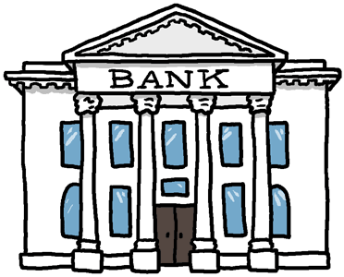
Last Monday we … in the bank

Slide 9
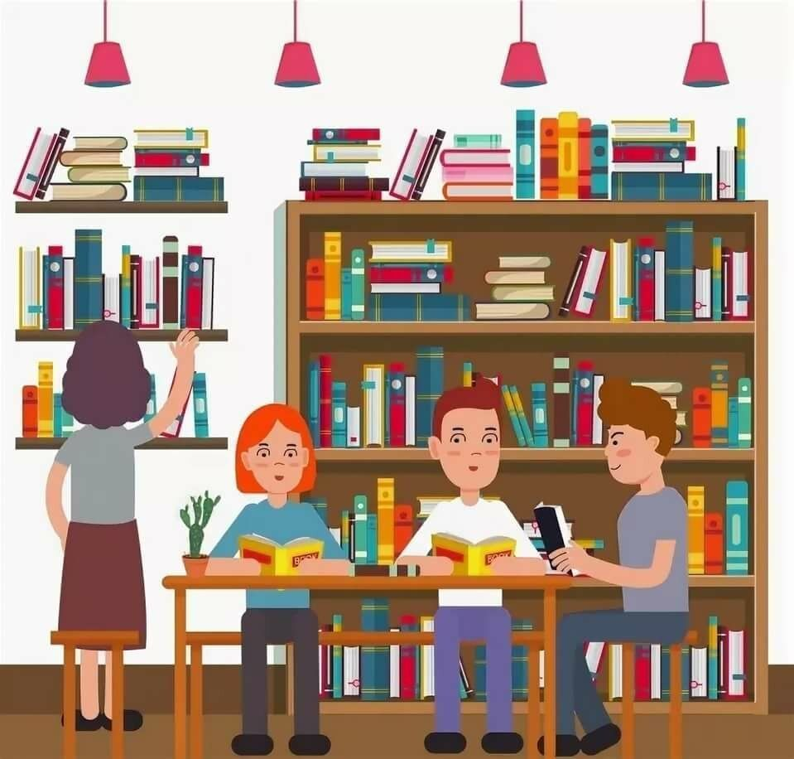
Last Tuesday you … in the library

Slide 10
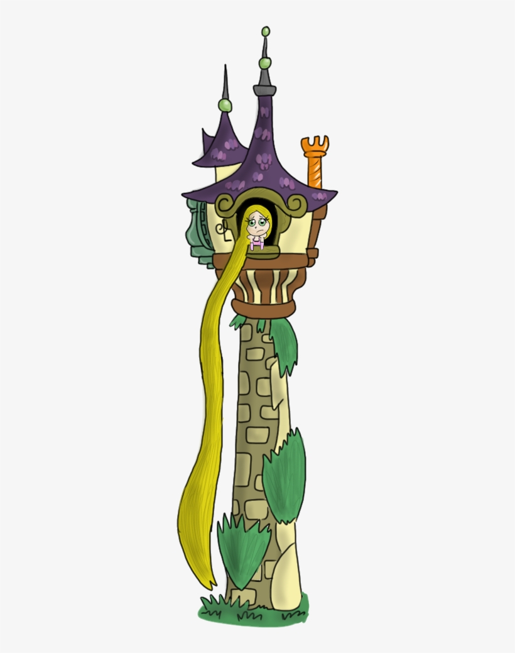
Last Wednesday we … in the tower

Slide 11
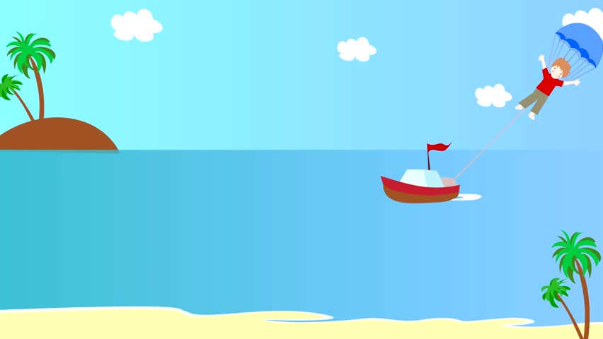
Last Thursday they … in the sea

Slide 12
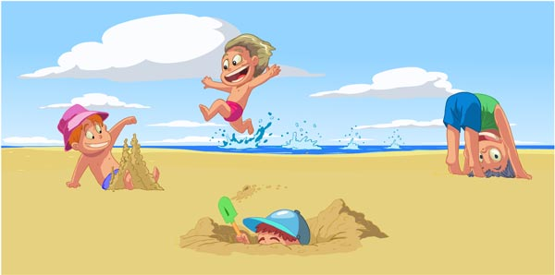
Last Friday we … on the beach

Slide 13
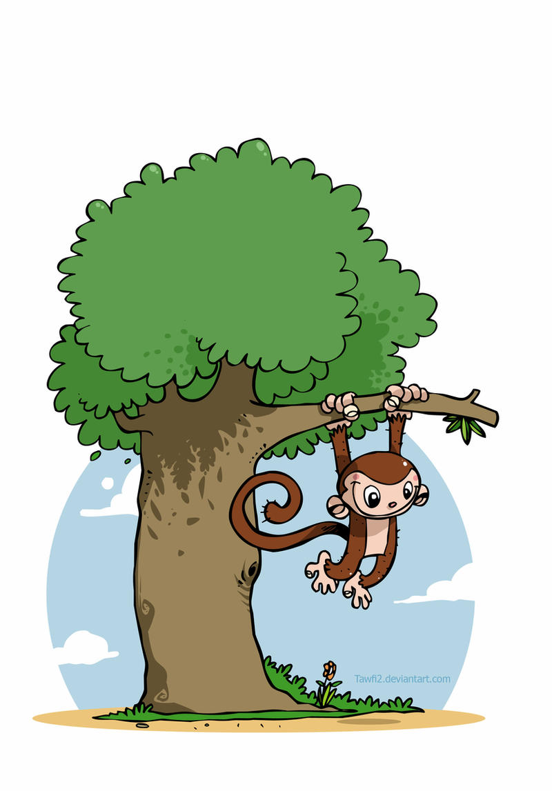
Last Saturday you … in the tree

Slide 14
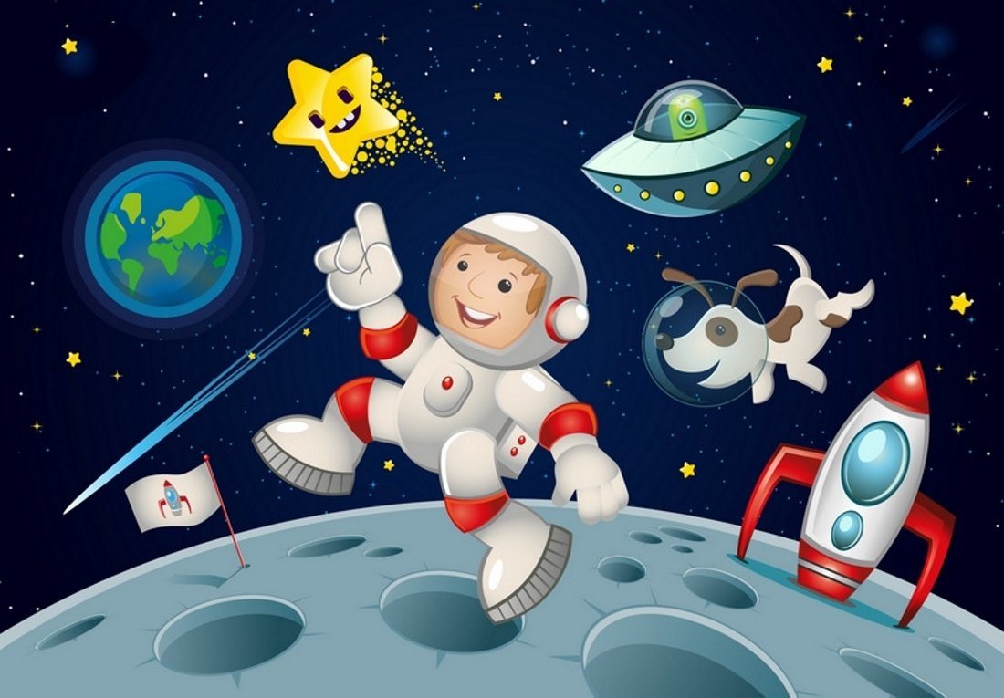
Last Sunday you … in the space

Slide 15
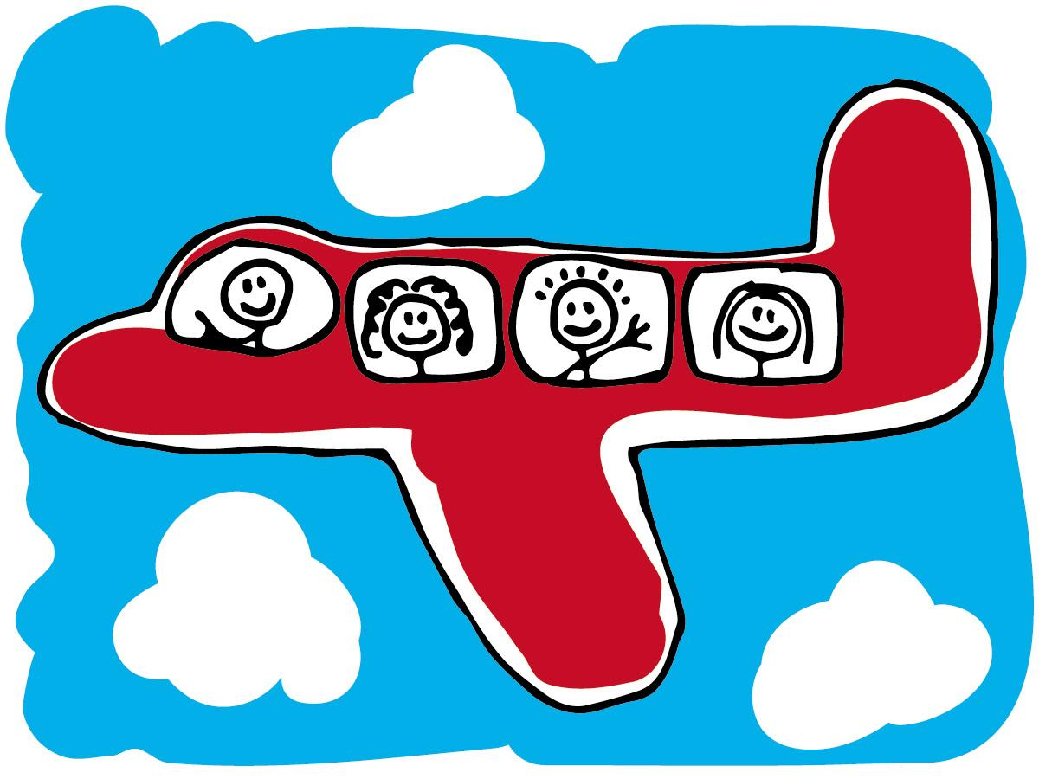
Last Monday they … on the plane

Slide 16
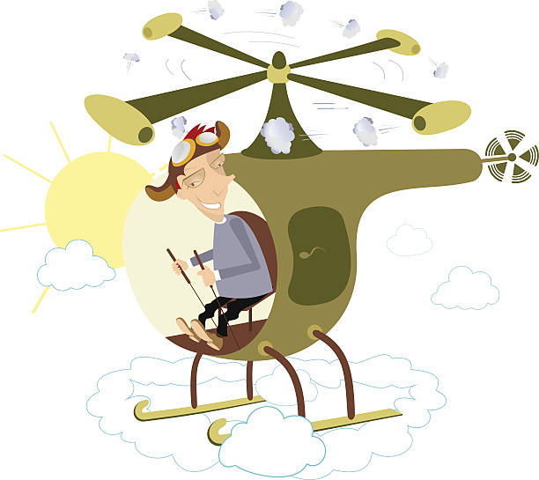
Yesterday morning they … in the helicopter

Slide 17
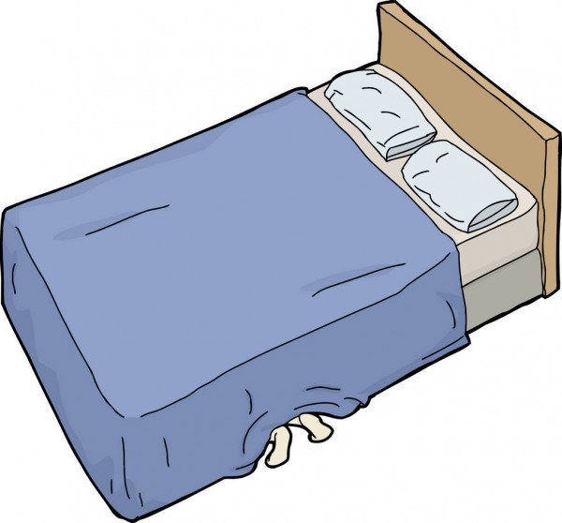
Yesterday afternoon you … under the bed

Slide 18
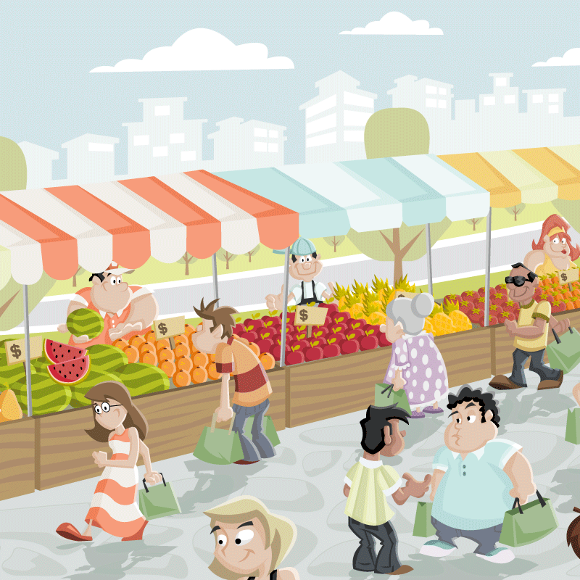
Yesterday evening we … on the market square

Slide 19
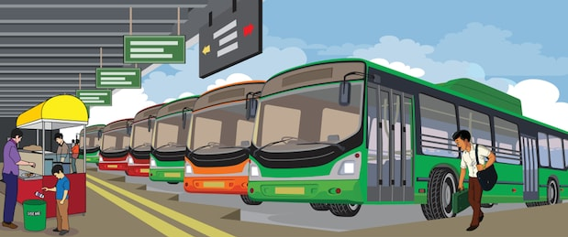
Last night they … at the bus station

Slide 20
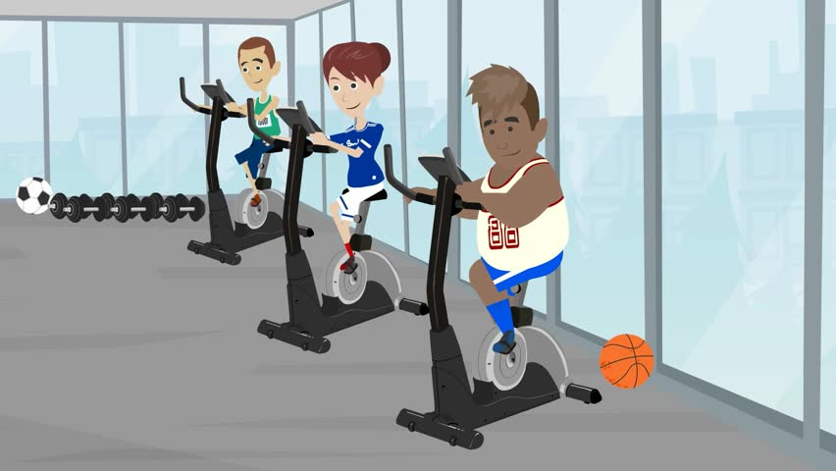
Yesterday they … in the sports centre

Slide 21
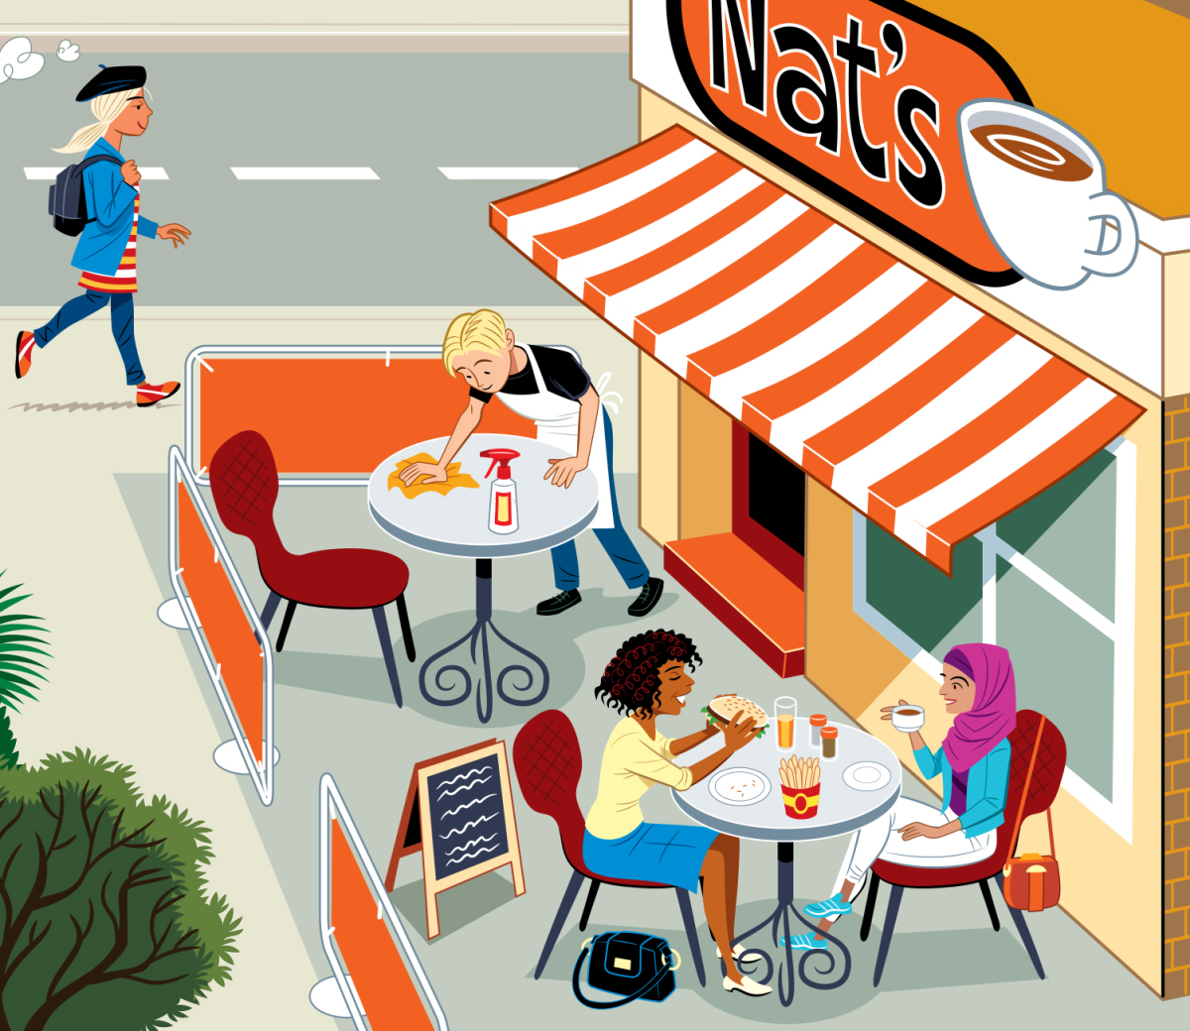
Yesterday afternoon you … in the café

Slide 22
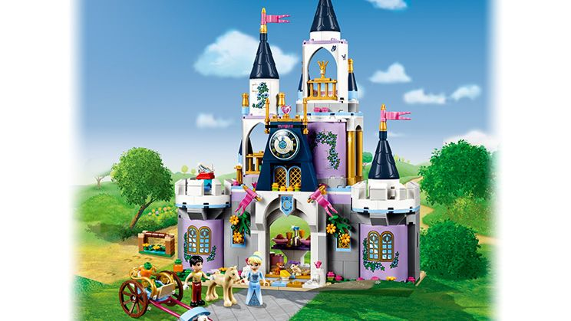
Yesterday evening we … in the castle

Slide 23
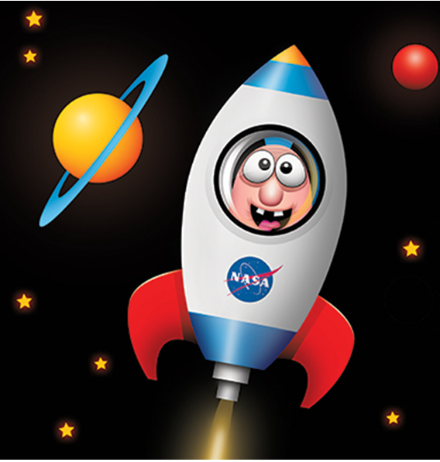
Yesterday morning you … in the rocket

Slide 24
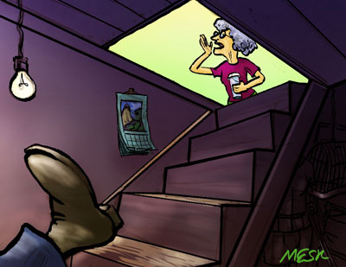
Last night they … in the cellar

Slide 25
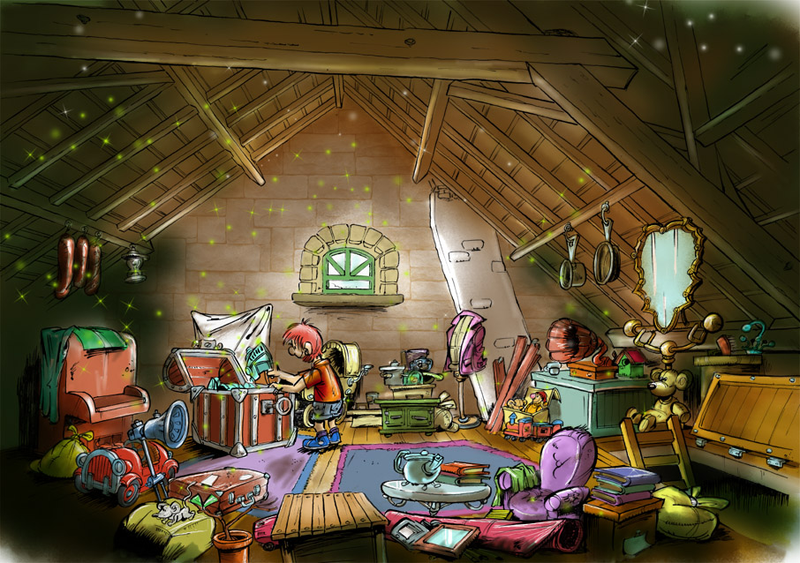
Yesterday morning we … in the attic

Slide 26
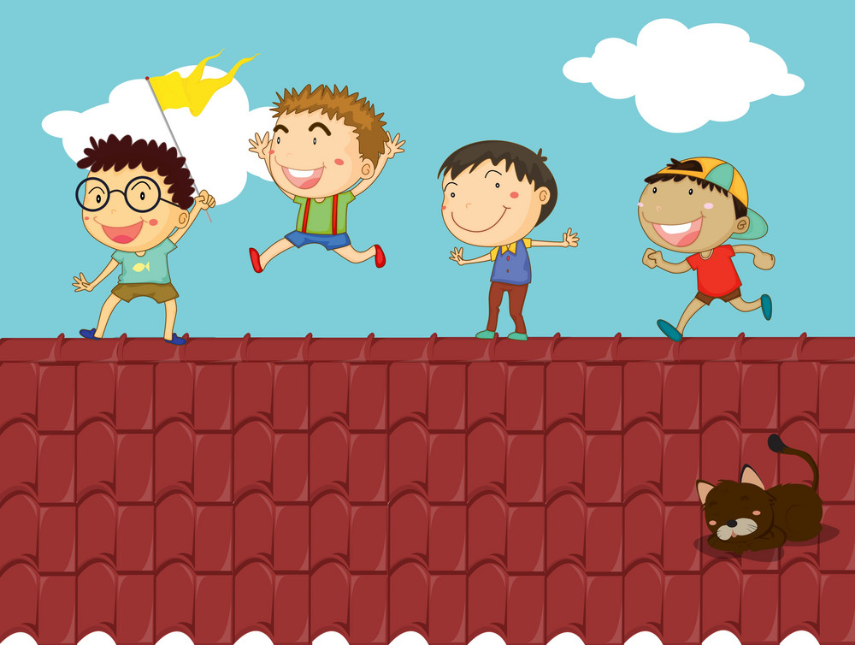
Yesterday afternoon you … on the roof

Slide 27
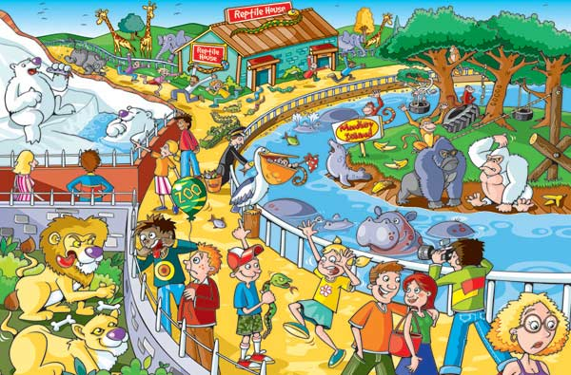
Yesterday evening they … at the zoo

Slide 28
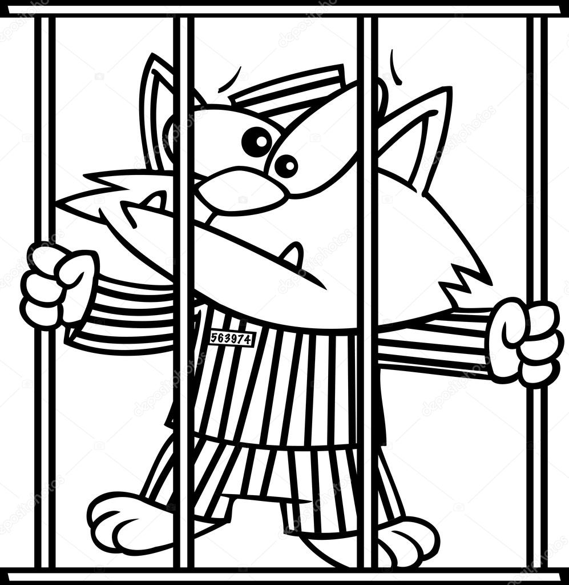
Last night you … in prison

Slide 29
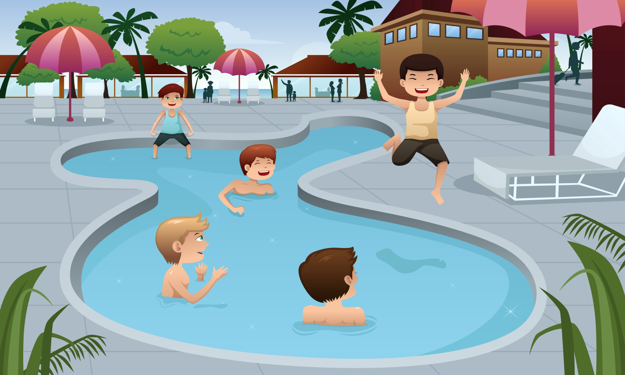
Yesterday morning they … in the swimming pool

Slide 30
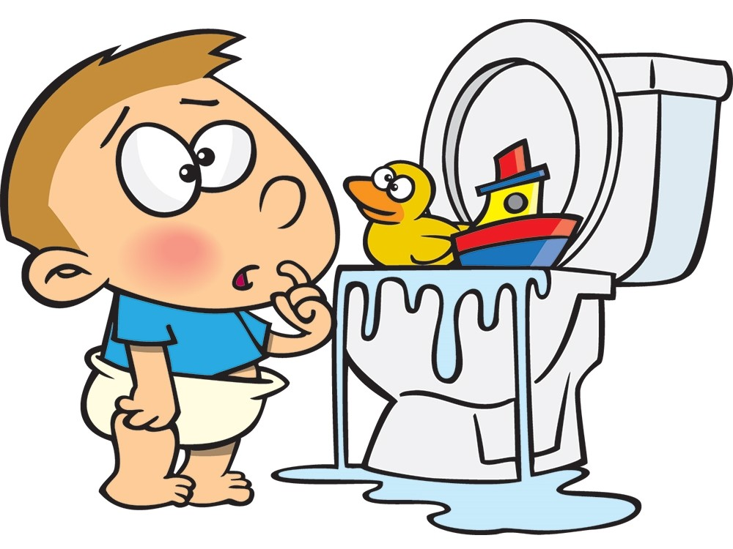
Yesterday afternoon we … in the toilet

Slide 31
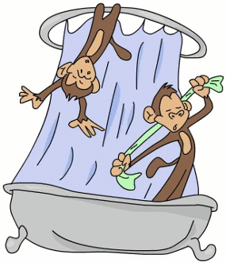
Yesterday evening they … in the shower

Slide 32
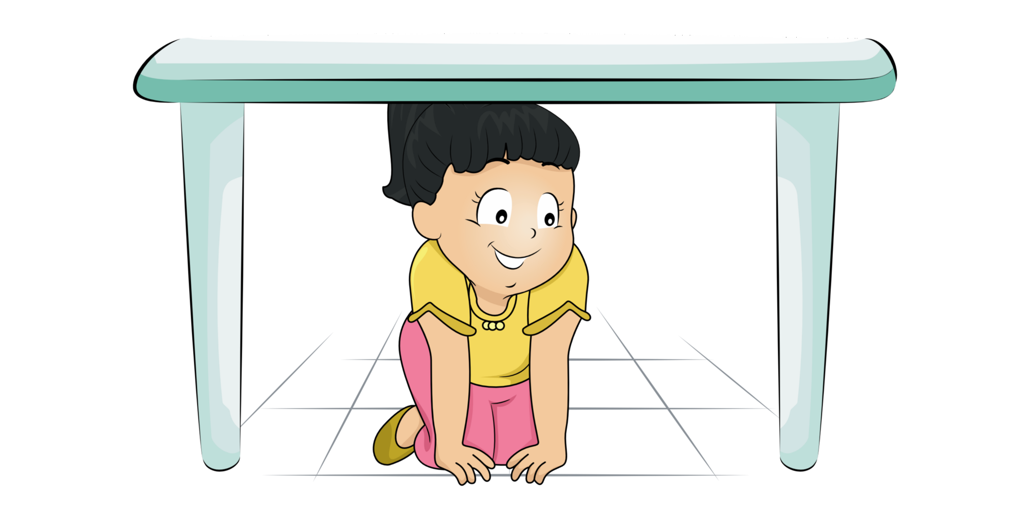
Last night you …. under the table

Slide 33
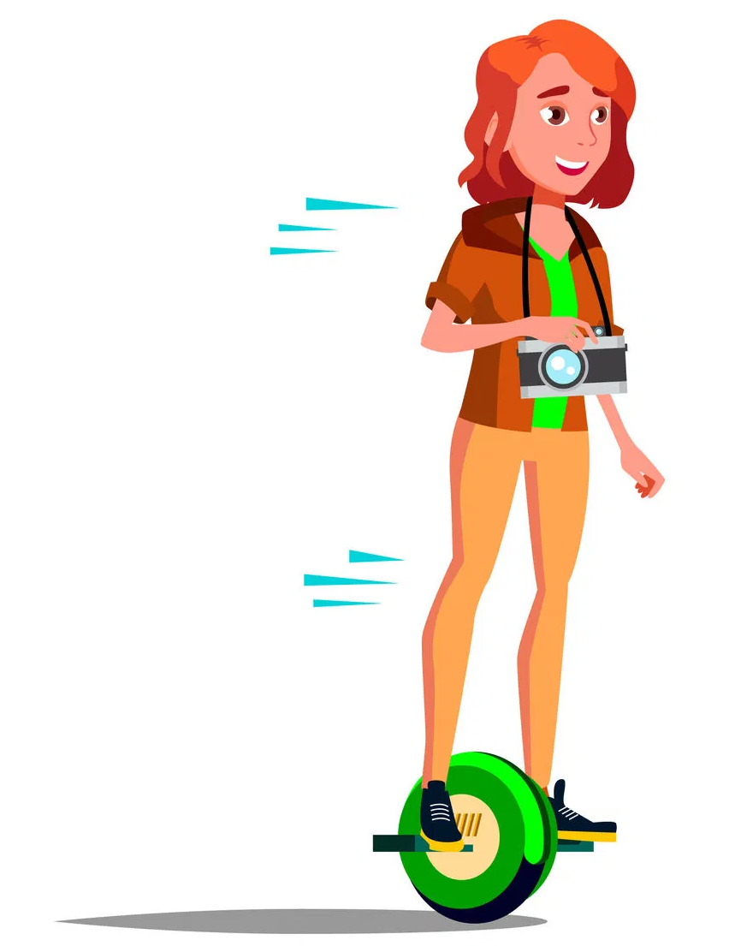
Yesterday evening you … on the gyroscope

Slide 34
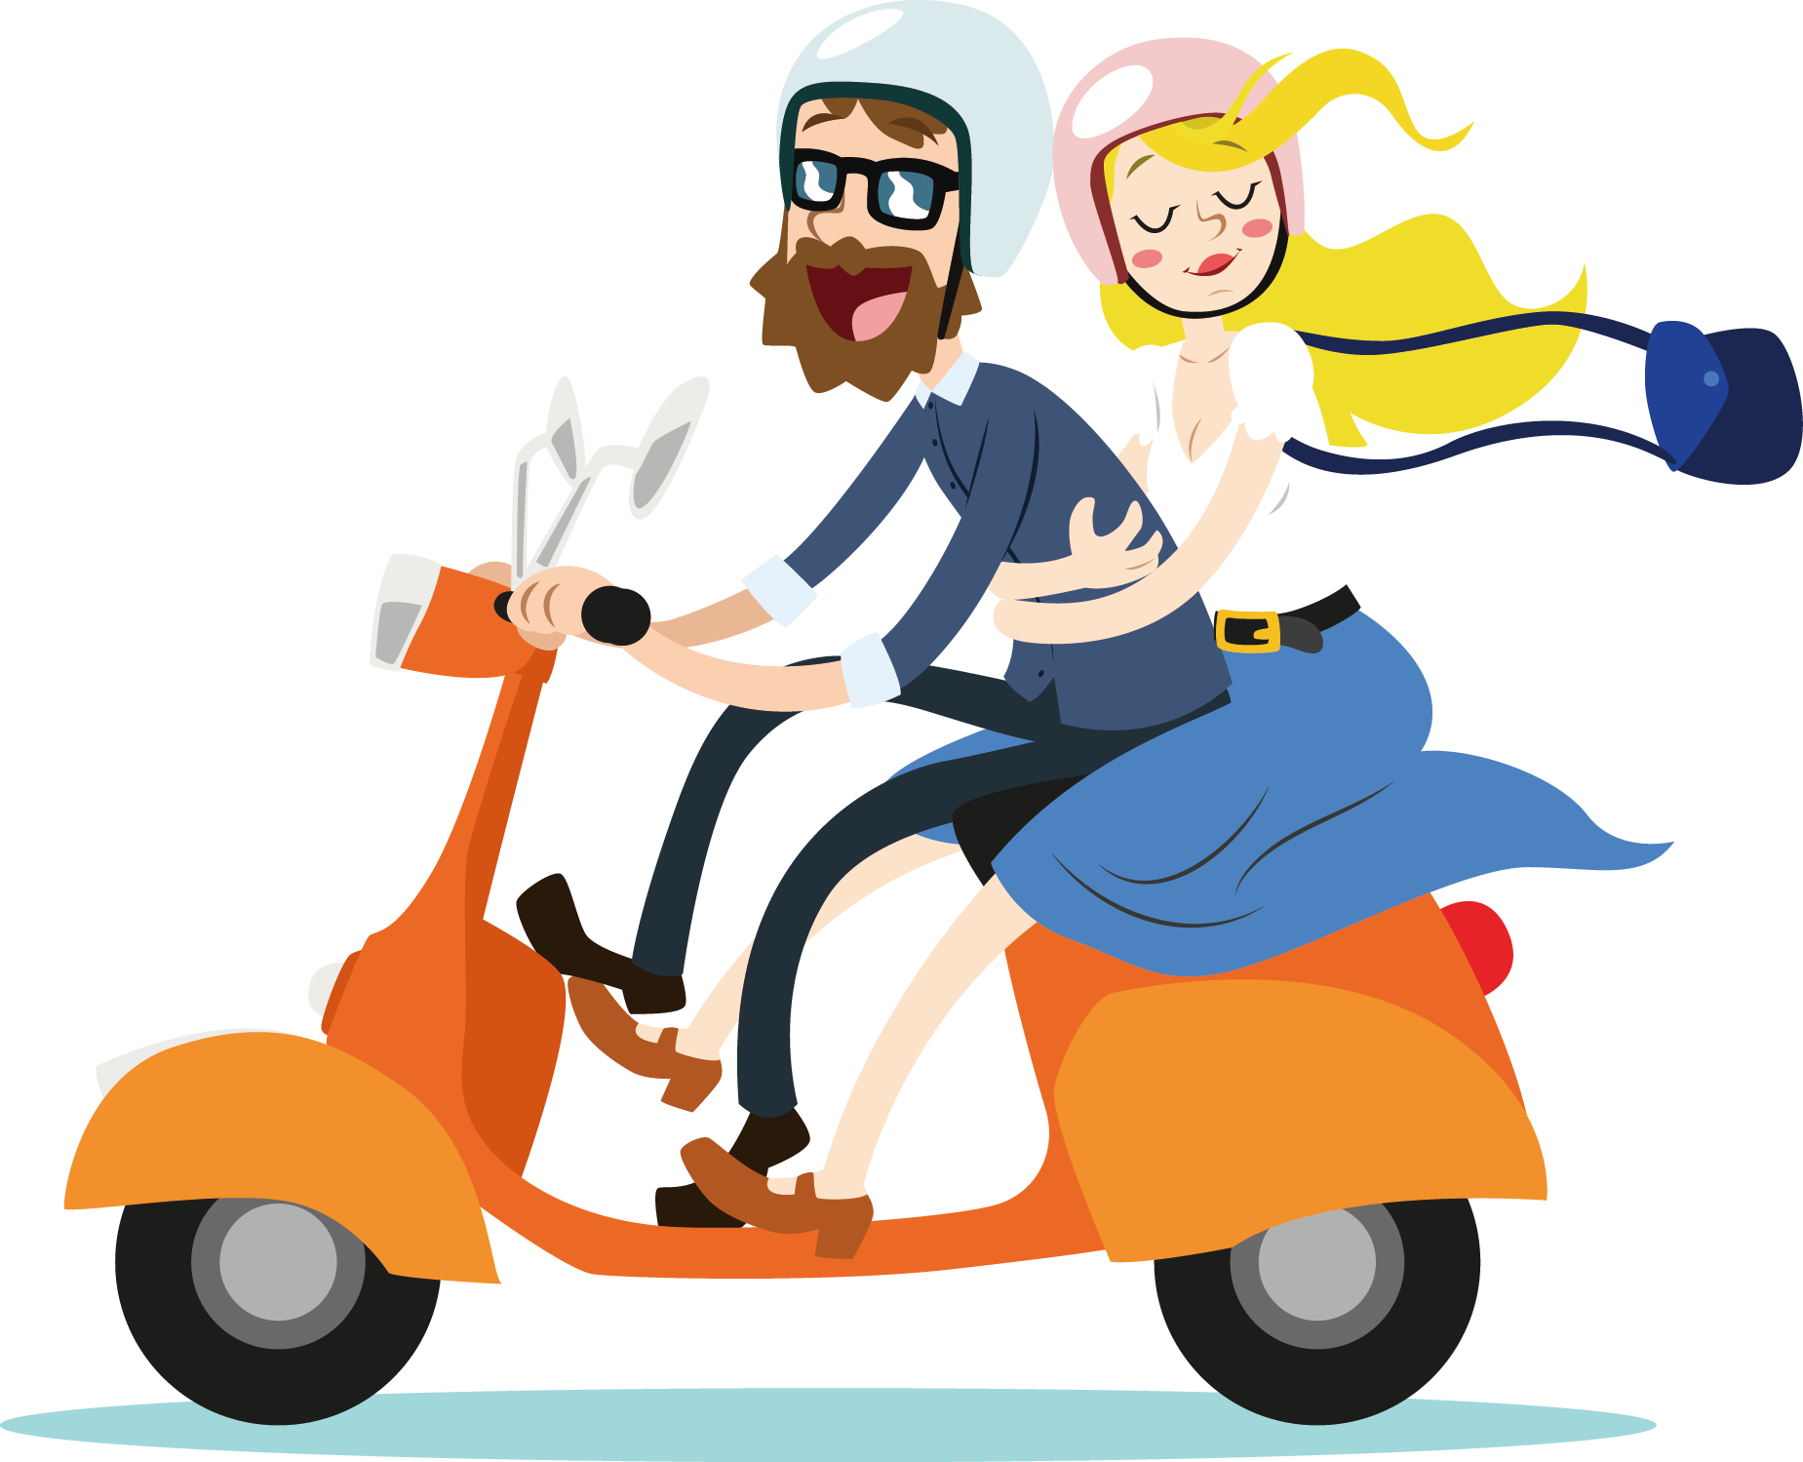
Yesterday morning we … on the scooter

