Slide 1
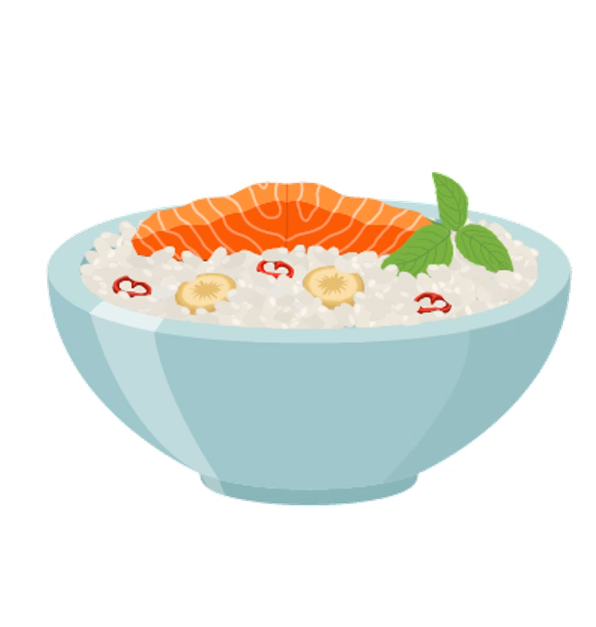

a/an
SOME
ANY
made by Sereda Nataliia

Slide 2
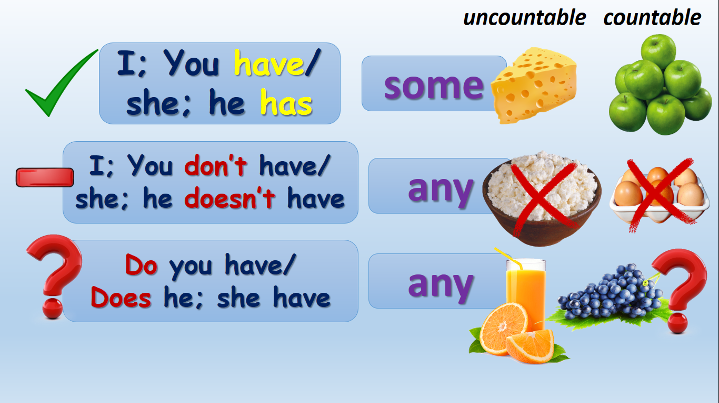

Slide 3
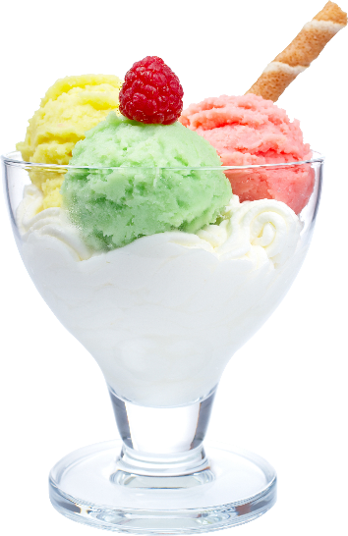
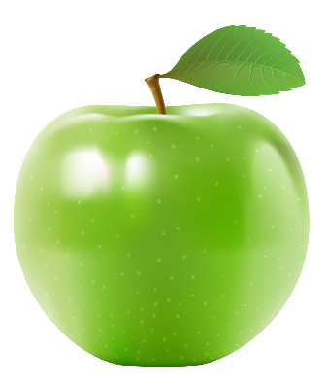
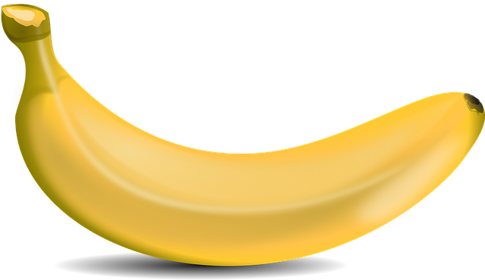
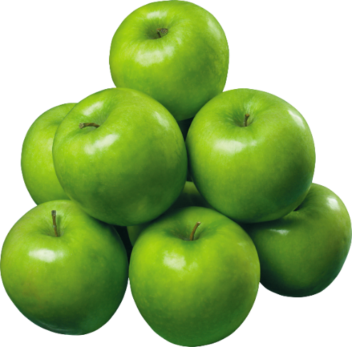
There is
some
There is
an; a
There are
some

Slide 4

Is there
any
Is there
an;a
Are there
any

Slide 5
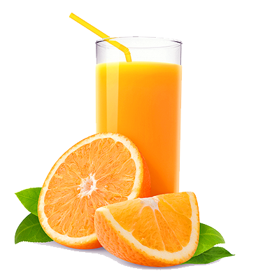
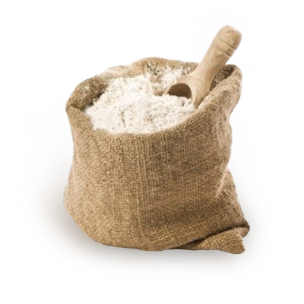
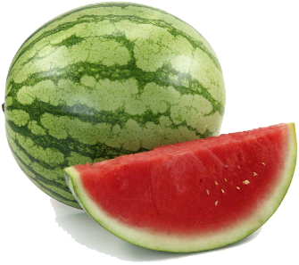
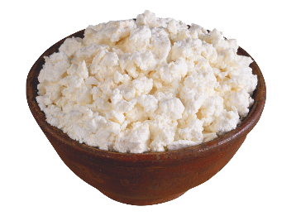
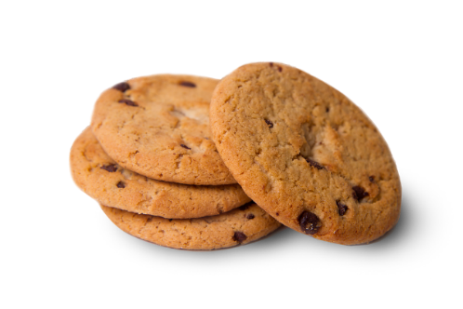
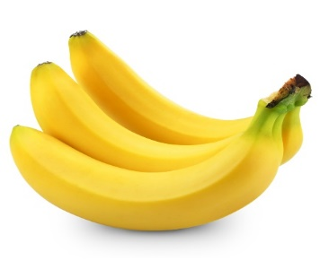
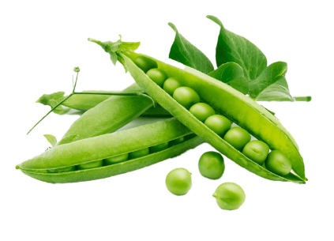
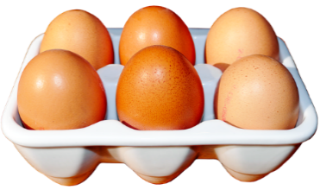

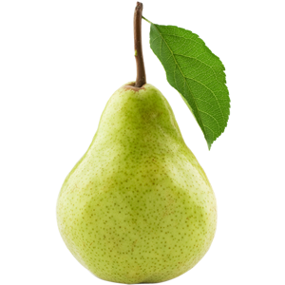
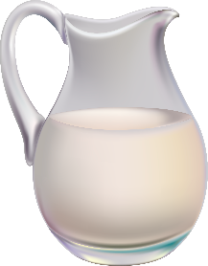
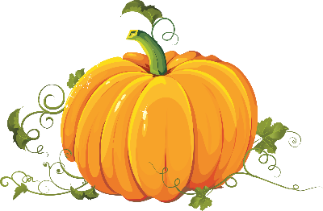
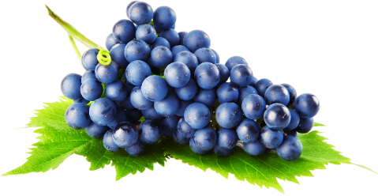
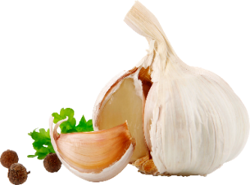
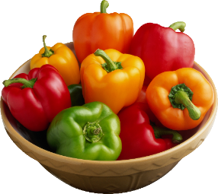
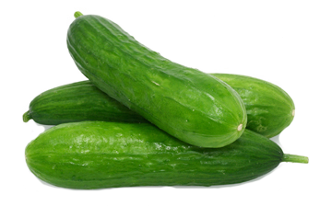
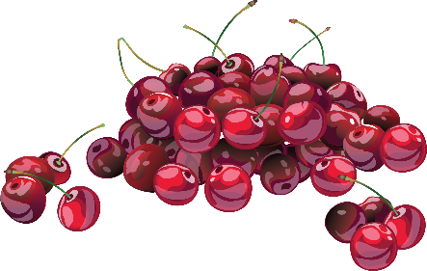
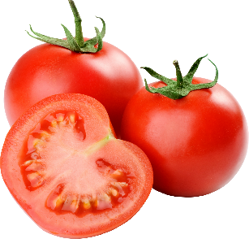
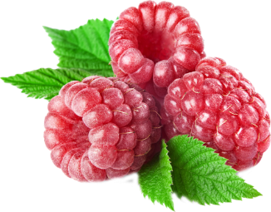
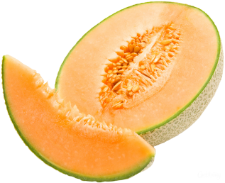
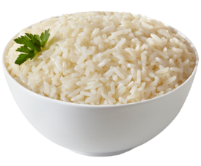
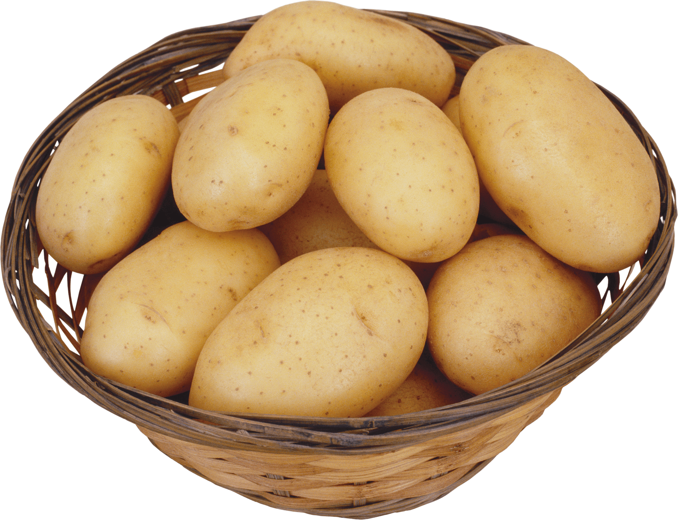
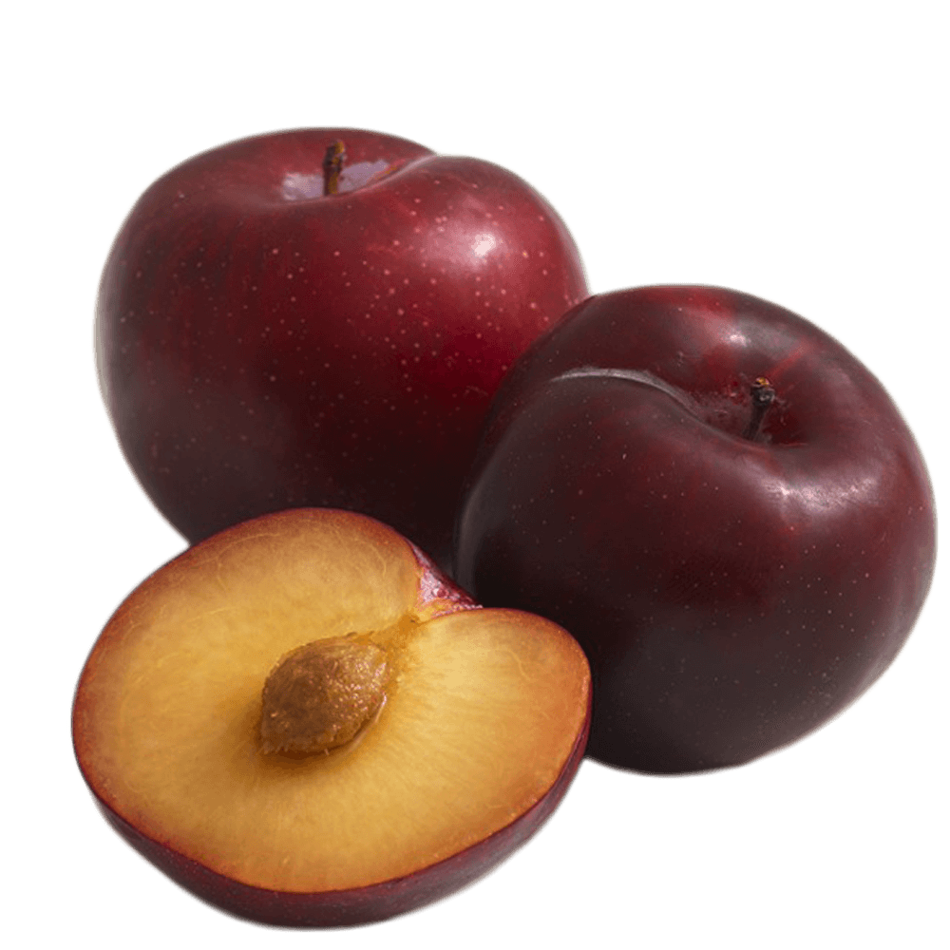
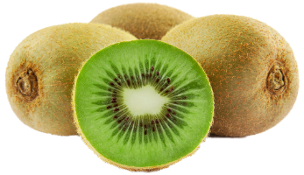
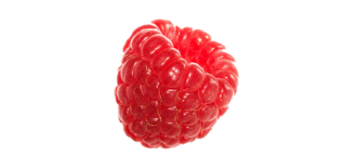
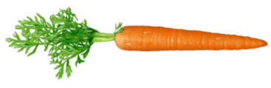
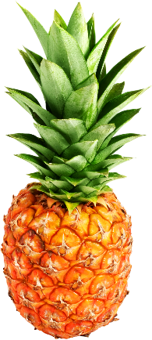
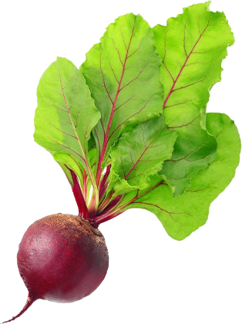
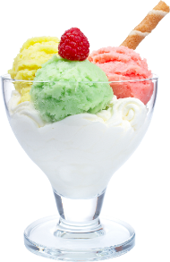
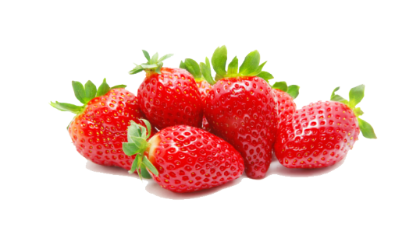

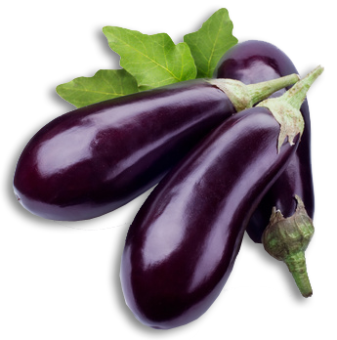
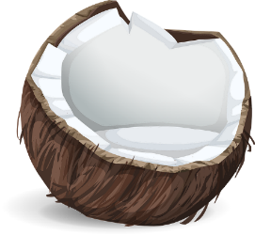
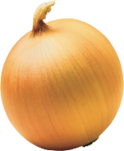
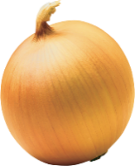
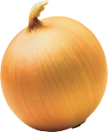
curd
eggs
biscuits
orange juice
bananas
peas
watermelon
flour
cucumbers
grapes
cherries
garlic
pepper
coffee
pear
milk
pumpkin
tomatoes
rice
kiwi
potatoes
raspberries
carrot
melon
plum
ice-cream
strawberries
apples
beetroot
eggplant
coconut
onions
pineapple

Slide 6
Do you have any; (a;an)…?
Yes, I have some; (a/an)…
No, I don’t have any; (a;an)…
Is there any; (a;an)…?
Are there any… (plural)?

Slide 7
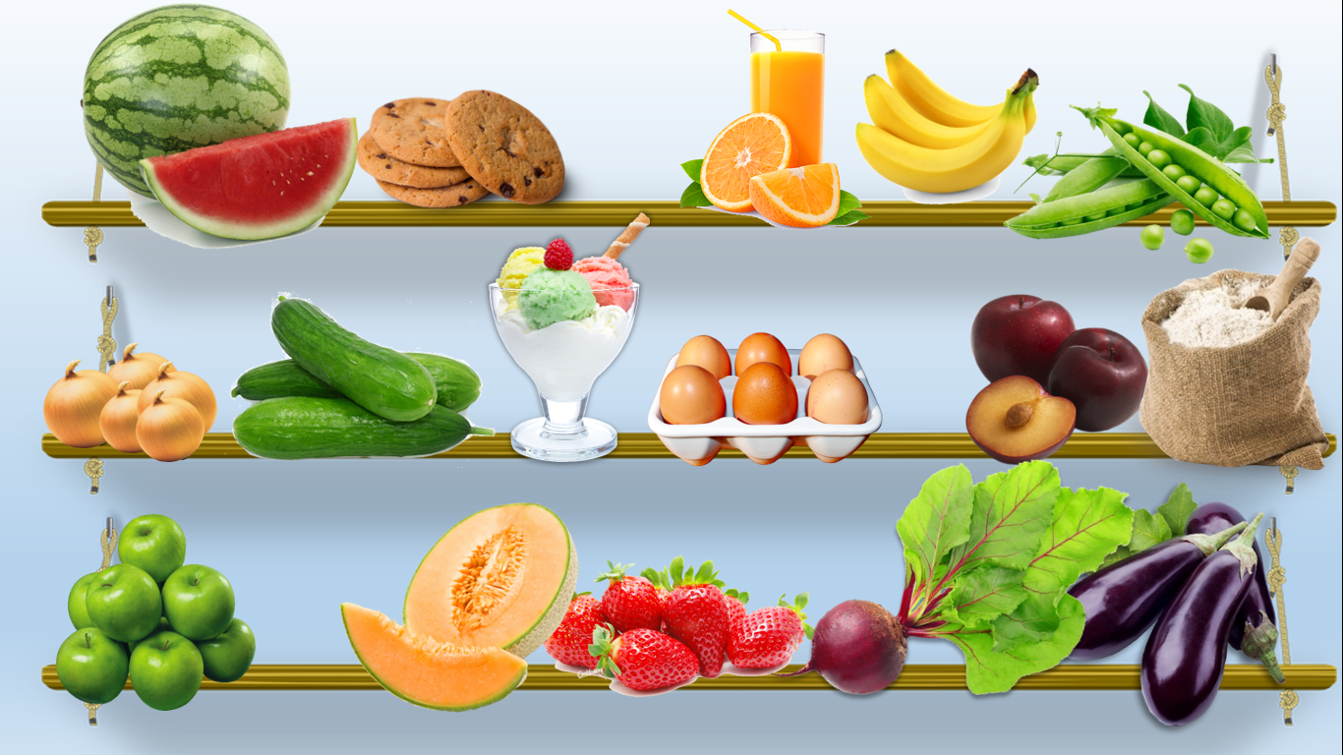

Slide 8
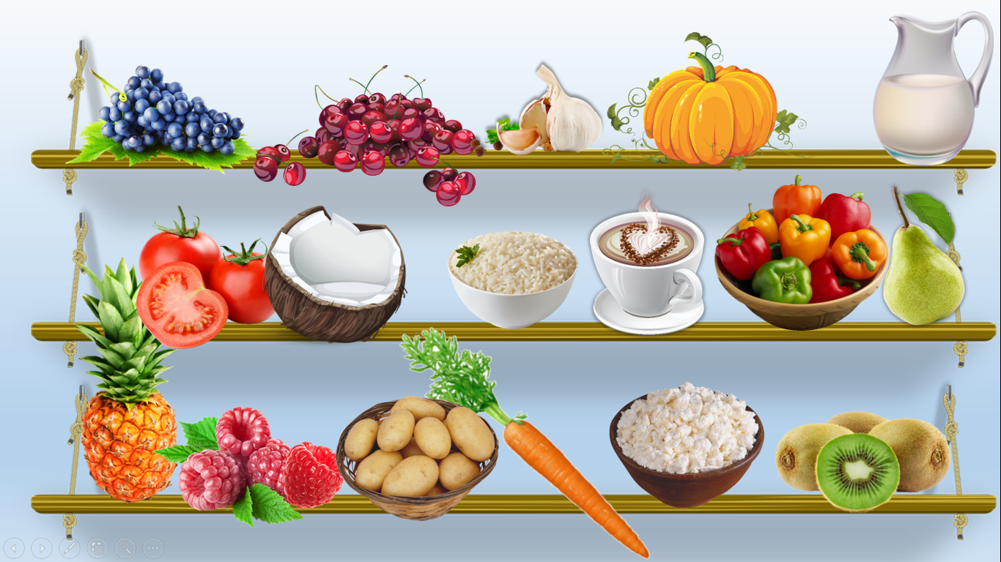

Slide 9
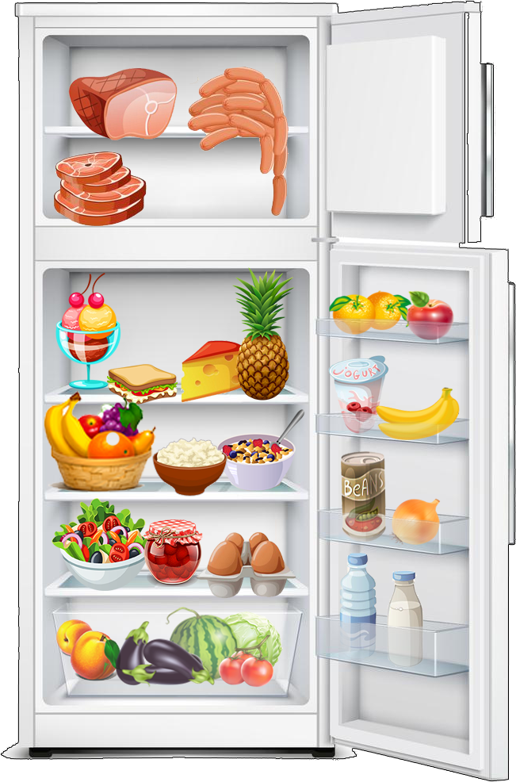
Write positive (+) or negative (-) sentences with a/an, some, or any.
meat
There is some meat
a pineapple
There is a pineapple
onions
There aren’t any onions
cottage cheese
There is some cottage cheese
biscuits
There aren’t any biscuits
fish
There isn’t any fish
grapes
There are some grapes
lemonade
There isn’t any lemonade
Ice-cream
There is some ice-cream

Slide 10
Make questions and short answers
(- Are there any ?; - Is there any/ a/ an?)
eggs
-Are there any eggs? -Yes, there are
yoghurt
-Is there any yoghurt? -Yes, there is
a melon
-Is there a melon? -No, there isn’t
jam
-Is there any jam? -Yes, there is
butter
-Is there any butter? -No, there isn’t
-Are there any eggplants?
-Yes, there are
eggplants
cereal
-Is there any cereal? -Yes, there is
carrots
-Are there any carrots? -No, there aren’t
a pizza
-Is there a pizza? -No, there isn’t
a sandwich
-Is there a sandwich? -Yes, there is

Slide 11








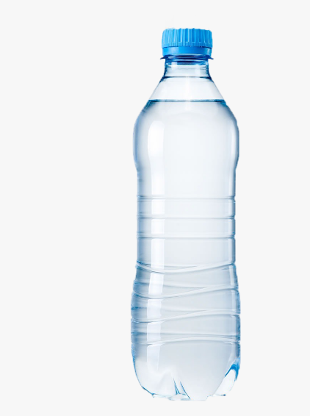
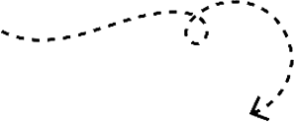



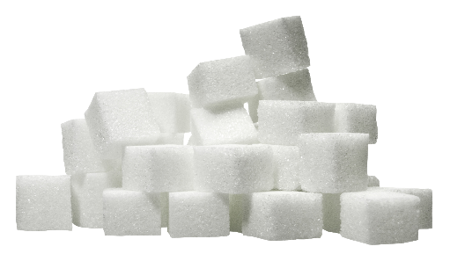
How much
How many
vs

Slide 12
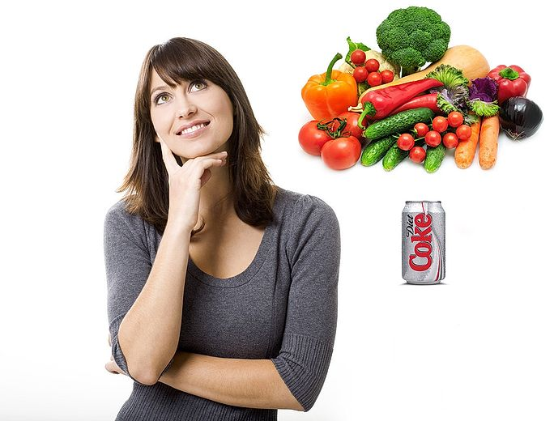
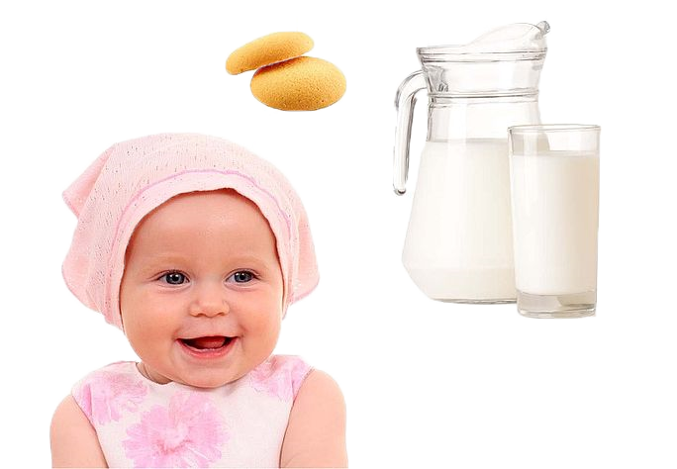
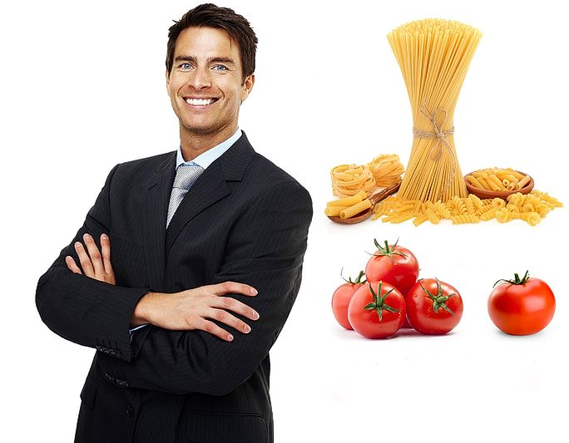
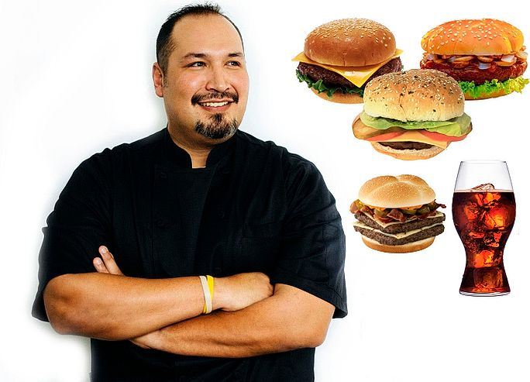
Select the correct word. Then answer the question with a complete sentence with a lot of, not... much, not... many, not... any
Valerie the vegetarian
Baby Belinda
Fabio the Italian Food Fan
Fast Food Phil

Slide 13
Valerie the vegetarian
Baby Belinda
much
1) How _______ meat does she eat?
_____________________________
much
1) How _______ milk does she drink?
_____________________________
She doesn’t eat any meat
She drinks a lot of milk
many
much
2) How _______vegetables does she eat?
_____________________________
2) How _______ coffee does she drink?
_____________________________
She eats a lot of vegetables
She doesn’t drink any coffee
many
3) How _______ biscuits does she eat?
_____________________________
much
3)How _______ diet cola does she drink?
_________________________________
She doesn’t eat many biscuits
She doesn’t drink much diet cola

Slide 14
Fast Food Phil
Fabio the Italian Food Fan
many
1) How _______ hamburgers does he eat?
_______________________________
much
1) How _______ juice does he drink?
___________________________
He eats a lot of hamburgers
She doesn’t drink any juice
many
2) How _______vegetables does he eat?
_________________________________
many
2) How _______ tomatoes does he eat?
_____________________________
He doesn’t eat any vegetables
He eats a lot of tomatoes
much
much
3) How _______ pasta does he eat?
________________________
3)How _______ mineral water does he drink?
_______________________________________
She doesn’t drink any mineral water
He eats a lot of pasta

Slide 15





















a bowl of
a bowl of
a spoon of
a carton of
a bunch of
a packet of
a jar of
a glass of
a cup of
a jug of
a loaf of
a bar of
a piece of
a box of
a slice of
a bottle of
a can of
a tin of

Slide 16













There is // There are
2 boxes of chocolate
4 jags of honey
6 slices of apple
2 brunches of grapes
3 bowls of strawberries
a packet of cookies
a can of coke
a piece of cake
a bar of chocolate
5 glasses of juice
3 cups of coffee
a carton of juice
3 loaves of bread
5 tins of tuna

Slide 17


Slide 18


