Slide 1
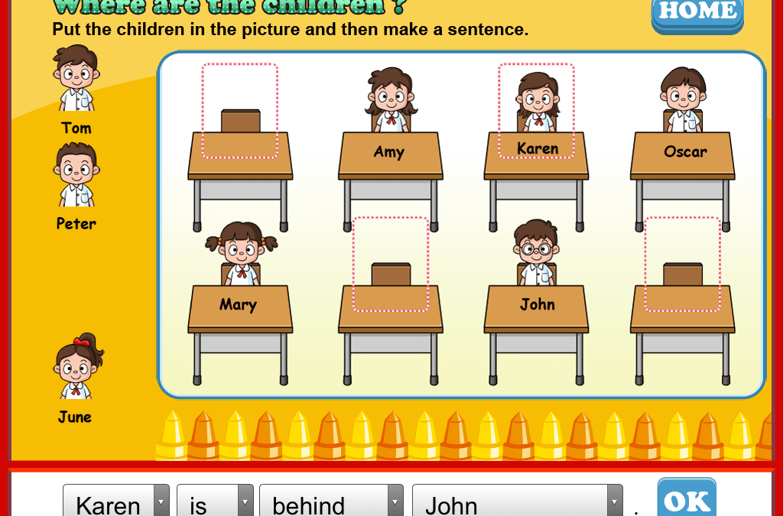
1
2
3
Tom is between Mary and John.
June is behind Mary.
Peter is in front of Oscar.

Slide 2
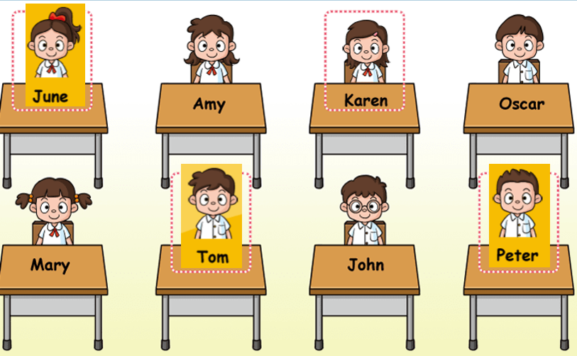
Who’s behind Tom?

Slide 3
Who’s in front of Karen?

Slide 4
Who’s between Mary and John?

Slide 5
Who’s behind Mary?

Slide 6
Who’s between Amy and Oscar?

Slide 7
Who’s behind Peter?

Slide 8
Who’s in front of Oscar?

Slide 9
Who’s next to Tom, in front of June?

Slide 10
Where’s..?

Slide 11
Is Mary in front of June?
yes, she is.

Slide 12
Is Tom between Mary and Oscar?
No, he’s not.

Slide 13
Is Oscar behind Peter?
yes, he is.

Slide 14
Is John in front of Karen?
yes, he is.

Slide 15
Is Amy behind June?
No, she’s not.

