Slide 1
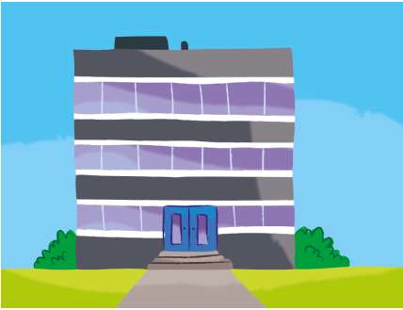
1. works / he / the / in / building

Slide 2
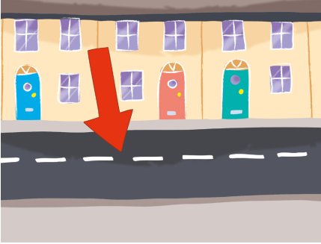
2. on / lives / Green Street / he

Slide 3
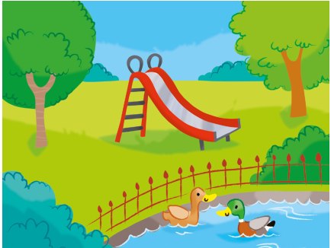
3. park / plays / she / in / the

Slide 4
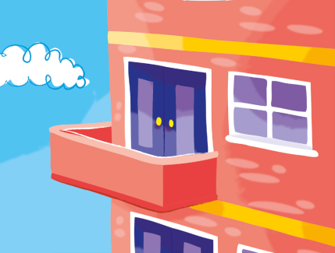
4. the / flat / in / lives / she

Slide 5
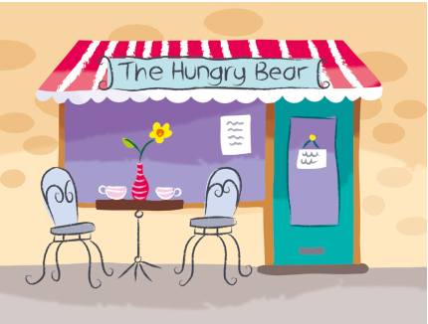
5. she / ice cream / eats / restaurant / the / in

Slide 6
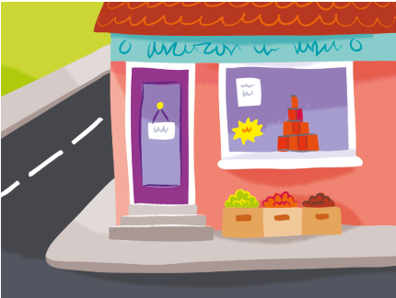
6. in / shop / the / she / works

Slide 7
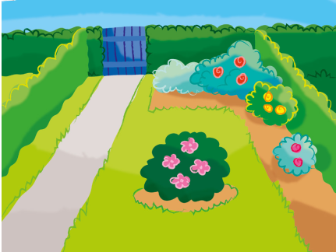
7. plays / she / garden / in / the

Slide 8
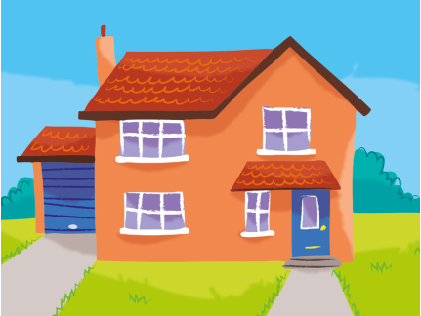
8. house / in / lives / the / he

