Slide 1
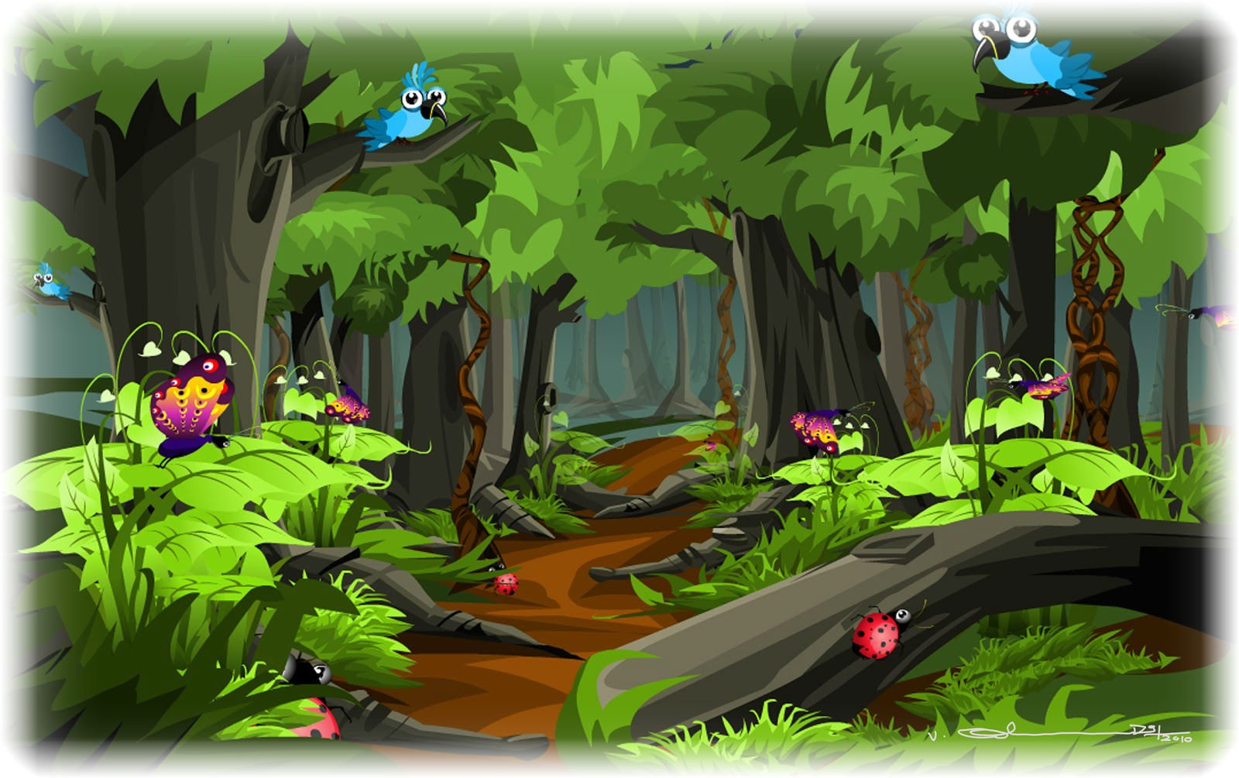
in the forest yesterday?
Notes:
Student 1 asks Student 2: Were you in the forest yesterday? Then the teacher clicks the “space” on the keyboard and the picture appears. If Student 2 sees the forest, he says Yes, I was. If he sees another picture, he says No, I wasn’t.

Slide 2
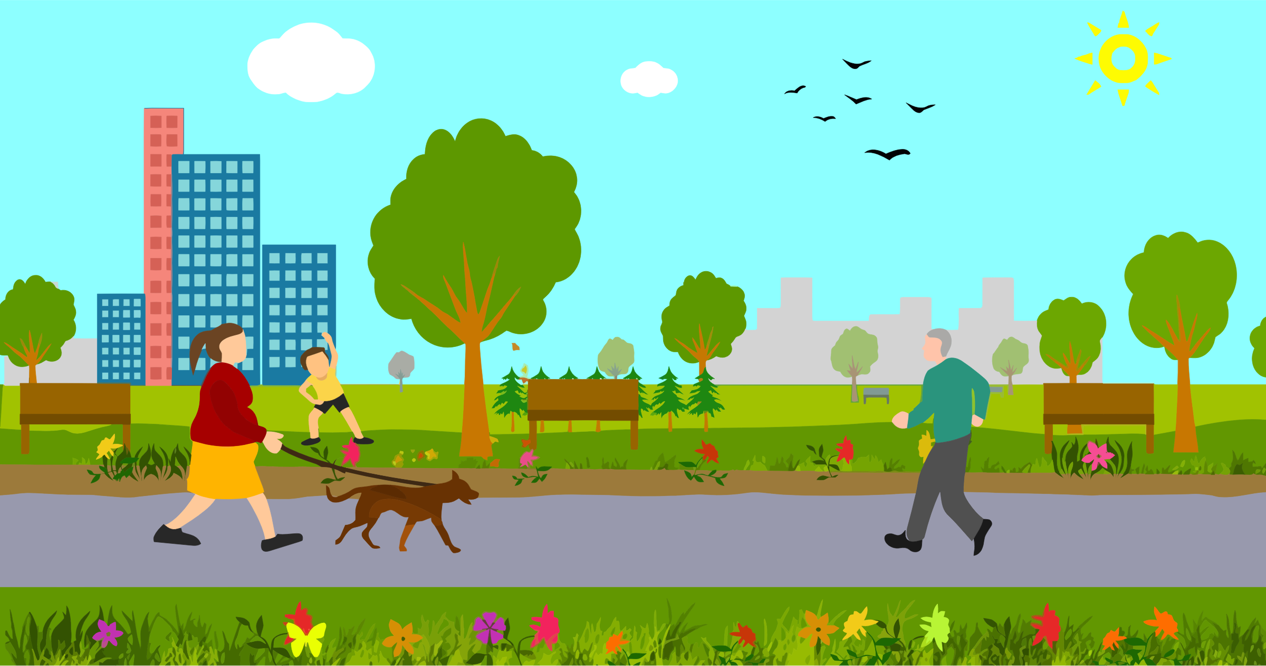
at the cinema yesterday?

Slide 3
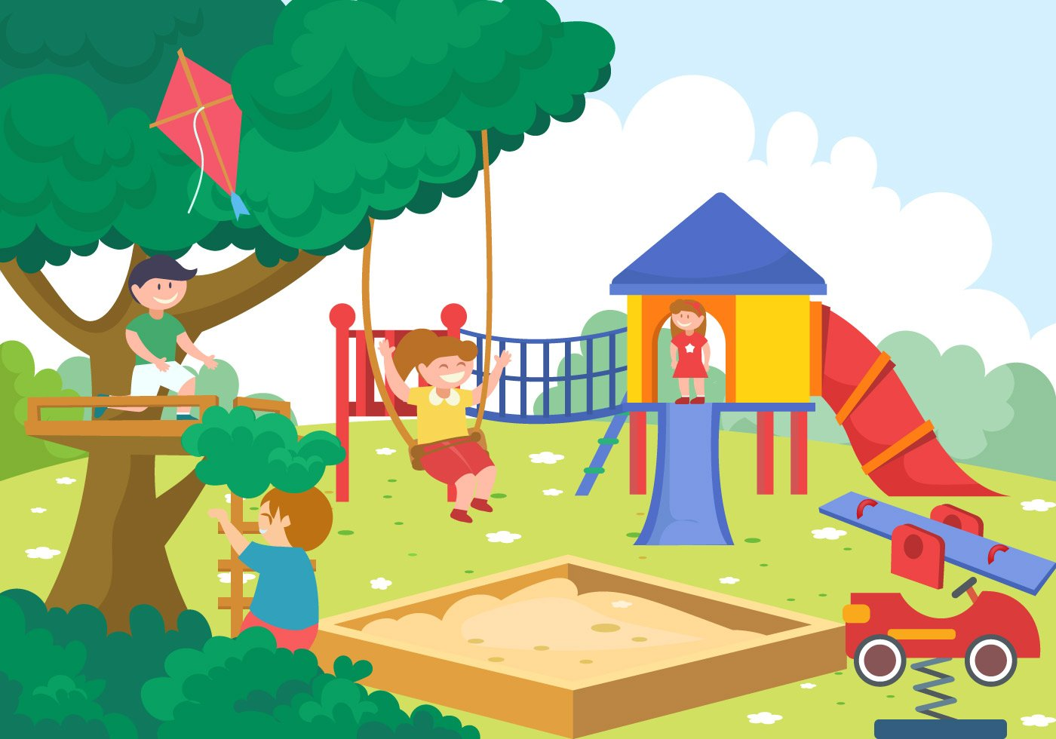
on the playground yesterday?

Slide 4
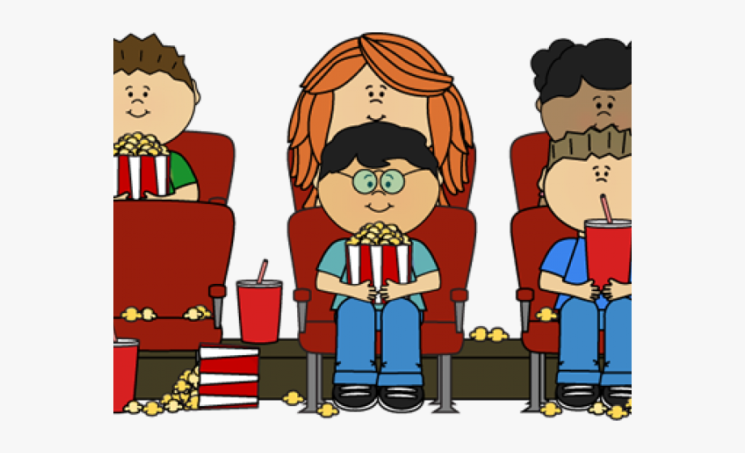
at the cinema yesterday?

Slide 5
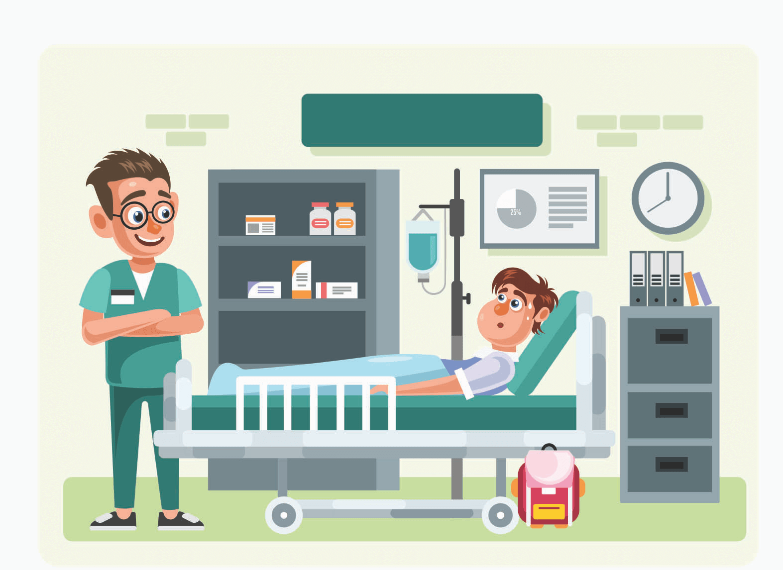
on the plane yesterday?

Slide 6
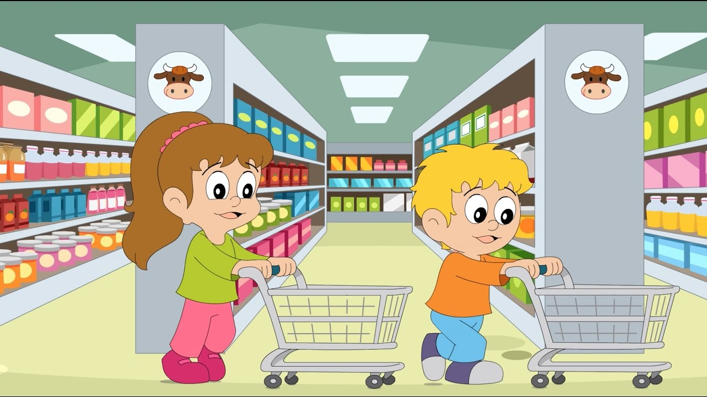
in the supermarket yesterday?

Slide 7
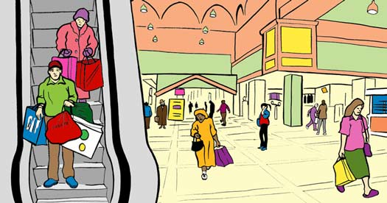
in the swimming pool yesterday?

Slide 8
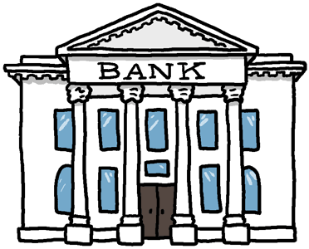
in the garden yesterday?

Slide 9
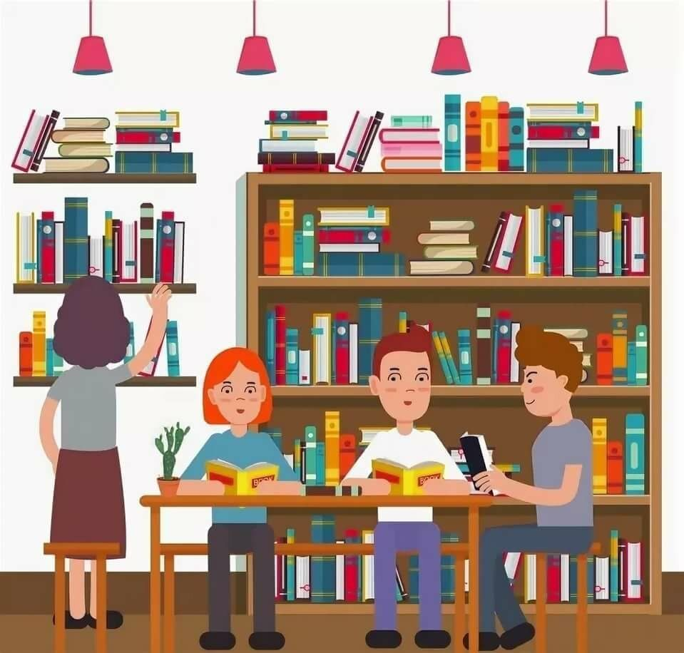
in the library yesterday?

Slide 10
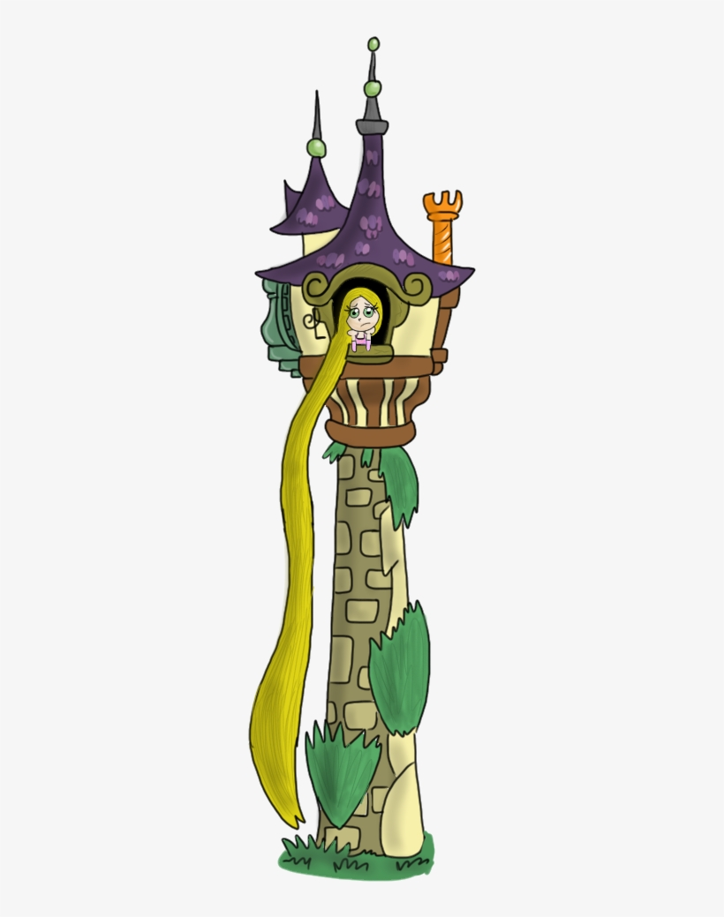
in the tower yesterday?

Slide 11
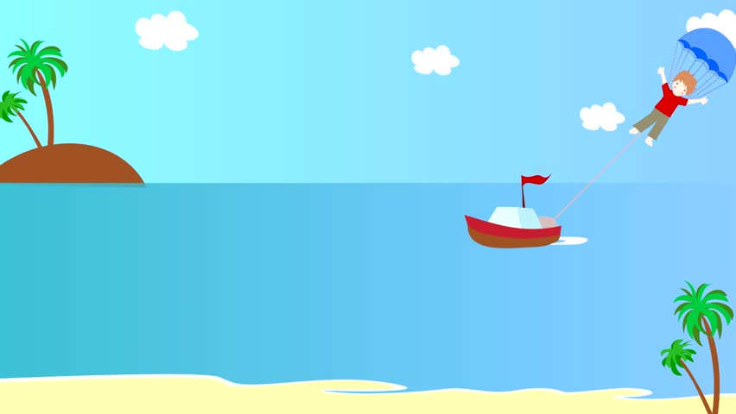
in the supermarket yesterday?

Slide 12
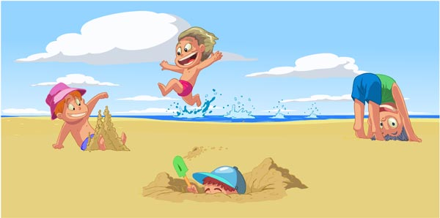
at school yesterday?

Slide 13
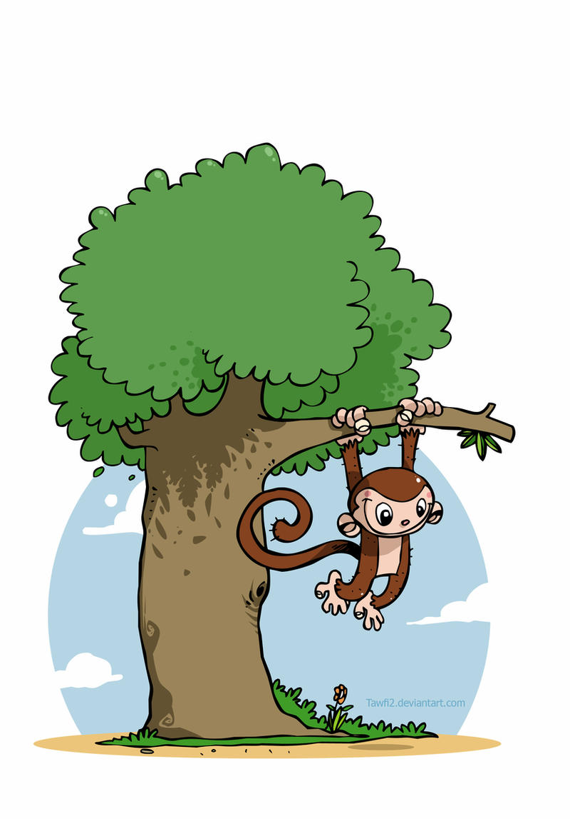
at home yesterday?

Slide 14
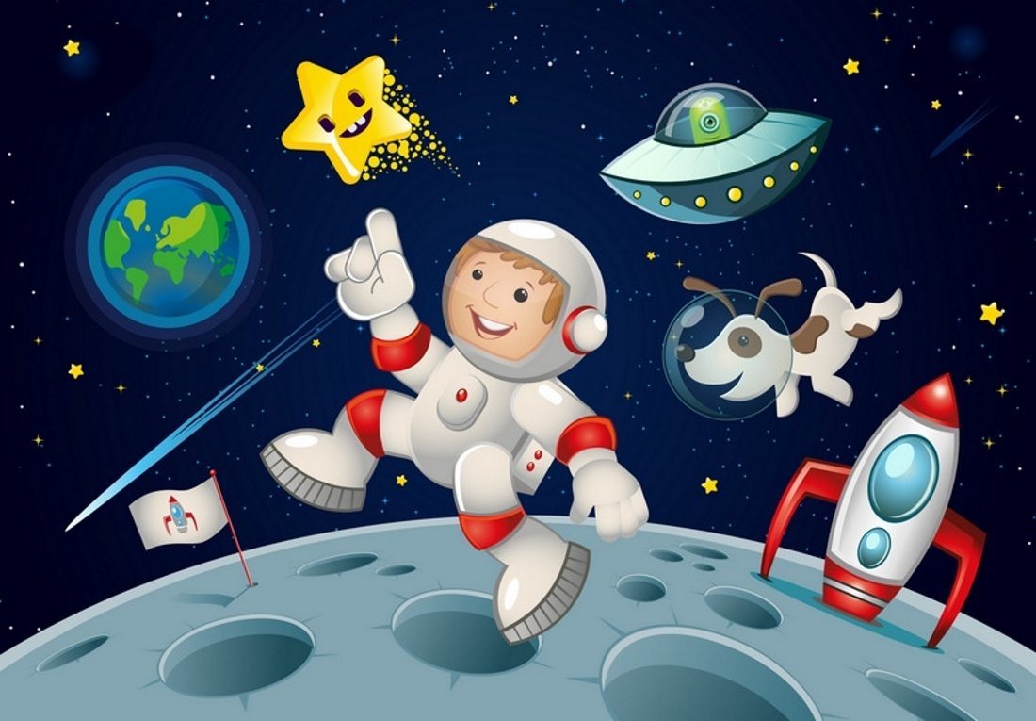
in the space yesterday?

Slide 15
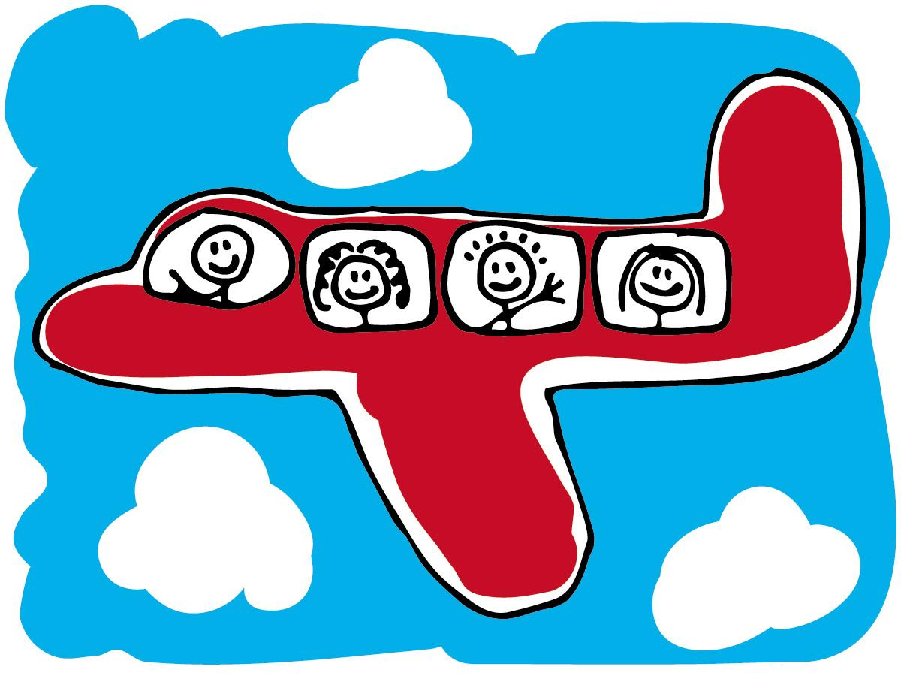
on the plane yesterday?

Slide 16
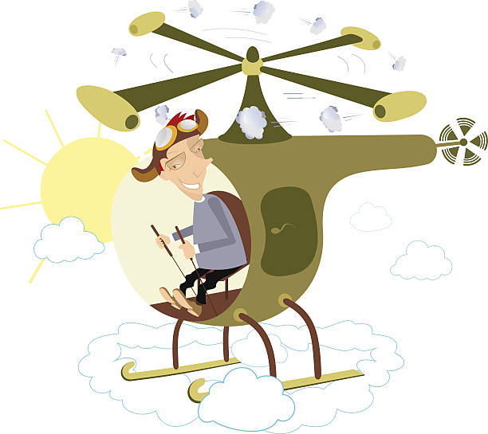
in the tree yesterday?

Slide 17
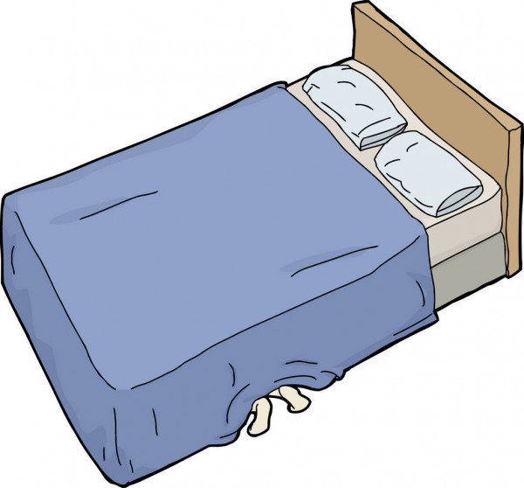
under the bed yesterday?

Slide 18
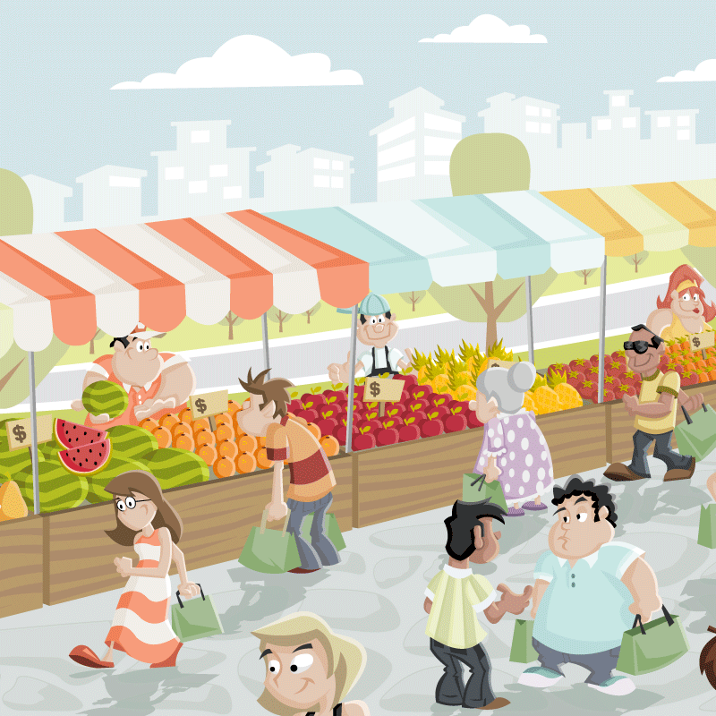
on the market square yesterday?

Slide 19
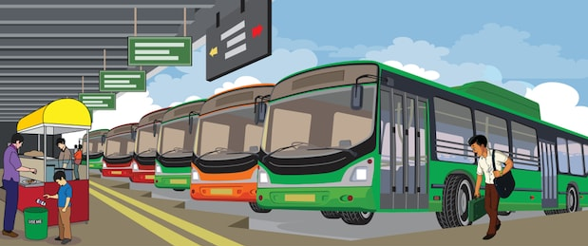
under the table yesterday?

Slide 20
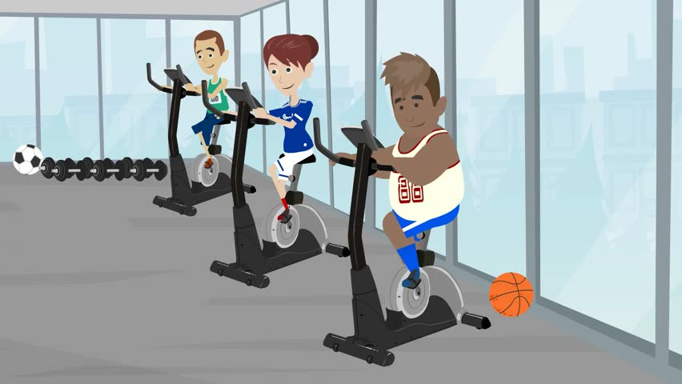
in the gym yesterday?

Slide 21
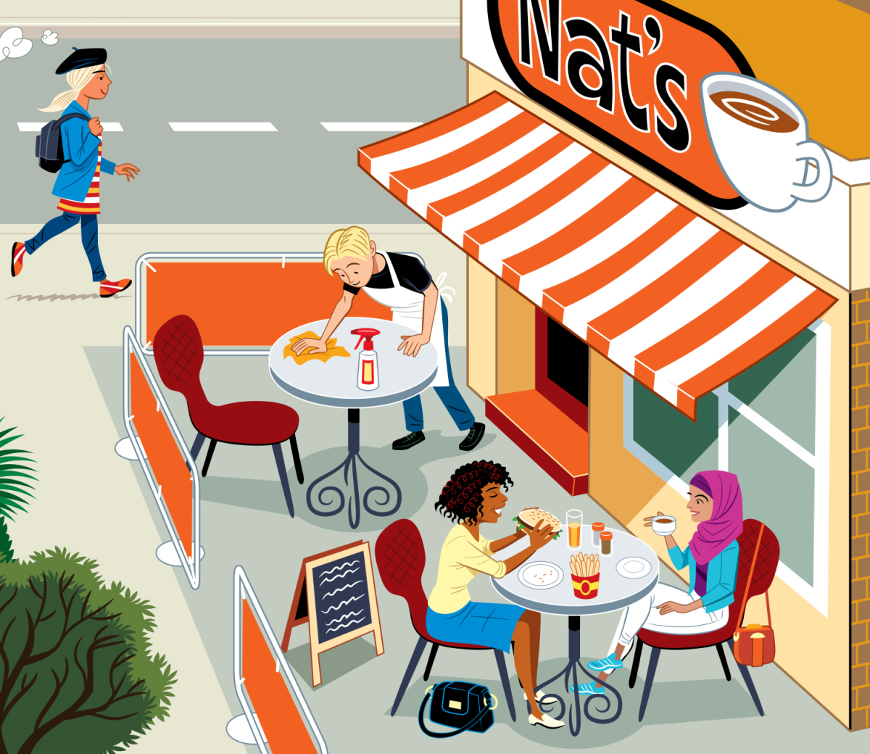
in the café yesterday?

Slide 22
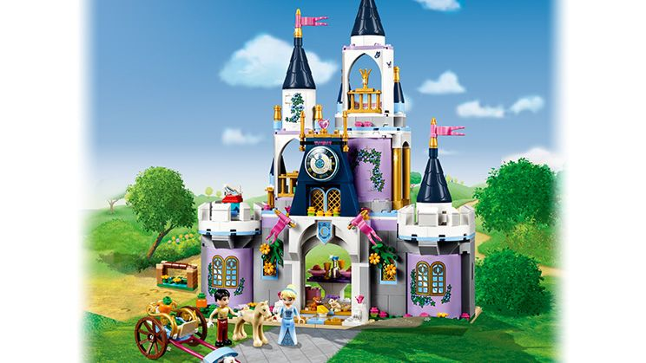
in the forest yesterday?

Slide 23
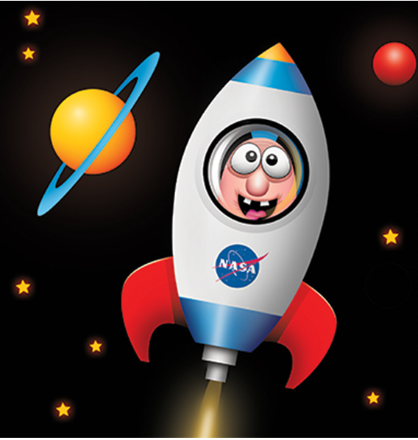
in the rocket yesterday?

Slide 24
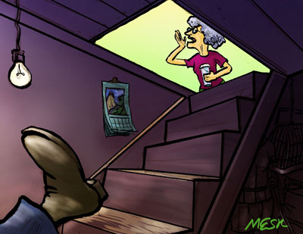
in the cellar yesterday?

Slide 25
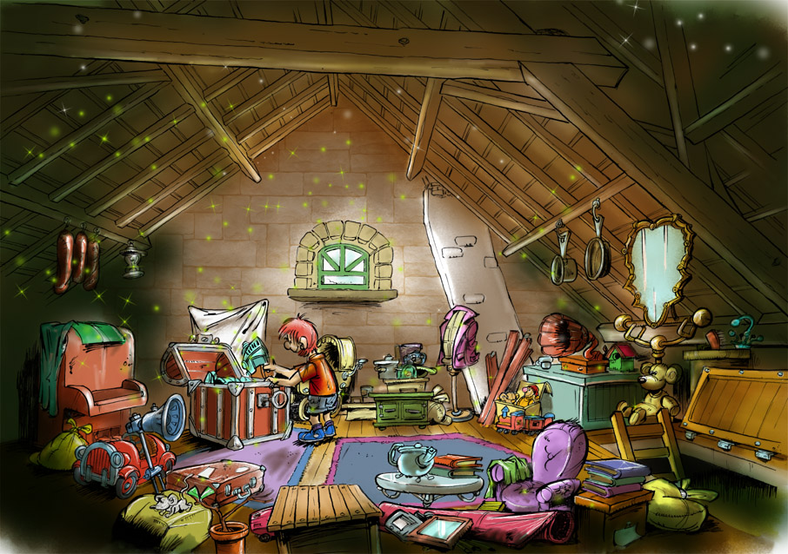
in the living room yesterday?

Slide 26
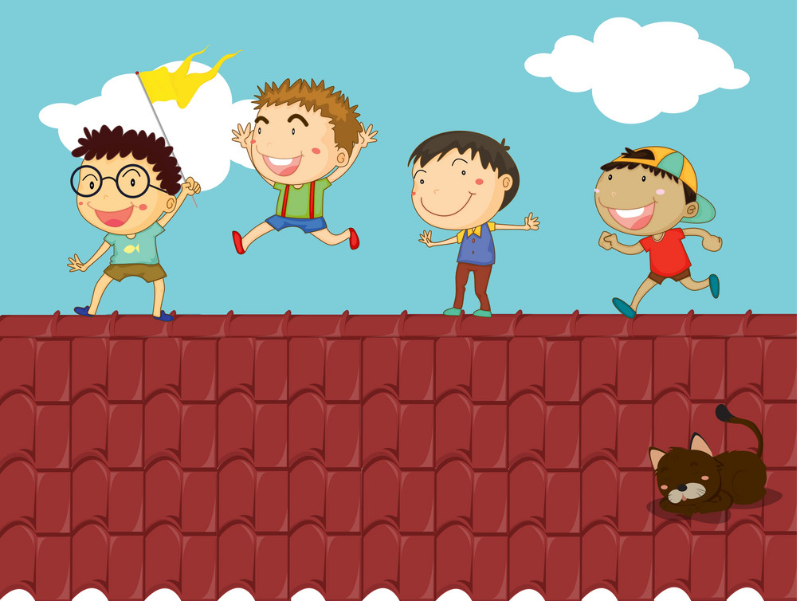
in the park yesterday?

Slide 27
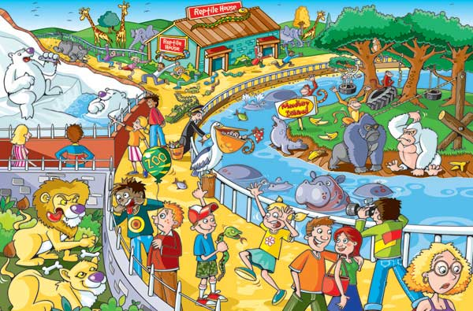
in the space yesterday?

Slide 28
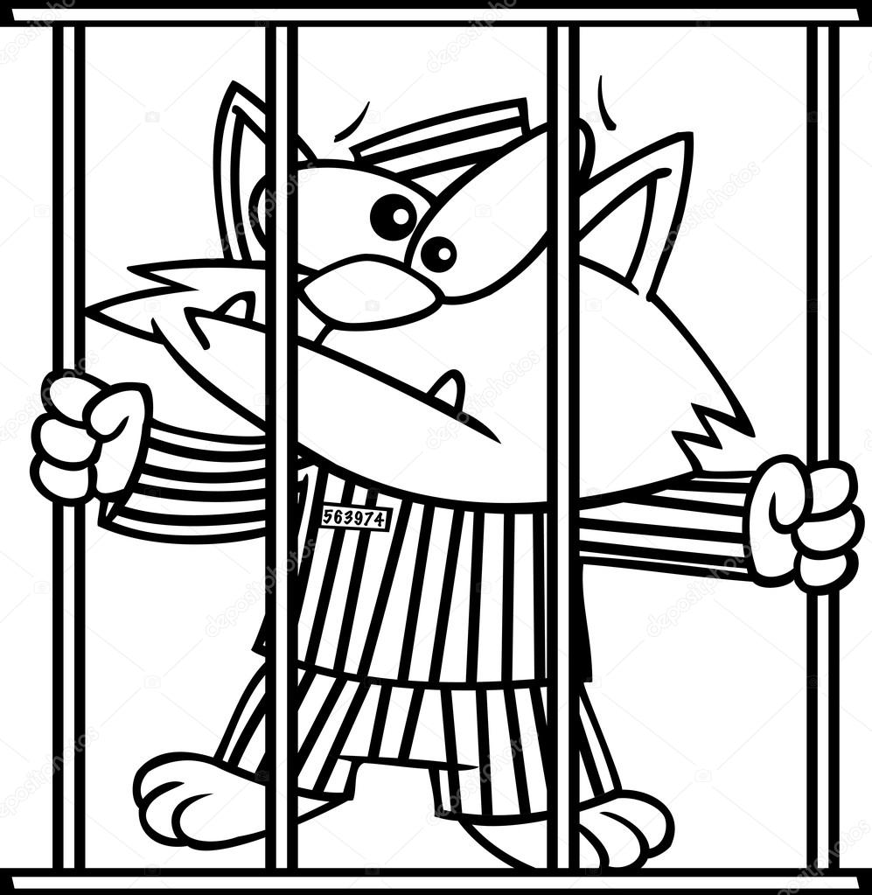
in hospital yesterday?

Slide 29
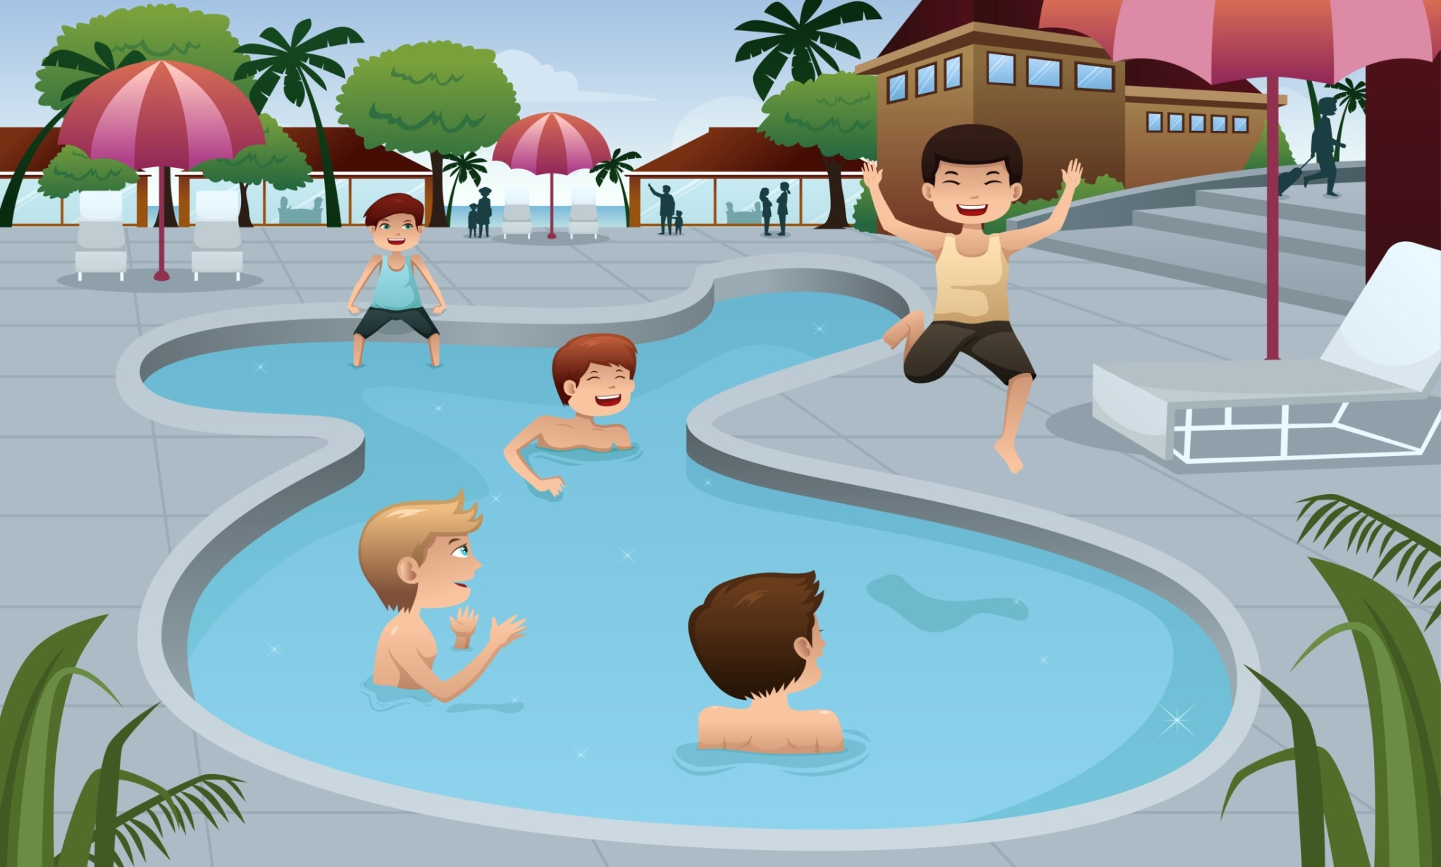
in the swimming pool yesterday?

Slide 30
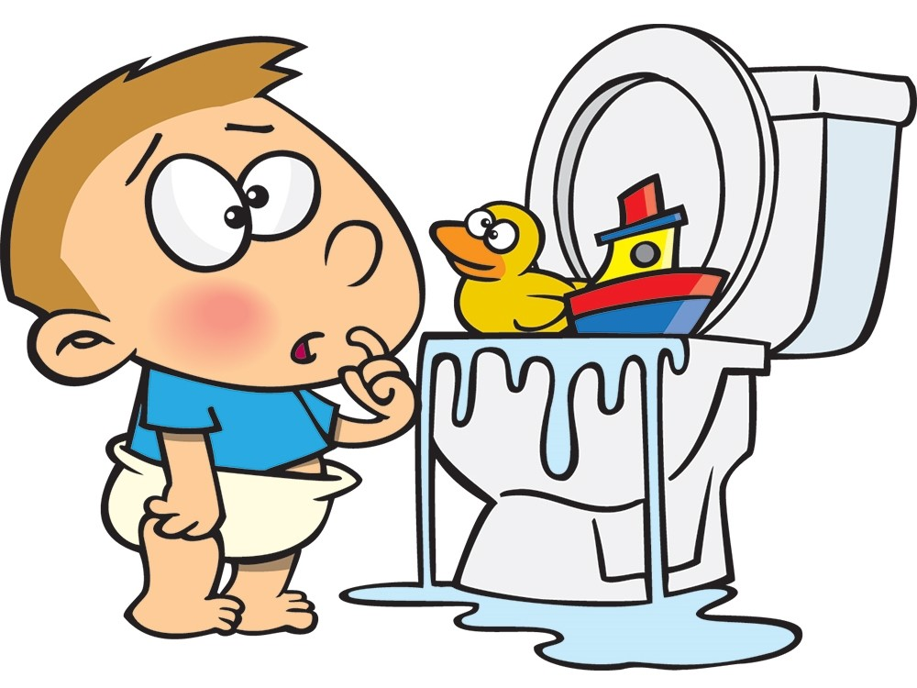
in the toilet yesterday?

Slide 31
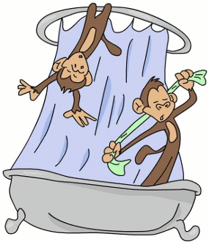
in the café yesterday?

Slide 32
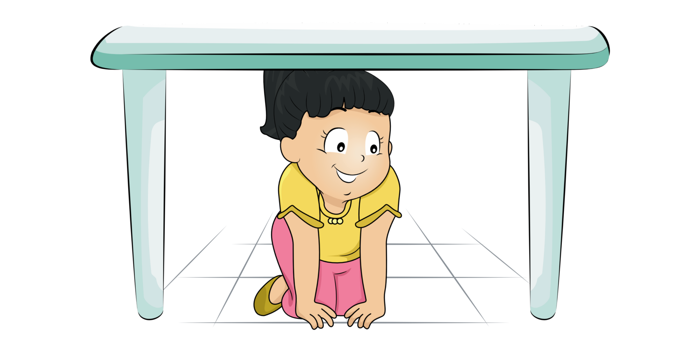
under the bed yesterday?

Slide 33
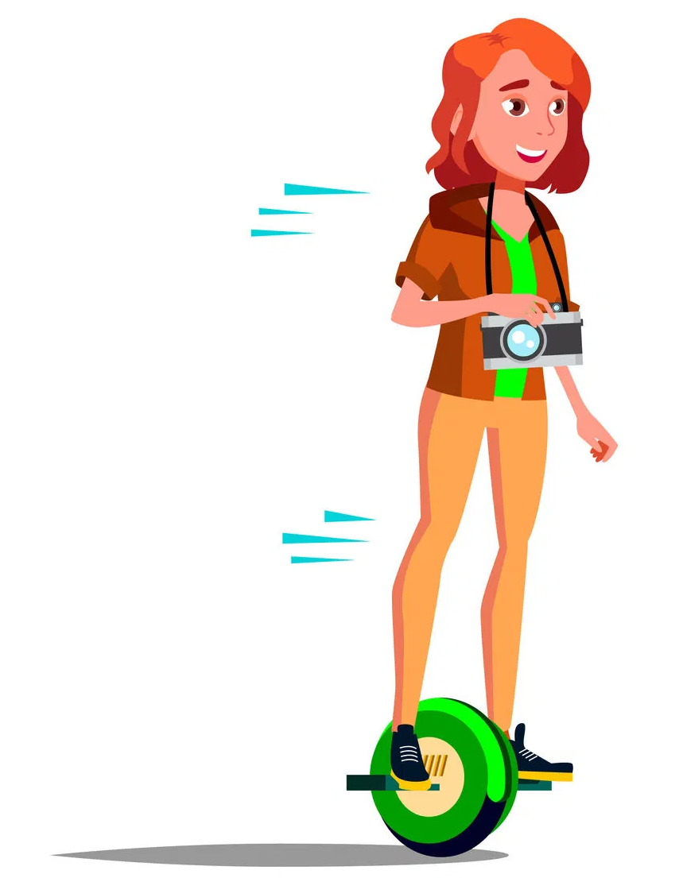
on the gyroscope yesterday?

Slide 34
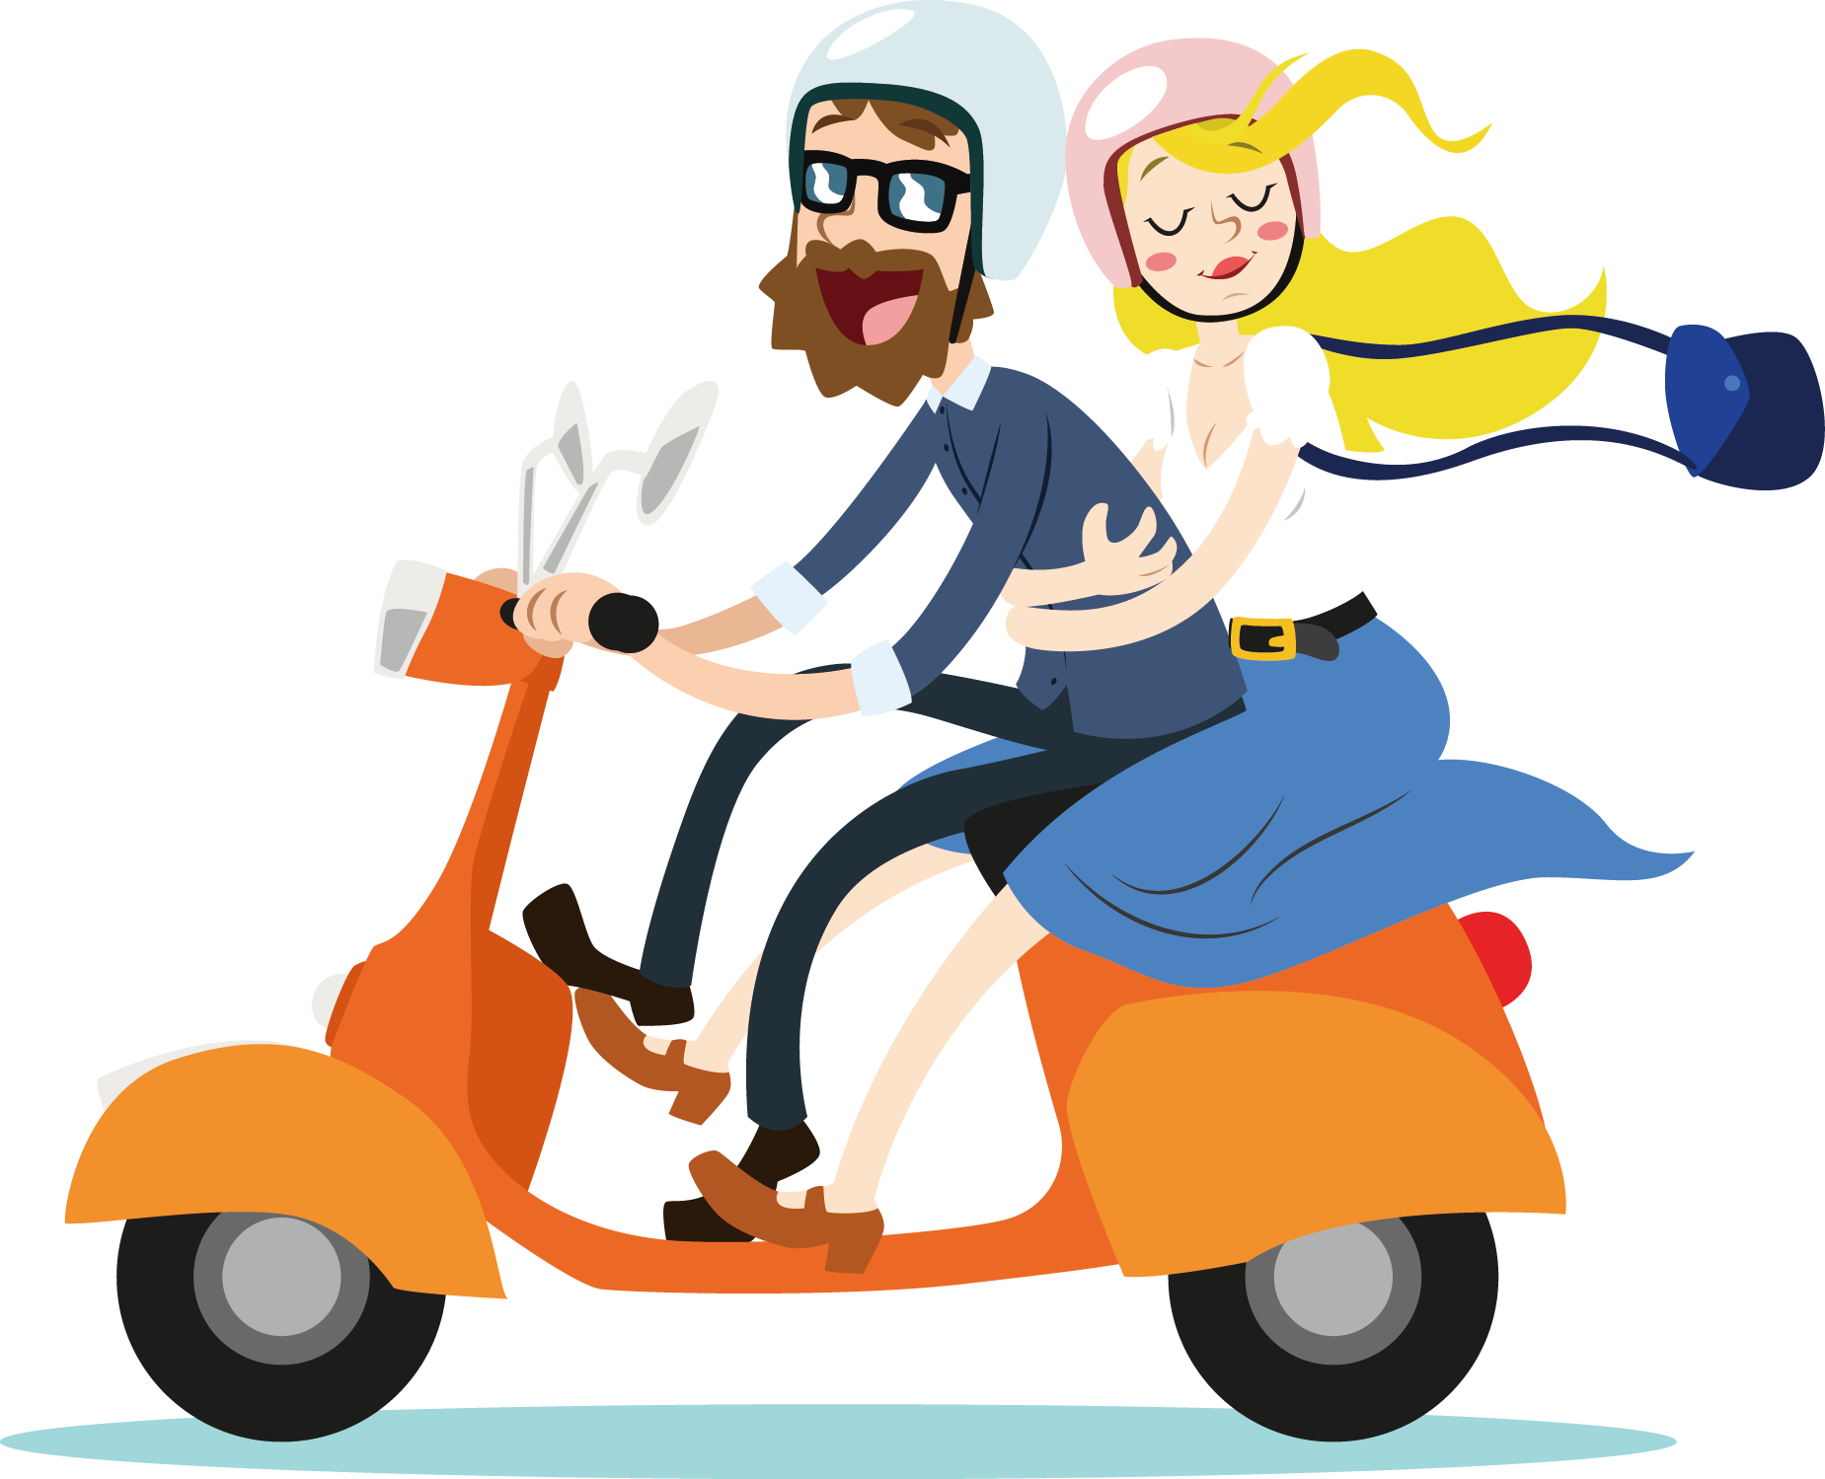
on the scooter yesterday?

