Slide 1






Slide 2
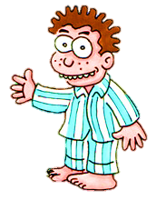


1/10
Answer the questions to make sentences with going to within the time limit (5 seconds)
What is he going to do?
TIME’S UP
CHECK

Slide 3
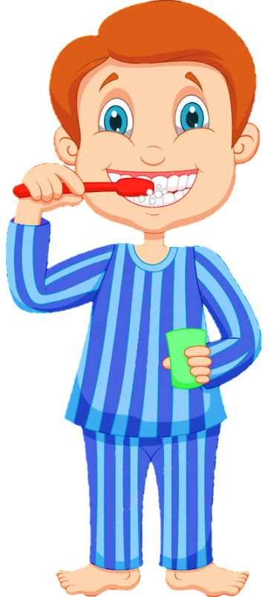
1/10
He is going to brush his teeth
NEXT

Slide 4

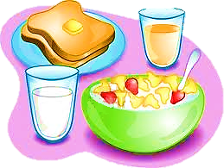
2/10
What is he going to do?
CHECK
TIME’S UP

Slide 5

2/10
He is going to have breakfast
NEXT

Slide 6

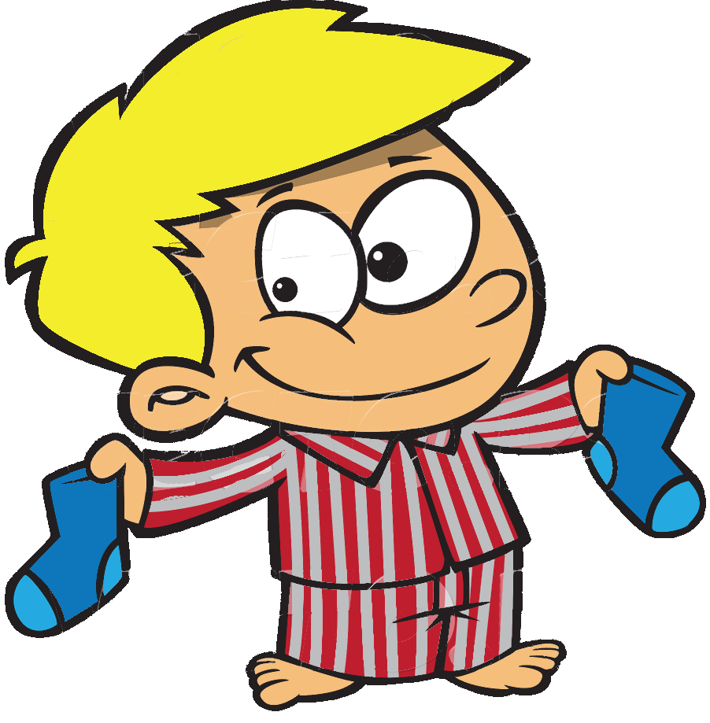
3/10
What is he going to do?
CHECK
TIME’S UP

Slide 7

3/10
He is going to get dressed
NEXT

Slide 8

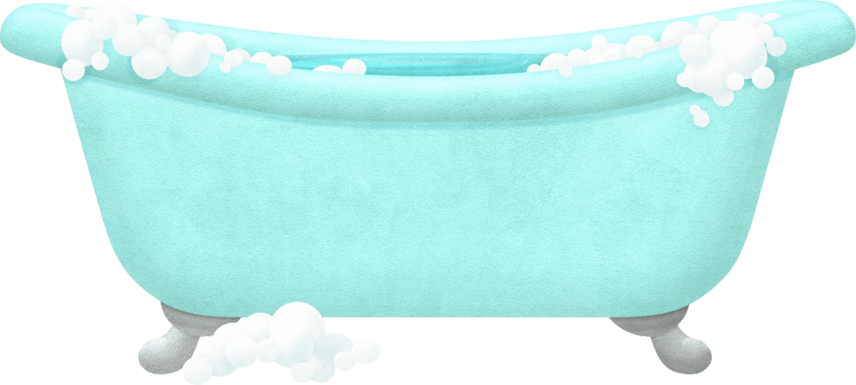
4/10
What is he going to do?
CHECK
TIME’S UP

Slide 9

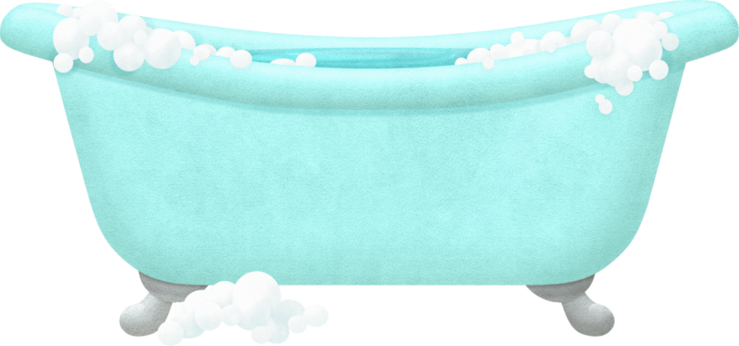
4/10
He is going to have a bath
NEXT

Slide 10




5/10
What is she going to do?
CHECK
TIME’S UP

Slide 11

5/10
She is going to do her homework
NEXT

Slide 12



6/10
What are they going to do?
CHECK
TIME’S UP

Slide 13
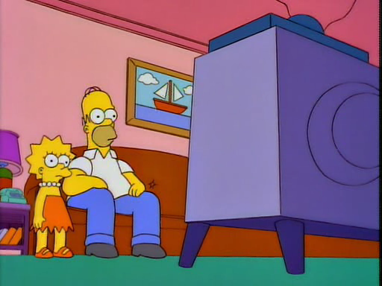
6/10
They are going to watch TV
NEXT

Slide 14
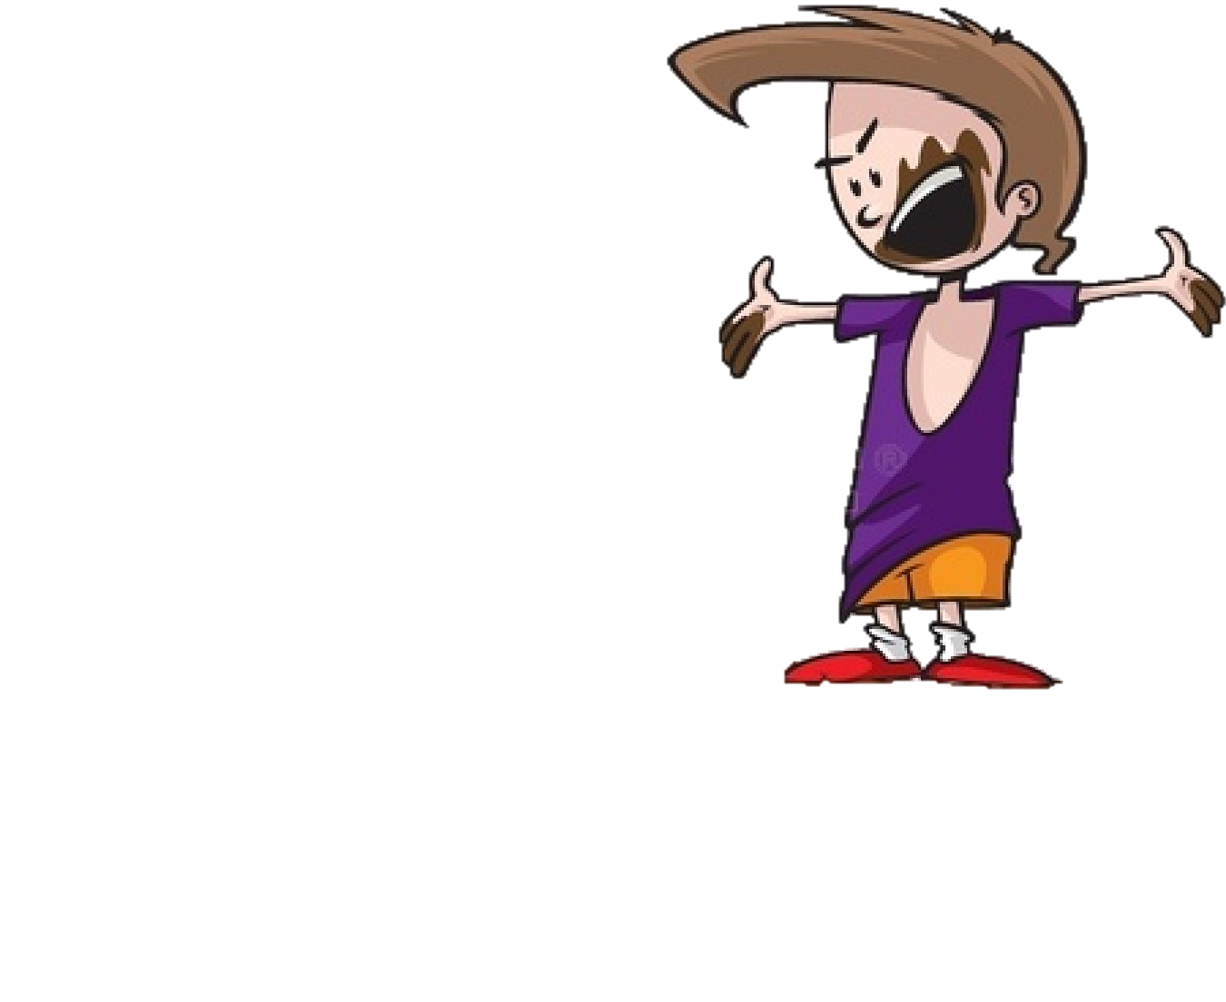

7/10
What is he going to do?
CHECK
TIME’S UP

Slide 15

7/10
He is going to wash his hands
NEXT

Slide 16


8/10
What is he going to do?
CHECK
TIME’S UP

Slide 17
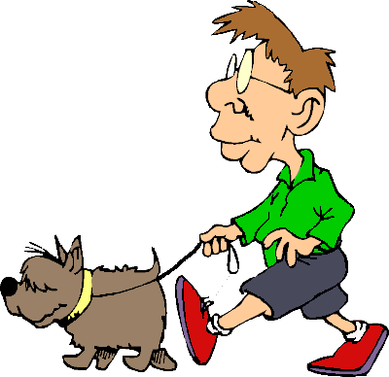
8/10
He is going to walk the dog
NEXT

Slide 18


9/10
What are they going to do?
CHECK
TIME’S UP

Slide 19

9/10
They are going to play video games
NEXT

Slide 20


10/10
What is he going to do?
CHECK
TIME’S UP

Slide 21

10/10
He is going to comb his hair
EXIT

