Slide 1

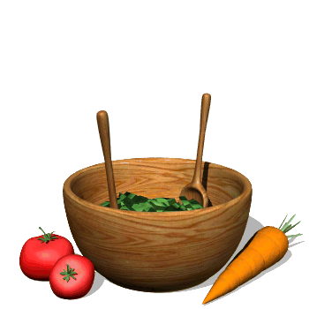
Talking about measures and amounts

Slide 2
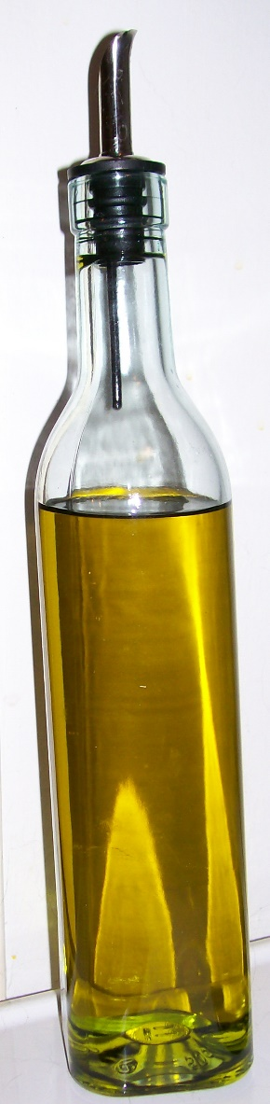
A bottle of oil

Slide 3

A cup of coffee

Slide 4
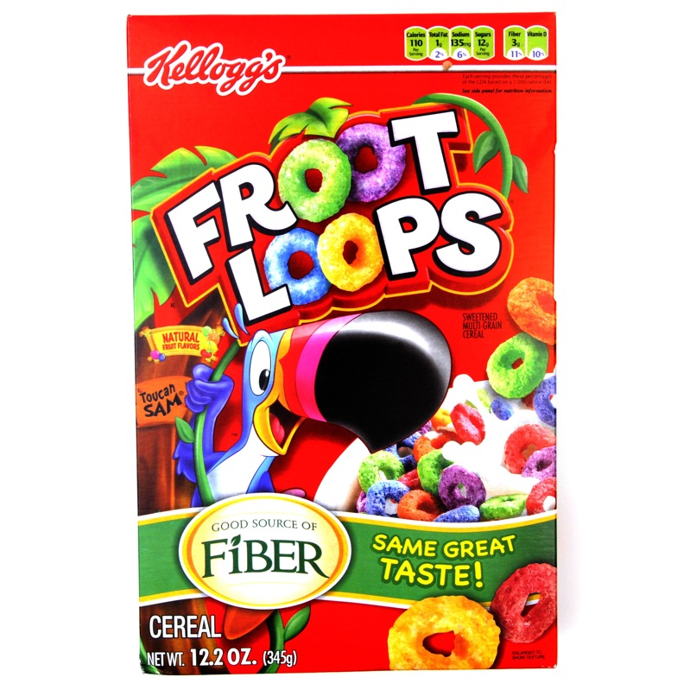
A box of cereal

Slide 5
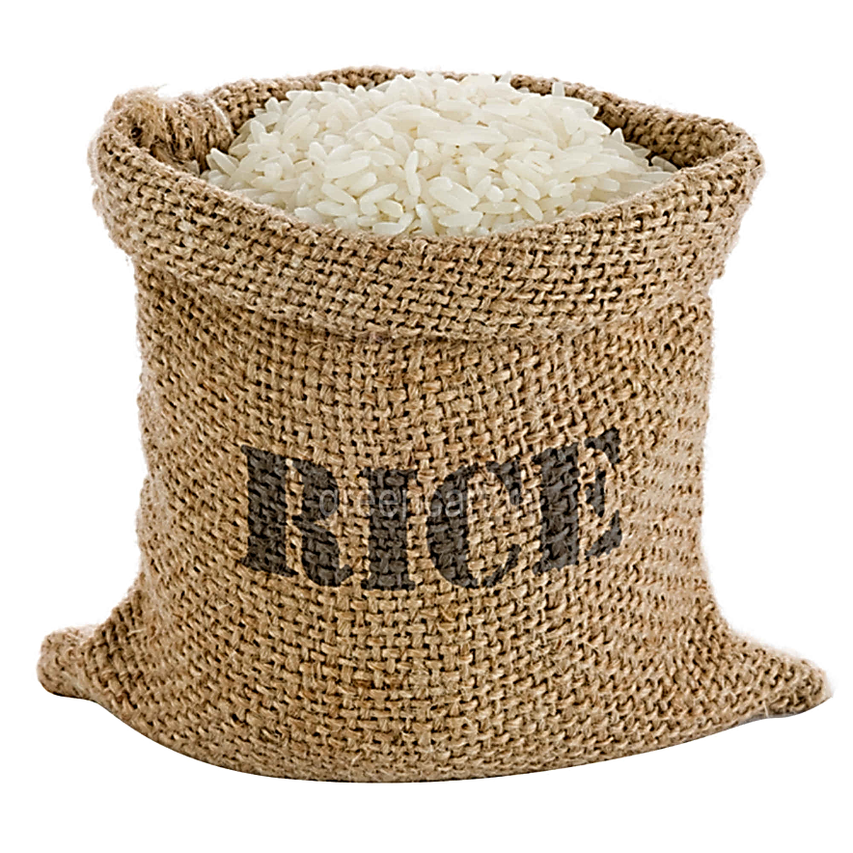
A bag of rice

Slide 6
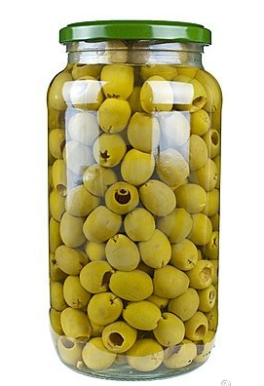
A jar of olives

Slide 7

A jug of lemonade

Slide 8
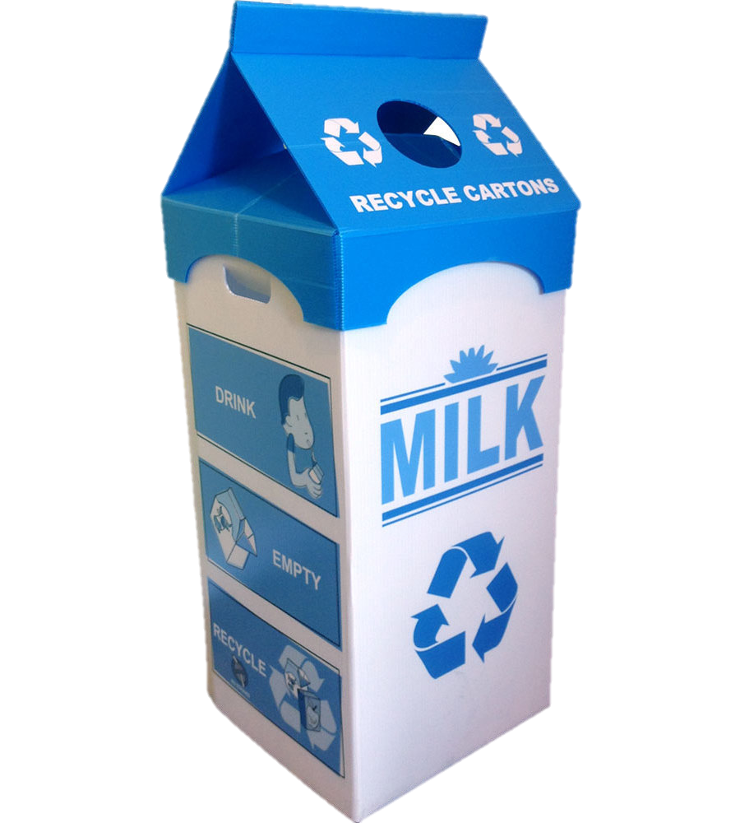
A carton of milk

Slide 9
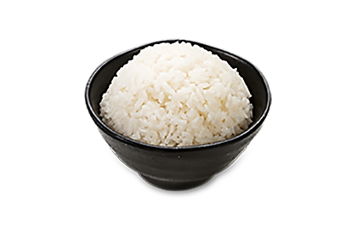
A bowl of rice

Slide 10
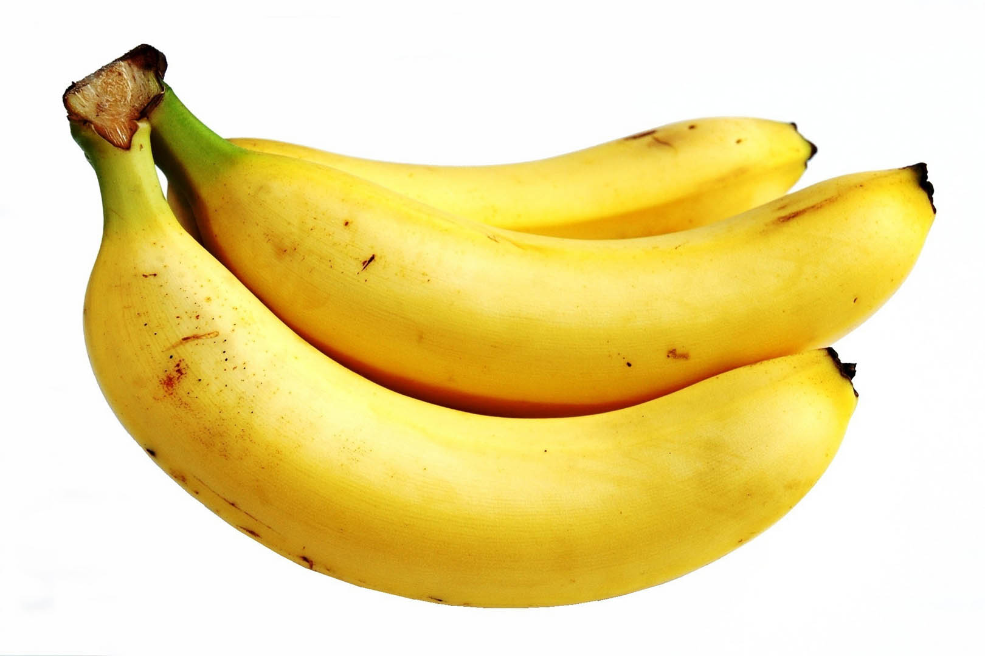
A bunch of bananas

Slide 11

A glass of juice

Slide 12
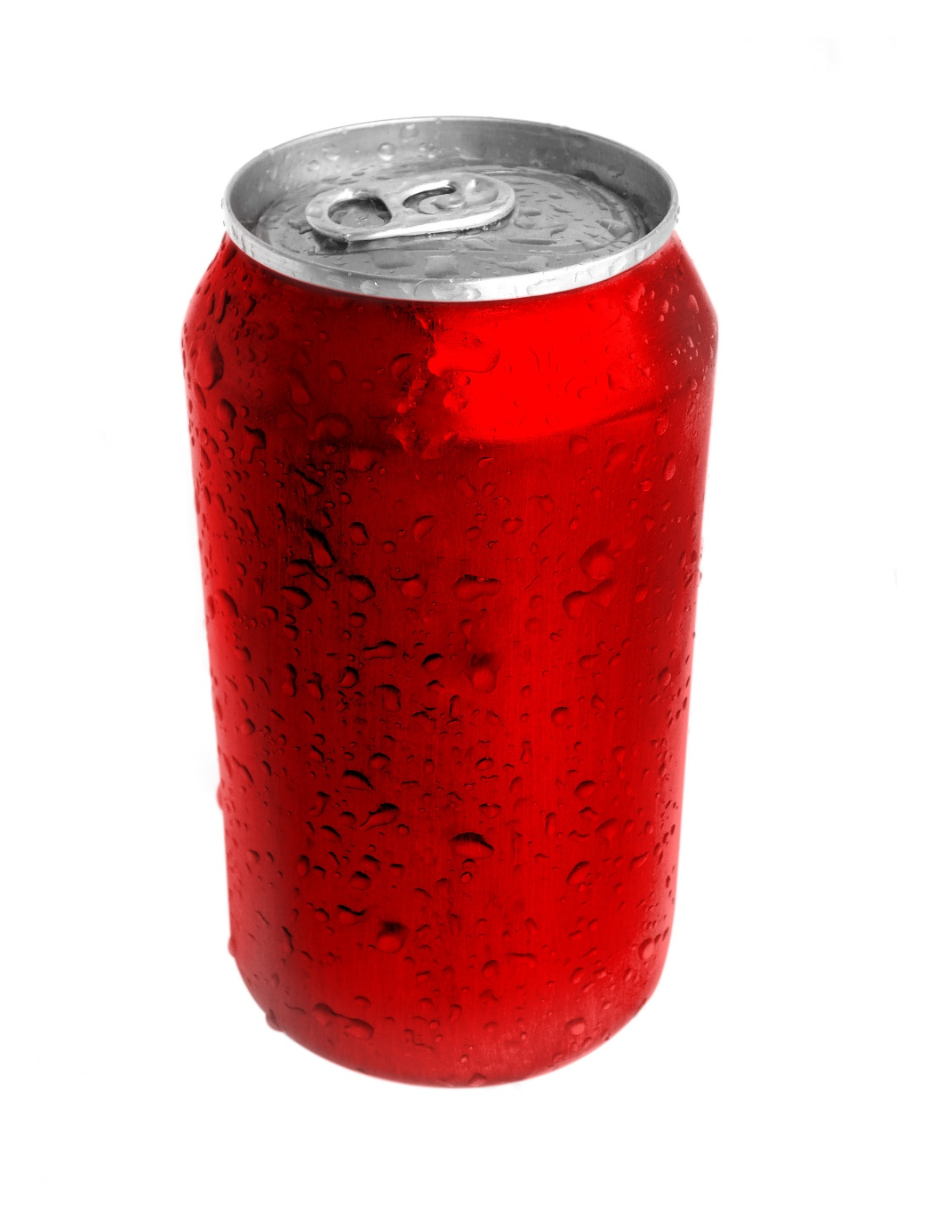
A can of soda

Slide 13
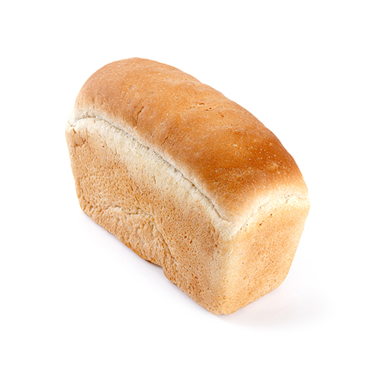
A loaf of bread

Slide 14

A piece of cake

Slide 15
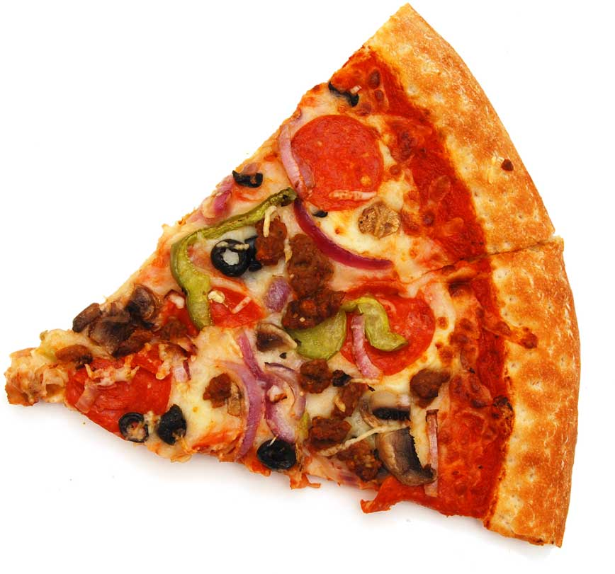
A slice of pizza

Slide 16
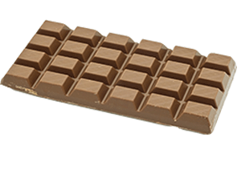
A bar of chocolate

Slide 17
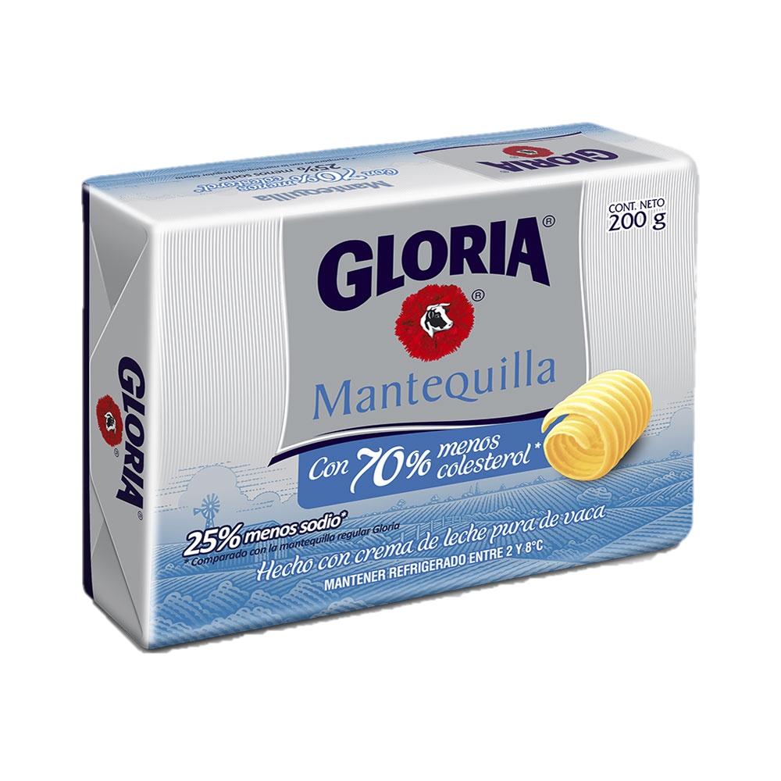
A packet of butter

Slide 18
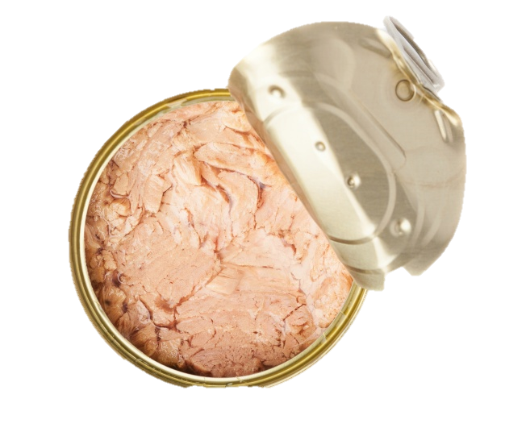
A tin of tuna

