Slide 1
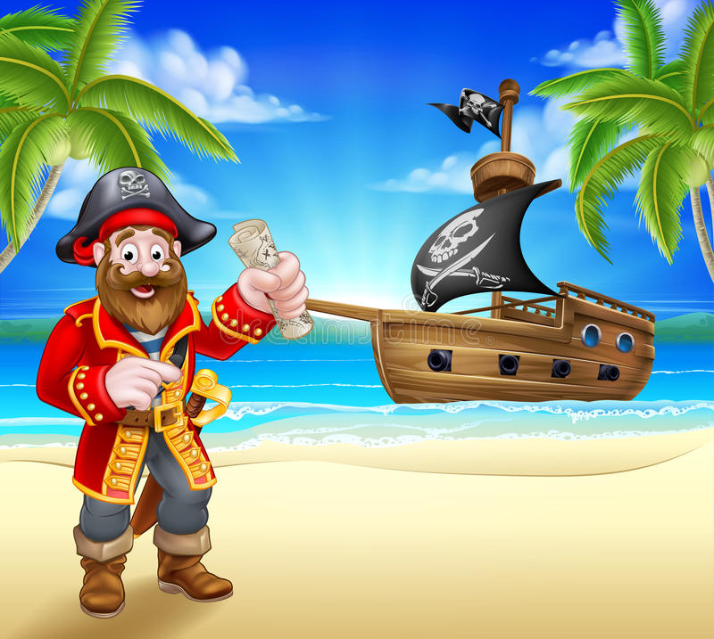

was
were
I________talking to my friend at 2 o’clock.
My congratulations

Slide 2
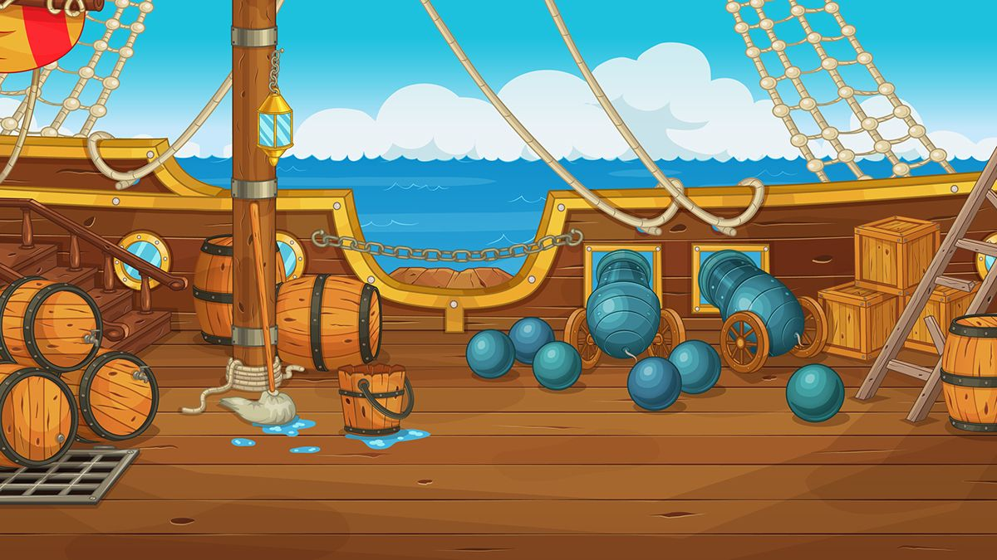
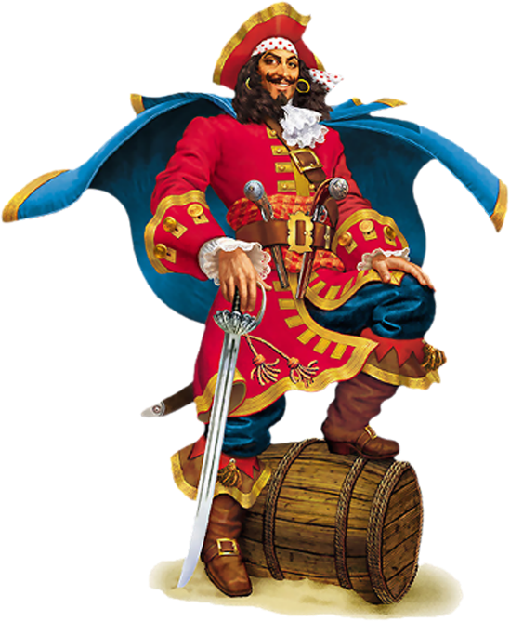
My congratulations
was
were
They________having lunch with their neighbours at that moment.

Slide 3
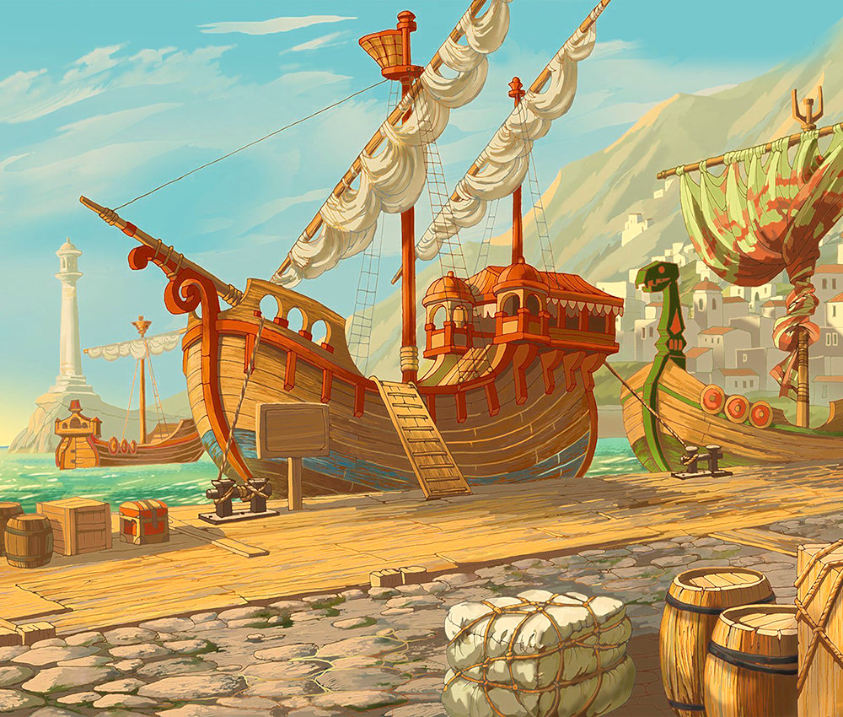
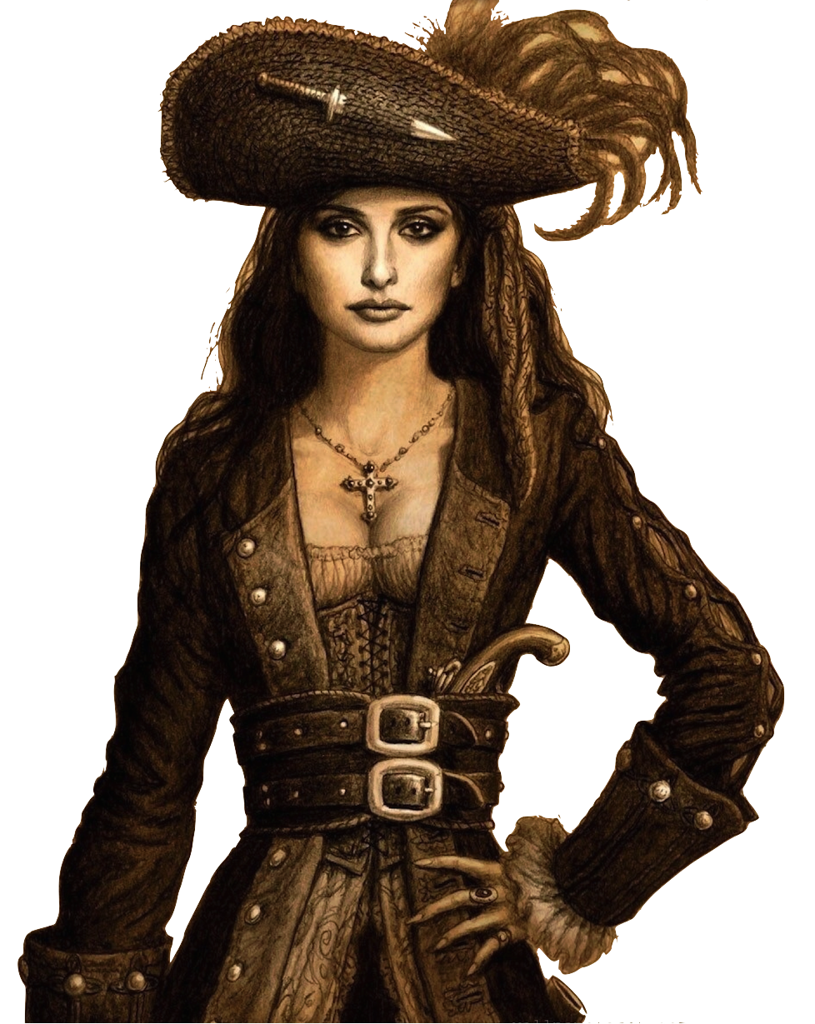
My congratulations
were
was
She________helping her sister at 1 o’clock.

Slide 4
were
was
________you visiting a friend at nine o’clock yesterday?
My congratulations

Slide 5
My congratulations
were
was
________you talking to her at that moment?

Slide 6
was
were
They________not talking about you at that moment.
My congratulations

Slide 7
My congratulations
was
were
What________he doing at that moment?

Slide 8
My congratulations
were
was
________she watching a play at 8 p.m. on Wednesday?

Slide 9
were
was
________they dancing at 3 o’clock last week?
My congratulations

Slide 10
My congratulations
were
was
________he telling lies at that moment?

Slide 11
More games can be found here
Game is made by Degtyareva Olesya
My congratulations
was
were
________she taking photos at 11 o’clock last Friday?
Music is from the site http://yourstoryinteractive.com/

